Slide 1
STA CCD Detector, Controller,
and System Developments
Scientific Detector Workshop 2013
Florence, Italy
7-11 October 2013
Richard Bredthauer, Kasey Boggs, Greg Bredthauer
Semiconductor Technology Associates, Inc.
27122 Paseo Espada, Suite 1004
San Juan Capistrano, CA 92675
(949) 481-1595 | greg.bredthauer@sta-inc.net

Slide 2
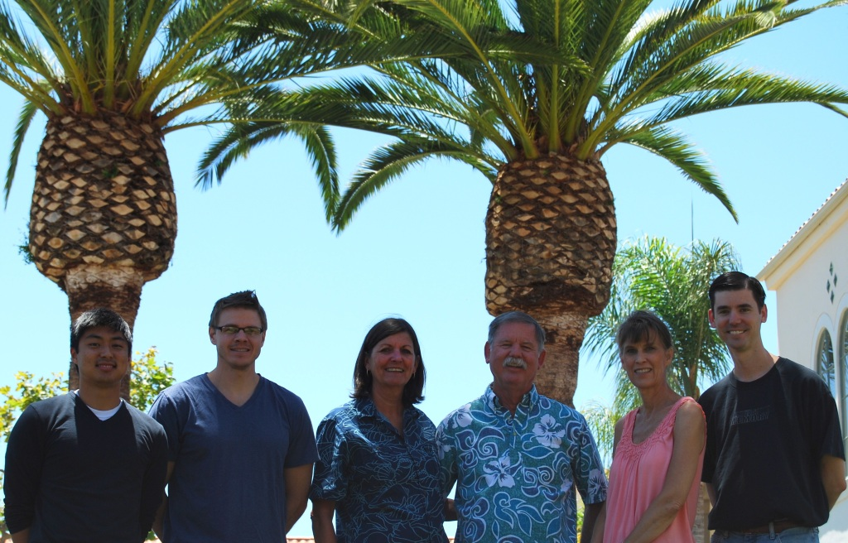
STA

Slide 3
Introduction
Recent systems
Archon controller
High dynamic range dual output

Slide 4
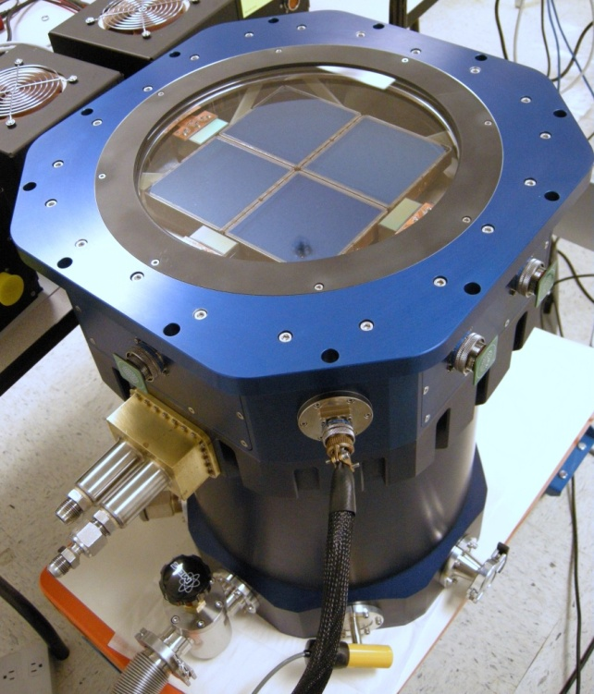
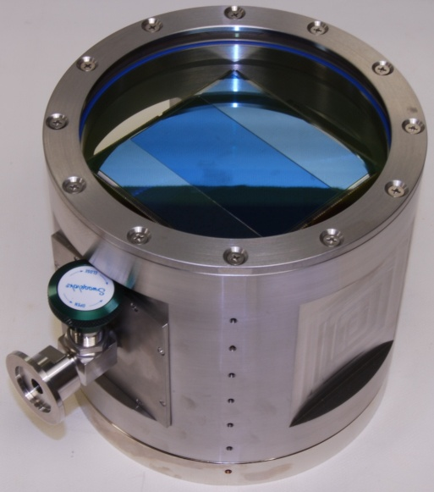
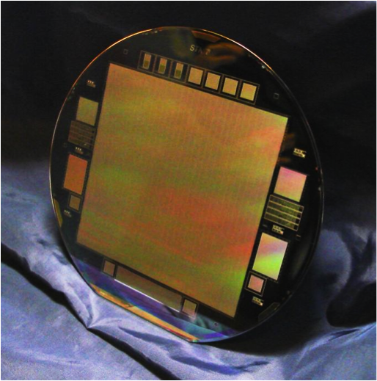
STA1600
Full 6” wafer imager
10560 x 10560 pixels
9 micron pixel
111,513,600 pixels per frame
16 outputs
Designed for US Naval Observatory

Slide 5
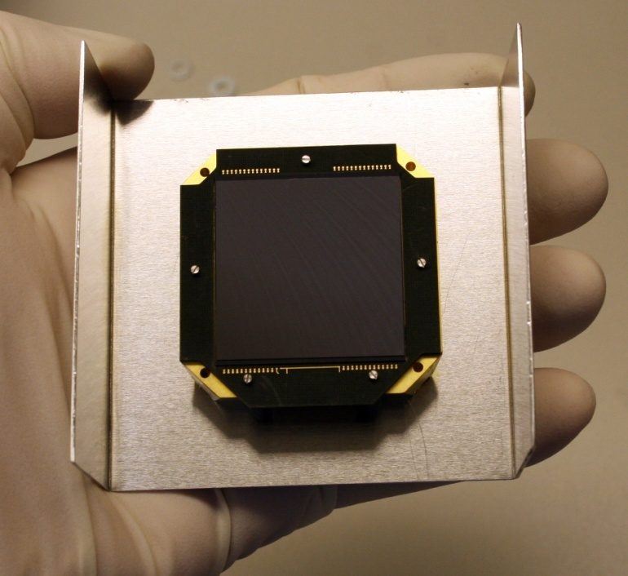
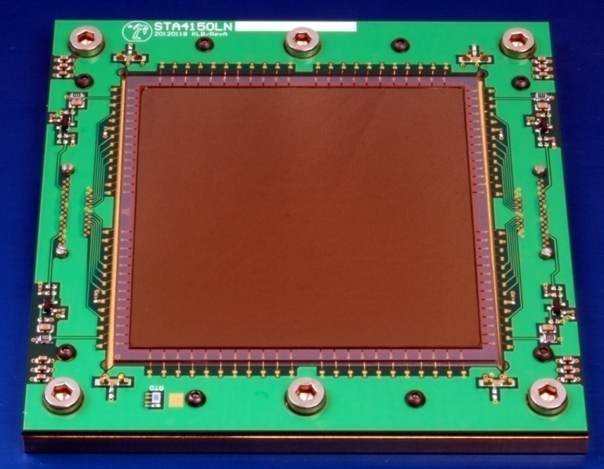
STA4150 and STA3600
STA4150, 4k x 4k 15µm
VIRUS, 2k x 2k 15µm

Slide 6
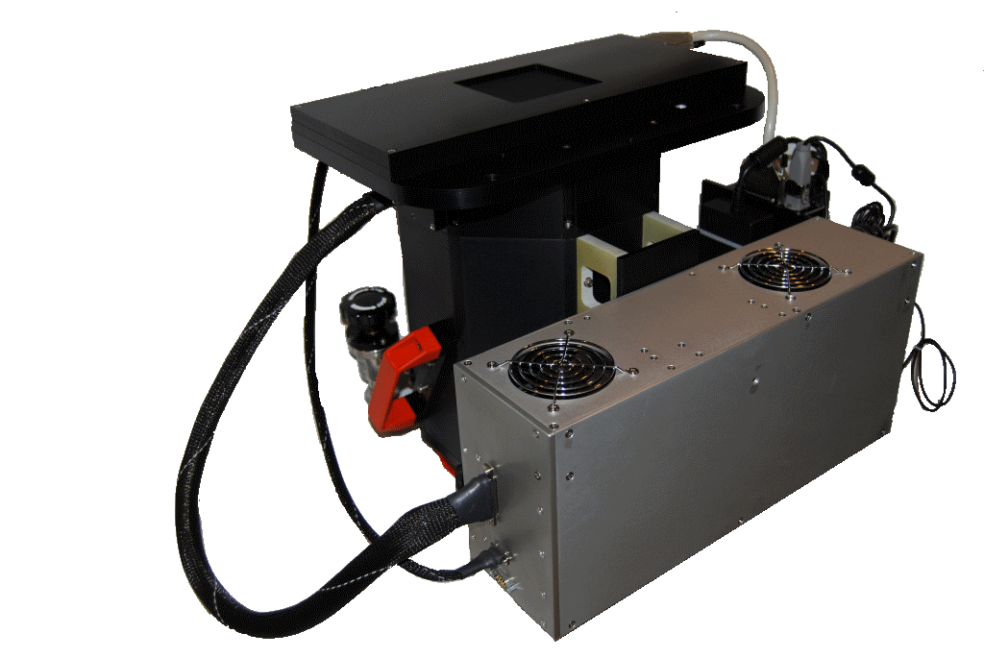
ARIES
STA4150 BI CCD – 4k x 4k 15 um, 4 Outputs
Archon Controller
Bonn Shutter
LN2 Cooling
Noise 2.7-2.9 e- 100 kHz
Full Well 249-265 ke-
Dark Current 0.8
e- / pixel / hour at -120C
HCTE > 0.9999997
VCTE > 0.99999998

Slide 7
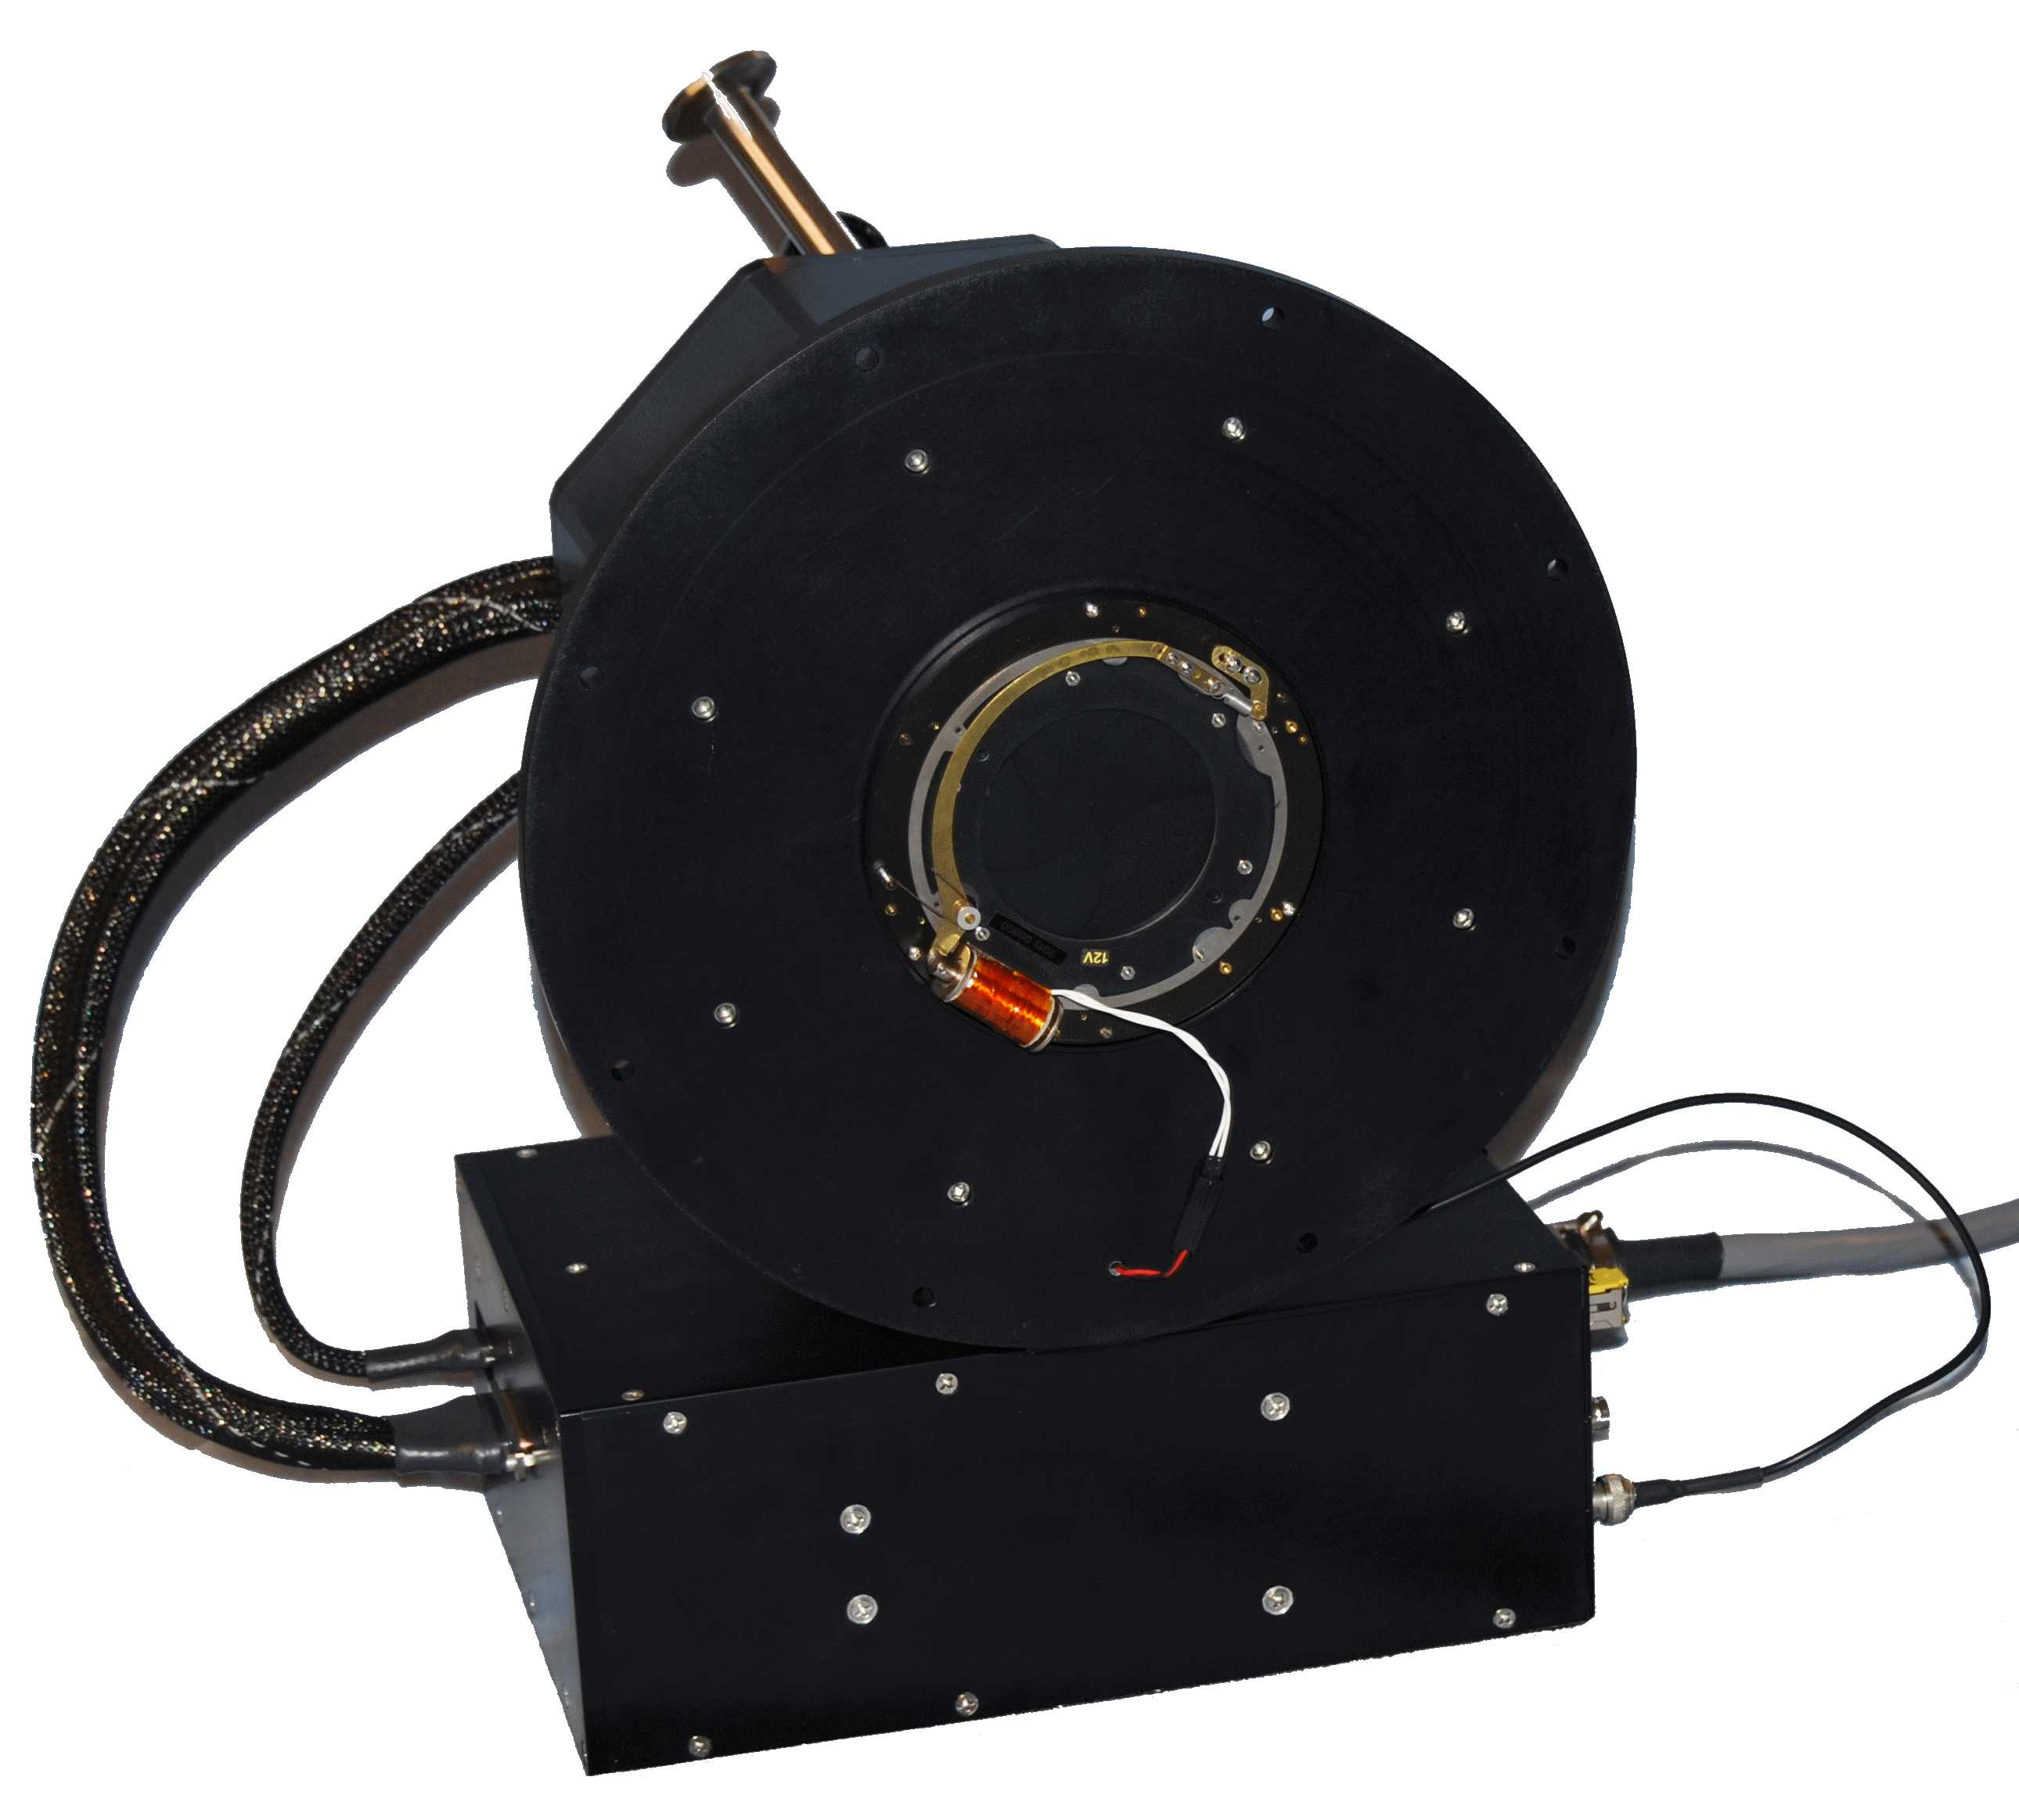
Vilnius University Observatory
STA3600 BI CCD – 2k x 2k 15 um, 4 Outputs
Archon Controller
Melles Griot UTS260 Shutter
Cryotiger Cooling
Noise 3.1-3.2 e- 100 kHz
Full Well 210-216 ke-
Dark Current 4.8
e- / pixel / hour at -100C
HCTE > 0.999999
VCTE > 0.999998

Slide 8
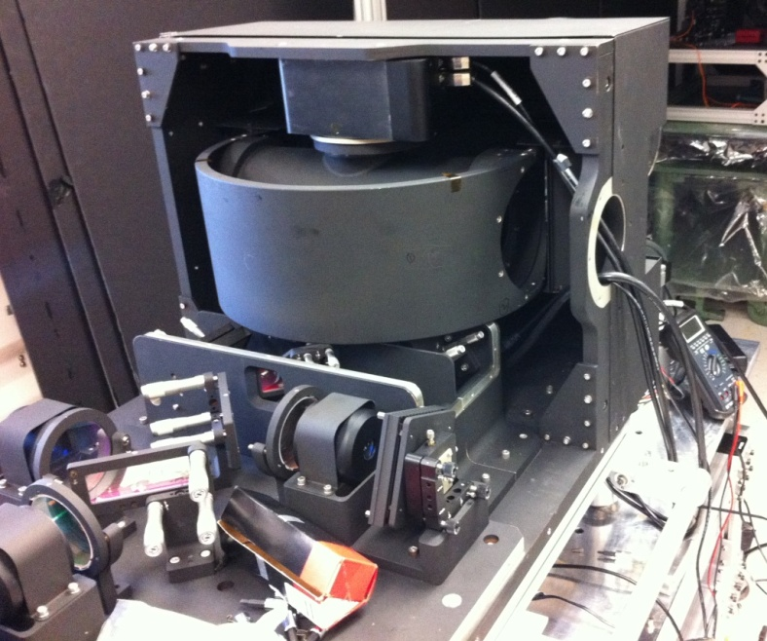
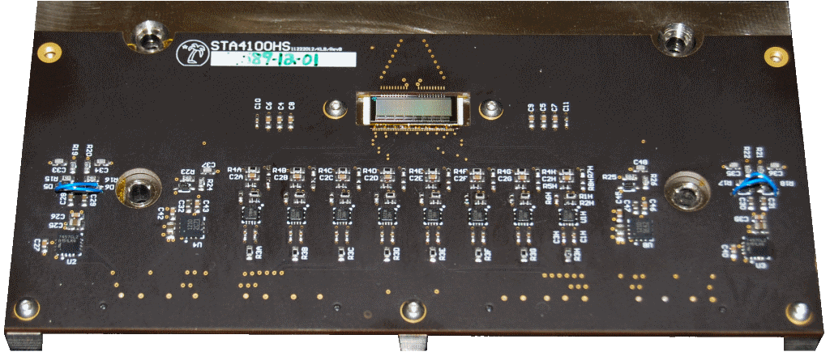
NASA Ocean Radiometer for Carbon Assessment
(ORCA)
STA4100 CCD – 512 x 128 TDI,
26 um pixels
Reflex Controller
8 Outputs at 20 MHz
Rotating telescope at 6 Hz,
33640 lines per revolution,
200 kHz line rate
2.5 uV / e-,
800 ke- full well

Slide 9
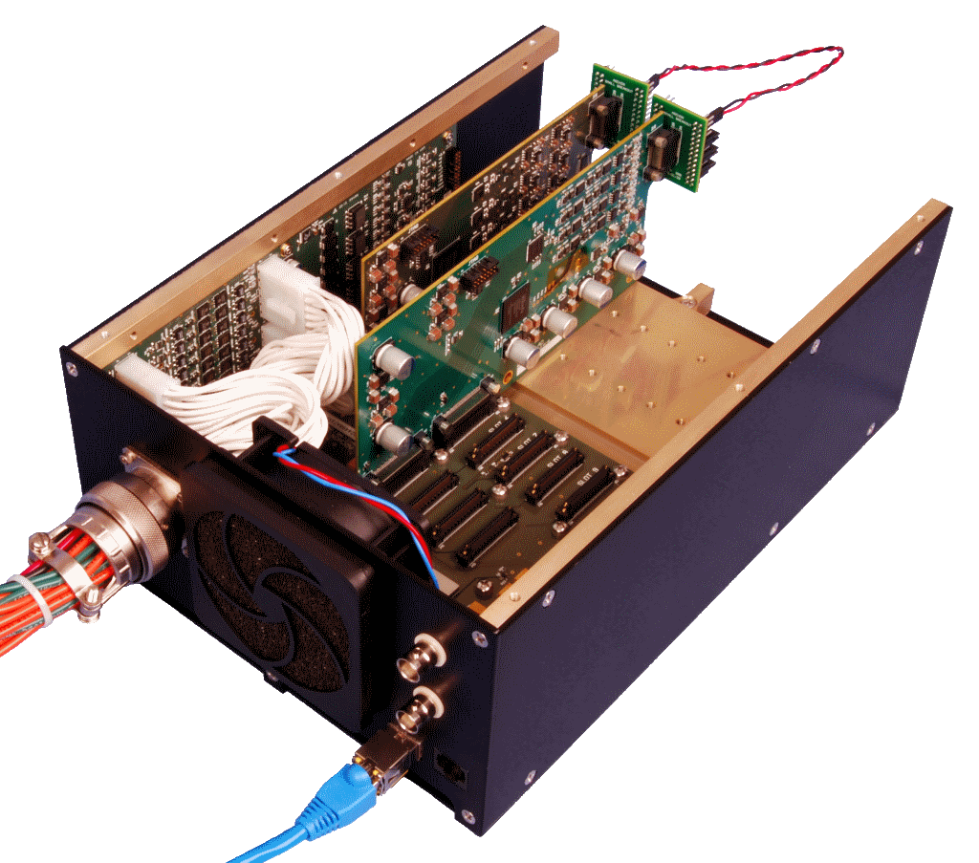
Archon
12 slot modular controller, 20 kHz – 3 MHz
Copper or fiber gigabit ethernet TCP/IP interface
Up to 16 input channels, 16-bit 100 MHz ADCs,
AC-coupled, 32-bit digital CDS
8 channel clock driver modules, 14-bit
100 MHz DACs, arbitrary waveform,
programmable slew
6/24 channel DC bias modules,
16-bit DACs, voltage/current
monitoring, programmable
current limit

Slide 10
High Dynamic Range

Slide 11
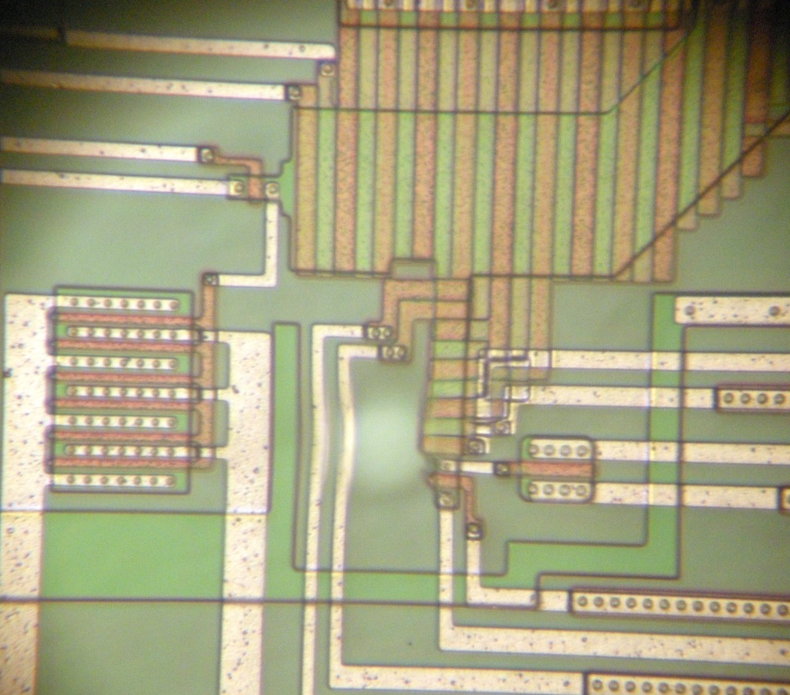
Dual Outputs

Slide 12
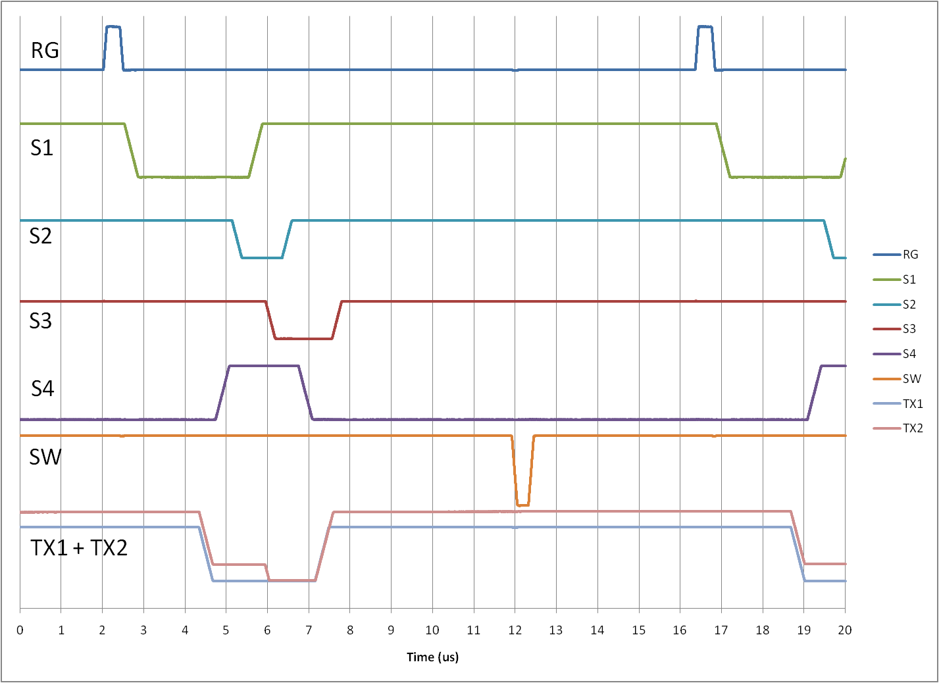
Image Area
S3
S2
S1
S1
S4
S3
S2
S1
S4
TX1
TX2
S4
S1

Slide 13
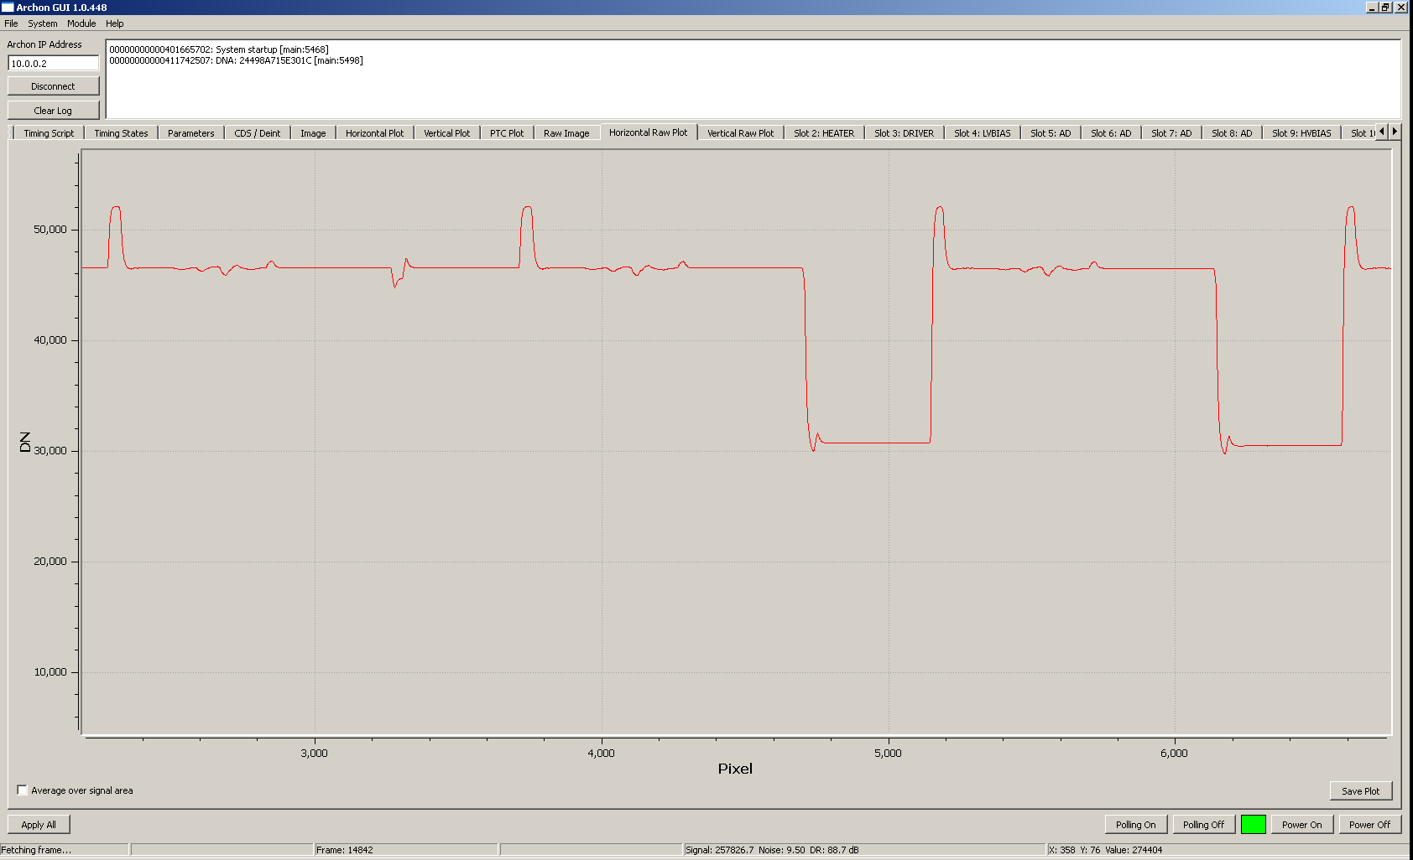
CCD Output

Slide 14
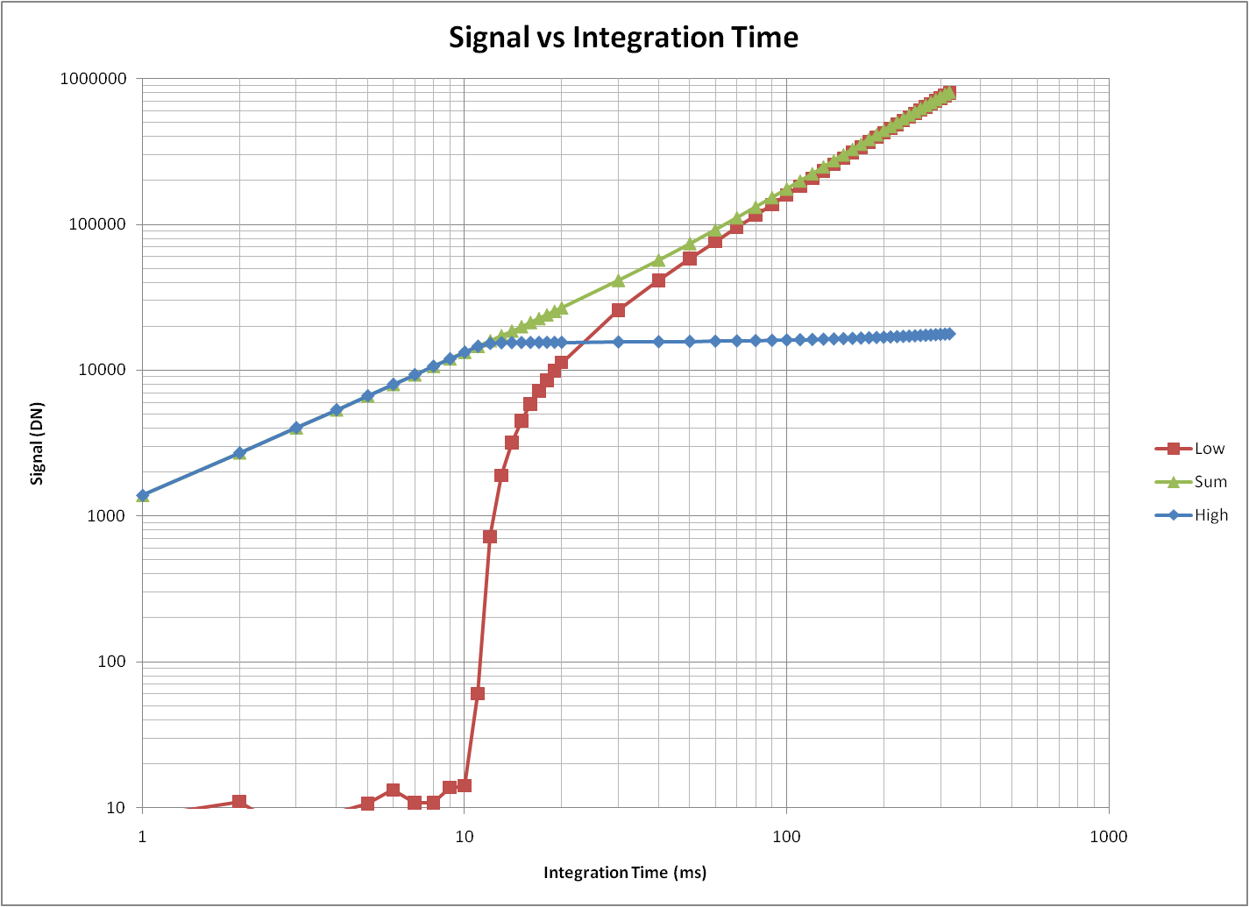

Slide 15
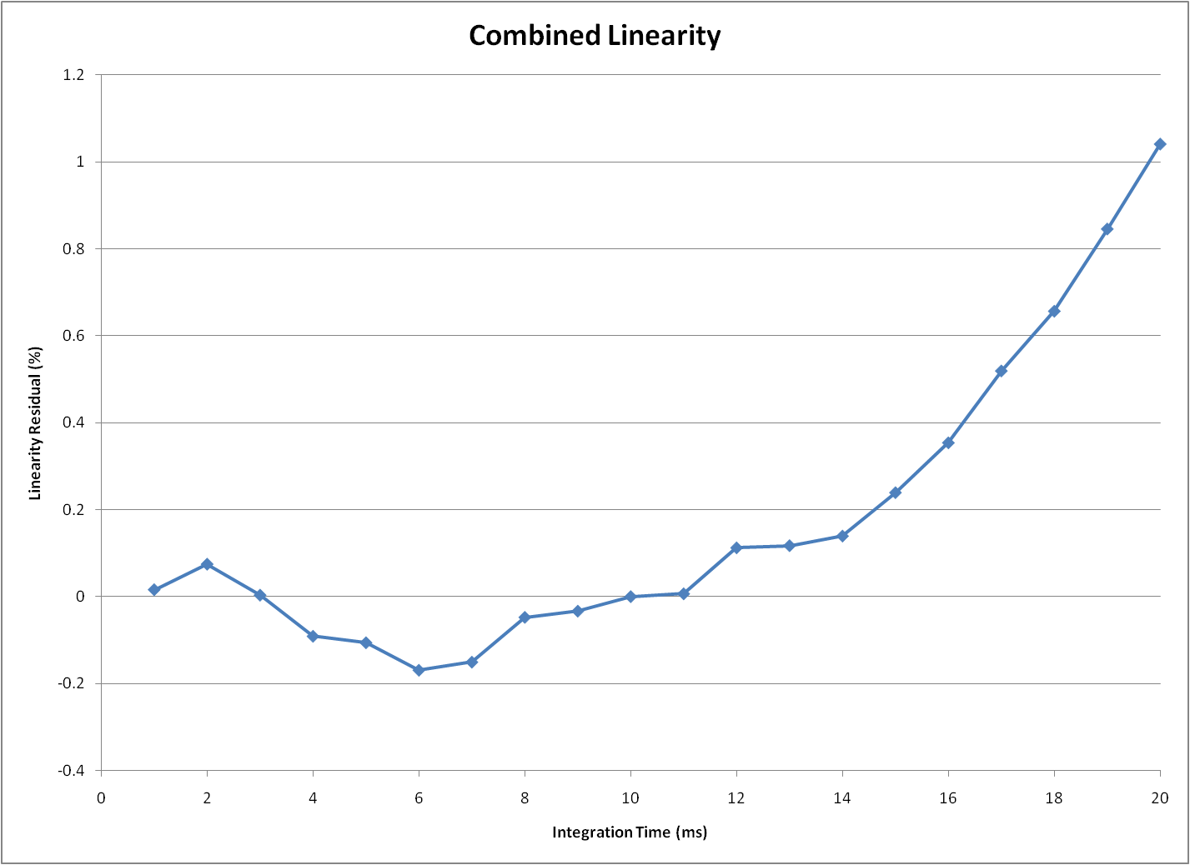

Slide 16
Performance
Low sensitivity alone: 104 dB
750000 DN full well, 4.5 DN noise
High sensitivity alone: 88 dB
250000 DN full well, 9.0 DN noise
Combined output: 114 dB
750000 DN full well, 1.5 DN noise equivalent

Slide 17
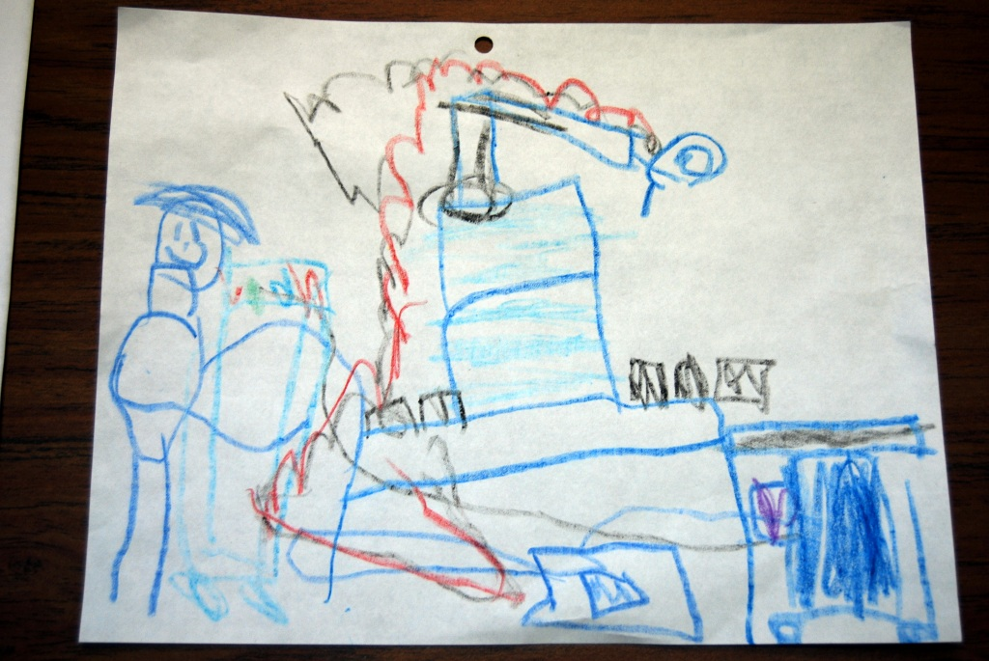
Future Work

