Slide 1

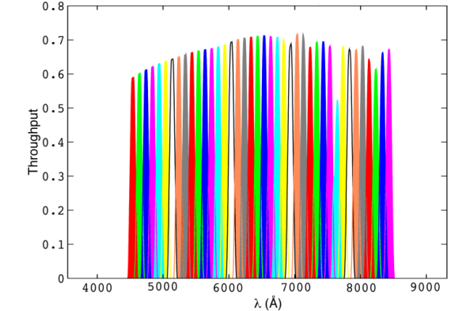
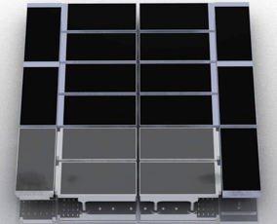
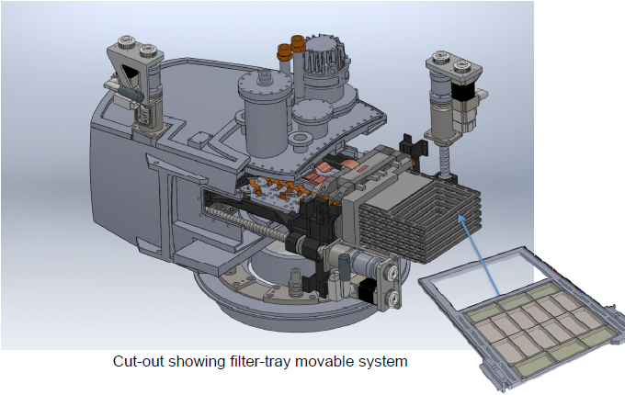
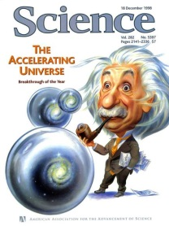
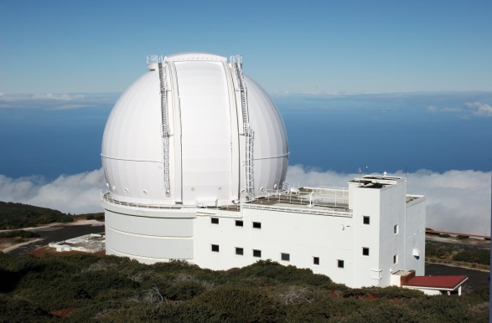
PAUCam mosaic 150 Mpixel
Scientific goal:
  Study the physics of the accelerating universe
  Method: precision photo-z (48 narrow band filters)
  Camera:
  18 CCDs (Hamamatsu Photonics, HPK), 2kx4k
  high quantum efficiency in near infrared
  there is not a filter wheel
  filters are automatically positioned above CCDs by means of
  14 mobile segmented filter trays operating in vacuum
  cryostat made of carbon fiber
  William Herschel Telescope (La Palma) in 2014
  also offered to the astronomical community as a facility
Juan De Vicente, CIEMAT (Madrid), Spain

Slide 2

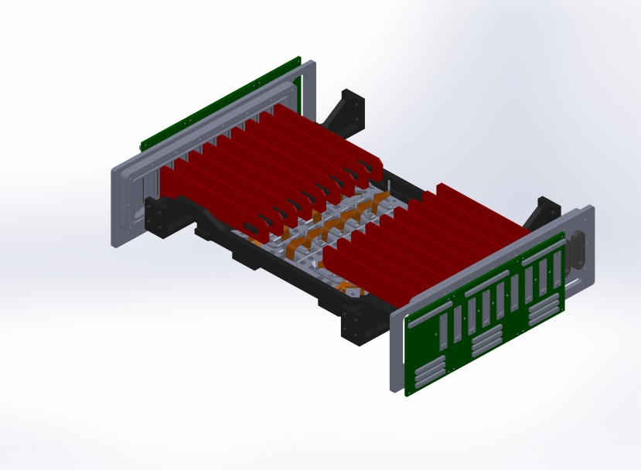
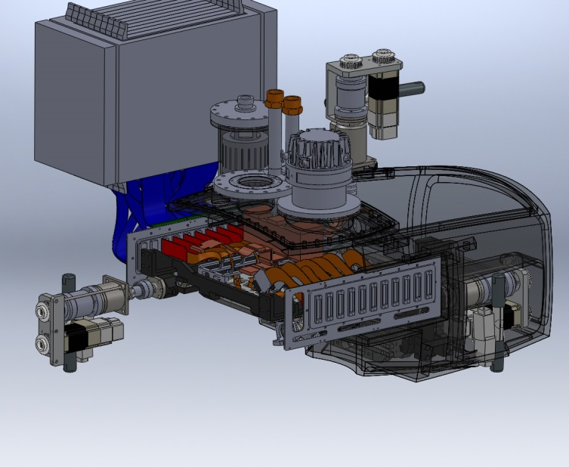
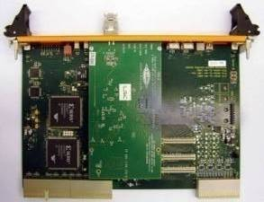
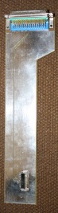
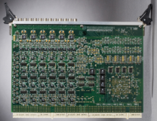
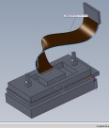
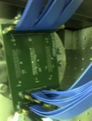
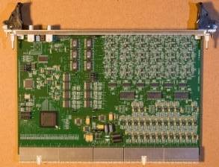
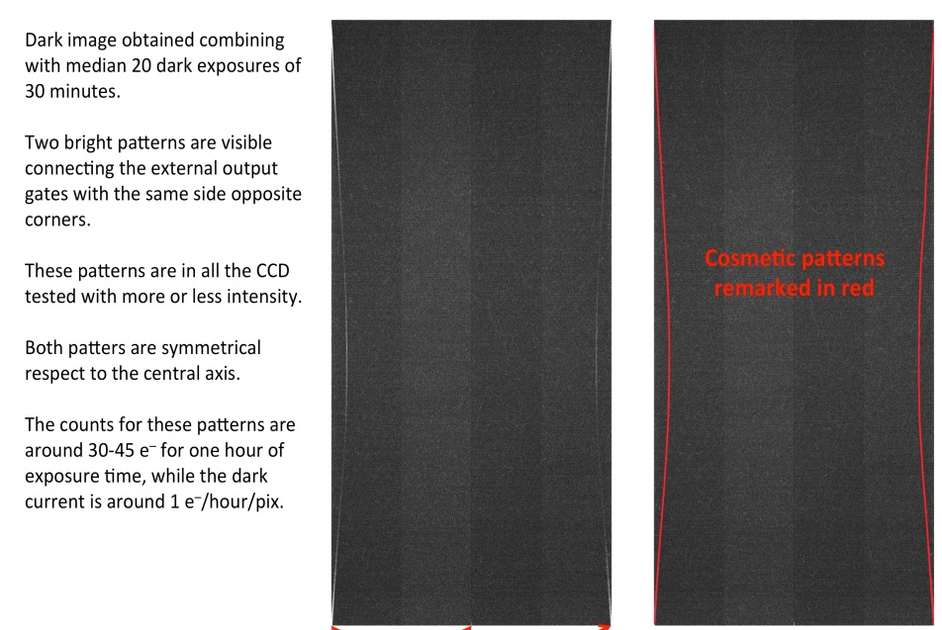
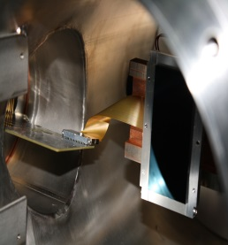
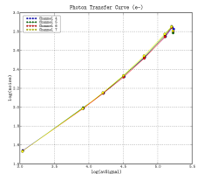
Readout Electronics
L9 poster
preamp boards (x18)
Monsoon upgrade
Control board
12
Videos
Focal plane
135
Clocks
Front-End
mix boards (x6)
Back-End
CCD characterization
Curious dark cosmetic pattern in large exposures
2 complementary setups
Barcelona
Madrid
Readout Noise: 5 e- rms @125 khz
Dark current: 1.1 e-/ h
Charg. Trans. Eff.: 0.999995
IDL, C routines
Python routines
Notes:
2

