Slide 1


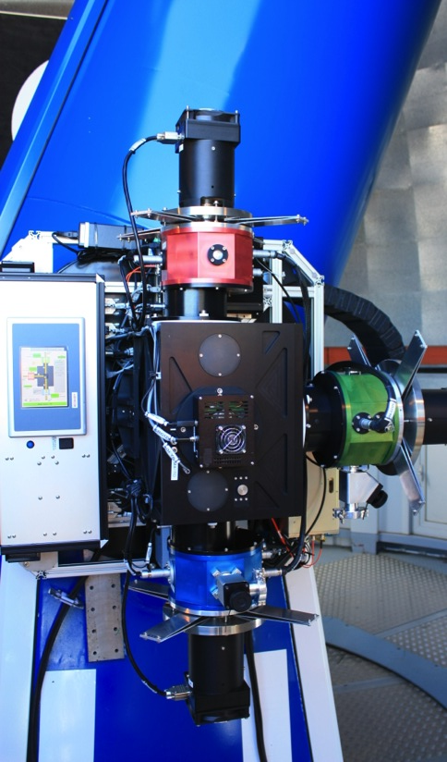
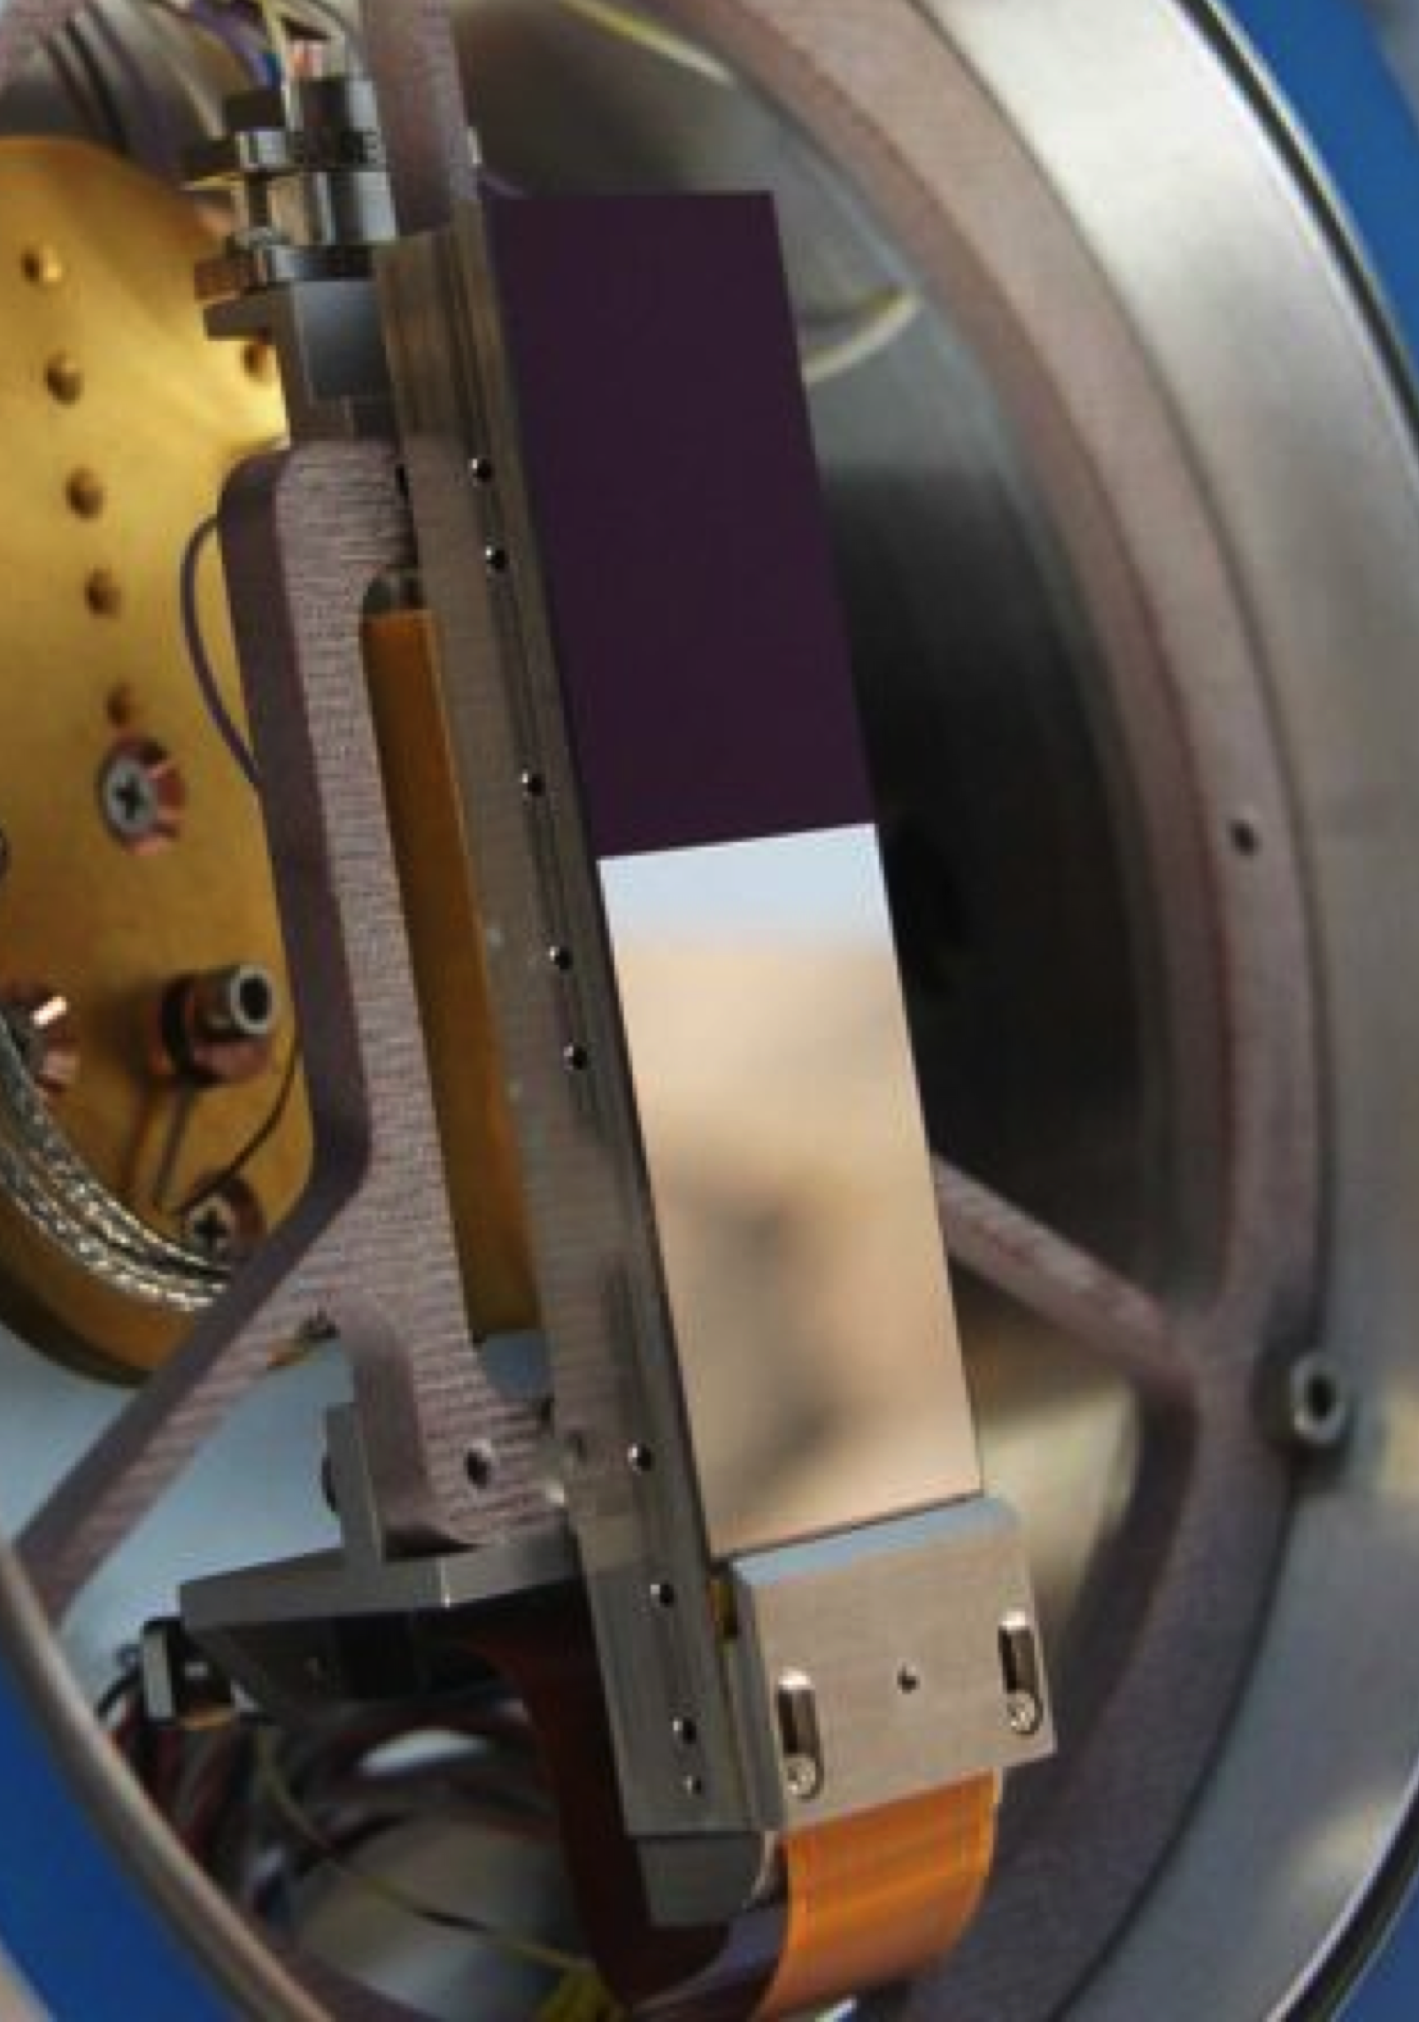
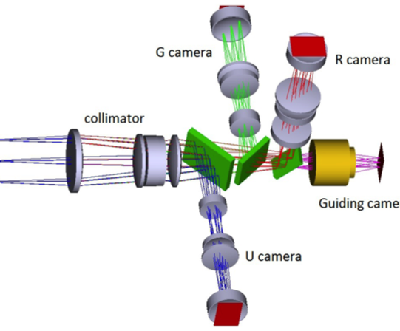
Compact Stirling cooling of astronomical detectors
Gert Raskin, Johan Morren, Wim Pessemier, Jeroen Vandersteen, Jesus Perez Padilla
Institute of Astronomy, KU Leuven University, Belgium
Mercator Telescope, La Palma, Spain
Mercator Telescope
Institute of Astronomy
MAIA: Mercator Advanced Imager for Asteroseismology
3-Channel imager: U G R bands
3 2kx6k FT CCDs (CCD42-C0, e2v)
CCDs cooled to 165K by free-piston Stirling coolers:
+ + : Compact, low power, simple to use, (long lifetime)
– – : Vibrations (linear cooling engine at 60 Hz)
400 – 550 nm
G camera
575 – 700 nm
R camera
Collimator
Guiding camera
λ > 875 nm
MAIA
FoV: 9.4’ x 14.1’
U camera
330 – 400 nm

Slide 2
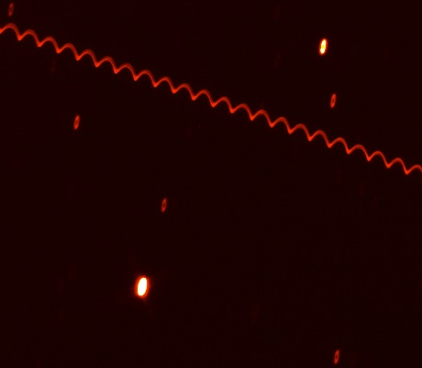
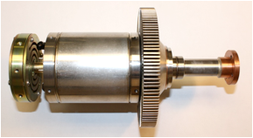
Compact Stirling cooling of astronomical detectors
Gert Raskin, Johan Morren, Wim Pessemier, Jeroen Vandersteen, Jesus Perez Padilla
Institute of Astronomy, KU Leuven University, Belgium
Mercator Telescope, La Palma, Spain
Mercator Telescope
Institute of Astronomy
Vibrations: < 10 arcsec PtP
MAIA: Mercator Advanced Imager for Asteroseismology
3-Channel imager: U G R bands
3 2kx6k FT CCDs (CCD42-C0, e2v)
CCDs cooled to 165K by free-piston Stirling coolers:
+ + : Compact, low power, simple to use, (long lifetime)
– – : Vibrations (linear cooling engine at 60 Hz)
5W lift @ 77K with
80W input power
243 mm total length
2.2 kg total mass
CryoTel MT cooler
MAIA
FoV: 9.4’ x 14.1’

Slide 3
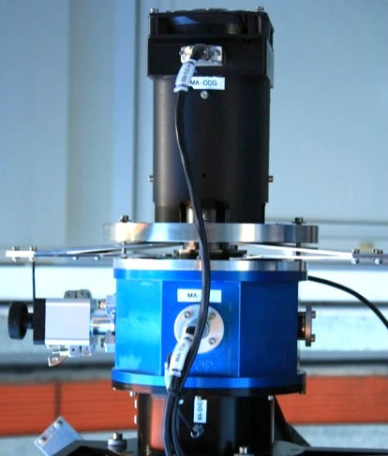
Poster R14
Filter out cryo-cooler vibrations
Stirling cooler mounted on 4 leaf springs
No damping
Spring-mass system: mechanical low-pass
filter (10 Hz)
60 Hz + harmonics strongly attenuated
Vibration reduction: ÷ 500 @ 60 Hz
Coolers have no longer any effect on image quality
Mercator Telescope
Institute of Astronomy

