Slide 1
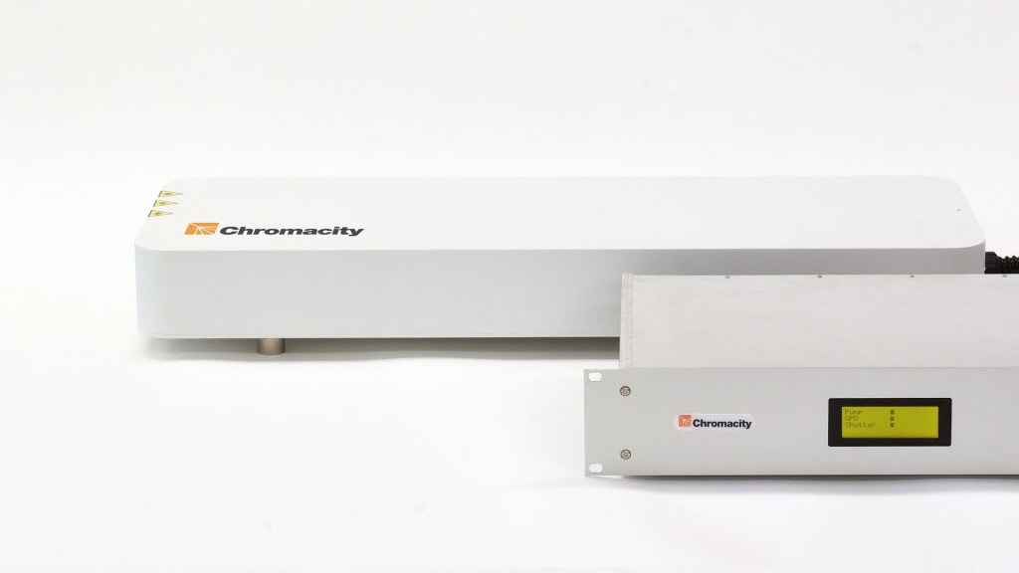
Discover more
Ytterbium Based Lasers Sources And OPOs For Quantum Technologies: Latest Capabilities
Rochester Institute of Technology
Photonics for Quantum – 23rd January 2019
Dr Christopher G. Leburn, Founder & Director

Slide 2


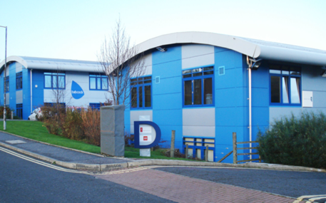

Chromacity – Introduction
  Founded in 2013, based in Edinburgh, Scotland.
  Venture capital backed.
  Chromacity design and manufacture ultrafast lasers for industrial and fundamental research markets.
  Recognised leaders in innovation in near and mid infra-red laser development.
  Specialize in Optical Parametric Oscillator (OPO) designs.
  Technical capability to design and build custom lasers that operate at unusual wavelengths.
  Patented Technology

Slide 3
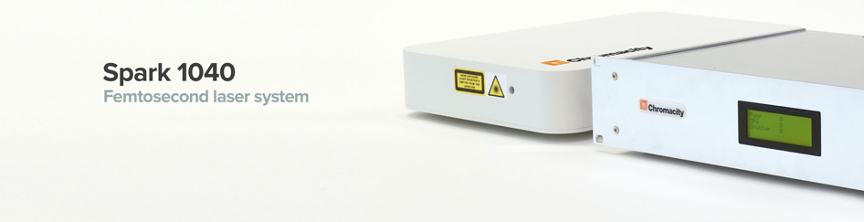
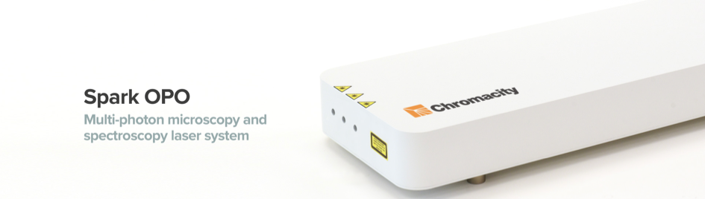
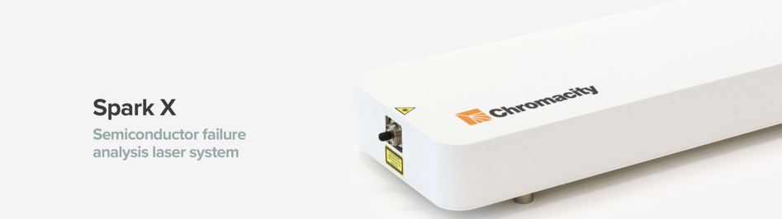
Chromacity – Product Range
Ytterbium fibre-based ultrafast laser delivering > 2.5 W output at 1040 nm with 100 MHz repetition rate.
Chromacity 1040 ultrafast laser source
New Product Launch – Chromacity 520 femtosecond laser
Chromacity 1040/520
The Chromacity OPO and FIR deliver light across the near and mid-IR (1.4 µm - 12 µm).
Chromacity OPO 1.4 – 4.2 μm
Chromacity FIR 5-12 μm
Both pumped by an integrated Chromacity 1040
Chromacity OPO/FIR
Ultrafast laser delivering up to 50 mW output at 1280 nm with 100 MHz repetition rate
Ultrashort pulse generation at 1280nm
Semiconductor fault analysis
Chromacity X

Slide 4
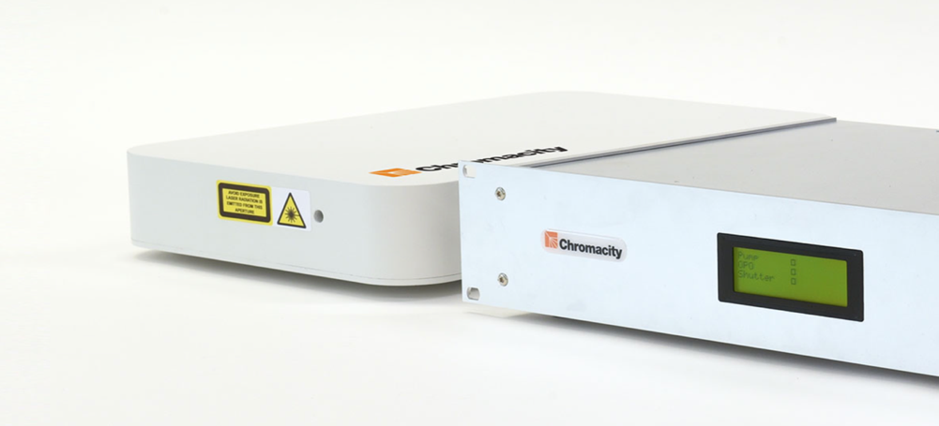
Chromacity 1040
Femtosecond laser source
  Average power: > 2.5 W
  Wavelength: 1040 nm
  15-40 nm bandwidth
  100 MHz repetition rate.
  Pulse width factory set from 130 fs – 3 ps.
  Linearly polarized free-space output
  M² <1.2 with ~1 mm beam diameter
Notes:
The Chromacity 1040 is a compact, turnkey, ytterbium fibre-based laser delivering high average power, short pulse duration for a wide range of applications that require light in the near-IR.
Primary use in the microscopy imaging market and fundamental physics research base, where the short pulses can drive non-linear effects.
This platform technology also acts as the integrated pump source for all our OPO products.
Standard powers are now in excess of 3 W and a 5 W version is expected to be launched early next year

Slide 5
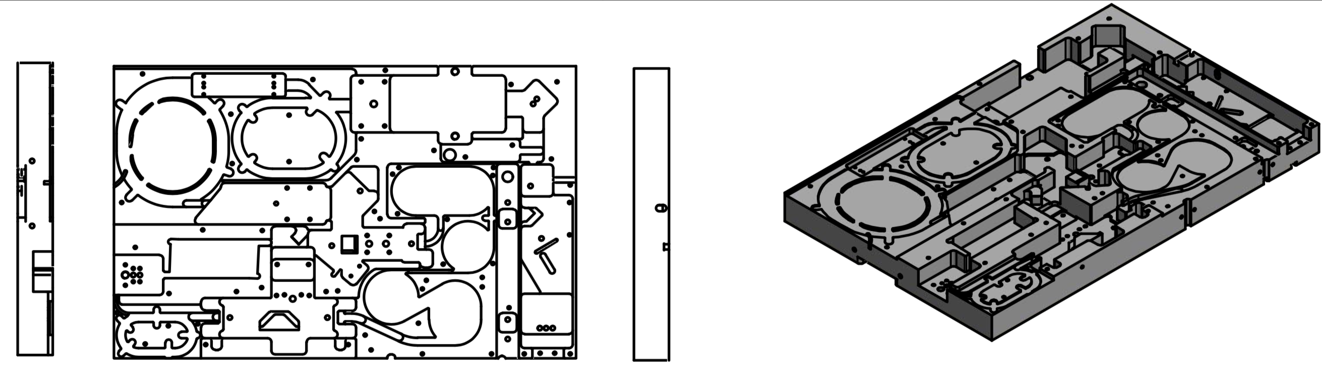
Chromacity 1040
Femtosecond laser source
  Average power: > 2.5 W
  Wavelength: 1040 nm
  15-40 nm bandwidth
  100 MHz repetition rate.
  Pulse width factory set from 130 fs – 3 ps.
  Linearly polarized free-space output
  M² <1.2 with ~1 mm beam diameter
  Part fiber, part free space
  High gain in fiber
  Ability to manage dispersion
  High efficiency (due to core IP)
Notes:
The Chromacity 1040 is a compact, turnkey, ytterbium fibre-based laser delivering high average power, short pulse duration for a wide range of applications that require light in the near-IR.
Primary use in the microscopy imaging market and fundamental physics research base, where the short pulses can drive non-linear effects.
This platform technology also acts as the integrated pump source for all our OPO products.
Standard powers are now in excess of 3 W and a 5 W version is expected to be launched early next year

Slide 6
Chromacity 520 & THG
Femtosecond laser source
  Significant expertise in non-linear optics
  Now have a 520n nm source
  Average power of up to 1 W
  Pulse duration ~120 fs
  100 MHz repetition rate.
  Linearly polarized free-space output
  M² <1.2 with ~1 mm beam diameter
  Also provides 1040 nm output
Notes:
The Chromacity 1040 is a compact, turnkey, ytterbium fibre-based laser delivering high average power, short pulse duration for a wide range of applications that require light in the near-IR.
Primary use in the microscopy imaging market and fundamental physics research base, where the short pulses can drive non-linear effects.
This platform technology also acts as the integrated pump source for all our OPO products.
Standard powers are now in excess of 3 W and a 5 W version is expected to be launched early next year

Slide 7
Chromacity 520 & THG
Femtosecond laser source
  Significant expertise in non-linear optics
  Now have a 520n nm source
  Average power of up to 1 W
  Pulse duration ~120 fs
  100 MHz repetition rate.
  Linearly polarized free-space output
  M² <1.2 with ~1 mm beam diameter
  Also provides 1040 nm output
  Third harmonic generation can be provided
  Wavelength: 347 nm
  Output powers now in excess of 400 mW
Notes:
The Chromacity 1040 is a compact, turnkey, ytterbium fibre-based laser delivering high average power, short pulse duration for a wide range of applications that require light in the near-IR.
Primary use in the microscopy imaging market and fundamental physics research base, where the short pulses can drive non-linear effects.
This platform technology also acts as the integrated pump source for all our OPO products.
Standard powers are now in excess of 3 W and a 5 W version is expected to be launched early next year

Slide 8

Photon pair counting
Working with Prof. Daniele Faccio
His research is pushing towards quantum imaging
He is looking to generate entangled photons as part of his research themes
Notes:
The Chromacity 1040 is a compact, turnkey, ytterbium fibre-based laser delivering high average power, short pulse duration for a wide range of applications that require light in the near-IR.
Primary use in the microscopy imaging market and fundamental physics research base, where the short pulses can drive non-linear effects.
This platform technology also acts as the integrated pump source for all our OPO products.
Standard powers are now in excess of 3 W and a 5 W version is expected to be launched early next year

Slide 9
Photon pair counting
Down conversion module
(2 type 1 BBO crystals)
THG module
λ = 1040 nm
λ = 347 nm
P = 58 mW
λ = 690 nm
λ/2
SPAD
  Significant advantages to this technique
  Two step process avoids interference from pump wavelength
  Peak of detection efficiency for APD is close to 690nm
SPAD
λ/2
Notes:
The Chromacity 1040 is a compact, turnkey, ytterbium fibre-based laser delivering high average power, short pulse duration for a wide range of applications that require light in the near-IR.
Primary use in the microscopy imaging market and fundamental physics research base, where the short pulses can drive non-linear effects.
This platform technology also acts as the integrated pump source for all our OPO products.
Standard powers are now in excess of 3 W and a 5 W version is expected to be launched early next year

Slide 10
Photon pair counting
  0 = coincidences within the same laser pulse.
  Peaks at other delays correspond to coincidences between one pulse and the next, which correspond to “accidentals”.
  The contrast between these two peaks is the “coincidence to accidentals ration” CAR.
  CAR that is of order ~100.
  Next steps – HOM measurement - to demonstrate generation of quantum signatures.
Notes:
The Chromacity 1040 is a compact, turnkey, ytterbium fibre-based laser delivering high average power, short pulse duration for a wide range of applications that require light in the near-IR.
Primary use in the microscopy imaging market and fundamental physics research base, where the short pulses can drive non-linear effects.
This platform technology also acts as the integrated pump source for all our OPO products.
Standard powers are now in excess of 3 W and a 5 W version is expected to be launched early next year

Slide 11
Generation and Detection of Down-converted Photon Pairs at 2.080 µm
Working with Dr Matteo Clerici
His motivation revolves around the the fact that there is a strain on current radio frequency based satellite communications
Quantum optical technologies are being considered as an alternative to improve free-space communication systems
These utilise fundamental properties of quantum mechanics: indeterminacy, superposition, entanglement, uncertainty etc.
Notes:
The Chromacity 1040 is a compact, turnkey, ytterbium fibre-based laser delivering high average power, short pulse duration for a wide range of applications that require light in the near-IR.
Primary use in the microscopy imaging market and fundamental physics research base, where the short pulses can drive non-linear effects.
This platform technology also acts as the integrated pump source for all our OPO products.
Standard powers are now in excess of 3 W and a 5 W version is expected to be launched early next year

Slide 12
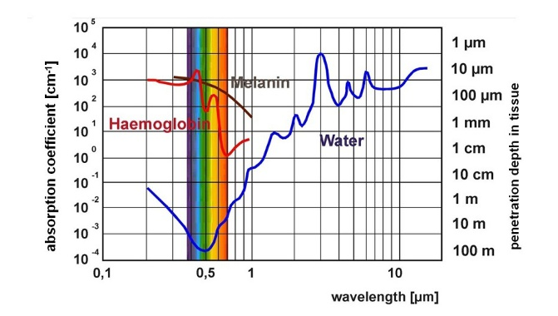
Generation and Detection of Down-converted Photon Pairs at 2.080 µm
  Demand for 2µm sources in fields such as:
  Medical surgery ~ strong water absorption
  LIDAR ~ “eye safe” wavelength range
  Atmospheric sensing ~ absorption lines for atmospheric gases (e.g. CO2, H2O, N2O)
Notes:
The Chromacity 1040 is a compact, turnkey, ytterbium fibre-based laser delivering high average power, short pulse duration for a wide range of applications that require light in the near-IR.
Primary use in the microscopy imaging market and fundamental physics research base, where the short pulses can drive non-linear effects.
This platform technology also acts as the integrated pump source for all our OPO products.
Standard powers are now in excess of 3 W and a 5 W version is expected to be launched early next year

Slide 13
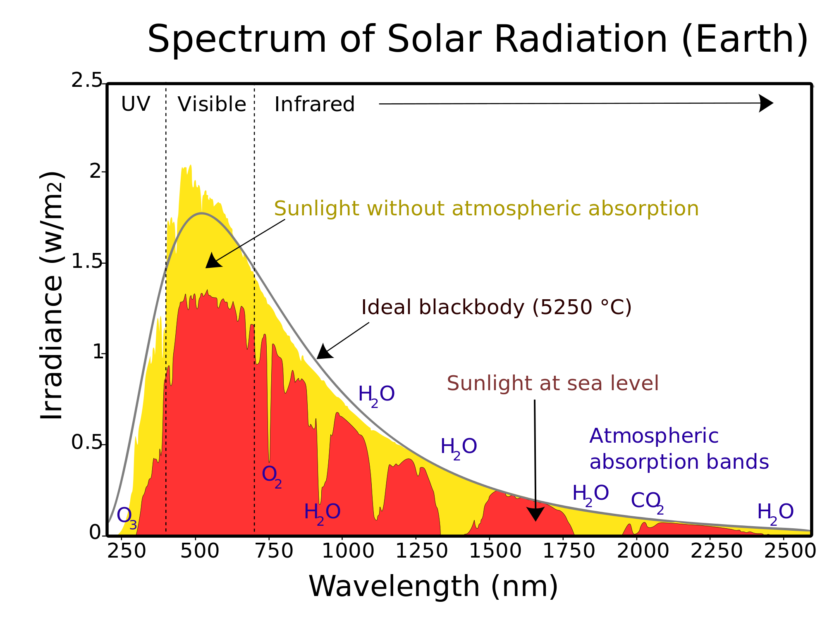
Generation and Detection of Down-converted Photon Pairs at 2.080 µm
  Ground-to-satellite quantum communications ~ atmospheric transparency window at 2µm
  Solar blackbody radiation at telecom wavelengths reduced by half
  Free-space QKD ~ complications in implementing these systems in urban areas (higher concentration of aerosols, scatters shorter wavelengths)
  However there are challenges……..
  Polarisation maintaining fibers at 2µm
  High efficiency single photon detectors at 2µm
Notes:
The Chromacity 1040 is a compact, turnkey, ytterbium fibre-based laser delivering high average power, short pulse duration for a wide range of applications that require light in the near-IR.
Primary use in the microscopy imaging market and fundamental physics research base, where the short pulses can drive non-linear effects.
This platform technology also acts as the integrated pump source for all our OPO products.
Standard powers are now in excess of 3 W and a 5 W version is expected to be launched early next year

Slide 14
Down conversion module
(2 type 1 BBO crystals)
λ = 347 nm
P = 58 mW
Generation and Detection of Down-converted Photon Pairs at 2.080 µm
λ/2
2 µm generation
OD3
λ = 2.08 µm
λ = 1040 nm
Ge filter
F/C
F/C
20 m SM2000 fiber
Detector
Notes:
The Chromacity 1040 is a compact, turnkey, ytterbium fibre-based laser delivering high average power, short pulse duration for a wide range of applications that require light in the near-IR.
Primary use in the microscopy imaging market and fundamental physics research base, where the short pulses can drive non-linear effects.
This platform technology also acts as the integrated pump source for all our OPO products.
Standard powers are now in excess of 3 W and a 5 W version is expected to be launched early next year

Slide 15
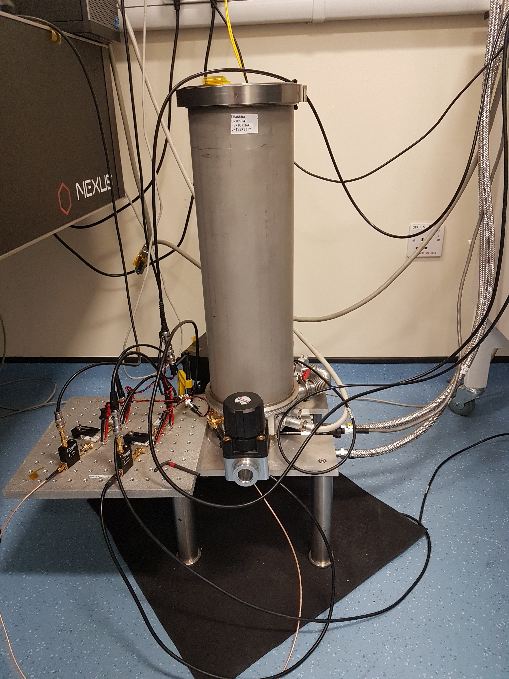
Down conversion module
(2 type 1 BBO crystals)
λ = 347 nm
P = 58 mW
Generation and Detection of Down-converted Photon Pairs at 2.080 µm
  Detection via superconducting nanowire single-photon detector (SNSPD) optimised for radiation at 1560 nm.
  System detection efficiency of ~10⁻⁵ at 2 μm.
  The generated photons at 2 µm are coupled to SM2000 fibres and routed to the SNSPDs
  SNSPD operates at < 3K.
Notes:
The Chromacity 1040 is a compact, turnkey, ytterbium fibre-based laser delivering high average power, short pulse duration for a wide range of applications that require light in the near-IR.
Primary use in the microscopy imaging market and fundamental physics research base, where the short pulses can drive non-linear effects.
This platform technology also acts as the integrated pump source for all our OPO products.
Standard powers are now in excess of 3 W and a 5 W version is expected to be launched early next year

Slide 16

Down conversion module
(2 type 1 BBO crystals)
λ = 347 nm
P = 58 mW
Generation and Detection of Down-converted Photon Pairs at 2.080 µm
  1 mm long magnesium-doped periodically-poled lithium-niobate crystal (MgO:PPLN) crystal with 31.62 µm poling period at a temperature of 40ºC.
  Characterization using InGaAs detectors
Notes:
The Chromacity 1040 is a compact, turnkey, ytterbium fibre-based laser delivering high average power, short pulse duration for a wide range of applications that require light in the near-IR.
Primary use in the microscopy imaging market and fundamental physics research base, where the short pulses can drive non-linear effects.
This platform technology also acts as the integrated pump source for all our OPO products.
Standard powers are now in excess of 3 W and a 5 W version is expected to be launched early next year

Slide 17
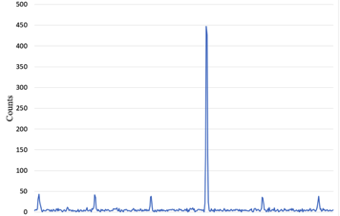
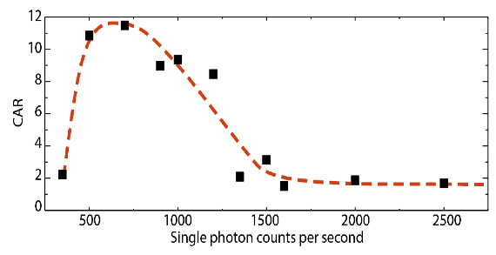
Down conversion module
(2 type 1 BBO crystals)
λ = 347 nm
P = 58 mW
Generation and Detection of Down-converted Photon Pairs at 2.080 µm
  For the first-time, they have generated and detected correlated photon pairs at 2 µm with maximum CAR ~ 11.5.
  These sources suotable for daylight free-space QKD in a spectral region with high atmospheric transparency & low solar background.
  Further improvements will be made with improved SNSPD/optical component technology at longer wavelengths as well as minimization of coupling losses
  Future work:
    HOM interference at 2 µm
    Hyperentanglement at 2 µm
    Free space QKD
Notes:
The Chromacity 1040 is a compact, turnkey, ytterbium fibre-based laser delivering high average power, short pulse duration for a wide range of applications that require light in the near-IR.
Primary use in the microscopy imaging market and fundamental physics research base, where the short pulses can drive non-linear effects.
This platform technology also acts as the integrated pump source for all our OPO products.
Standard powers are now in excess of 3 W and a 5 W version is expected to be launched early next year

Slide 18
Chromacity – Product Range
THG@
347 nm
Chromacity
520
Chromacity
1040
Near IR
Mid-IR
800 nm
Near-IR
3 µm
Mid-IR
12 µm

Slide 19
Chromacity – Product Range
THG@
347 nm
Chromacity
520
Chromacity
1040
OPO NEAR-IR
1.45 µm – 4.2 µm
OPO MID-ID
5 µm – 12 µm
Near IR
Mid-IR
800 nm
Near-IR
3 µm
Mid-IR
12 µm

Slide 20
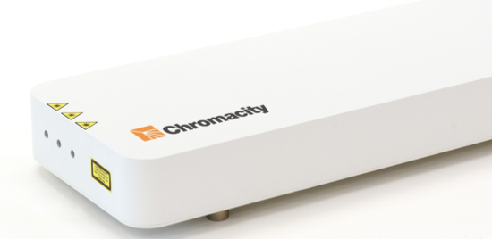
Chromacity OPO / Chromacity FIR
Near-Infrared and mid-Infrared OPOs
  The Chromacity OPO provides tunable output from 1.4 - 4.2 μm.
  Underlying OPO architecture is able to work with a range of existing non-linear crystals.
  The Chromacity FIR is the world’s first commercial mid-infrared OPO
  Pumped by an integrated Chromacity 1040 is available in different variants depending on customer requirements
  Delivers light from 1.4 µm – 4.2 µm
  Typically 1-5 ps output at 100 MHz
  Signal 1.4 µm - 1.9 µm up to 1.5 W
  Idler 2.3 µm – 4 µm up to 350 mW (near IR)
  Pumped by an integrated Chromacity 1040
  Residual pump up to 500 mW
  Delivers light from 5 µm - 12 µm in discrete broadband spectra
  ~100mW at 5 µm
  ~10 mW at 12 µm
  Pumped by an integrated Chromacity 1040
  Residual pump up to 500 mW available

Slide 21
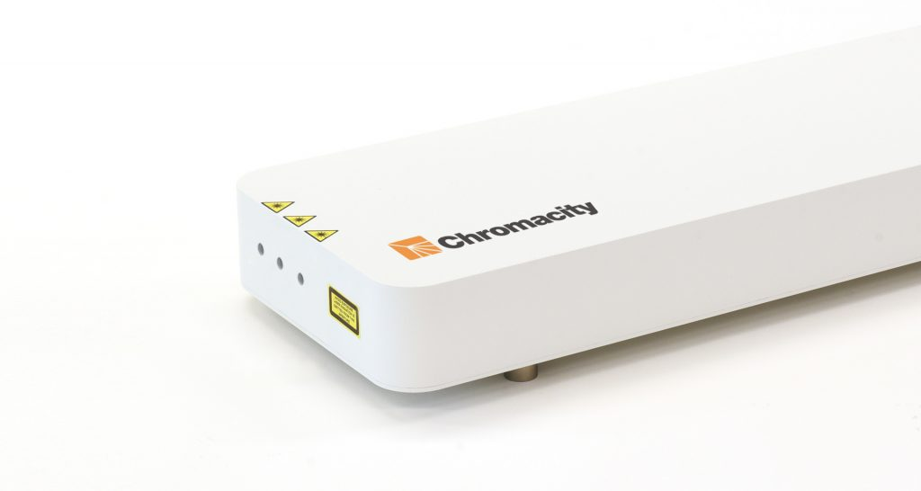

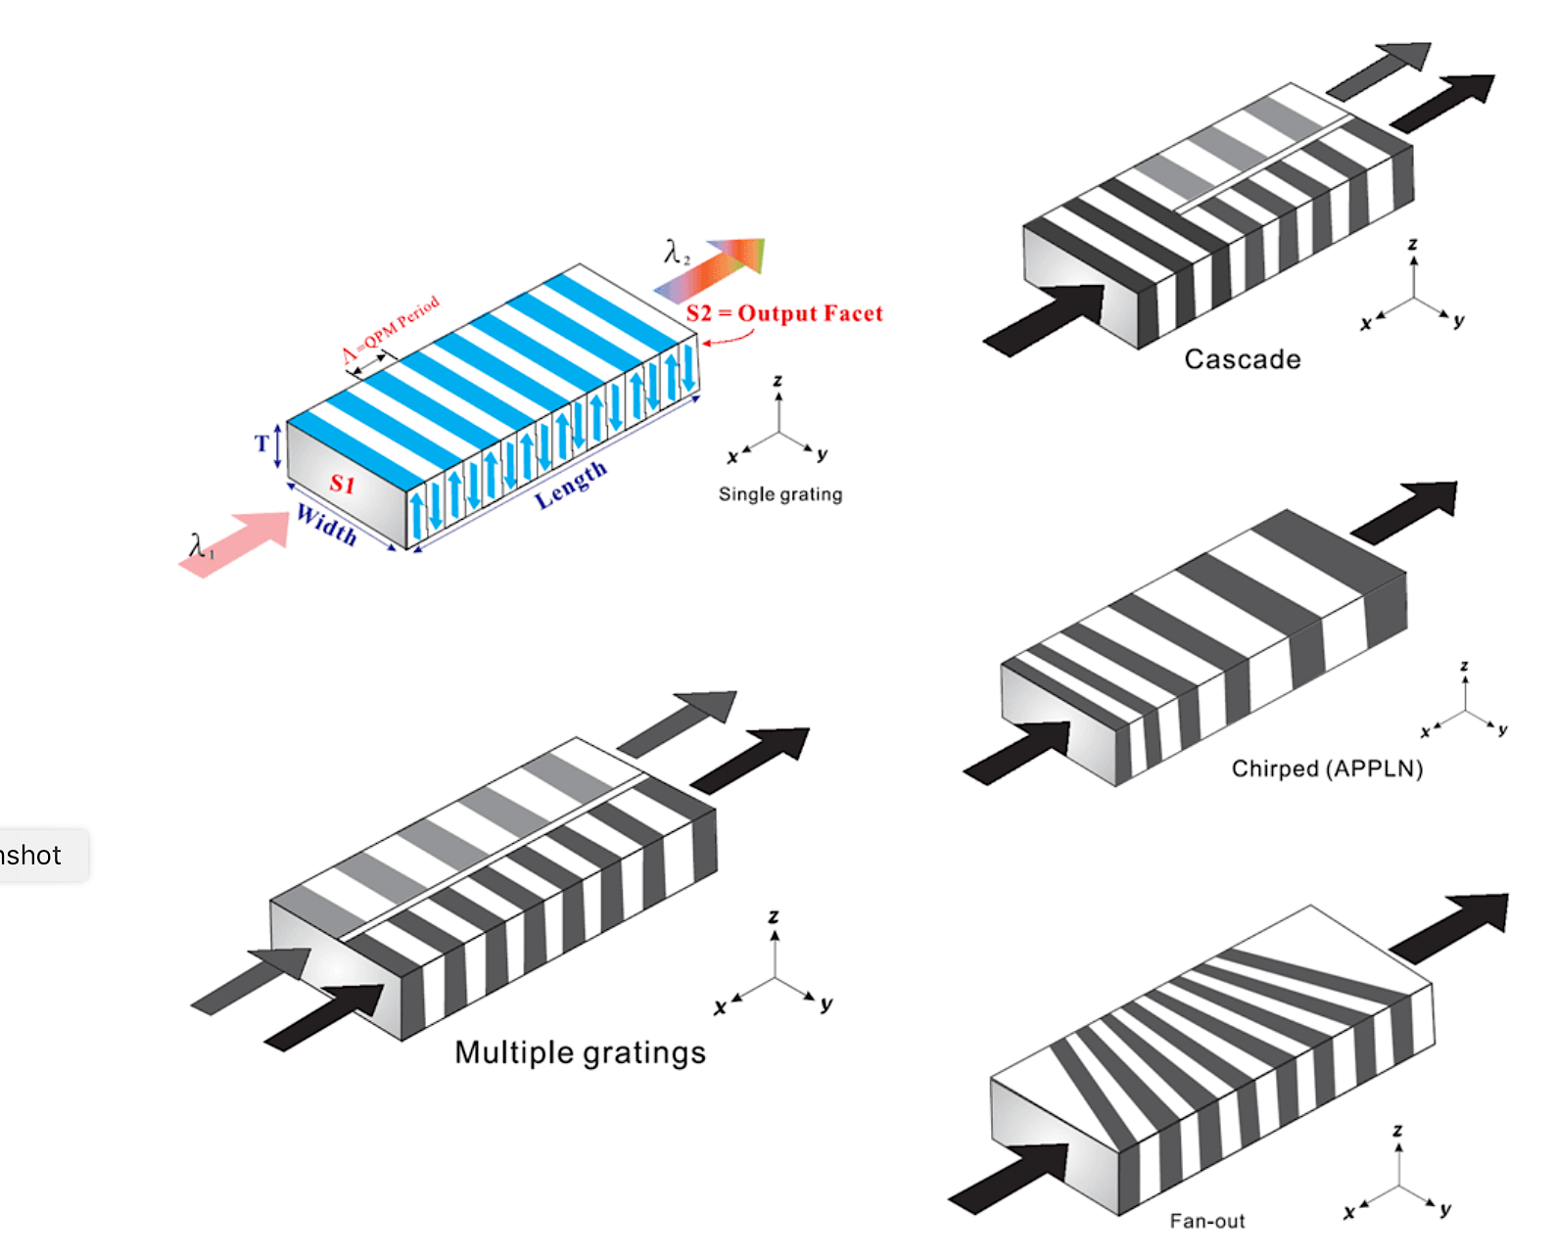
Chromacity OPO-CX
Femtosecond laser source
Idler
Signal
Residual pump
λ = 1040 nm

Slide 22
Chromacity OPO-CX
Femtosecond laser source
Idler
Signal
Residual pump
λ = 1040 nm
Fan-out grating structure

Slide 23
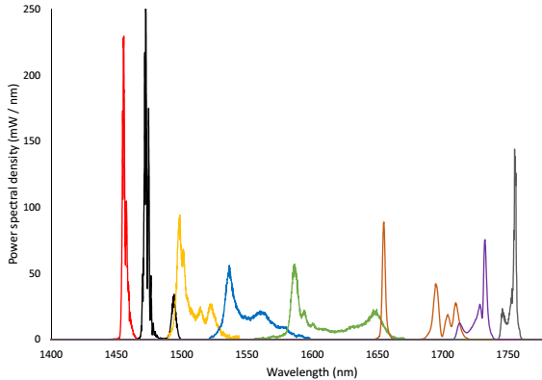
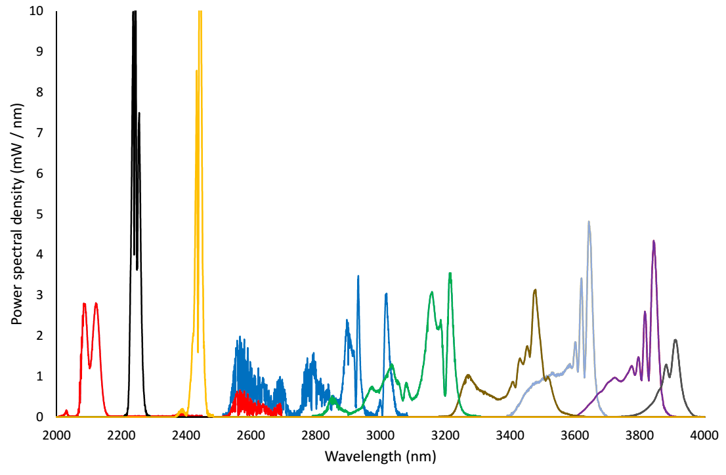
Chromacity OPO-CX
Femtosecond laser source
Idler
Signal
Residual pump
  Incorporate the 1040 pump and OPO cavity onto one unit
  Machined from a single aluminium block to improve stability/reliability
  Air cooled
  All this keeps costs down
  Signal 1.4 µm - 1.9 µm up to 1.5 W
  Idler 2.3 µm – 4 µm up to 350 mW

Slide 24
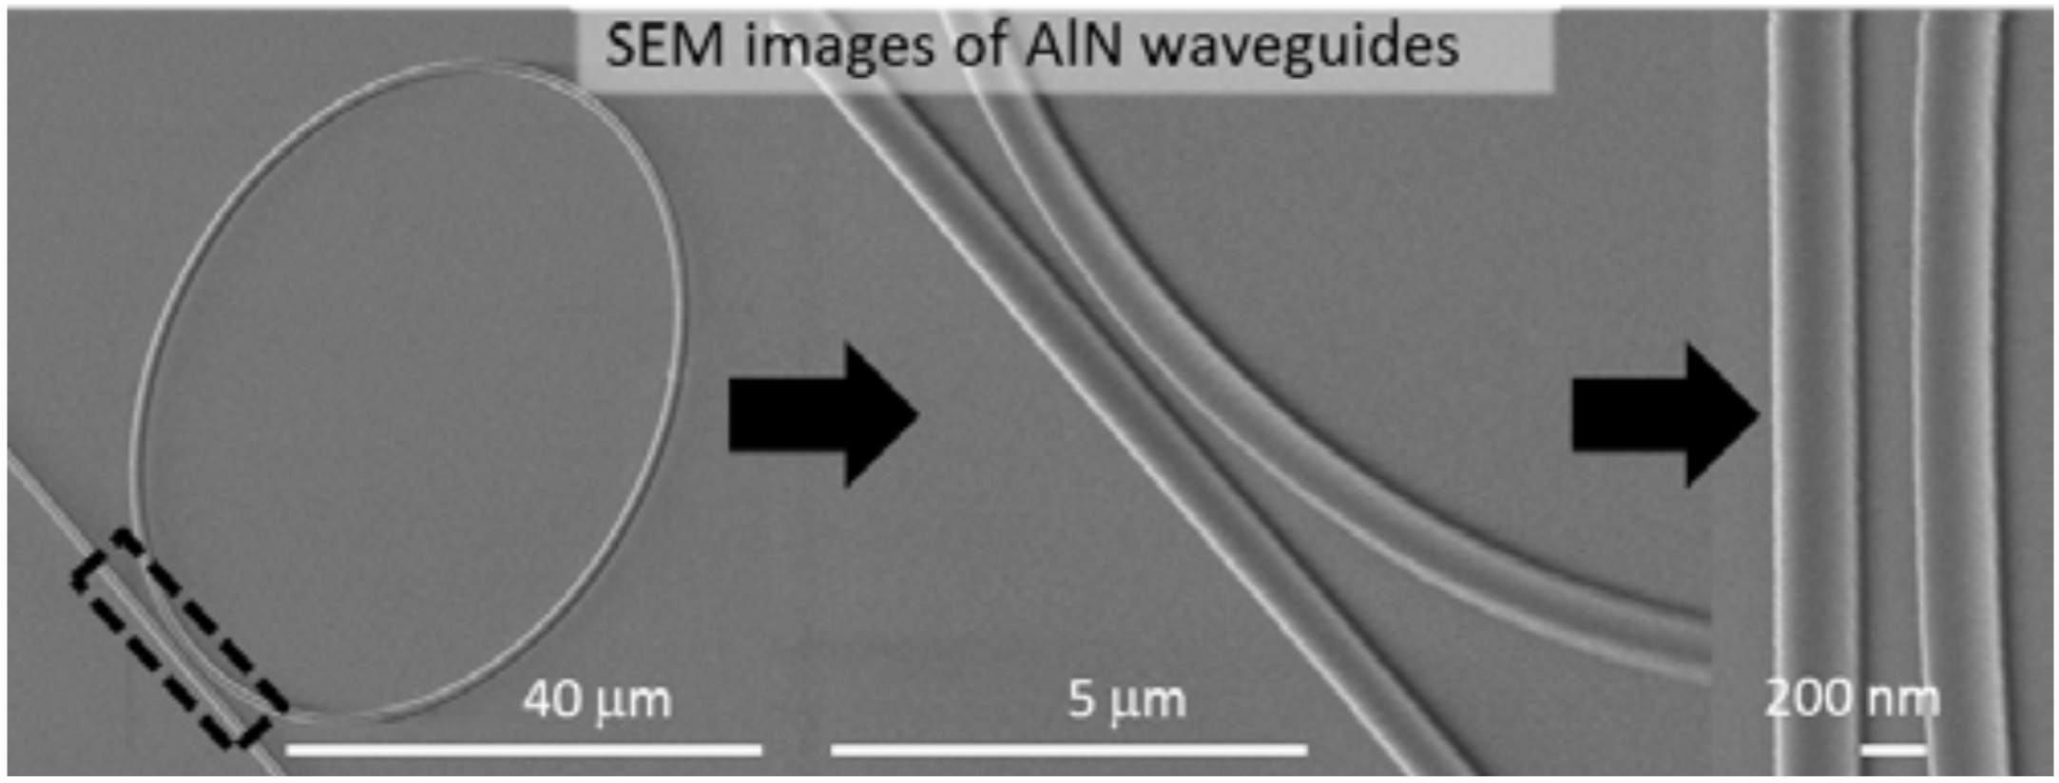
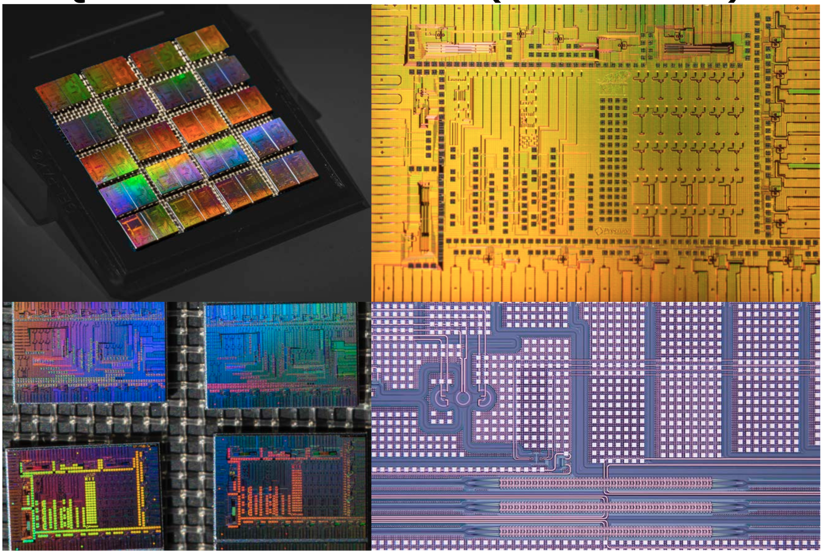
Quantum Photon Sources & Photonic Circuits
  Michael Fanto has recently taken delivery of a Chromacity OPO-CX to interrogate next generation integrated circuits.
  Quantum information processing relies on photon interference and requires qubits to be identical in order to perfectly interfere.
  He is investigating integrated waveguides in a number of different compound semiconductors
  The Chromacity OPO allows him to interrogate in the near/mid IR (beyond standard telecoms wavelengths) and into the UV by using the output of our source to generate THG.
Notes:
The Chromacity 1040 is a compact, turnkey, ytterbium fibre-based laser delivering high average power, short pulse duration for a wide range of applications that require light in the near-IR.
Primary use in the microscopy imaging market and fundamental physics research base, where the short pulses can drive non-linear effects.
This platform technology also acts as the integrated pump source for all our OPO products.
Standard powers are now in excess of 3 W and a 5 W version is expected to be launched early next year

Slide 25
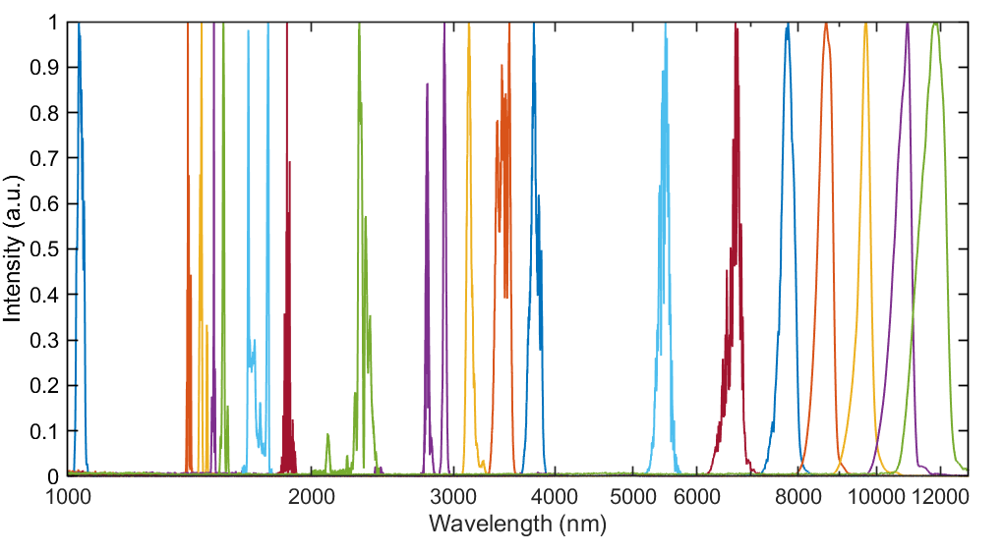
Summary
  Chromacity has a range of systems that cover the near & mid-IR as well as 520 nm and 347 nm.
  The team has significant expertise in ultrafast lasers, OPOs and non-linear optics.
  We are keen to engage with the Quantum Optics/Comms community.

Slide 26
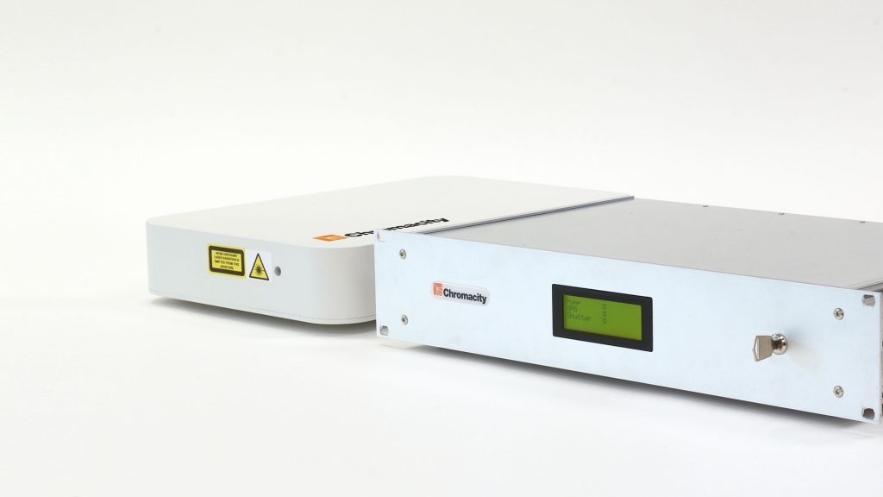
Rochester Institute of Technology
Photonics for Quantum – 23rd January 2019
Dr Christopher G. Leburn, Founder & Director
c.g.leburn@chromacitylasers.com

