Slide 1
Low Order Adaptive Optics with Very Faint Reference Stars
Craig Mackay,
Institute of Astronomy, University of Cambridge.

Slide 2
Introduction and Outline
The Hubble space telescope gave extraordinary image quality. Resolution was ~ 0.1 arcsec vs. ~ 1 arcsec from the ground.
JWST will give somewhat poorer images (coarser pixels).
Ground-based systems using Shack-Hartmann wavefront sensors need scarce bright reference stars (~12-14m).
Laser guide stars only give ~0.1 arcsec resolution at best and are often unusable because of thin cloud, lack of sodium.
A completely different technique has been developed in Cambridge that already delivers resolution three times that of Hubble (35 milliarcsec).
It allows very faint reference objects to be used, both stars and compact galaxies, as faint as I ~17-18mag.

Slide 3
Lucky Imaging
Lucky Imaging is already in relatively wide use (over 350 papers already published), providing near diffraction-limited angular resolution on telescopes in the 1-2.5 m class range.
By taking images at high speed (10-30 Hz frame rate) it is possible to freeze the motions due to atmospheric turbulence.
The sharpest images are selected and combined to give a much higher resolution output.
On a Hubble sized telescope (2.5 meter) it can give Hubble resolution in the visible with relatively high efficiency.
Also gives wide isoplanatic patch allowing wider fields of view.

Slide 4
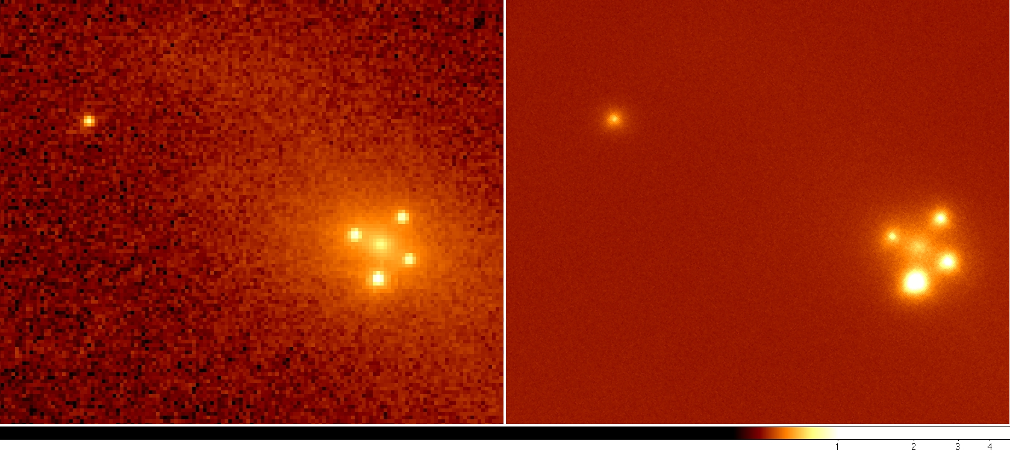
Lucky Imaging: The Einstein Cross
The image on the left is from the Hubble Space Telescope Advanced Camera for Surveys (ACS) while the image on the right is the lucky image taken on the NOT in July 2009 through significant amounts of dust.
The central slightly fuzzy object is the core of the nearby Zwicky galaxy, ZW 2237+030 (z~0.04) that gives four gravitationally lensed images of a distant quasar at redshift of 1.7.

Slide 5
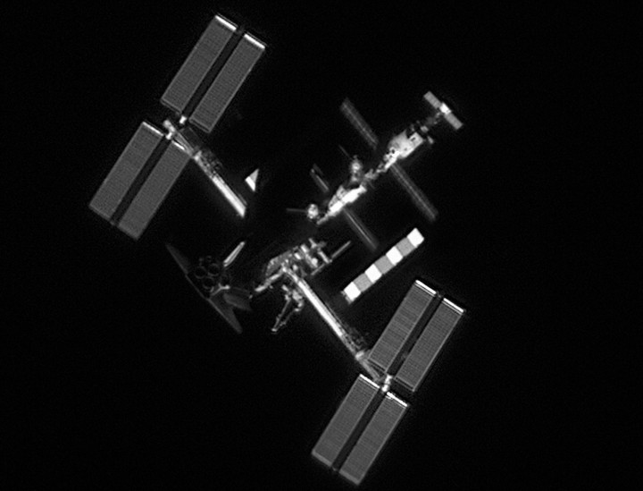
Amateurs Are Enthusiastic about Lucky Imaging
Image of the International Space Station, with Space Shuttle Atlantis & Soyuz, June 2007.
Resolution ~20 cm at an altitude of 330 km altitude, or ~ 0.12 arcsec.
Downward looking resolution is much better, ~20 milliarcsecs or ~ 2 cm.

Slide 6
Lucky Imaging on Much Larger (>2.5m) Ground-Based Telescopes
Zernike terms removed | Residual power fraction
1 | 1.000
2 | 0.565
3 | 0.130
4 | 0.108
5 | 0.085
6 | 0.063
7 | 0.057
8 | 0.051
9 | 0.045
10 | 0.039
11 | 0.037
12 | 0.034
On larger telescopes, the chance of getting a sharp image becomes vanishingly small.
Most of the turbulent power is in the largest scales.
These may be removed with low order adaptive optic systems.
Technique tried on the Palomar 5 m (200 inch) telescope behind the low order PALMAO system in 2007.

Slide 7
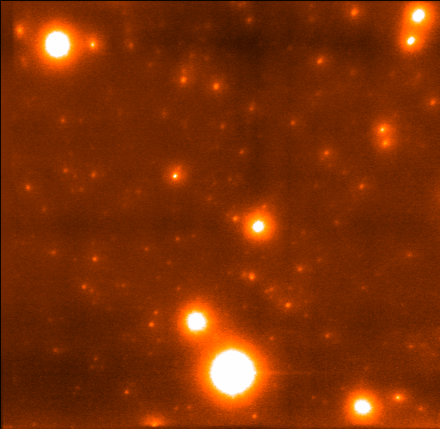
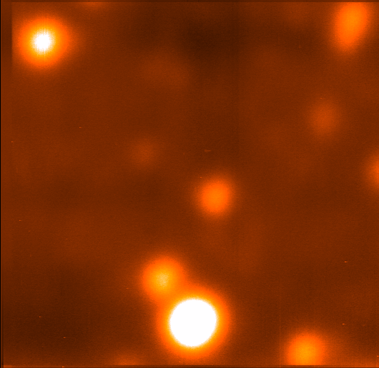
Large Telescope Lucky Imaging.
Globular cluster M13 on the Palomar 5m.
Seeing ~650 mas.
PALMAO system and our EMCCD Camera.
Achieved 17% Strehl ratio in I-band, giving ~35 mas resolution.
This is the highest resolution image ever taken in the visible on faint targets.

Slide 8
Advances on the Palomar configuration
Most AO effort is for very high order correction for exoplanets.
Our AO work targets much fainter reference stars.
Pupil plane (NOT focal plane) sensor, sensitive to low and high orders
Reconstruction with ≈x100-1000 fewer photons, star or compact galaxy.
At the lowest light levels will still produce a limited degree of correction.
“Good enough” approach: Lucky Imaging uses a degree of selection
Notes:
Initially for WHT – long term to take to 10m GTC
Range of magnifications and field of views by having interchangeable lenses – 50, 80, 150mm.

Slide 9
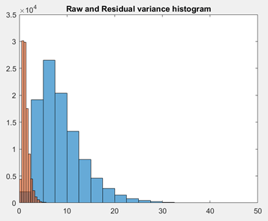
Wavefront Reconstruction
The phase patterns are extracted with radon transforms (widely used in x-ray/MRI tomographic scanning systems).
By interpolating these phase patterns we can extract the phase error in the pupil plane.
That output drives a deformable mirror (we use the ALPAO 241 actuator unit) at 100 Hz.
We have run extensive simulations which confirms the performance we got on Palomar and in the laboratory.

Slide 10
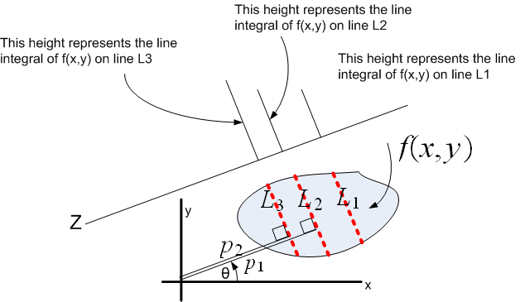
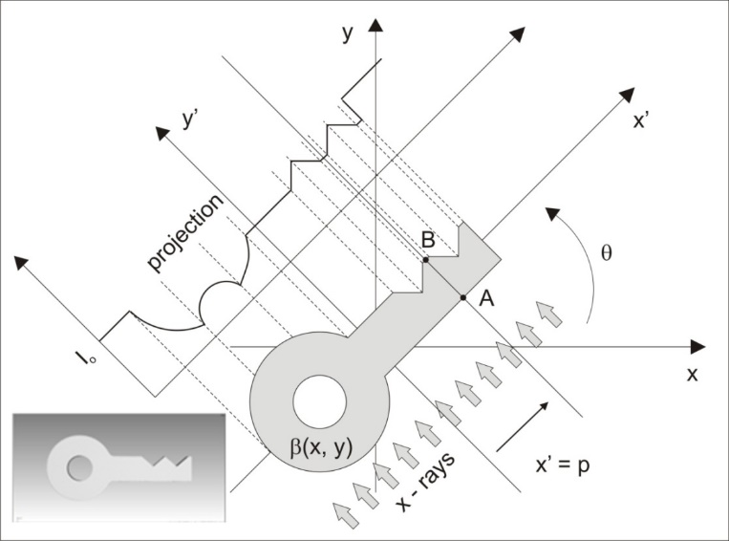
Wavefront Reconstruction
The phase patterns are extracted with radon transforms
This shows the original then the recovered phase, incl tip-tilt.

Slide 11
Wavefront Reconstruction
Removing tilt-tip (Lucky Imaging allows that on every image) shows next stage, and the improvement to the image.
In this instance we see a combination of defocus and astigmatism dominates.
Once they are removed the processed image is dramatically sharper.
Since most of the power is in these lower orders the output is close to being diffraction limited.

Slide 12
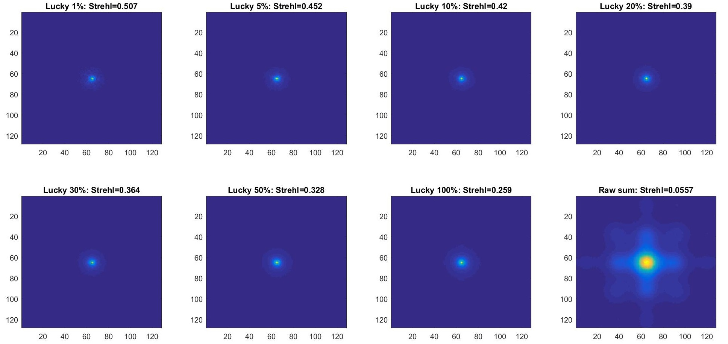
Wavefront Reconstruction
After running a sequence of many images we accumulate very great improvements in image quality.
If we use only a small fraction then the images are very sharp.
Even using 100% but of course with tip-tilt removed, gives an improvement of a factor of 2.5-3.

Slide 13
CWFS Predicted Performance.
Image sharpness is determined by wavefront variance.
We see here that this process reduces the variance dramatically.
That is why the images are so greatly improved by combining Lucky Imaging and low order adaptive optics.

Slide 14
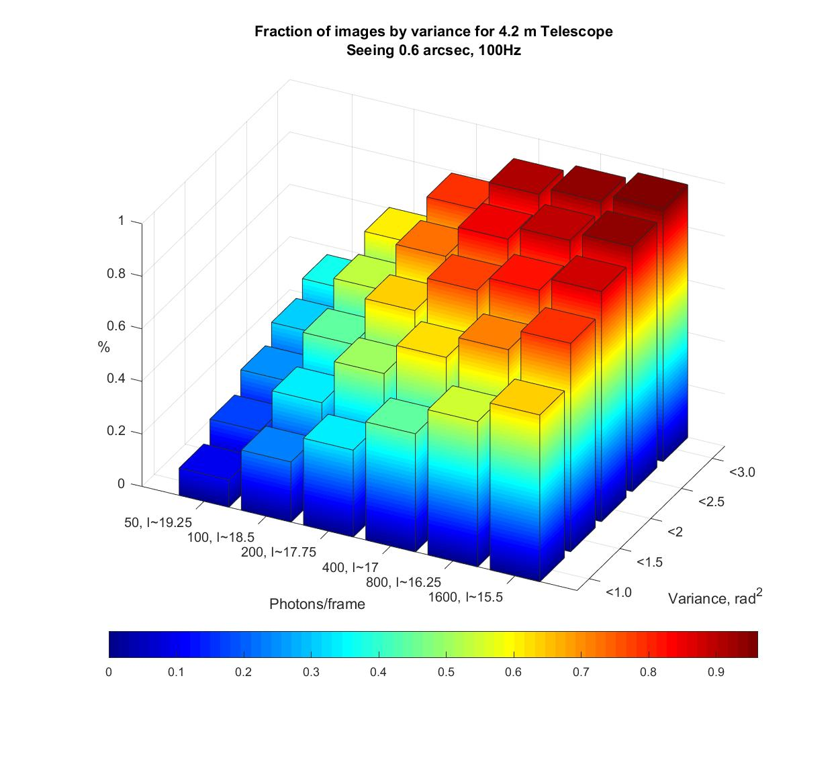
CWFS: 4.2m Predicted Sensitivity.
Even at very low photon rates per frame system produces images close to the diffraction limit with high efficiency.
200 photons/frame from I ~ 17.5-18.
At low photon rates it is important not to try to fit too many Zernike modes.
That will simply increase the noise and blur the output images.

Slide 15
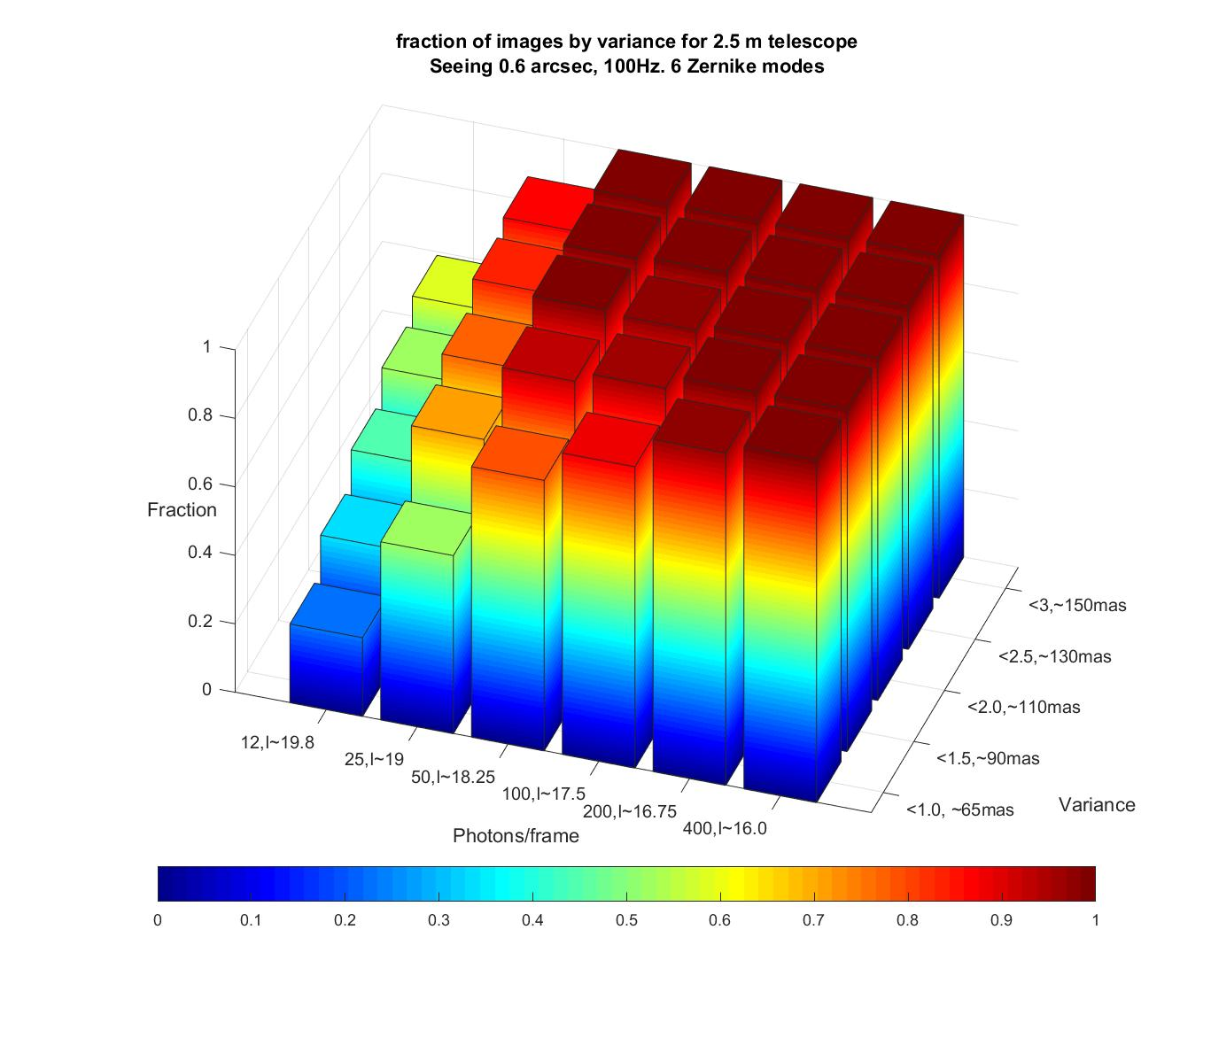
CWFS: 2.5m Predicted Sensitivity.
Allows a 2.5 m telescope made close to diffraction limited in the visible with a CWFS.
100 photons/frame from I ~ 17.5-18.
Removing tip tilt, the focus and astigmatism increases r₀ from 30cm to 1.2m (0.15 arcsec seeing).
Gives ground based 2.5m near HST performance in the visible.

Slide 16
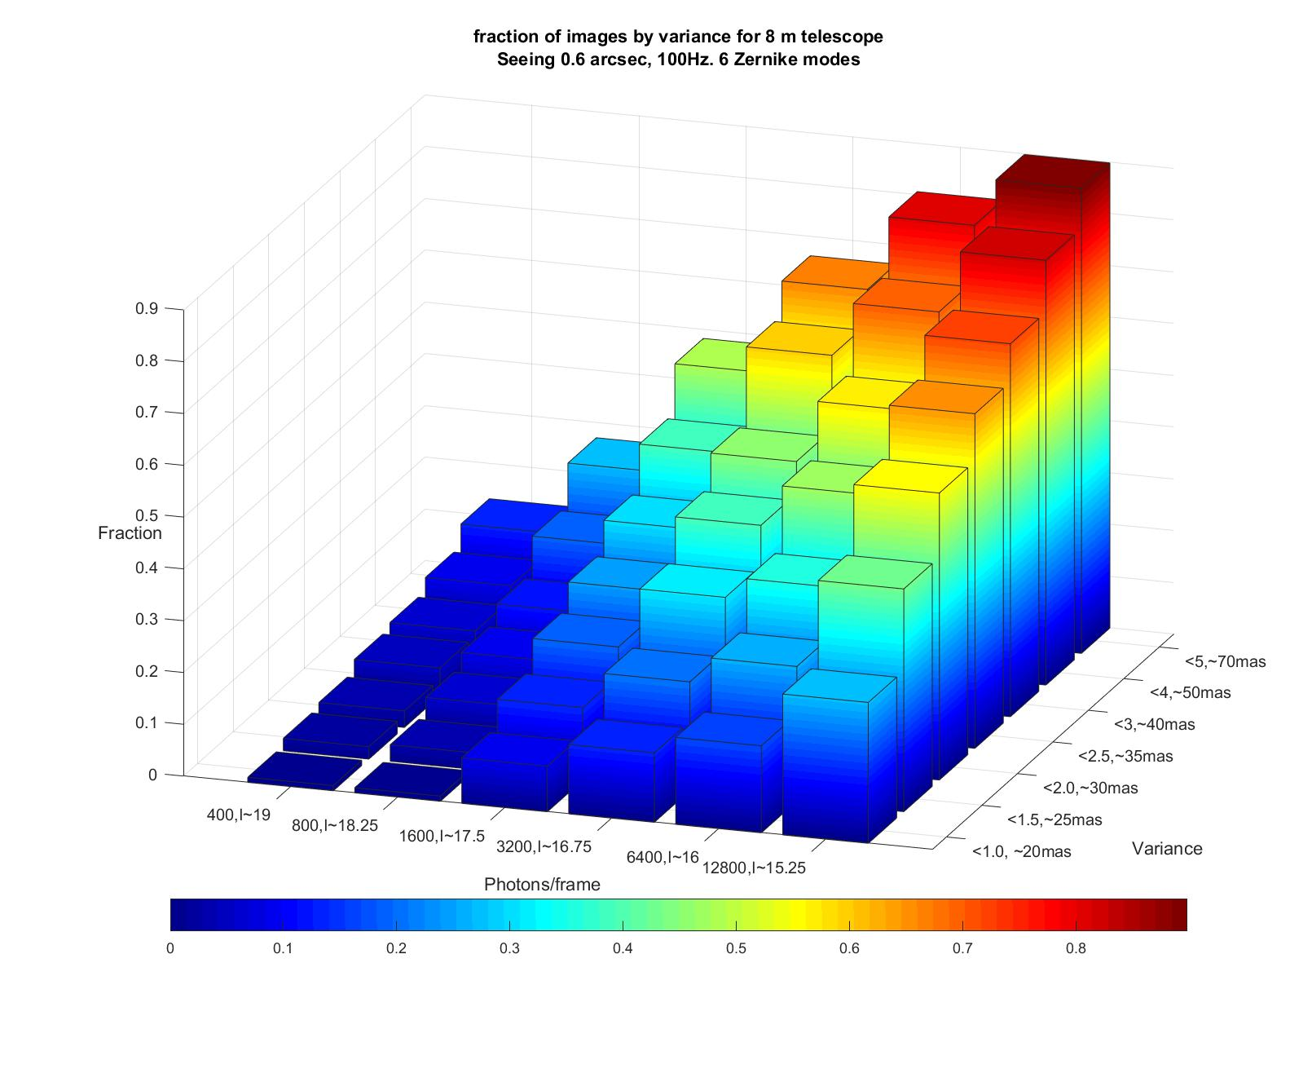
CWFS: 8m Predicted Sensitivity.
Even with an 8m telescope get near diffraction limited images in the visible..
800 photons/frame from I ~ 17.5-18.5
With 25% selection images will be ~20 mas resolution in the visible.
~Five times HST resolution.
All images in the isoplanatic patch have this resolution, even if very much fainter!”

Slide 17
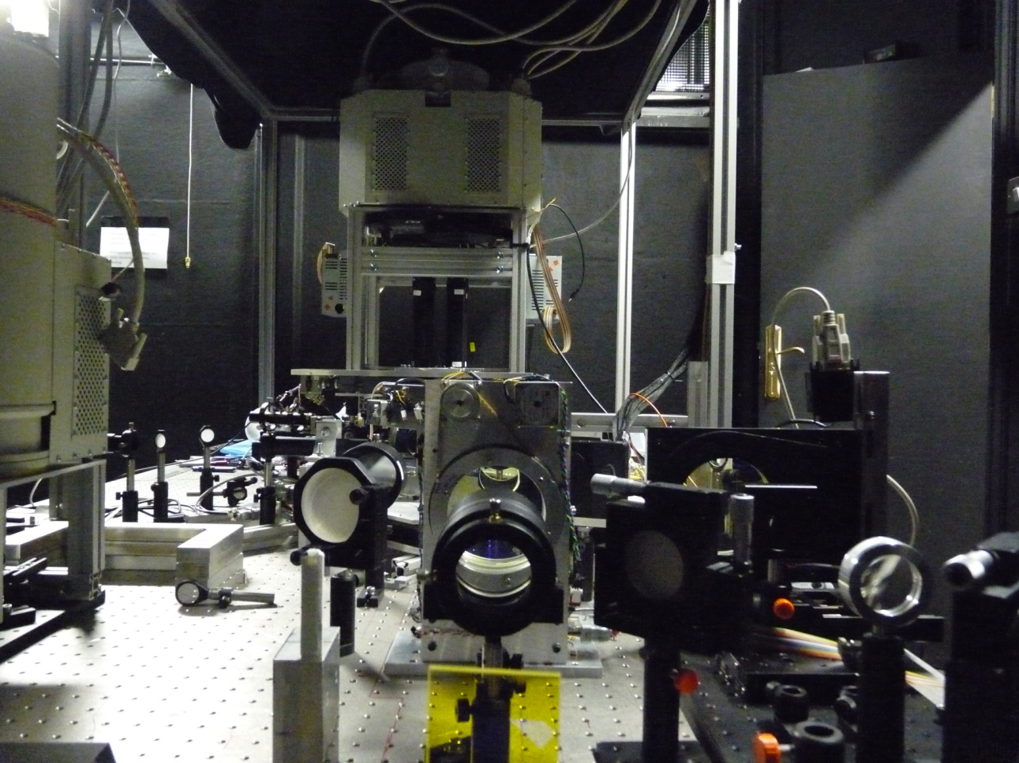
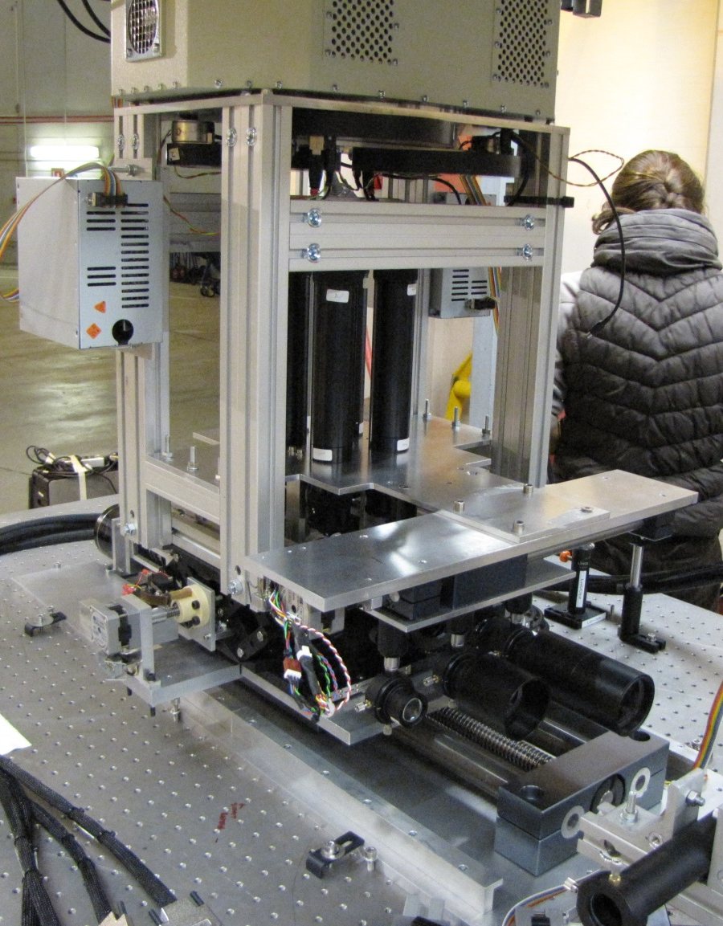
AOLI: Adaptive Optics Lucky Imager

Slide 18
Son of AOLI on the ELT?
Have already demonstrated that these techniques should work in the visible on 4-10 m class instruments.
Predicted to give an angular resolution in the visible of 40-15 milliarcseconds giving unique insights into the structure of a wide range of astronomical objects.
The ELT will give similar resolution in K-band (2.2 µ), and the techniques should transfer fairly directly.
The key component will be fast relatively low noise infrared array detectors, and these are rapidly becoming available.
They are already under development (ESO & ESA at Selex).
Most of the challenges (curvature wavefront sensors, real-time processing software) already sorted out for AOLI.

Slide 19
Lucky Imaging Group Institute of Astronomy University of Cambridge, UK cdm@ast.cam.ac.uk

