Slide 1
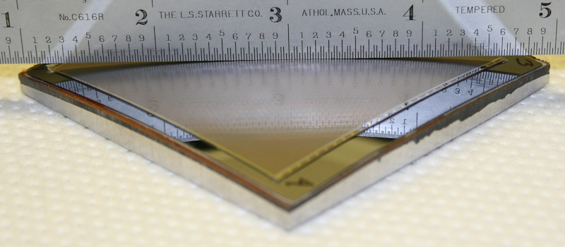
Curved Detectors (3D) – Status
Olaf Iwert, ESO

Slide 2
Skeptic about curved detectors ?
A participant from SPIE 2013, Edinburgh:
    “….Are these guys crazy ??
    (IR)Detectors are complex
    enough already !
    We should stop this development…..”
But what about Progress ?

Slide 3
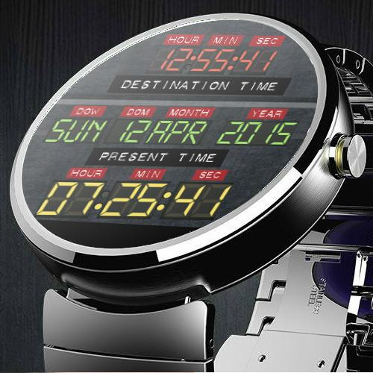
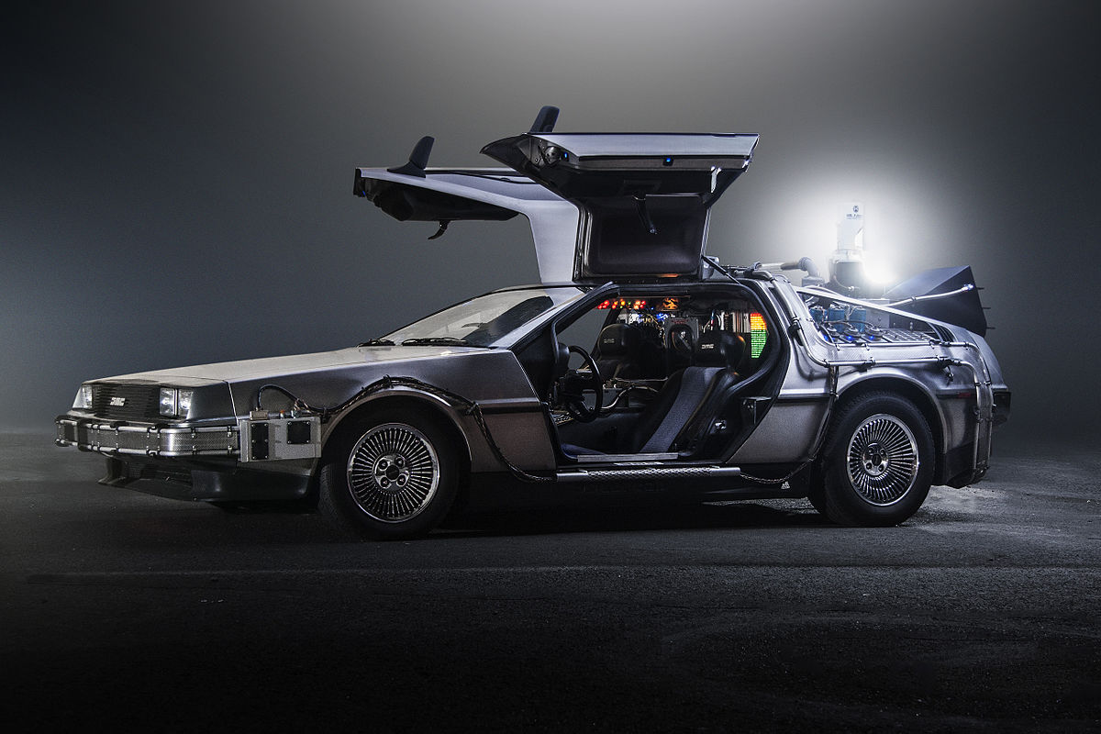
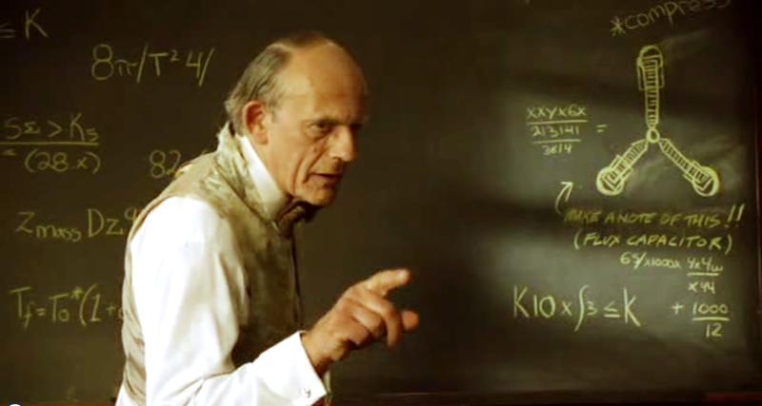
BACK TO THE FUTURE
Notes:
TIME MACHINE – BOTH WAYS : PAST and FUTURE
https://play.google.com/store/apps/details?id=com.seenapps.bttf_face
https://en.wikipedia.org/wiki/DeLorean_time_machine
http://backtothefuture.wikia.com/wiki/Flux_capacitor

Slide 4
It takes a looong time from
the first idea to the
actual product…..
(ALWAYS), but some examples how long:
A.) Solid State Imagers:
What is the first time you came into touch ?
What were your thoughts at that time on their future for the impact on our daily life ?
What do you think the astronomers / engineers replied, whom I talked to ?
Notes:
Asked Paoloa, Jason, Luca, Mark: At that time they were so lousy and problematic >> NO WAY !!!
Did not even THINK ABOUT Impact on digital photography

Slide 5
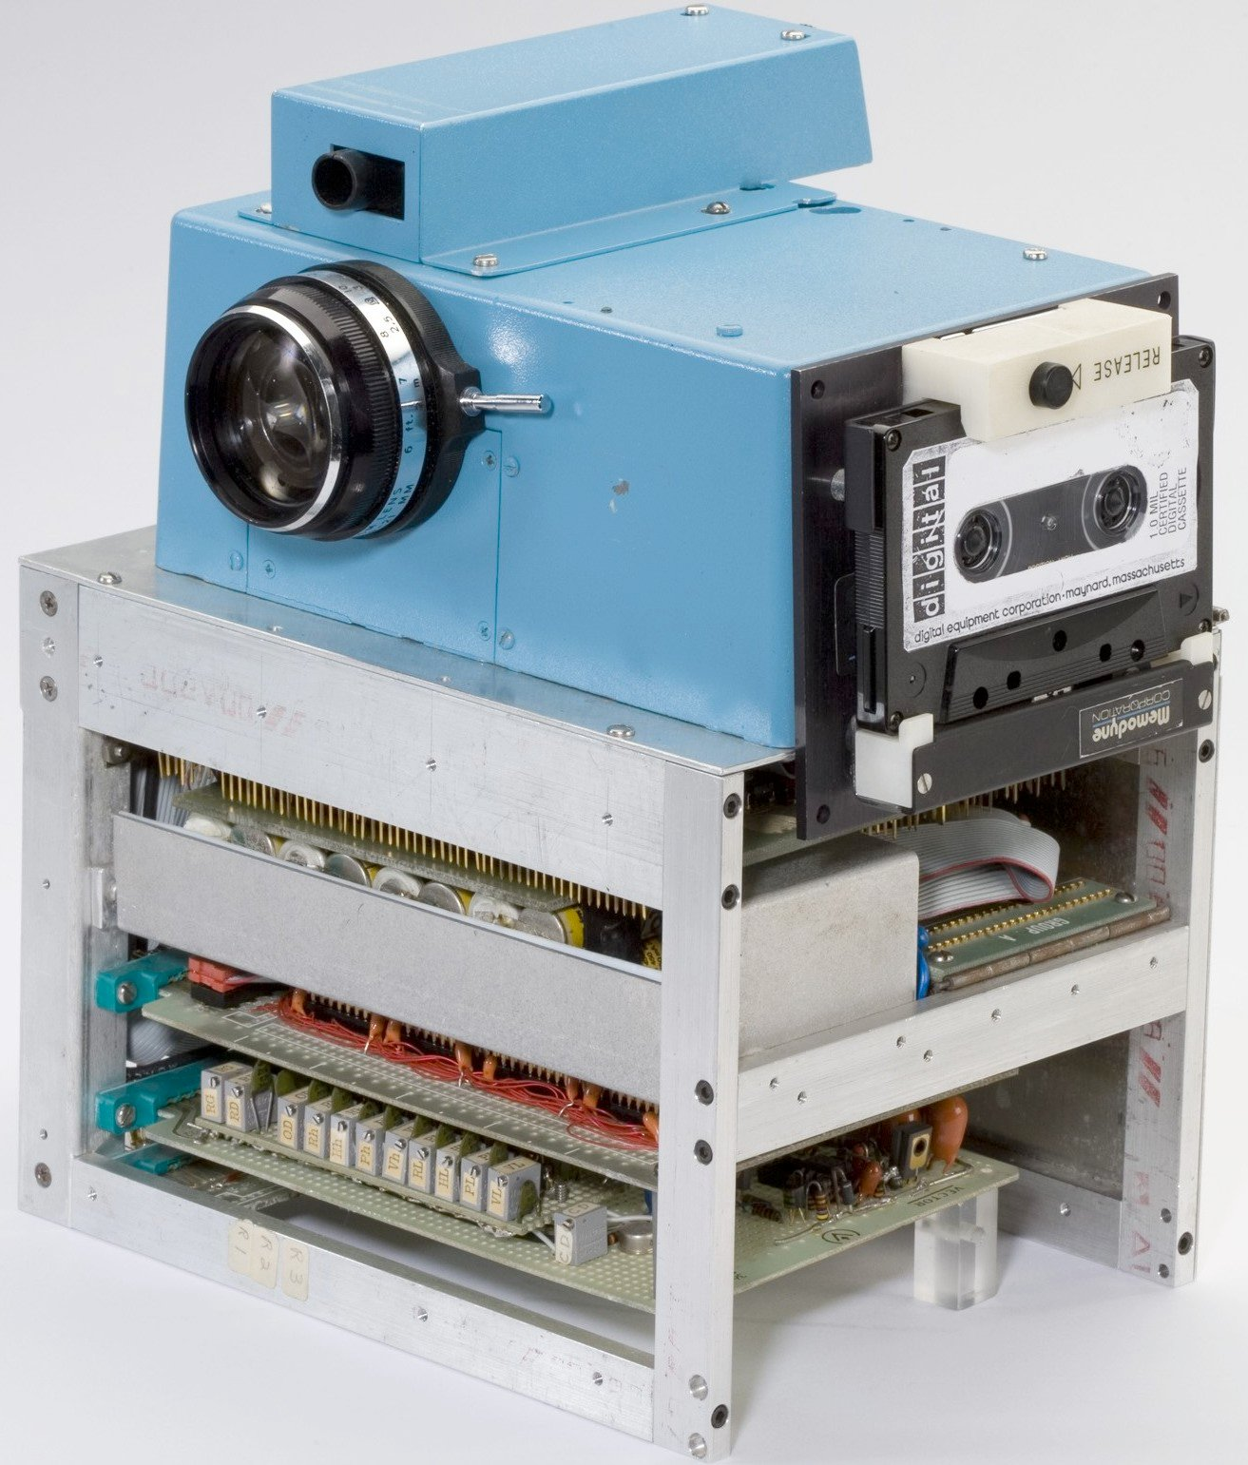
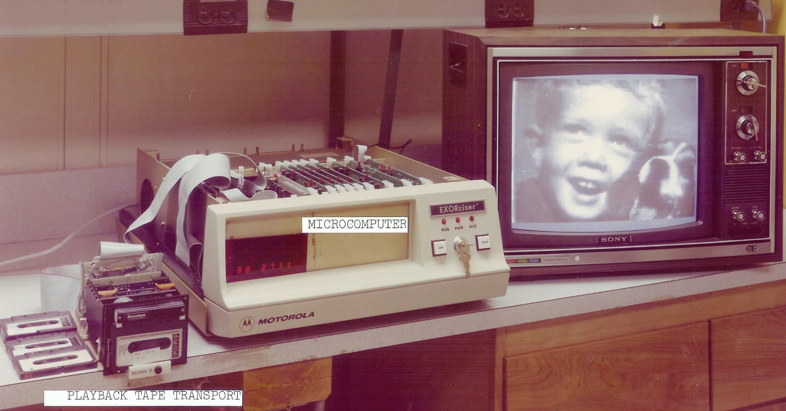
1975: FIRST Digital Camera (Kodak)
Kodak’s inventor of the first digital camera has revealed how bewildered company executives couldn’t understand why anyone would ever want to look at images on a TV screen when he first proposed the idea of a ‘filmless camera’ to them in 1975.
Patent US4131919A
Notes:
Revolutionized our life
(tribute to bredthauer and Janesick) based on major work for Hubble Space Telescope (TI 800 x800)
Kodak first digital camera
https://lens.blogs.nytimes.com/2015/08/12/kodaks-first-digital-moment/#slideshow/100000003848463/100000003848467
Kodak DCS
https://en.wikipedia.org/wiki/Kodak_DCS
Building a house !!
Restoring an old car !!!
Driving from Alaska to Argentina !!!!
Unification of Europe :-(
Building the LSST :-)
And many more which are still to be accomplished ...
1975 Steve sasson,
ttps://lens.blogs.nytimes.com/2015/08/12/kodaks-first-digital-moment/
It had a lens that we took from a used parts bin from the Super 8 movie camera production line downstairs from our little lab on the second floor in Bldg 4. On the side of our portable contraption, we shoehorned in a portable digital cassette instrumentation recorder. Add to that 16 nickel cadmium batteries, a highly temperamental new type of CCD imaging area array, an a/d converter implementation stolen from a digital voltmeter application, several dozen digital and analog circuits all wired together on approximately half a dozen circuit boards, and you have our interpretation of what a portable all electronic still camera might look like.

Slide 6
Analog <> Digital Camera (large format) :
“Digital wonderbricks” now everywhere since ~ 2003, but not in 60 mm x 60 mm, which was the medium format standard
Largest commercially offered medium format detectors now have ~ 60 mm x 40 mm, but no backside illumination
Hubble “Trigger” for all scientific CCD work !

Slide 7
B: CCD versus CMOS:
Talk by M. Loose SDW 2005, Taormina:
“CCDs are dead / dinosaurs >> CMOS is the future”
2017:
Commercial poducts (OK)
Scientific products (no way yet…)
e.g. ESPRESSO CCD detectors 90 x 90 mm State-of-the-Art), plus required binning

Slide 8
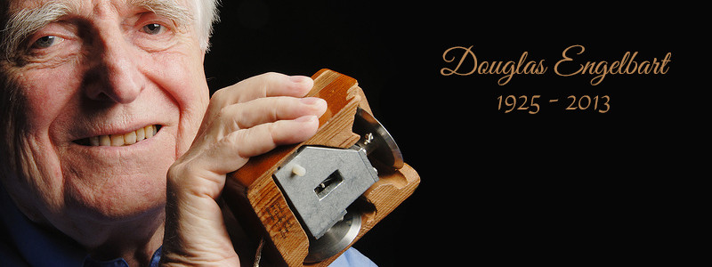
C: 1961 - COMPUTER MOUSE / GUI
SRI Stanford Research Institute - now Stanford Research International, owned by Sarnoff
~ 1985 again by Apple; early 90’s widespread
Google also : ‘Mother of all presenttations, Engelbart
Notes:
http://szaboka.com/news/doug-engelbart-inventor-of-the-mouse-passed-away/

Slide 9
FLASHBACK TO SDW 2013:
Curved detectors: Where did we stop ?
Notes:
(Koifman sensors world blogspot Theuwissen)

Slide 10
In a nutshell: Curved Detector KEYPOINTS
Optical advantages of system performance
Curved detectors plus simplified optics >> not really elaborated this time in detail >> Zwicky ?
Advantages as f (Field, speed, vignetting, resolution)
Fixed / modulated curvature
Cryogenic / non-cryogenic curvature
Curving thin or thick detectors ?
Theory of tensile stress versus practical experiment
High curvature / low curvature with small / large detectors
Curvature shape with high / low accuracy
Commercial world: Mirrorless cameras / cellphones
Notes:
(Koifman sensors world blogspot Theuwissen)

Slide 11
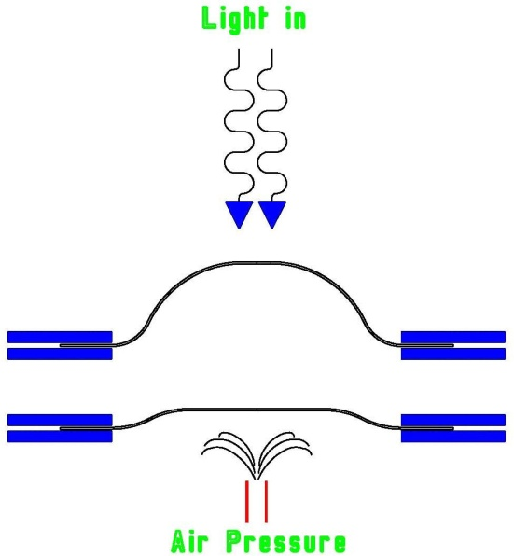
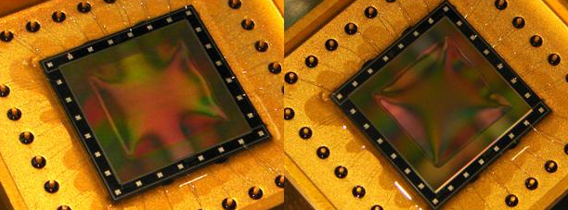
Milestone developments 2013 (1)
JPL modulated curvature on the fly,
relying on thinning
Unsupported, frame thinned, curvature modulated on the fly during imaging:
Shouleh Nikzad, JPL, USA: CCD of 12 x 12 mm²,
Device curvature modulation - 250 mm … + 250 mm radius on the fly
Operated at room temperature without obvious performance loss,
but not fully characterized >> talk to Shouleh
Images courtesy
of S. Nikzad, JPL

Slide 12
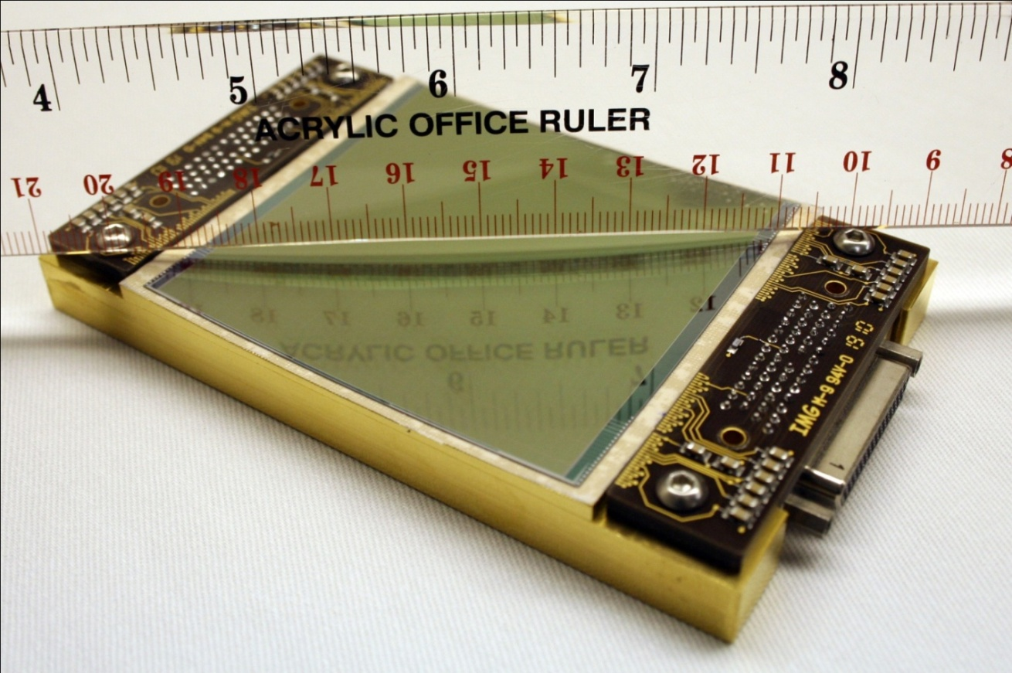
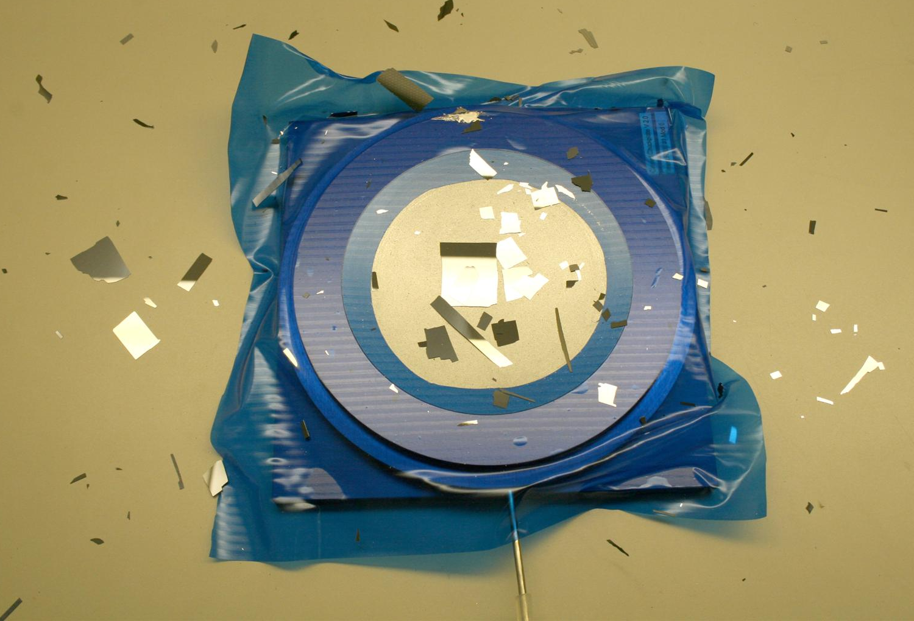
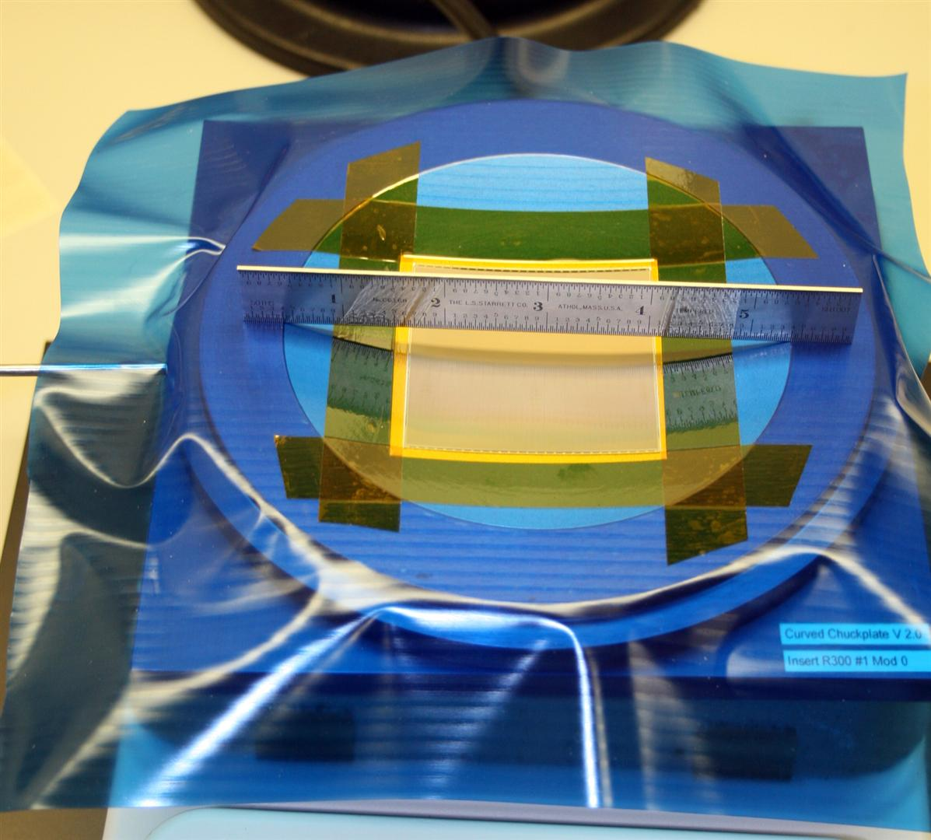
Milestone developments 2013 (2)
ESO / ITL 1st Curved Astronomical detector, 4k x 4k, 15 um detector
1st curved large detector
~ 200 um thick, frontside
Limit of curvature ?
500 mm curvature radius
Concave, fixed
Cryogenically cooled
Chracterized before & after
curvature with similar result
Curved above known
theoretical limit
>> Talk to Mike Lesser, me
Notes:
(Koifman sensors world blogspot Theuwissen)

Slide 13
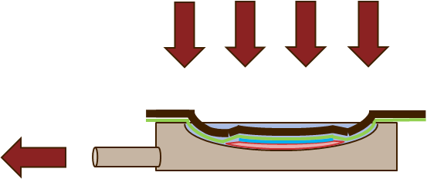
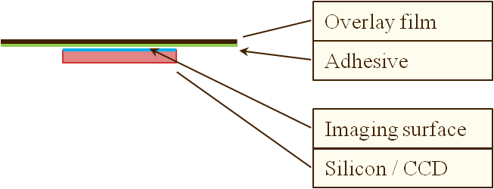

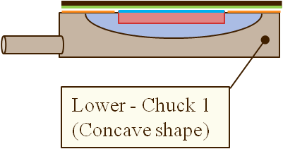
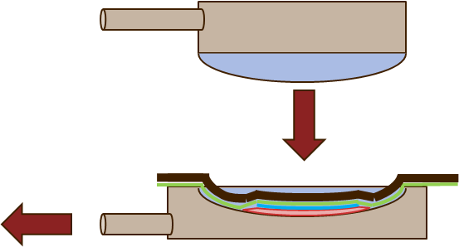
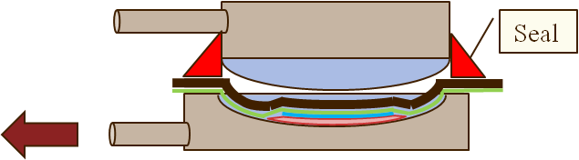
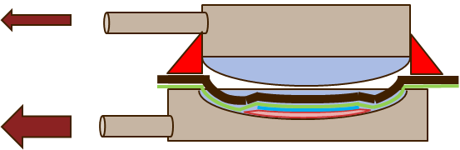
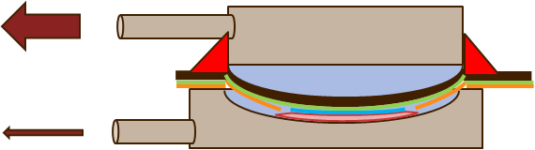
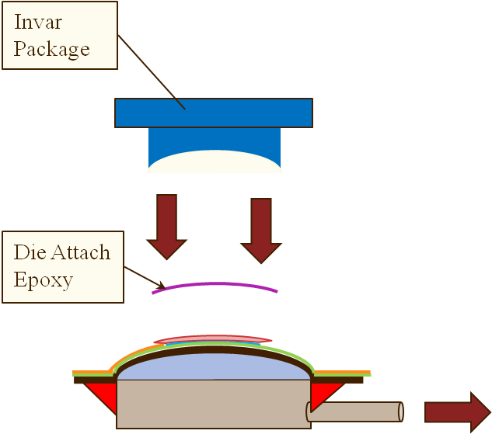
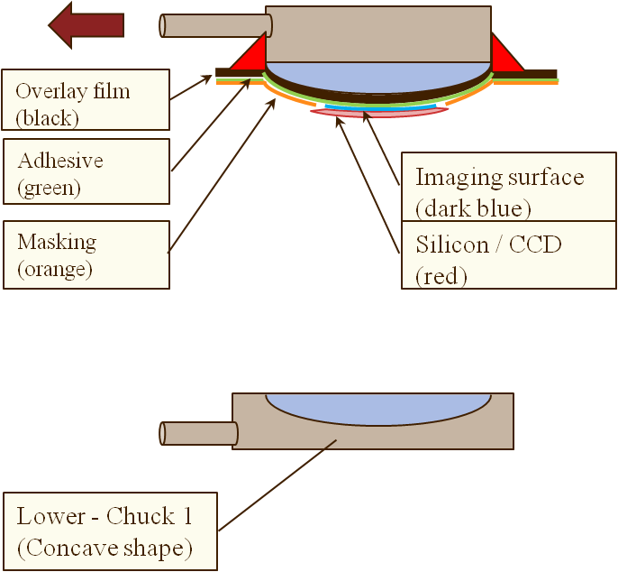
ESO / ITL curving process: 2 Vac
Overview of process steps:
A
B
C
D
G
H
E
F
I
J

Slide 14
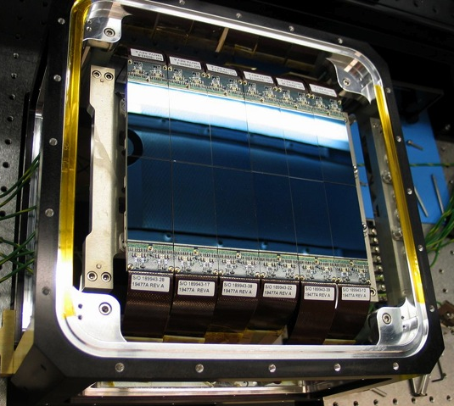
Milestone developments 2013 (3)
MIT / LL SST Telescope (3.5 m, F1) designed for individually curved detectors in a mosaic
6 x 2 detectors of 2k x 4k, 15um each
Not a prototype – pioneering a very courageous decision, independent of anyone else
Convex, 5.44 m curvature radius
Extremely accurate curvature ~3 um for combined curvature across mosaic
Now a second mosaic built for 2nd telescope
>> Talk to Vyshi S., Barry Burke
Notes:
(Koifman sensors world blogspot Theuwissen)

Slide 15
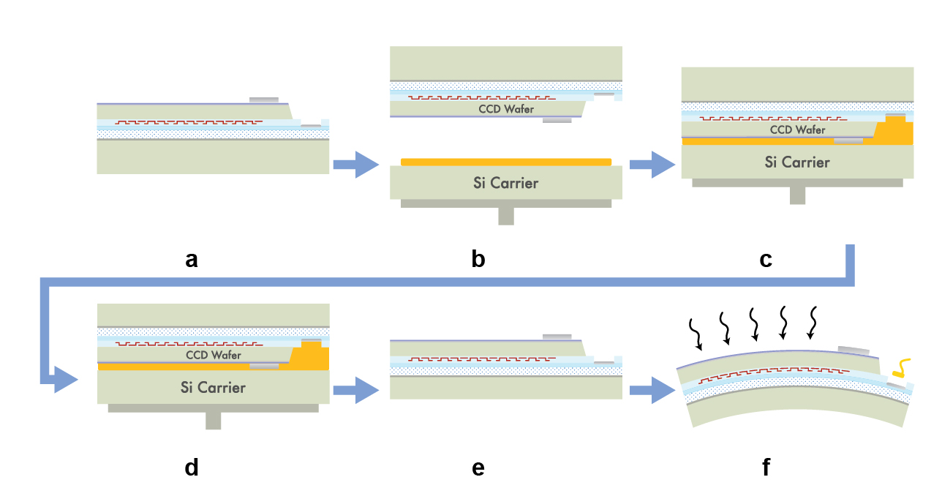
Processing of Curved CCD to Completion
Thinned,
Back-illuminated
CCD Wafer
Handle Wafer
Mount back-illuminated, functional CCD wafer (a) to carrier wafer (b+c)
Thin handle wafer (d)
Remove from platen (e)
Dice wafer and deform CCD to spherical shape (f)
Notes:
Begin process with back-illuminated CCD (a). Mount to carrier wafer on platen (b and c). Thin handle wafer to provide flexibility (< 300 µm) (d). Remove from platen (e). Deform to spherical shape (f).
Cleared for AMOS Conf 2013, T. Blake (DARPA/TTO) et al.

Slide 16
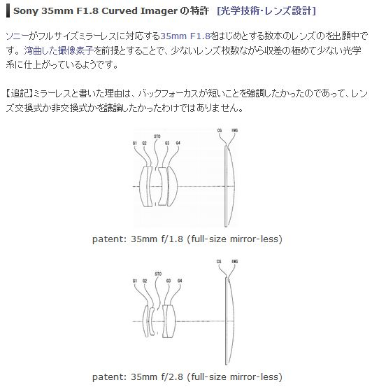
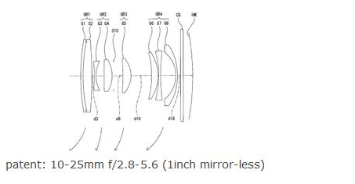
Milestone developments 2013 (4)
It’s not a Trick – it’s a SONY Patent
Optics for Curved Detector
Sony patent 2013-61476 in Japan
Back focal distance minimized
Not possible with flat det.
Already built with flat detector:
>= 8 lenses (Nikon, Olympus)
>= 7 lenses
(Olympus)
Curved detector:
4 lenses
+ ZOOM in connection with lens shift and curvature modification
Curved detector:
4 lenses
Notes:
OK, 1
Estimate curvature radius, but exact radii and index of refraction are not known !
Also Pentax rumours about curved Detectors

Slide 17
CURVED DETECTORS SINCE SDW 2013

Slide 18
ESO DEVELOPMENTS (1)
A.) Broaden the interest base / inform the community
B.) MOS instruments – demand as seen e.g. in 4MOST
C.) Open exchange with LAM and co-operating to see
what is a common basis to push this forward for
scientific detectors
D.) ESA/ESO collaboration with support from highest level:
Space projects : better image quality,
weight reduction,
alignment insensitivity
Notes:
Proceedings Volume 9906, Ground-based and Airborne Telescopes VI;
10.1117/12.2232289
Event: SPIE Astronomical Telescopes + Instrumentation, 2016, Edinburgh, United Kingdom, downloaded

Slide 19
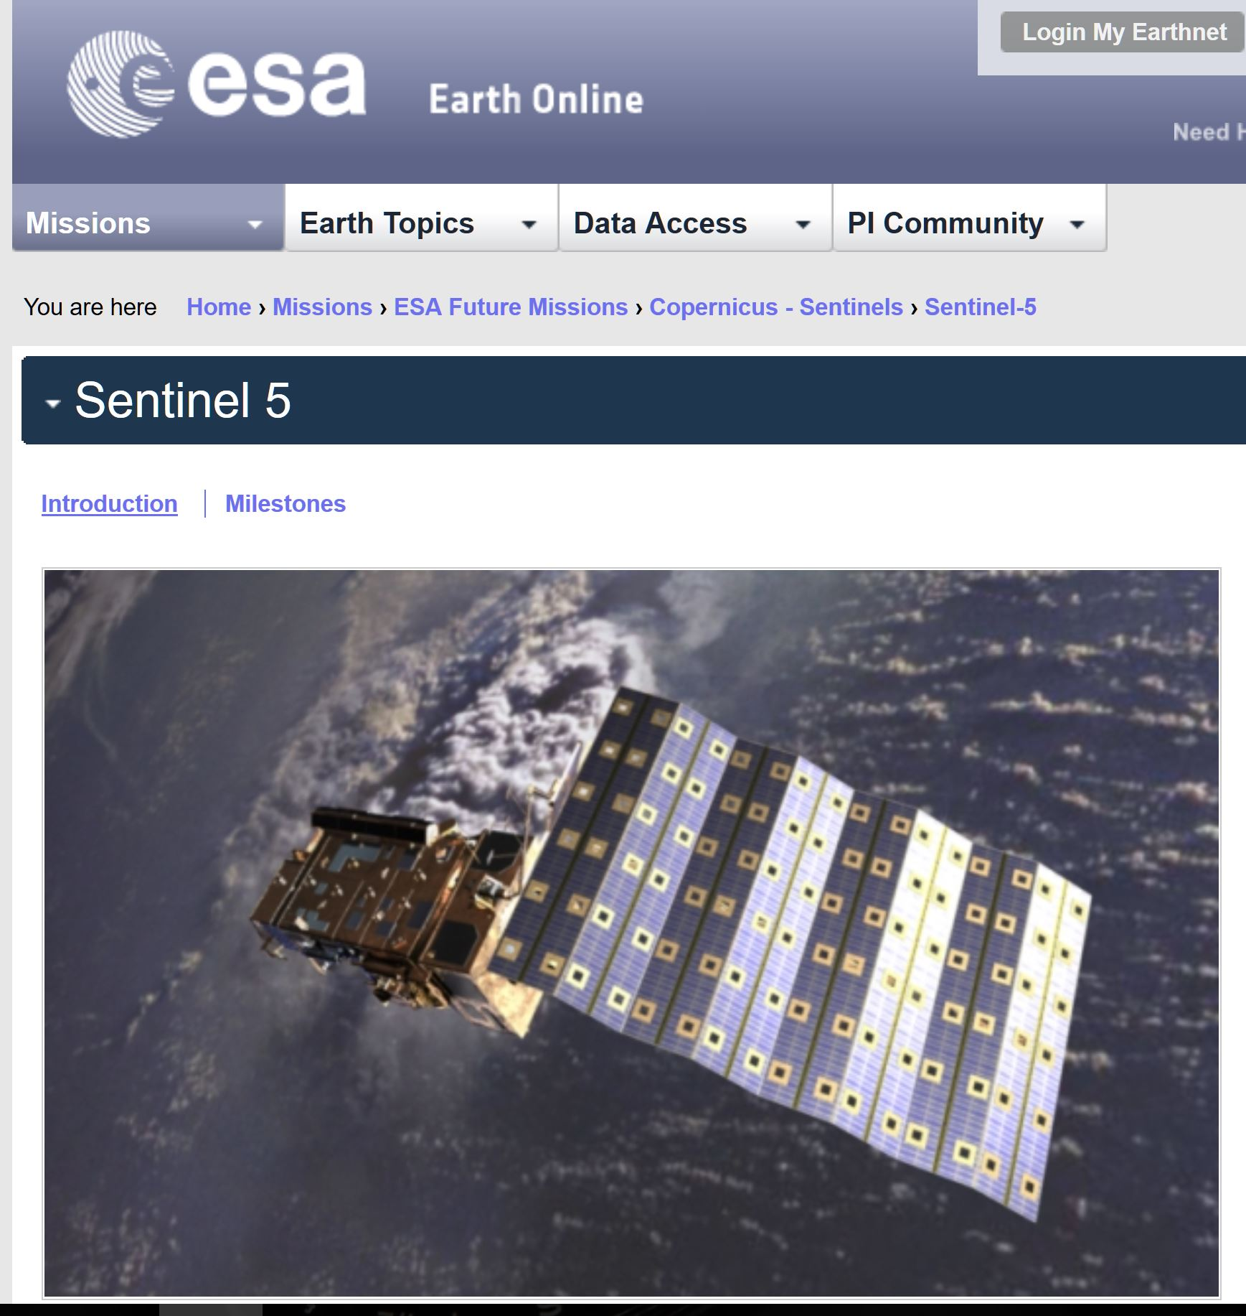
ESO / ESA CURVED DETECTOR
Example of an optical system simplification
Study done on Sentinel 5 UV2VIS camera

Slide 20
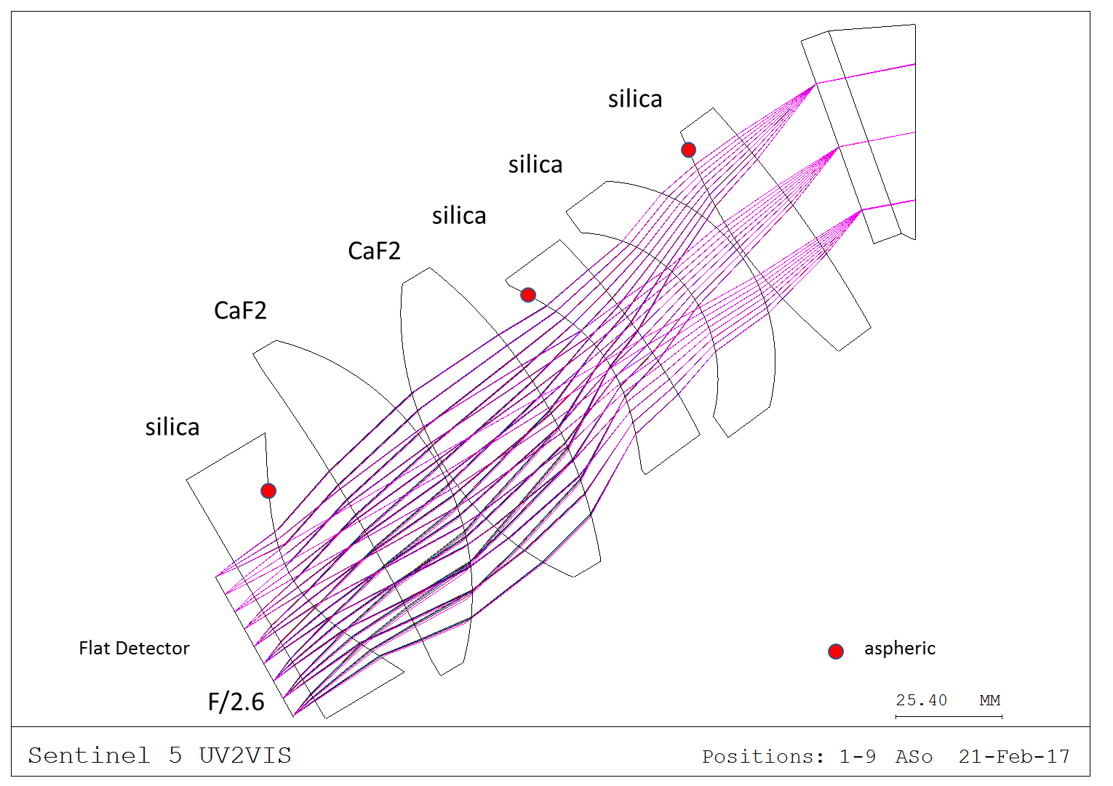
Original Optical Design Sentinel V
Notes:
Bernard Delabre !

Slide 21
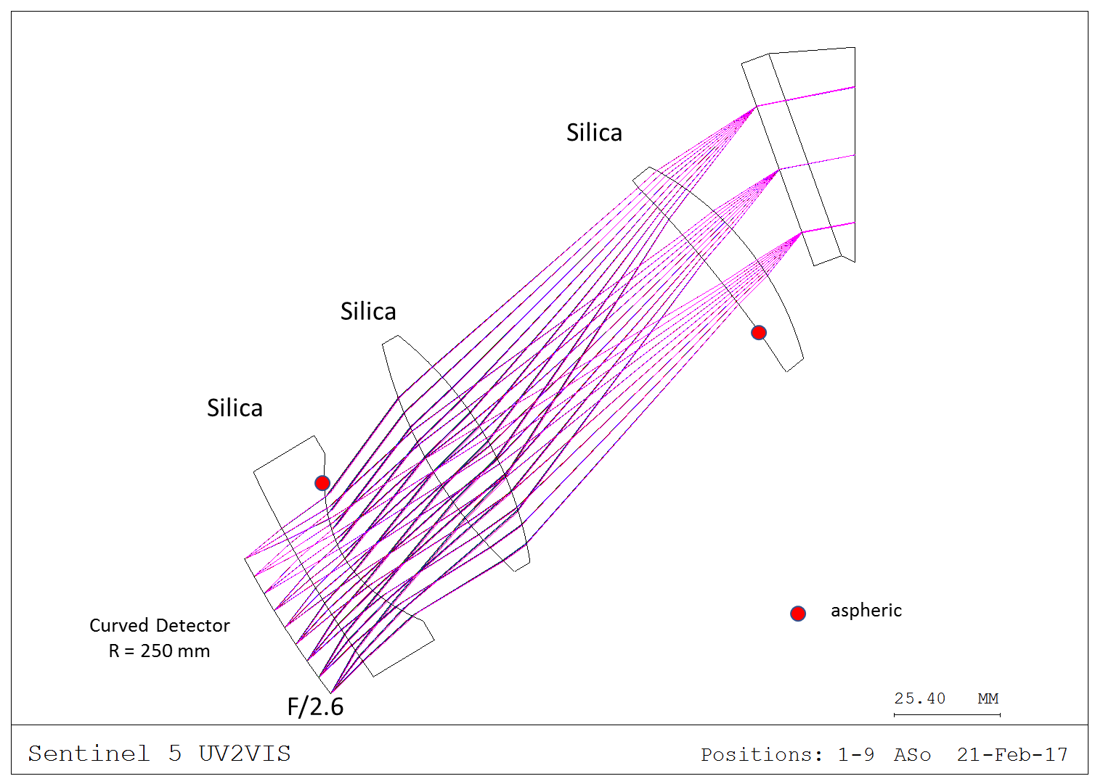
New Design with a curved detector

Slide 22
ESO DEVELOPMENTS (2)
Plans for novel Spectroscopic telescope facility
L. Pasquini et al.: New telescope designs suitable for massively multiplexed spectroscopy, SPIE Digital Library 2016 & 2017
L. Pasquini et al.: ESO spectroscopic Facilty, IAU Symposium 331, 2017
Large 10 – 12 meter dedicated new spectroscopic telescope combined with
Larger FOV (~ 5 square degrees) – survey
Massively multiplexed spectroscopy (~ 5000 fibres)
Matched sampling telescope – instrument
Fast cameras (~F1) and matched pixel size
Several hundred standardized spectrographs with curved detectors 4k x 4k 15 um, R~ 250 mm
Notes:
Proceedings Volume 9906, Ground-based and Airborne Telescopes VI;
10.1117/12.2232289
Event: SPIE Astronomical Telescopes + Instrumentation, 2016, Edinburgh, United Kingdom, downloaded

Slide 23
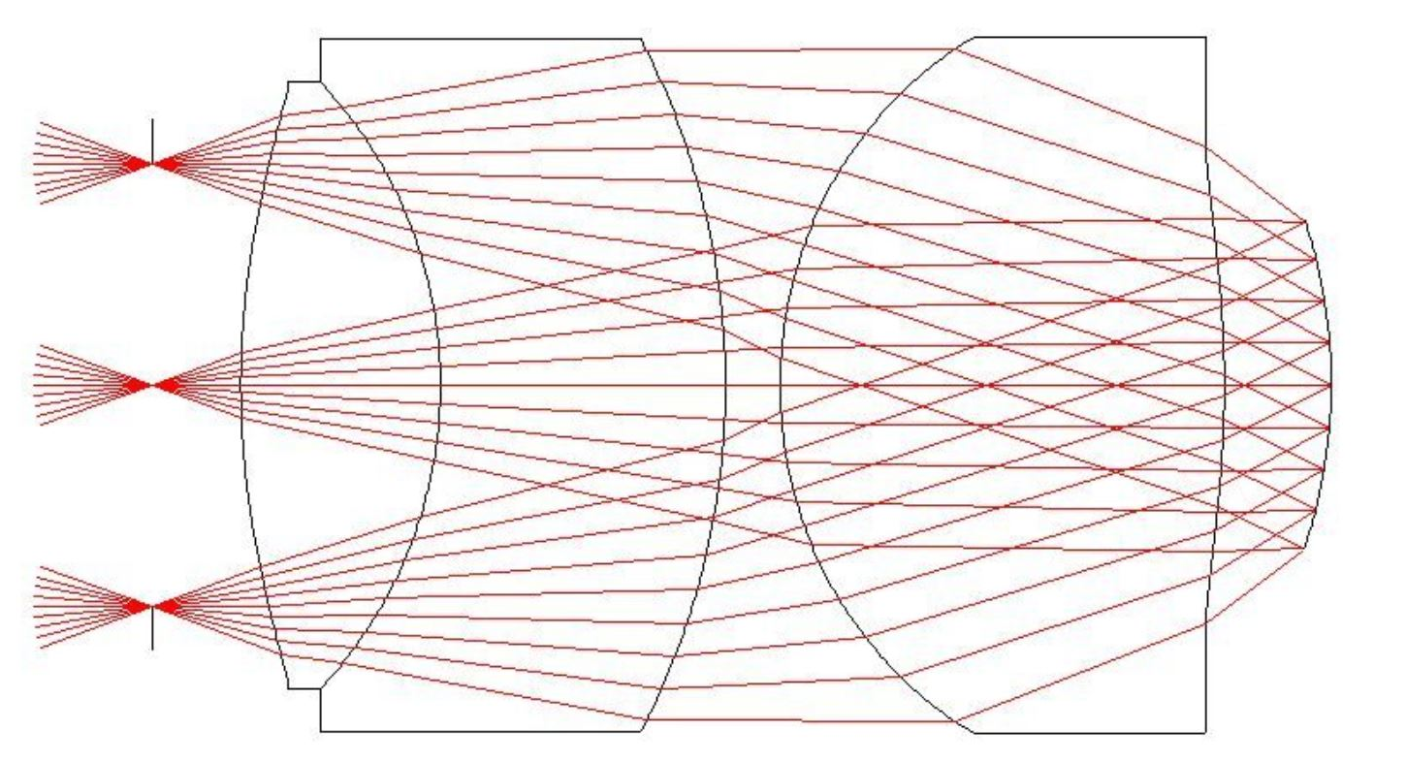
ESO DEVELOPMENTS (2a)

Slide 24
JPL DEVELOPMENTS
Continued on curvature development with thick detectors
Confidential: Medical developments
19 mm curvature radius >> Talk to Shouleh Nikzad
MIT DEVELOPMENTS
Continued on curvature development
2nd focal plane built, with even better performance
Confidential developments (defense), high curvature
>> Talk to Vyshi S., Barry Burke

Slide 25
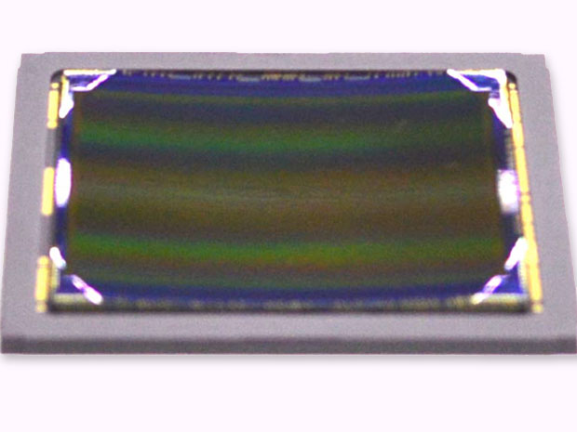
SONY DEVELOPMENTS
Kazuichiro Itonaga: A Novel Curved CMOS Image Sensor Integrated with Imaging System
2014 Symposium on VLSI Technology Digest of Technical Papers
2014: About 100 backside illuminated 3D curved CMOS sensors fabricated in both smartphone and 35mm format (24 mm x 36 mm) as R&D project
Process developed in house, intention for mass production, reliability testing done
Huge commercial interest for mirrorless FF cameras, & compacts and others (later)
Detector and System tests with special optics done – no absolute numbers, but ….

Slide 26
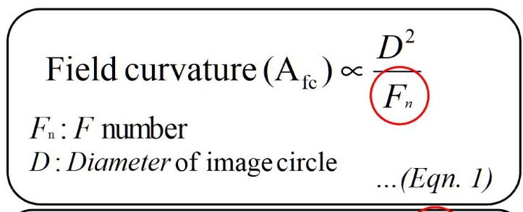
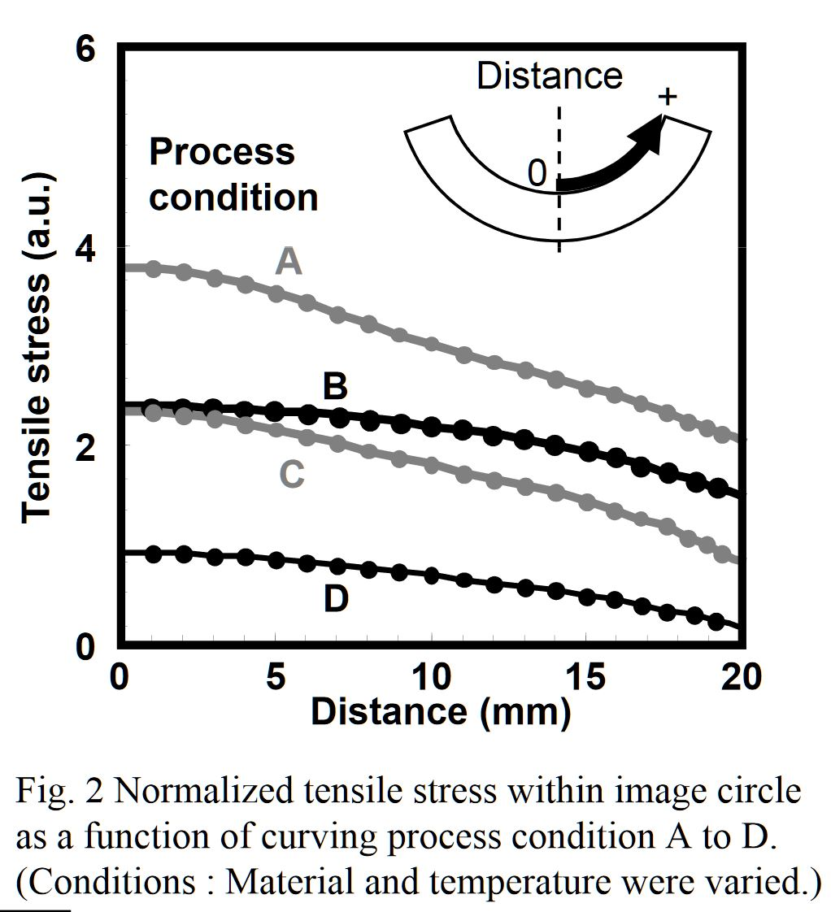
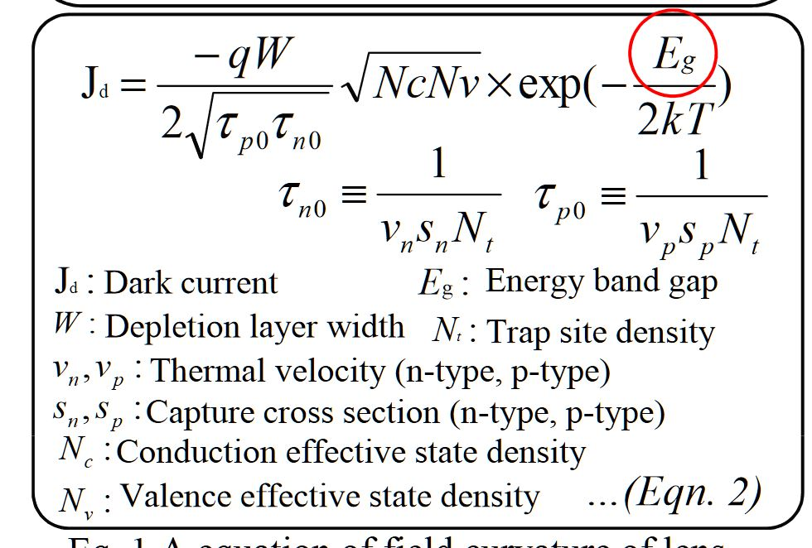
SONY DEVELOPMENTS (2)

Slide 27
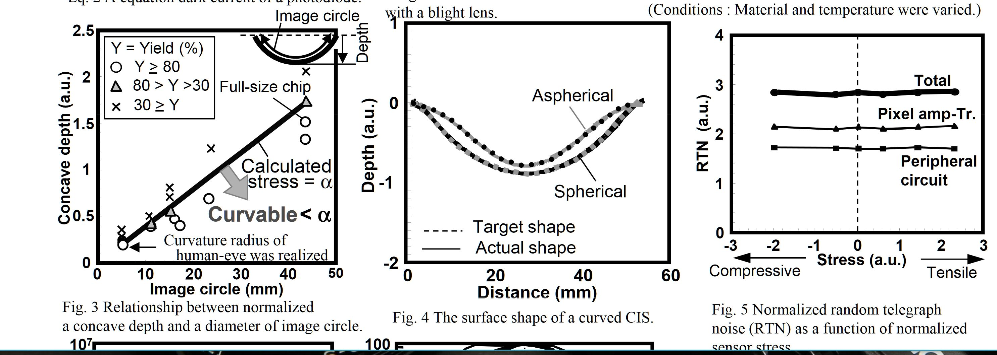
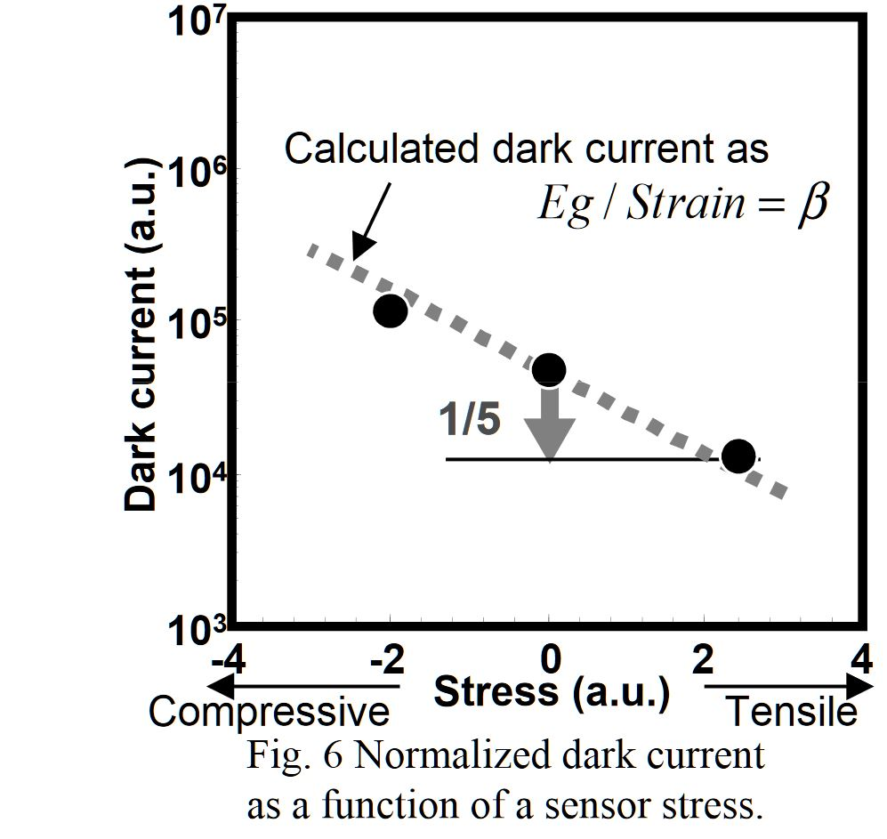
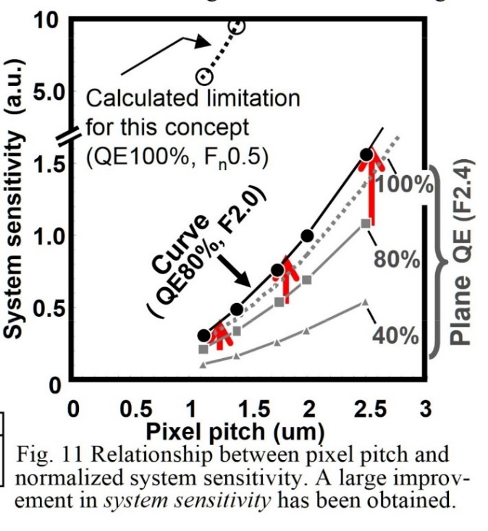
SONY DEVELOPMENTS (3)

Slide 28
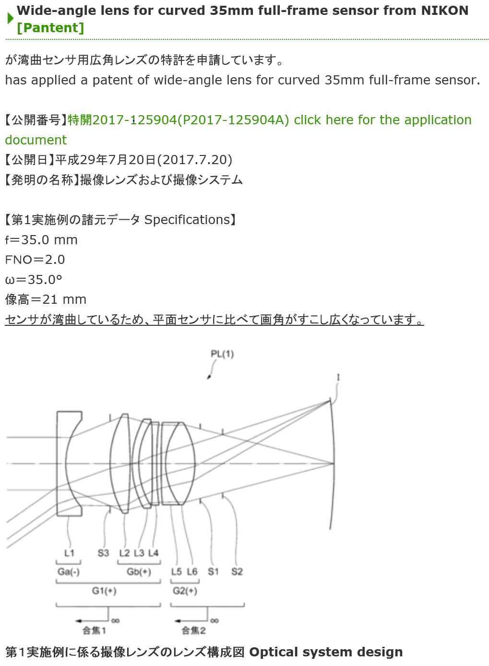
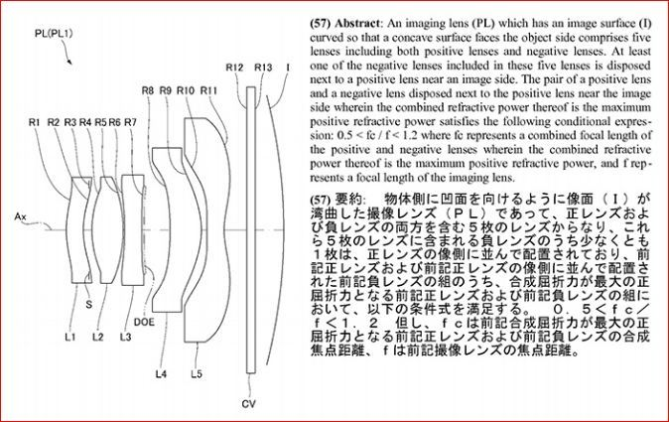
NIKON DEVELOPMENTS
2016 bottom / 2017right
Notes:
http://thenewcamera.com/nikon-working-on-curved-sensor-camera/
http://hi-lows-note.blog.so-net.ne.jp/2017-07-20, patent above
https://www.j-platpat.inpit.go.jp/web/PU/JPA_H29125904/TKBS_GM302_Detailed.action is the detailed patent

Slide 29
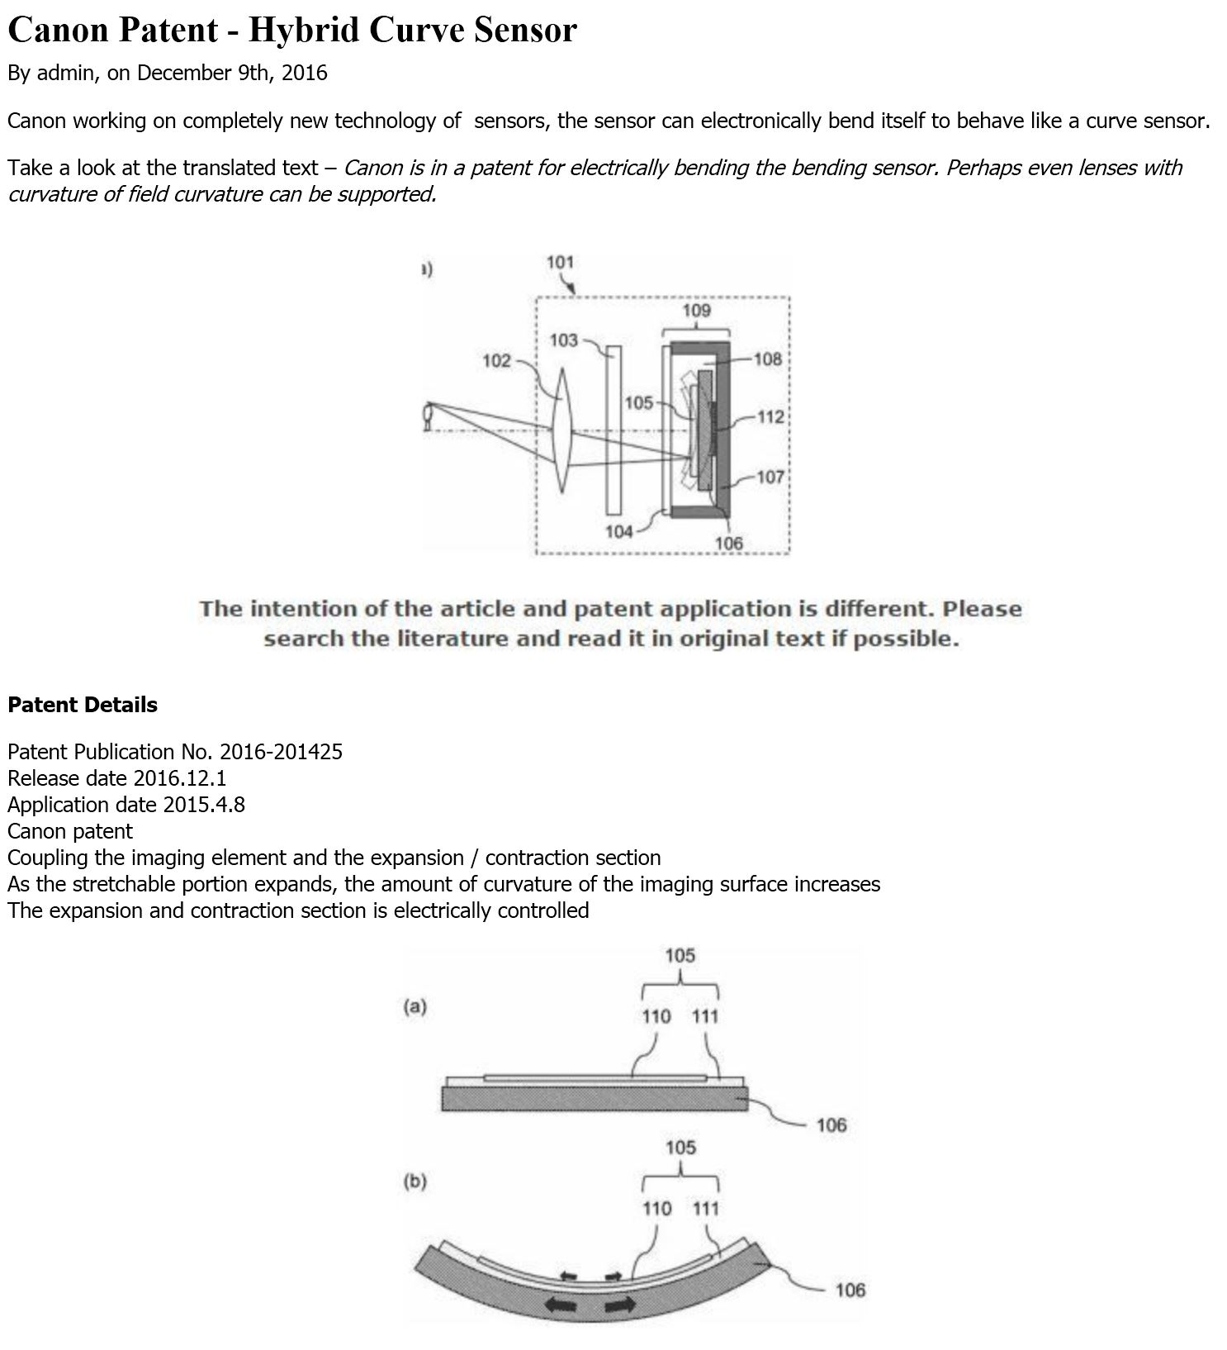
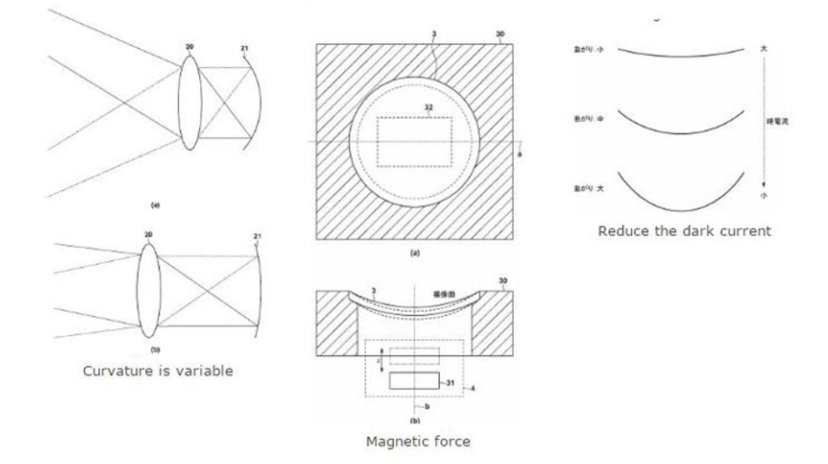
CANON DEVELOPMENTS
At least 4 different recent patents on curved sensors:
2016-173496; 2016-197603; 2016-201425; 2016-213571
Modulation of the curvature on-the-fly (magn./piezo)
Reduction of dark current
Notes:
Patent 1 http://thenewcamera.com/canon-working-on-curve-sensor-new/
Patent 2 : fibers not interesting
Patent 3: Curving on edges only
Patent 4: hybrid, contains them all in a link below
http://thenewcamera.com/canon-patent-hybrid-curve-sensor/

Slide 30
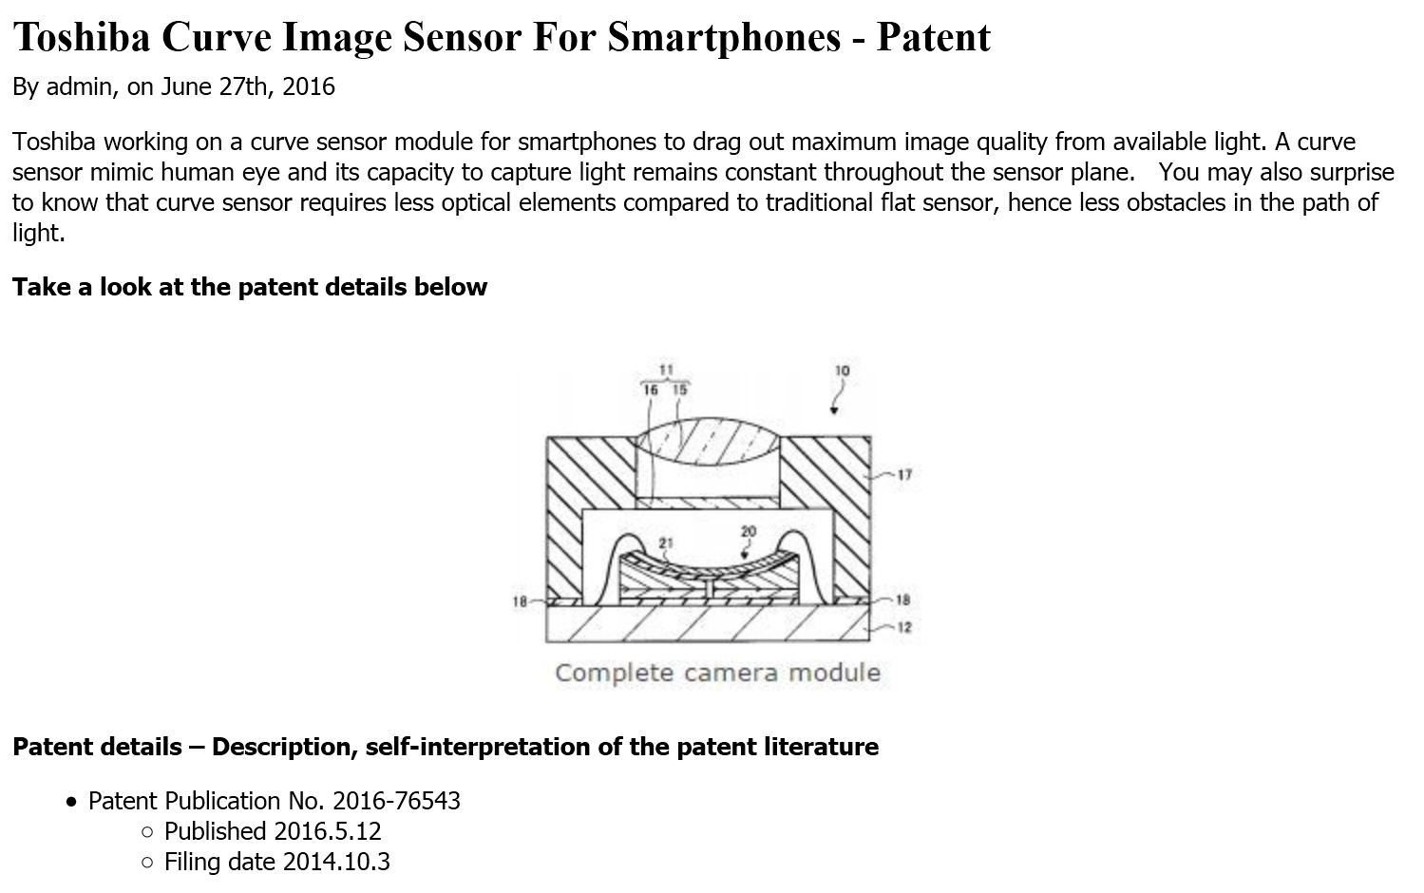
TOSHIBA DEVELOPMENTS
Notes:
http://thenewcamera.com/tag/curve-sensor/

Slide 31
TELEDYNE Hybrid IR DEVELOPMENTS
Internal R&D project, team led by Majid Zandian:
Substrate removed HgCdTe array that is being bent in one (two) axis in a cylindrical / 3D shape – hybridized with multiplexer
Array size: 640 x 480 pixels, 15 micron pixel pitch
A special new process was developed to enable this type of flexible IR array to be made
Production Process for curvature is ITAR controlled and a Teledyne trade secret
Proof of concept is shown, no damage of the array observed
>> Talk to Majid Z. / Jim B.

Slide 32
Video Teledyne
No redistribution of this video please !

Slide 33
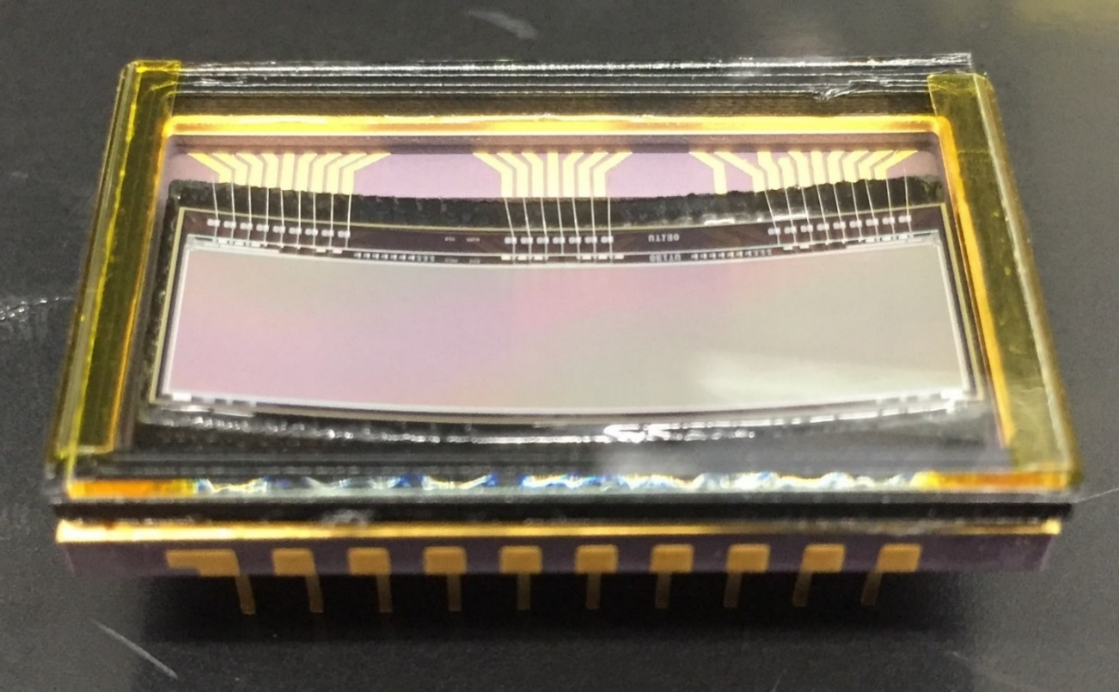
E2V DEVELOPMENTS
Minimum scope demonstrator:
CCD30-11, frontfaced,
thinned to 150 um
[1024 X 256; 27 * 7 mm]
Ceramic package with curved insert
Cylindrical Curvature exclusively
Curvature Radius = 7 cm
Several devices have been made,
More deliverable devices in progress;
Very much appreciated that e2v / Teledyne work experimentally on this,
but we really need 3D Curvature for all our examined applications

Slide 34
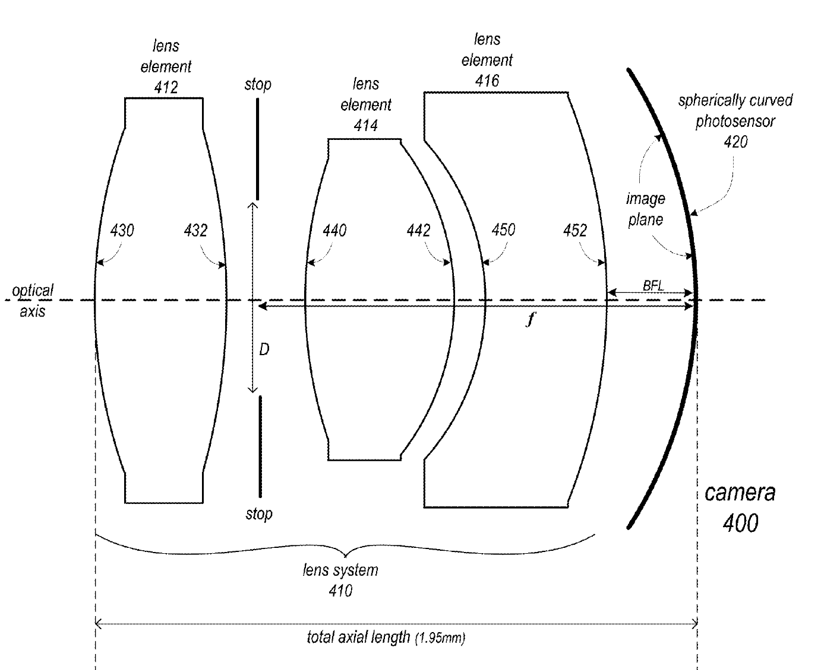
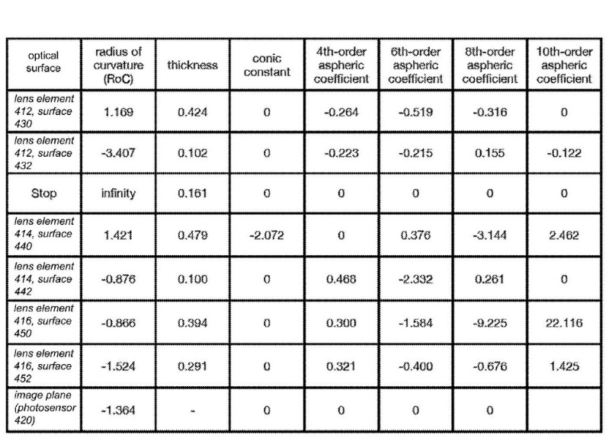
APPLE DEVELOPMENTS
Flat camera design: smartphones, laptops, tablets
Focal length within ~ 20 % of Radius of Curvature of detector
Notes:
https://www.dpreview.com/articles/8027168176/apple-patent-describes-use-of-curved-image-sensor-to-design-small-camera-module
https://www.forbes.com/sites/paulmonckton/2016/01/31/apples-curved-camera-to-bring-smaller-iphones/#7551af0e22a2
Patent downloaded

Slide 35
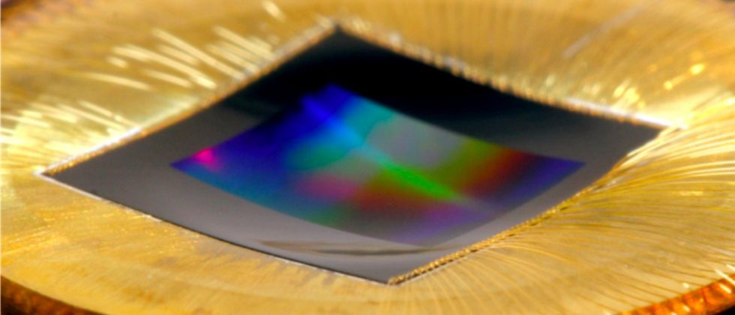
MICROSOFT / HRL* DEVELOPMENTS
(originated from Hughes Research Laboratories)
Brian Guenther et al.: Highly curved image sensors: a practical
approach for improved optical performance, June 2017, Optics Express
Notes:
If apple does it, then also Microsoft is not far – although real competitors, both are mentioning us in their literature as a reference

Slide 36
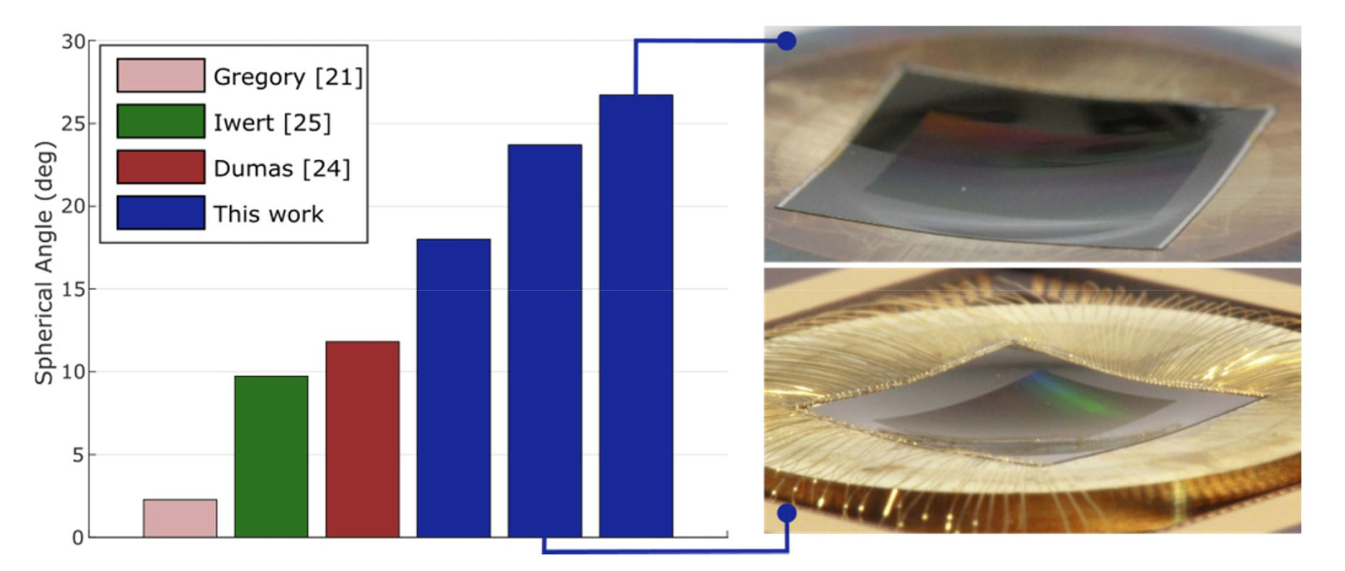
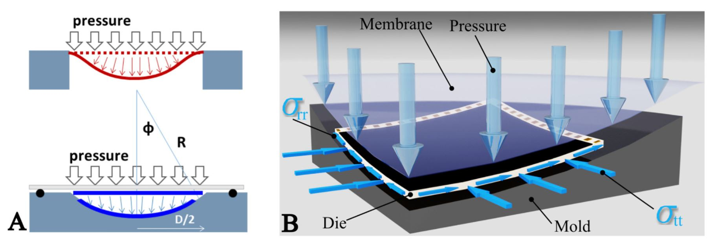
MICROSOFT / HRL DEVELOPMENTS (2)

Slide 37
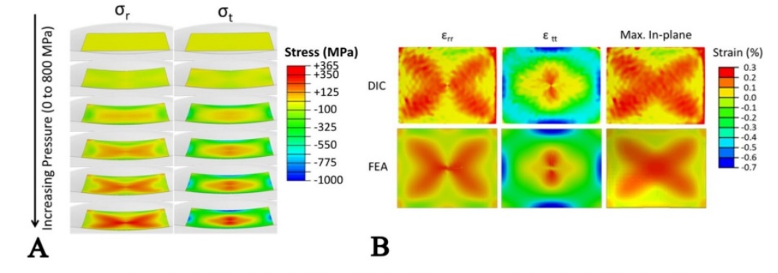
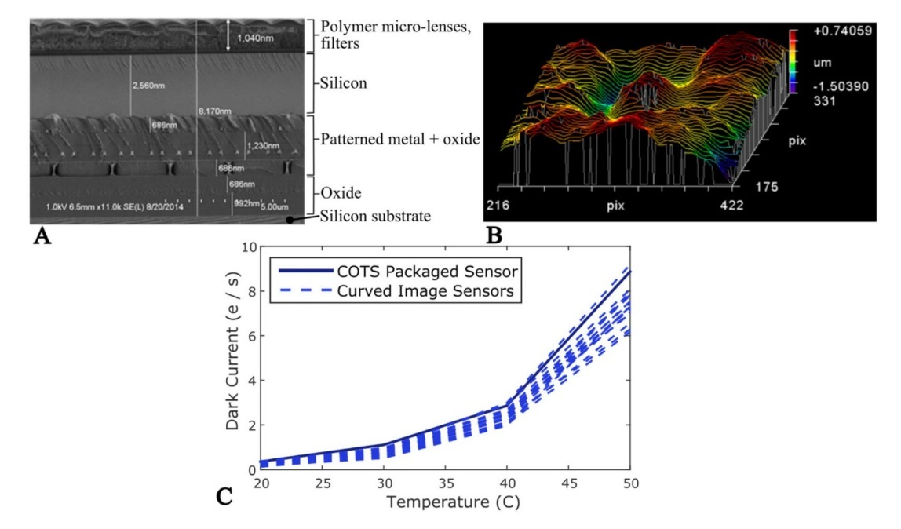
MICROSOFT / HRL DEVELOPMENTS (3)
CMOS back side illuminated 18 megapixel CMOS sensor (Aptina AR1820HS)
1.25 μm pixel; the light sensitive area 6.1 x 4.6 mm. thinned to 16 μm
General curvature radius between 24.6 and 16.7 mm,
18.74 mm radius for camera
dies bondig to mold surface using an epoxy adhesive / solder,
Deviations from the targeted radius of curvature of 0.3 μm RMS and 2.2μm peak to valley, measured interferometrically

Slide 38
Have done “their homework” to compare to literature and results, theoretically and practically
High curvature and high accuracy
New process wih movable die edges, such as to surpress tensile stress, rather foster compression
Optical System performance measured in comparison with Canon 1Ds with 50mm / F 1.2 (FF) with small curved sensor and special optics: Vignetting and sharpness especially in corners are outperformed (!)
Claim that proess is scaleable to any die size nd curvature at high curvature accuracy and mass production compliant.
MICROSOFT / HRL DEVELOPMENTS (4)

Slide 39
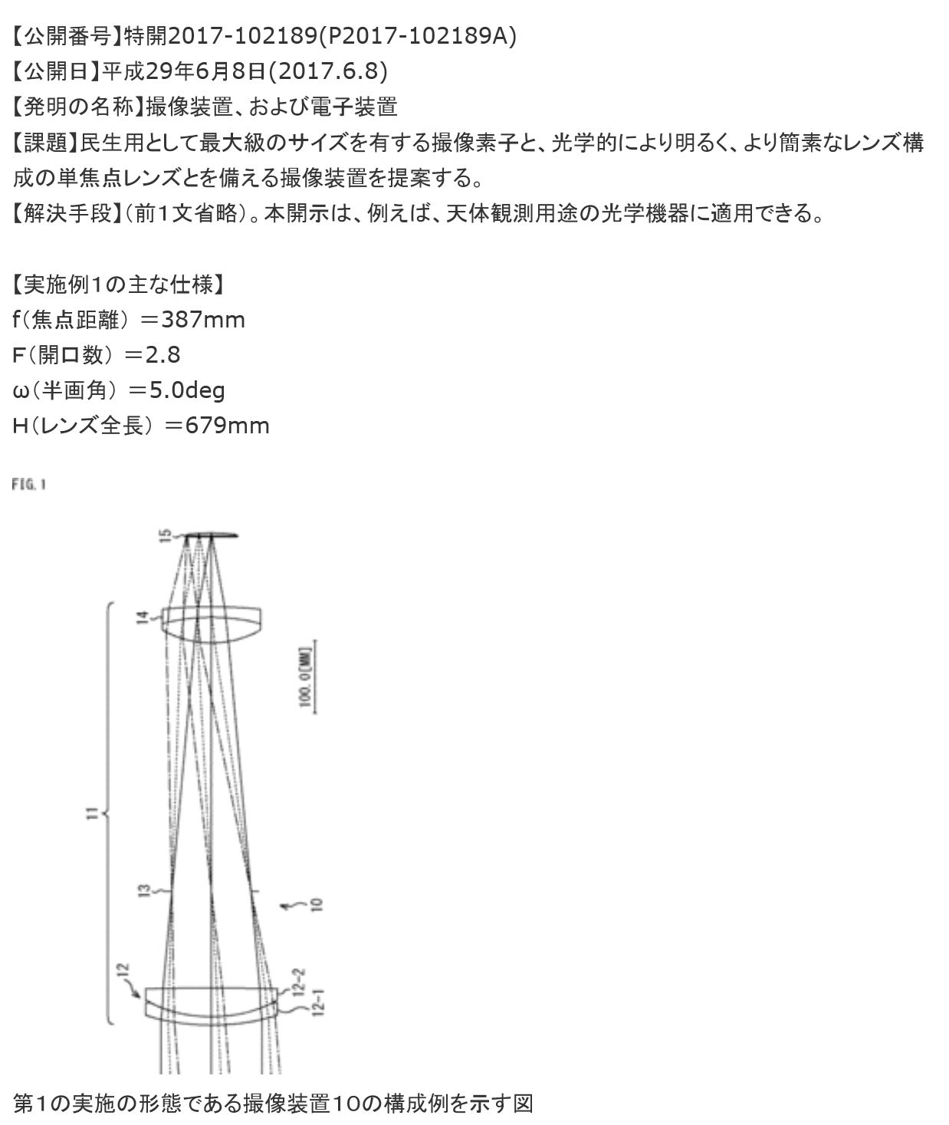
SONY “ASTRO” DEVELOPMENTS (1)
Japanese patent 2017-102189:
Sony 400mm f/2.8 lens and whole lens family designed for a curved medium format sensor for real 6 x 4.5 format.
High MTF, highest resolution, simple lens design, for high resolution curved detector.
The patent mentions industrial, astronomical and photography.
Sony clearly thinks about the possibility to make a medium format mirrorless system camera with curved sensor.
Notes:
http://hi-lows-note.blog.so-net.ne.jp/archive/20170609
Text: http://www.sonyalpharumors.com/oh-yes-sony-really-first-curved-medium-format-sensor-patented/
https://photorumors.com/2017/07/21/sony-has-a-patent-for-astronomical-camera-with-a-curved-medium-format-sensor/
Also other interchangeable lenses shown for medium format
– 387mm f/2.8, - 323 mm f2.8
– 258 mm f/2.8
– 161 mm f2.8
– 84mm f/2.9

Slide 40



SONY “ASTRO” DEVELOPMENTS (2)
Notes:
http://www.sonyalpharumors.com/additional-info-five-sony-medium-format-lenses-fora-sony-curved-sensor-camera/

Slide 41

LAM / CEA / LETI DEVELOPMENTS
Emmanuel Hugot’s talk - next
Notes:
Differences / similartiries to Microsoft Vermont technology and ESO / ITL ?
Scaleability ? Detector size ?
Accuracy ?
Cooling ?

Slide 42
CONCLUSION / OUTLOOK
Please think out of the box for
SYSTEM Performance
Curved sensors are just around the corner – everywhere:
    Commercial products / Scientific Use
    Sooner or later…
Thank you for your attention !
Notes:
Watch this space

Slide 43
Sony Alpha rumours similar Foveon Sensor Patents

Slide 44
WHAT REMAINS TO BE DONE

Slide 45


NOT USED:
out of the box 11 ideas
http://www.lifehack.org/articles/featured/11-ways-to-think-outside-the-box.html
Study a different market –A
for commercial devices (full frame)
Patent clauses (Rolf)
What a journey
No power point at all – but just tell them ?
Like a carpenter – building something and seeing the result immediately at the end of the same day
Kastl wo I eischoitn ko
How many summers in your life ? (foodblog)
Morlockmotors <> naming from time machine
Make a Instagram website for curved detectors <> test interest
Analogy electric cars or something different ?
Formual 1 sketch parallelism how long it takes for the old guys…
https://www.pcwelt.de/ratgeber/Die_spektakulaersten_Fehlprognosen_der_IT-Geschichte-6948150.html

Slide 46
A.) Active optics first papers in 70ies, independent until realization by Ray in 1989 - now on every serious telescope
Lothar Noethe : Example active optics – long path to reality ?? – built demonstrato

Slide 47
TIME MACHINE
The book's protagonist is an English scientist and gentleman inventor living in Richmond, Surrey, in Victorian England, and identified by a narrator simply as the Time Traveller. The narrator recounts the Traveller's lecture to his weekly dinner guests that time is simply a fourth dimension and his demonstration of a tabletop model machine for travelling through it. He reveals that he has built a machine capable of carrying a person through time, and returns at dinner the following week to recount a remarkable tale, becoming the new narrator.
In the new narrative, the Time Traveller tests his device with a journey that takes him to A.D. 802,701, where he meets the Eloi, a society of small, elegant, childlike adults. They live in small communities within large and futuristic yet slowly deteriorating buildings, doing no work and having a frugivorous diet. His efforts to communicate with them are hampered by their lack of curiosity or discipline, and he speculates that they are a peaceful, communist society, the result of humanity conquering nature with technology, and subsequently evolving to adapt to an environment in which strength and intellect are no longer advantageous to survival.
Returning to the site where he arrived, the Time Traveller is shocked to find his time machine missing and eventually concludes that it has been dragged by some unknown party into a nearby structure with heavy doors, locked from the inside, which resembles a Sphinx. Luckily, he had removed the machine's levers before leaving it (the time machine being unable to travel through time without them). Later in the dark, he is approached menacingly by the Morlocks, ape-like troglodytes who live in darkness underground and surface only at night. Within their dwellings, he discovers the machinery and industry that makes the above-ground paradise possible. He alters his theory, speculating that the human race has evolved into two species: the leisured classes have become the ineffectual Eloi, and the downtrodden working classes have become the brutal light-fearing Morlocks. Deducing that the Morlocks have taken his time machine, he explores the Morlock tunnels, learning that due to a lack of any other means of sustenance, they feed on the Eloi. His revised analysis is that their relationship is not one of lords and servants but of livestock and ranchers. The Time Traveller theorizes that intelligence is the result of and response to danger; with no real challenges facing the Eloi, they have lost the spirit, intelligence, and physical fitness of humanity at its peak.
Meanwhile, he saves an Eloi named Weena from drowning as none of the other Eloi take any notice of her plight, and they develop an innocently affectionate relationship over the course of several days. He takes Weena with him on an expedition to a distant structure that turns out to be the remains of a museum, where he finds a fresh supply of matches and fashions a crude weapon against Morlocks, whom he must fight to get back his machine. He plans to take Weena back to his own time. Because the long and tiring journey back to Weena's home is too much for them, they stop in the forest, and they are then overcome by Morlocks in the night, and Weena faints. The Traveller escapes when a small fire he had left behind them to distract the Morlocks catches up to them as a forest fire; Weena and the pursuing Morlocks are lost in the fire, and the Time Traveler is devastated over his loss.
The Morlocks open the Sphinx and use the time machine as bait to capture the Traveller, not understanding that he will use it to escape. He reattaches the levers before he travels further ahead to roughly 30 million years from his own time. There he sees some of the last living things on a dying Earth: menacing reddish crab-like creatures slowly wandering the blood-red beaches chasing enormous butterflies in a world covered in simple lichenous vegetation. He continues to make short jumps through time, seeing Earth's rotation gradually cease and the sun grow larger, redder, and dimmer, and the world falling silent and freezing as the last degenerate living things die out.
Overwhelmed, he goes back to the machine and returns to Victorian time, arriving at his laboratory just three hours after he originally left. Interrupting dinner, he relates his adventures to his disbelieving visitors, producing as evidence two strange white flowers Weena had put in his pocket. The original narrator then takes over and relates that he returned to the Time Traveller's house the next day, finding him preparing for another journey. After promising to return in a short period of time, the narrator reveals that after 3 years of waiting, the Time Traveller has never returned.

Slide 48

Notes:
https://photographylife.com/fujifilm-gfx-50s-considerations

