Slide 1
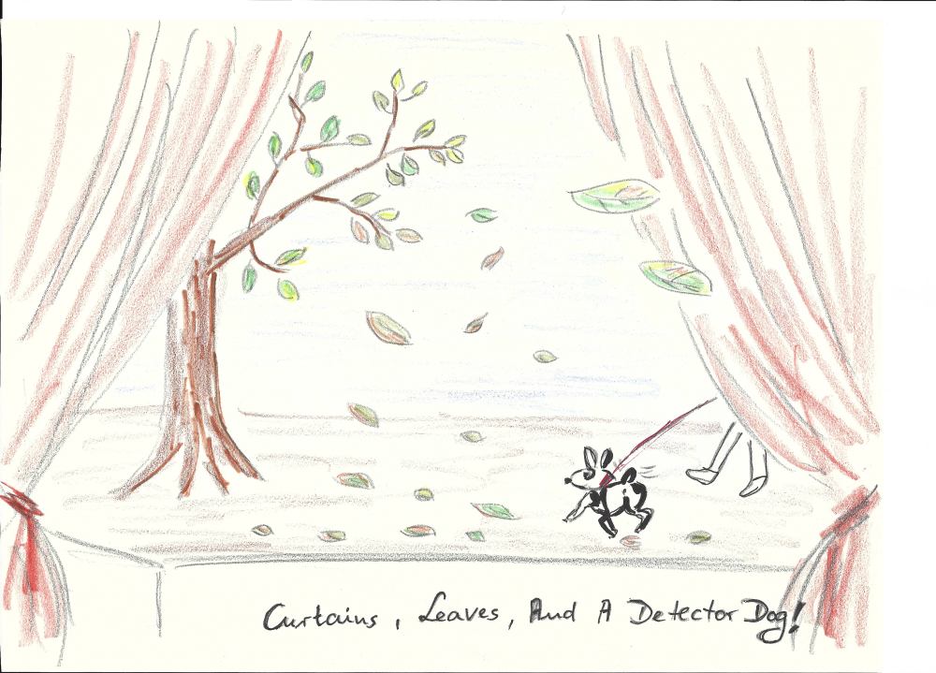
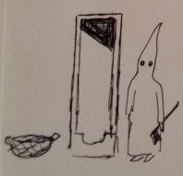
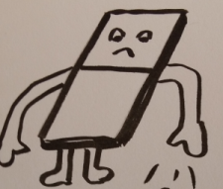
Leaves, curtains, guillotines and a detector dog -making shutters for astronomy
All illustrations
© Renate Voss-Obst
Klaus Reif, Bonn-Shutter UG
for the Bonn-Shutter team:
G. Klink (ret.), Ph. Müller, M. Polder, H. Poschmann, F-J. Willems

Slide 2
History
+
Fun
Paola, SDW 2013, Firenze

Slide 3
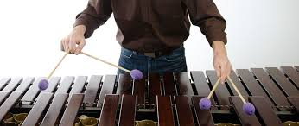
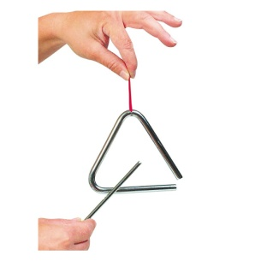
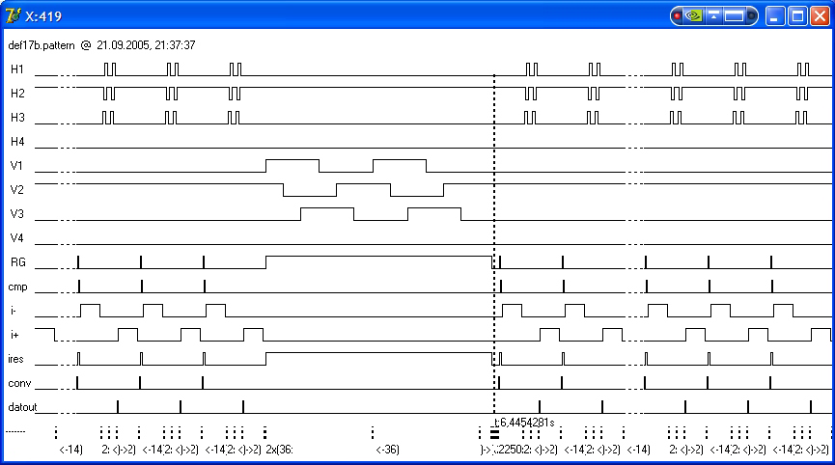
Oh dear! Having fun with … SHUTTERS??
CCD control vs. Shutter control

Slide 4
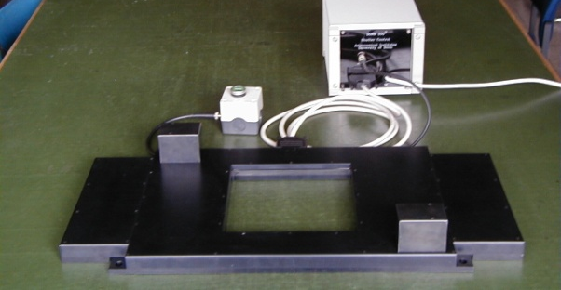
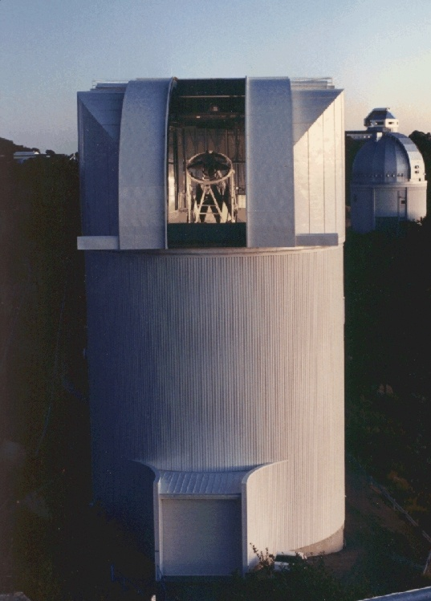
Mike Lesser on shutter entertainment:
In 2000: First descendant (200x200mm²) of the original Bonn shutter
We had a great time one day lying on our backs looking at the shutter through the Cass hole in the telescope (up at prime focus) and changing integration times to see the slit move back in different widths.
That's entertainment!
Michael Lesser, Steward Observatory, 2002/06/10
Steward Observatory 90inch telescope, KPNO

Slide 5
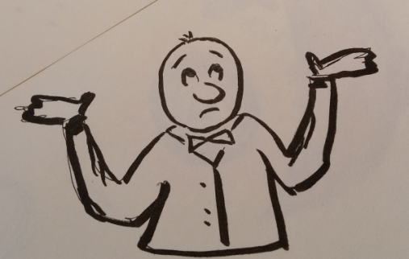
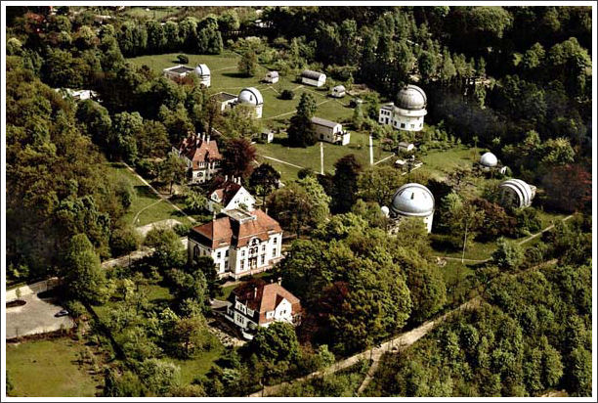
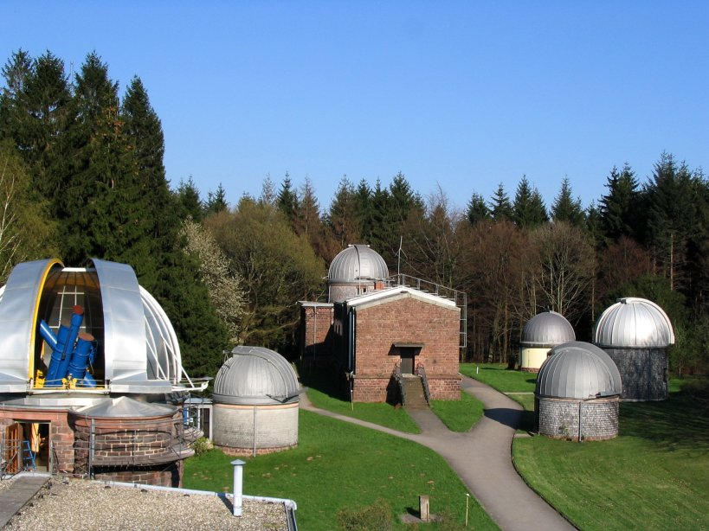
Shutters in historical telescopes/instruments?
Hamburg-Bergedorf , since 1912 (1867)
Heidelberg-Königstuhl , since 1898
www.bergedorf-info.de
de.wikipedia.org

Slide 6
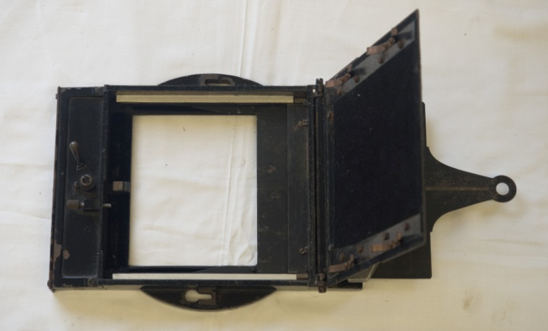
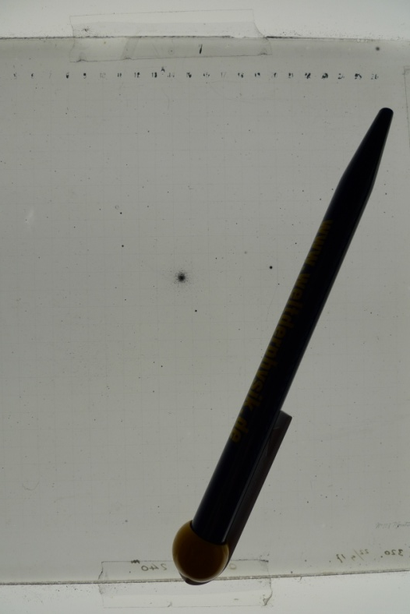
“No shutters at all!”
Front side “dark slide” = Shutter
Photographic plate
with globular cluster

Slide 7
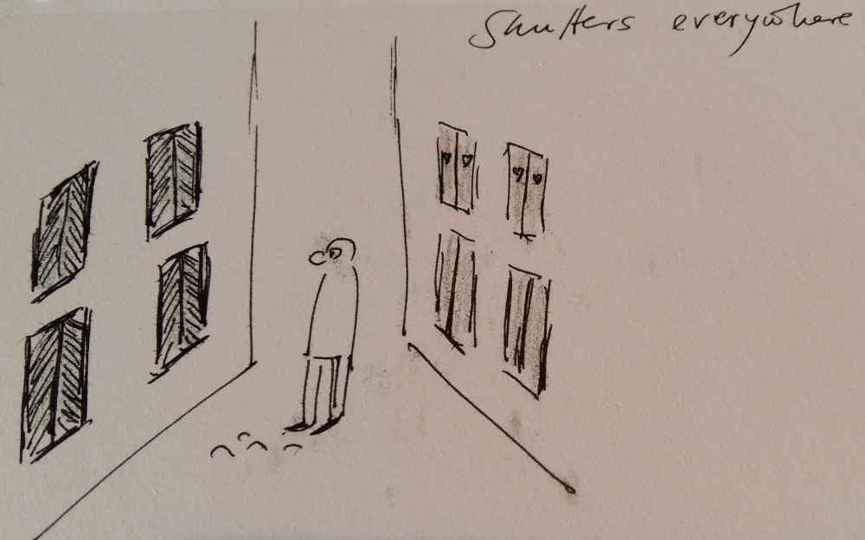
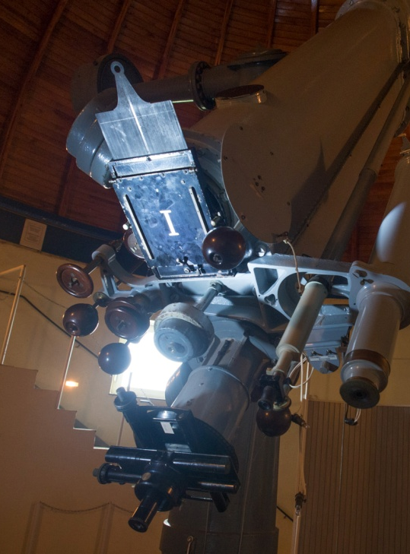
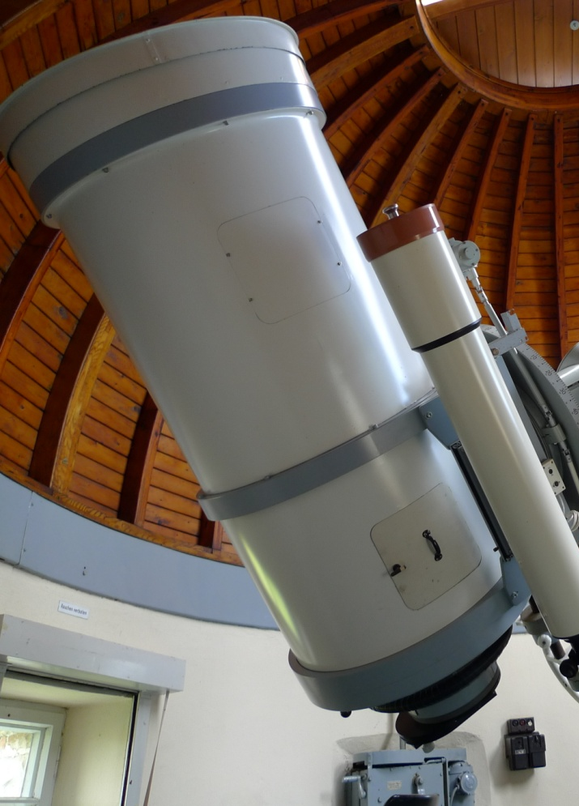
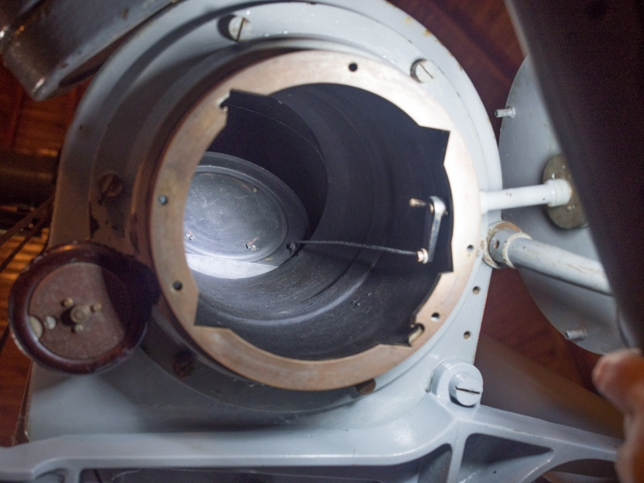
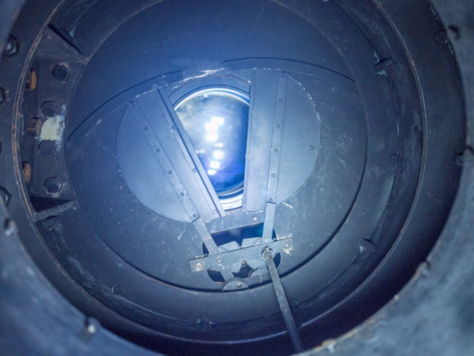
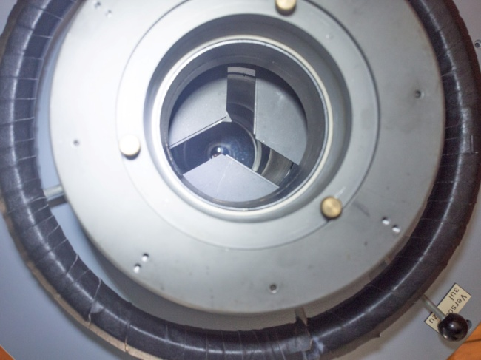
Shutter or no shutter?
1899
1925
1981
Telescopes at the former University of Bonn observatory

Slide 8
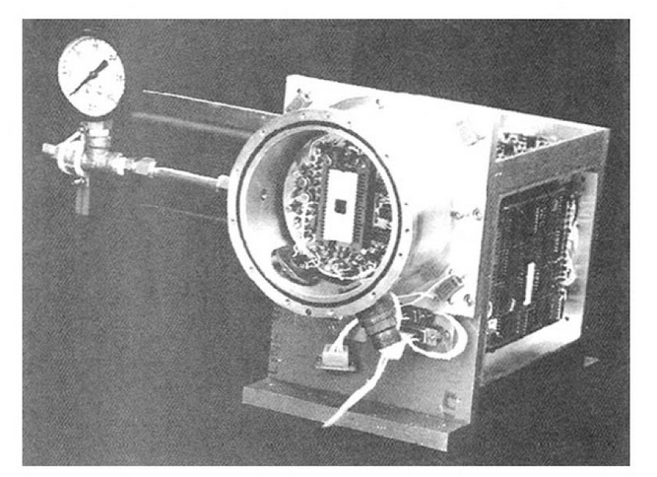
In the 1970ies
I wanna have a
precision shutter
The “traveling” CCD camera (JPL, 1976),
CCD size: 6mm x 6mm (400x400 pixels),
(from Janesick, J.R., 2001)
Notes:
Shutter had to compete with sensitivity and linearity.
luckily they were not dependent on the telescope shutters.
Small and fast shutters did already exist for decades.

Slide 9
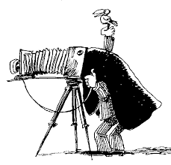
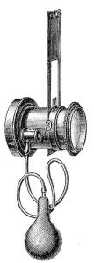
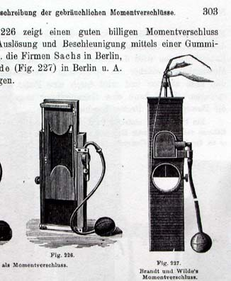
Fast shutters = photographic shutters
Guillotine shutters
(later: curtain type)
Rotary disk shutter
(“rotating guillotine”)
Iris or leave shutter
(exposure time control)
1881 Sachs
1892 Goertz
1902 Steinheil
Notes:
Driving force was the interest of photographers in ”moment” pictures
By 1890, the early forms of all of the common shutters used in the 20th century had been developed.
Sector disk, leave shutters, curtain-type

Slide 10
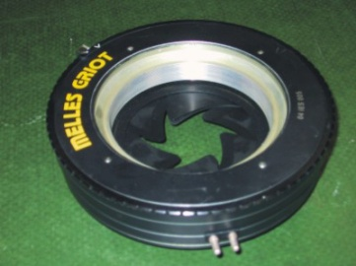
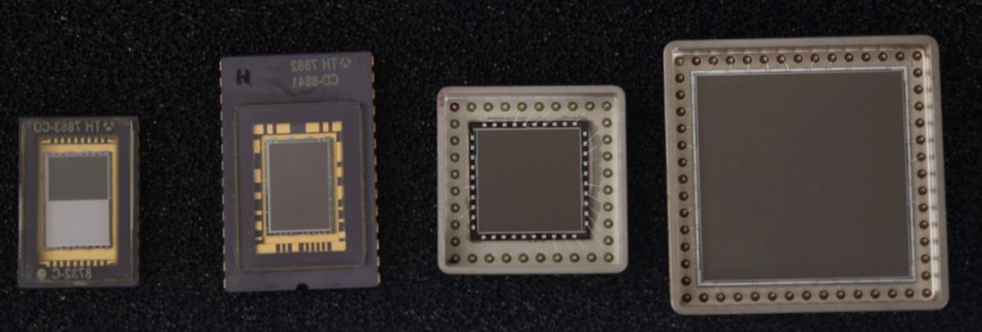
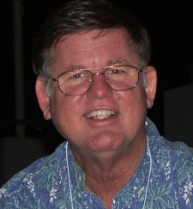
Iris shutters for small CCD detectors
Iris shutters used in Bonn since the 1980ies. Some are still in use.
Disadvantages:
Size
Power dissipation
Uniformity
(Speed)
Melles Griot
60 mm
Prontor
60 mm
Prontor
100 mm
CCDs from about 1990
(Bonn)
Still in operation.
Same performance.
After 26 years!
FA2048, 30x30mm²
Notes:
These or similar iris type shutters were used by most groups.
At least as long as their size was sufficient. But independent from the pure size
these shutters had and have some drawbacks.
Improvements were invented.

Slide 11
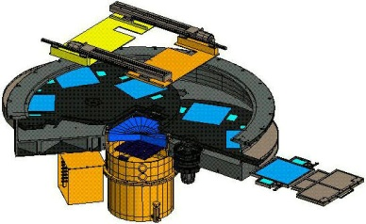
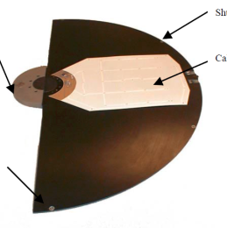
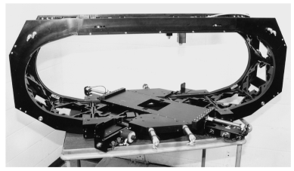
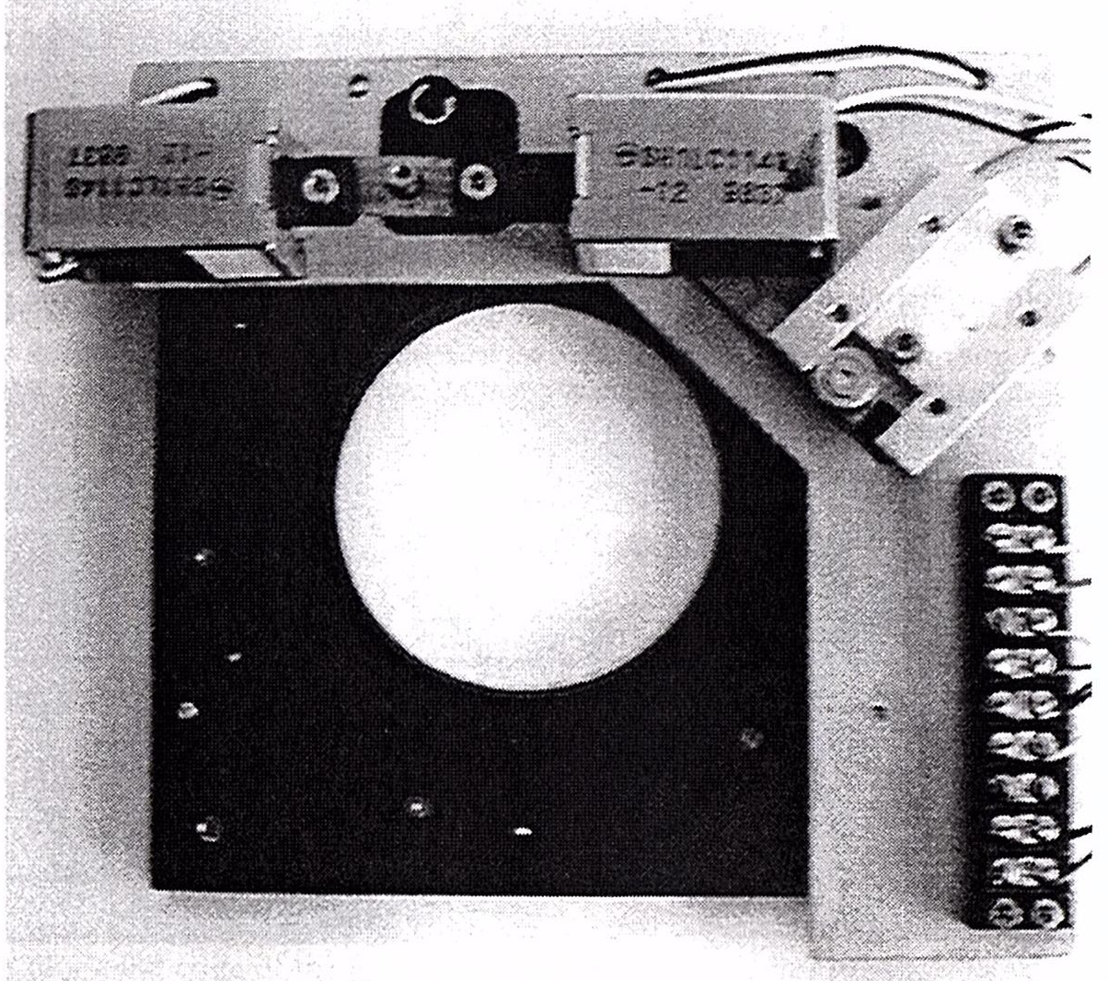
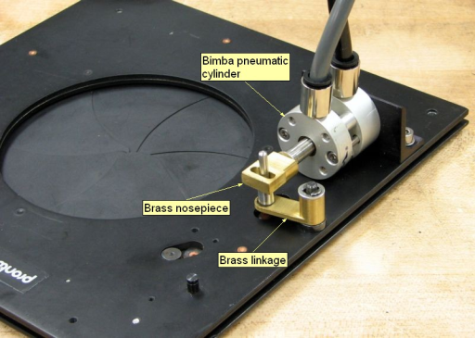
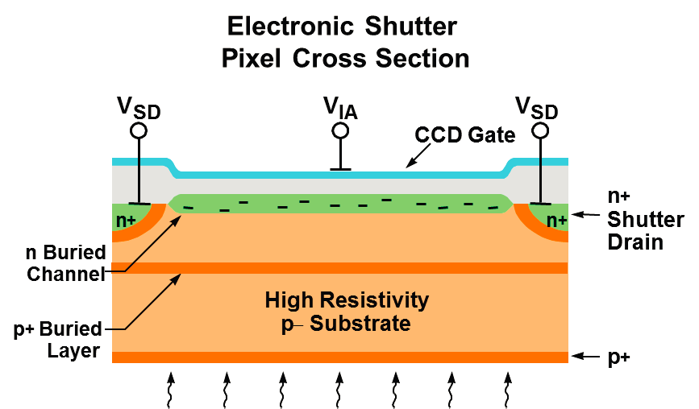
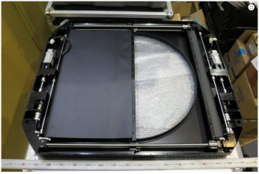
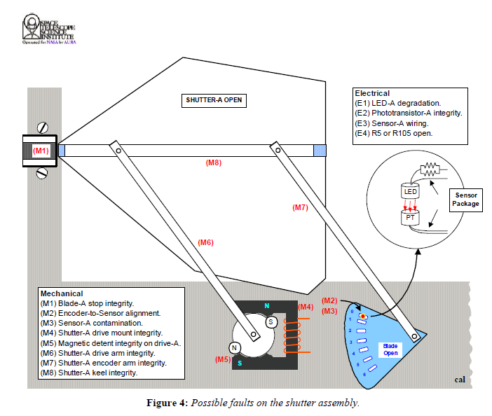
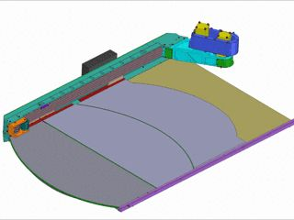
Many shutter innovations
since the 1990ies.

Slide 12
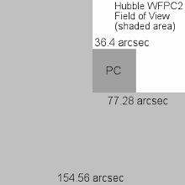
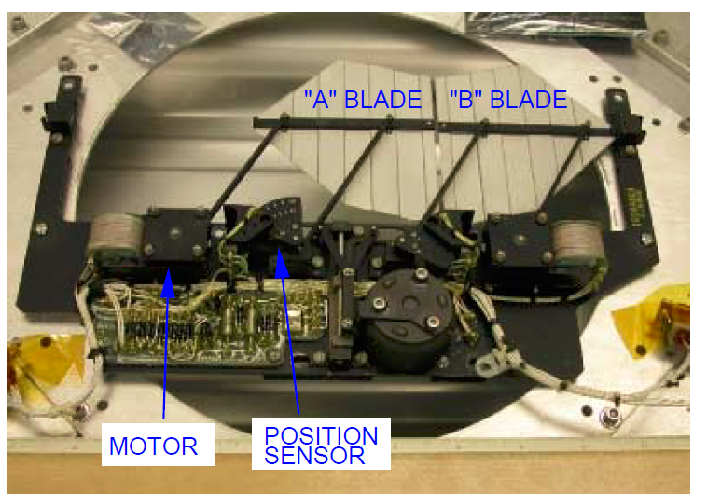
Shutters high above: WFPC2
Two shutter blades operate
in either direction!
Motor Position sensor
From STScI Final External Report 01-045 Revision
(Long, A.C., 2001)
From STScI Technical Instrument Report WFPC2 2001-01
(Riess, A. et al., 2001)

Slide 13
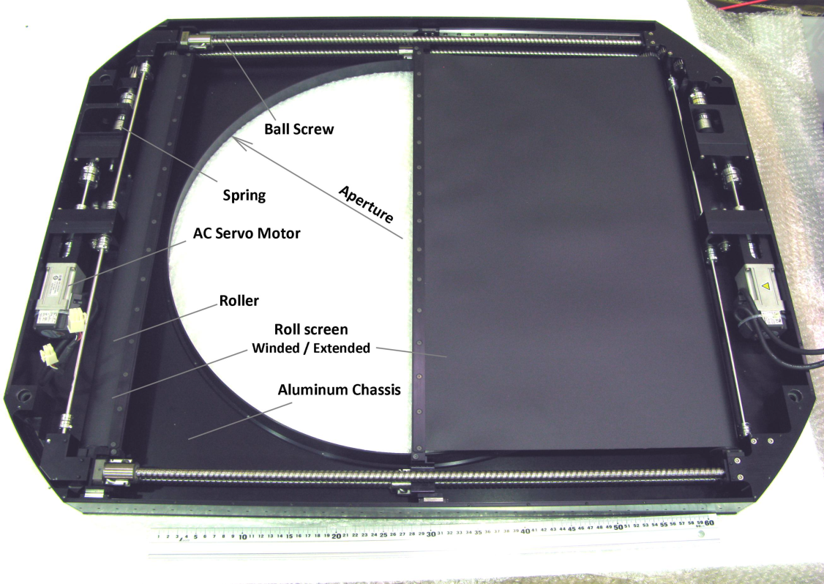
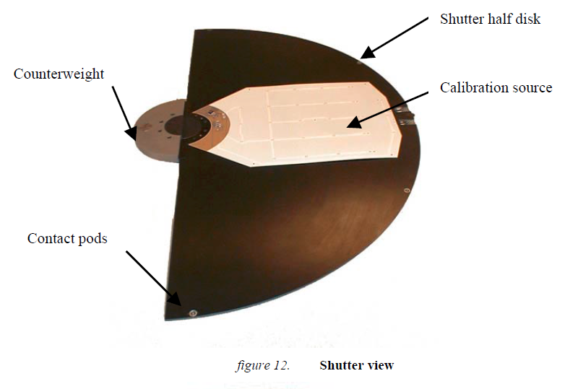
Shutter variety on the ground
MOSAIC , KPNO, ca. 140mm
pneumatic cylinders
(Muller, G.P. et al., 1998)
Megacam for MMT and Magellan, ca 300mm
servo motors
(McLeod, B. et al., 1998 and 2015)
Uniform exposures.
Hyper Suprime-Cam, SUBARU, 600mm
rolled foil
(Uraguchi, F. et al., 2012)
Megacam, CFHT, ca. 200mm
Rotating half-disk
(Aune, S. et al., 2003)
Choices, choices!

Slide 14
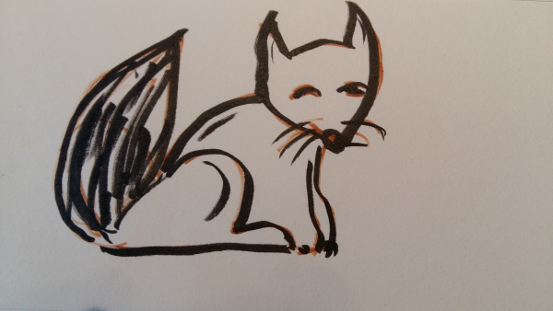
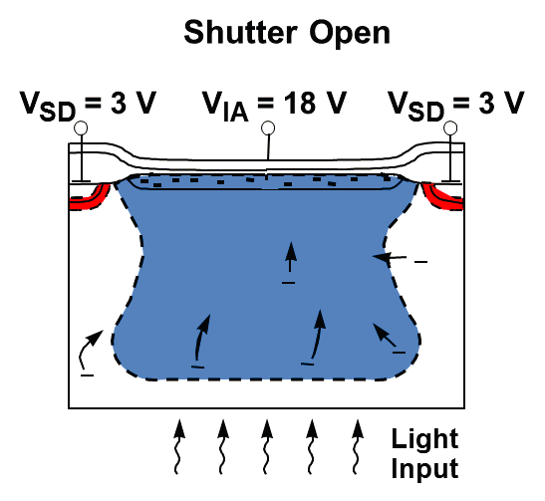
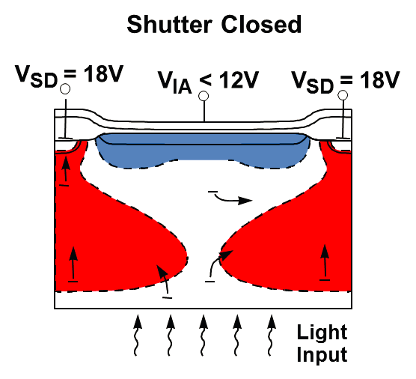
e⁻
Fox the electrons!
The only true focal plane shutter!
from Schuette, D.R. et al., 2014
after Reich, R.K. et al., 1993

Slide 15
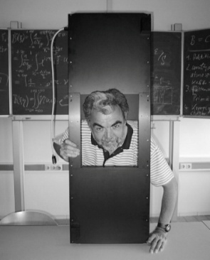
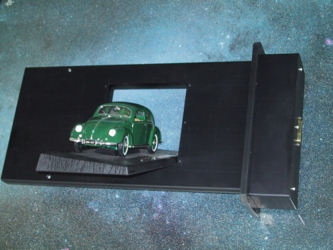
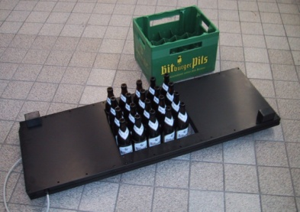
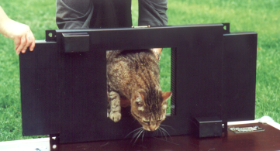
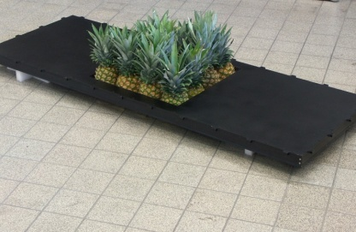
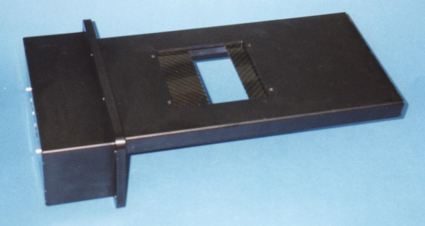
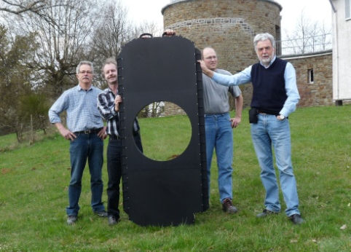
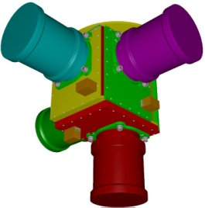
The Bonn shutter short story.

Slide 16
BUSCA – the Bonn University Simultaneous Camera
New big shutter required for big CCDs

Slide 17
The BUSCA shutter (1998)
Aperture 110x110mm²
Massive base plate.
Blades move on rails.
Two independent motors.
Dedicated control unit.
Programmable motion profiles.
Precision motion control
Born to grow bigger
Notes:
We thought it was something really big, but didn’t know
That it Was just the infancy.
The Busca shutter has got dozens of descendants. I will mention some of them.
They all share similar specs and performace parameters. As you can see
On this slide

Slide 18
Bonn shutter design upgrades
In 2000:
Standard type (flat)
Point symmetric design
Baseplate (Al) + frame + covers
2 Shutter blades (carbon fibre, sandwich)
2 belts
2 stepper motors
2 angular encoders (incremental)
In 2008: Making the control unit more compact
….

Slide 19
Typical Bonn Shutters and Shutter specs
60mm x 60mm aperture
100mm x 100mm aperture
280mm x 280mm aperture
Basic materials | Aluminium, Steel
Blade material | Carbon fiber, carbon fiber and foam sandwich
Exposure time error | <300 μs
Minimum exposure time | 1 ms (minimum puls length: 300 μs) *
Exposure non-uniformity | <1 ms
Power dissipation | 240 mW (standby) + 20Ws per exposure
* John Tonry, Pan-STARRS: Parenthetically we were completely impressed at the ability to take a 1 msec (!) exposure of the moon.

Slide 20
Camera: 90PRIME, 8k x 8k mosaic
Telescope: Steward Obs. 90inch @ KPNO
Aperture: 200mm x 200mm
Delivered: July 2000
Exposure uniformity at 0.1sec expo. time
1% p-p → 1 ms
It fits!
Bumpy road to Tucson
Notes:
It fits: another test

Slide 21
What has happened at San Francisco airport in summer 2000?
Shutter untraceable for more than a week!
Delivered with a broken belt and missing CD-ROM!
The current hypothesis: Philipp’s photo shooting!
Puzzling perfumes for a brave detector dog.
ajc.com
Notes:
Was too much for the keen nose of dutiful dog.

Slide 22
Fun with shutters: Final photo shooting
For catchy cover pictures
PEPSI@LBT
Soft drinks after hard work
MONET project
Not only impressive - impressionistic
OGLE@1.3m Tel. ,Las Campanas
Gravitationally lensed shutter
USNO Robotic Astrometric Tel.
With 2x2 of Dick’s biggest CCDs

Slide 23
Fun with shutters: A cover picture and what happened afterwards.
…refill…
Excavate…
…cool…
…Prost!
Notes:
A farewell without sadeness

Slide 24
At times we have to struggle
Case #1
Case #2
Ready for shipping: Apertures from 100mm to 450mm.
Individual flight cases.
Idential shutters (200mm) for the four-channel HERMES spectrograph at AAO.
Notes:
Despite all difficulties and stress, eventually there is another cover photo with Australian elements and another moment of great fun.

Slide 25
The budget battle and special requirements
Project budgets…
… Space (e.g. back focal distance)
… Instrument weight
… Dissipated heat
… Error budget (opto-mechanics)
... Time for maintenance/repair
… Money
…
The shutter should please…
… occupy no space
… have zero weight
… dissipate no power
… support a whole cryostat
... have unlimited lifetime
… cost no/little money
“The shutter maker’s blues again?”

Slide 26
smaller
“Can you make it bigger?”
125mm standard shutter
464mm x 205mm x 22mm
125mm compact shutter
284mm x 220mm x 30mm
Divided blades
Segments are mechanically
coupled.
Notes:
There are people who make the biggest CCDs on earth and then they call us and ask for an extra small shutter.

Slide 27
No space (but time)
PFS@Subaru, four spectrograph units, 2400 fibers
Black and white:
Blade front side reflective for fiber back-illumination
4x
http://pfs.ipmu.jp/images/Spectrograph3.png
Waving for
good-bye.
4x
400x400mm² and 300x300mm²
Notes:
We have learned that in theory space and time are orthogonal.
But sometimes real life doesn’t care about theory.
This is an example where probably the shutters have lost the budget battle.
The last moment before getting into the boxes.
.

Slide 28
A Shutter cannot hold a cryostat but…
Closed box:
Shutter (80mm) can be removed independently.
Bracket, U-shaped :
Camera has to be detached to remove the shutter (80mm).
Both mounts shield against stray light.

Slide 29
“Can you make it bigger”
Instrumentation Group, Astron. Institutes, Univ. of Bonn
Bonn-Shutter UG

Slide 30
Spread and concentrations on the globe
Bonn
Notes:
This is one of the last points I have inserted and this is our biggest project so far.

Slide 31
The Monster
Notes:
It was a cold winter night four and a half years ago and it was already close to midnight when I got a message from Caltec:

Slide 32
January 31, 2013 23:37
“Hi Klaus,
I have a new adventure for you to contemplate !”
Roger Smith
(Photo taken from the
Taormina book, 2005)

Slide 33
A shutter for the “Zwicky Transient Facility” (ZTF) CCD mosaic
Telescope: Samuel Oschin (Palomar Schmidt) telescope (1.2m/1.8m)
Camera: 16 CCDs 6k x 6k 15μ, 560mm diagonal (POSS plates 510mm)
Roger’s suggestions:
Extreeeemely compact focal plane shutter (obscuration!)
Modern version of the “doors”
Option #3: Bonn shutter for the telescope aperture (1300mm aperture size)

Slide 34
The first precision telescope aperture shutter
ZTF shutter near the corrector lens
Decam shutter vs. ZTF shutter
Notes:
But not only the size was so much different. It was the whole shutter concept.

Slide 35
ZTF shutter and blade motion concept
Blade A
Blade B
Schematic:
Blade A
pusher dog
Blade B
pusher dog
One common belt on either side:
Blades move always synchronously.
Blade motion is symmetrical.
Weights and forces can be balanced.
Net force to the telescope neglegible.
One single motor

Slide 36
Key requirements
Structure:
Clear aperture: 1304mm
Total mass: <100kg
Environmental (blades):
Dust protection: Vacuum cleaning while closed
Static load survival: 200N over 10cm *10 cm area
Wind load, operability: 15.5m/s, 152N on single blade
Dynamics:
Open close time: 0.5 s
Open close time variability: 10ms rms
Peak force orthogonal to optical axis: <3N (moving mass: 7.4kg)
Light leaks (dome lights on): <0.1 ph/sec/pix(15μ)
Notes:
We agreed on these numbers but I can tell you that from time to time I heard the monster scratching at my window.

Slide 37
Monster final design (78kg)
Aluminum-honeycomb covers
Aluminum-extrusions
Single Motor
Custom made shutter blades,
3.7kg each
Reflective coating
towards camera
Commercial motor control
+Custom interface box:
Control/status signals
Safety features
Tongue-and-groove
for light tightness

Slide 38
Team work: Bonn-Shutter UG and DESY/Zeuthen
Bonn-Shutter UG:
Shutter design and production
Shutter tests
DESY/Zeuthen (Berlin area):
Test equipment
Support with shutter tests
The proof of the pudding is in the eating!
Bonn team: F.J. Willems, H. Poschmann, K. Reif, Ph. Müller, M. Polder
DESY team: L. van Vu, A. Donat, Marek Kowalski (not shown)

Slide 39
ZTF shutter on tour…
2017/08/05
Departure from Zeuthen (Berlin)
… and at its job site.
Notes:
In August last year the ZTF shutter was put in his shipping container. One of us travelled to Palomar to help with the installation. The shutter makes the Samuel Oschin telescope look a bit different now.
The project has pushed us close to our limits. We all hope that the shutter will become part of the success of the ZTF project.

Slide 42
The proof of the pudding is in the eating!

Slide 43
Environmental, wind load
No wind but water
Load: 150N
Maximum deflection : 1.8mm

Slide 44
Enough power even at low temperatures?
“Operating temperature: -10C < T < 30C “
Support frame to mount the
shutter in 3 main orientations for motion tests.
Shutter in the DESY climate chamber
Result: Shutter works well down to -15C with various motion profiles
Motor torque increase by 50% - 60%

Slide 45
Forces and oscillations
“Forces perpendicular to the optical axis <3N”
Forces on load cells during open and close
A) At nominal speed (0.5s to open/close)
A large support frame holds the shutter
vertical on two load cells:
(0.001kg resolution, 500Hz sampling).
B) At 1/2 nominal speed (1.0s to open/close)

Slide 46
Photons!...through the gaps!
Measuring light tightness
Requirement:
60W filament bulb
30cm from the shutter
measured 1.2 m behind the shutter
< 0.1 ph/s/15µm*15µm
Tongue-and-groove between the blades
20min exposures
4 cnts 30µm*30µm (2x2 binning)
→ 0.003 ph/s/15µm*15µm

Slide 47
Okay… photons, you need some help.
Tongue: 10mm
Vertical gaps: 2mm

Slide 48
Open-close time variability
The experimental setup
Shutter mounted at the front side of the “black box”
Light box at some distance from shutter and diffusing screen
LN cooled CCD camera (2k x 2k, 15μm) on the back side
Shielded against external light

Slide 49
Open-close time variability (continued)
Reproducibility of the shutter operation
Horizontal illumination profile
Taking pictures of the ZTF shutter aperture while the shutter is operated
Difference of
consecutive exposures (normalized)

Slide 50
Open-close time variability (continued)
Long term stability
Open close time variability < 10ms peak to peak

Slide 51
Rotary disk shutters
Often used in cheap cameras, e.g. Box Camera

