Slide 1


Advances in Deep Depletion CCD Detectors for the Transiting Exoplanet Survey Satellite and Lynx Strategic X-Ray Missions
Distribution authorized to U.S. Government agencies and their contractors. Other requests for this document shall be referred to the MIT Lincoln Laboratory Technology Office.
This material is based upon work supported by the National Aeronautics and Space Administration and Assistant Secretary of Defense for Research and Engineering under Air Force Contract No. FA8721-05-C-0002 and/or FA8702-15-D-0001. Any opinions, findings, conclusions or recommendations expressed in this material are those of the author(s) and do not necessarily reflect the views of the National Aeronautics and Space Administration and Assistant Secretary of Defense for Research and Engineering.
© 2017 Massachusetts Institute of Technology.
Delivered to the U.S. Government with Unlimited Rights, as defined in DFARS Part 252.227-7013 or 7014 (Feb 2014). Notwithstanding any copyright notice, U.S. Government rights in this work are defined by DFARS 252.227-7013 or DFARS 252.227-7014 as detailed above. Use of this work other than as specifically authorized by the U.S. Government may violate any copyrights that exist in this work.
Vyshi Suntharalingam
D. Young, K. Warner, B. Burke, J. Ciampi, M. Cooper,
R. Lambert, D. O’Mara, D. Woods (MIT-LL)
M. Bautz, R. Foster, A. Krishnamurthy, B. LaMarr, A. Malonis,
G. Prigozhin, G. Ricker, C. Thayer, R. Vanderspek, J. Villasenor (MIT-MKI)
26 September 2017
Notes:
1
1
RAMS request ID1004097
Document title/description Advances in Deep Depletion CCD Detectors for the Transiting Exoplanet Survey Satellite and Lynx Strategic X-Ray Missions
Primary program number--2237
Additional program numbers--10228
Date work was completed01-MAY-2017
Material type--Presentation/BriefPatent/software
disclosure? No
Comments This presentation represents work from two programs.
10228 (TESS) results have been previously approved by the sponsor for other presentations (see individual slides)
2237 (AD Line Digital CCD) results appear in PARROT Group Codes 115230 and 404996
Blanket approval No

Slide 2
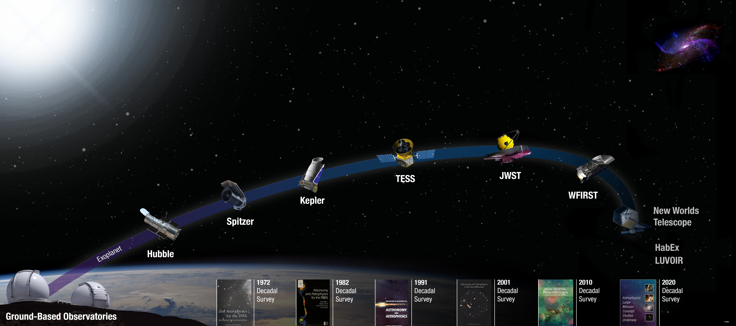
X-Ray Astrophysics and Exoplanet Missions
Keck Observatory, JPL, 2008., NASA ISS007-E-10807, 2003.
Notes:
Kepler revolutionized exoplanetary Science by revealing the abundance of planets in size between Earth and Neptune.
Most of Kepler stars are too faint for detailed follow up observation
TESS is an Astrophysics Explorer mission launching next year (2018). It will search for planets transiting bright and nearby stars. The TESS satellite falls in a line of electro-optical sensor NASA missions in the hunt for habitable planets in our Galaxy.
MIT Kavli, Lincoln Laboratory and partners developed the TESS satellite
Candidates identified by TESS will followed up by Ground Based Observatories and by JWST
Clearance Info: Satellite images in this slides are from Keck Observatory, JPL (2008), and NASA ISS007-E-10807 (2003)

Slide 3
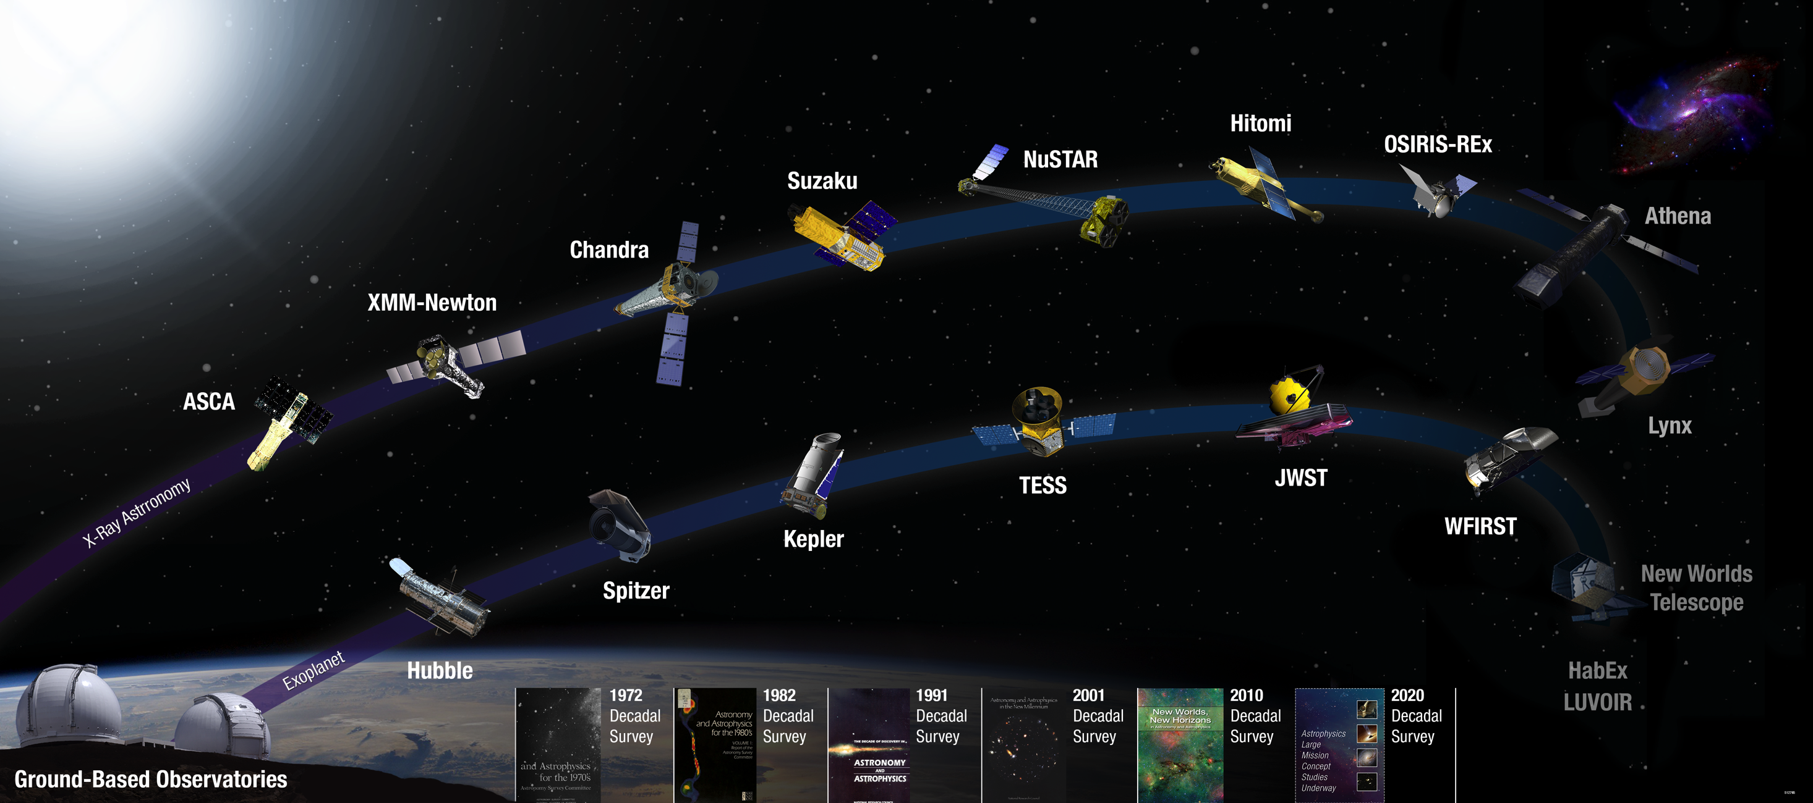
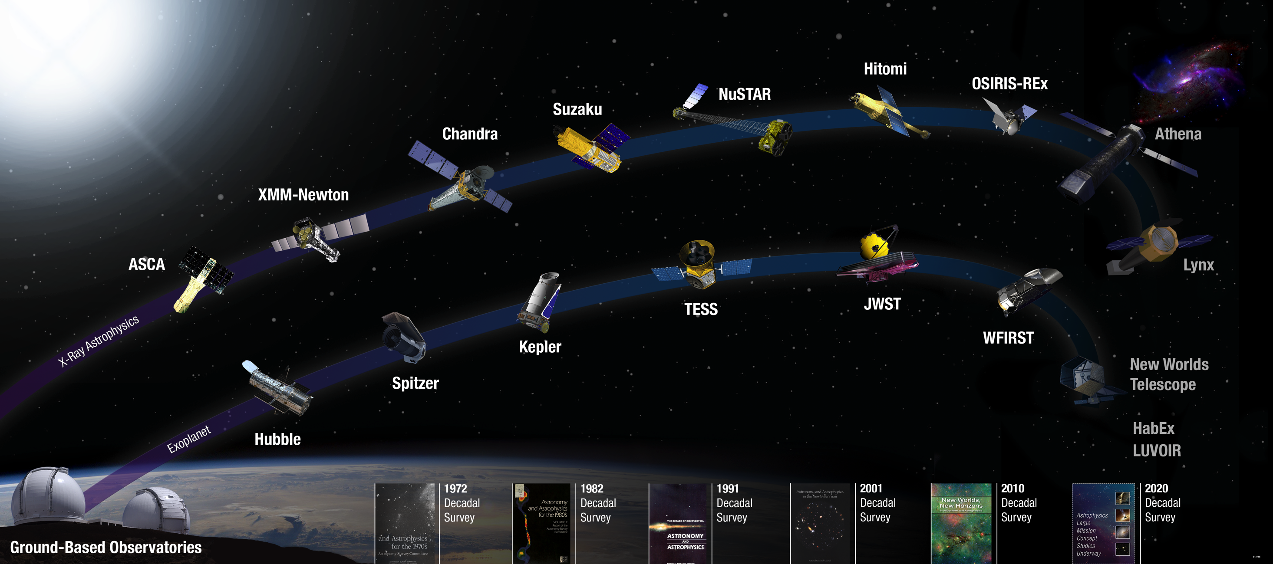
X-Ray Astrophysics and Exoplanet Missions
Keck Observatory, JPL, 2008., NASA ISS007-E-10807, 2003.
Notes:
Some of the most demanding detector requirements come from direct detection X-Ray astrophysics missions
Similar drivers for wider field of view from Science priorities and from advances in X-ray optics and mirrors
Lincoln developed the detectors for the Chandra, Suzaku missions and the REXIS instrument on the OSIRIS-Rex mission.
Advancements in x-ray optics and lightweight mirror technology lay new demands for
The Science and Technology Definition teams for the 2020 Decadal Survey are outlining needs for future missions (HabEx and LUVOIR)
Clearance Info:
Satellite images in this slides are from Keck Observatory, JPL (2008), and NASA ISS007-E-10807 (2003)

Slide 4
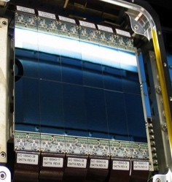
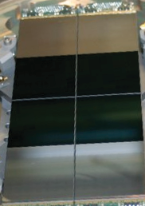

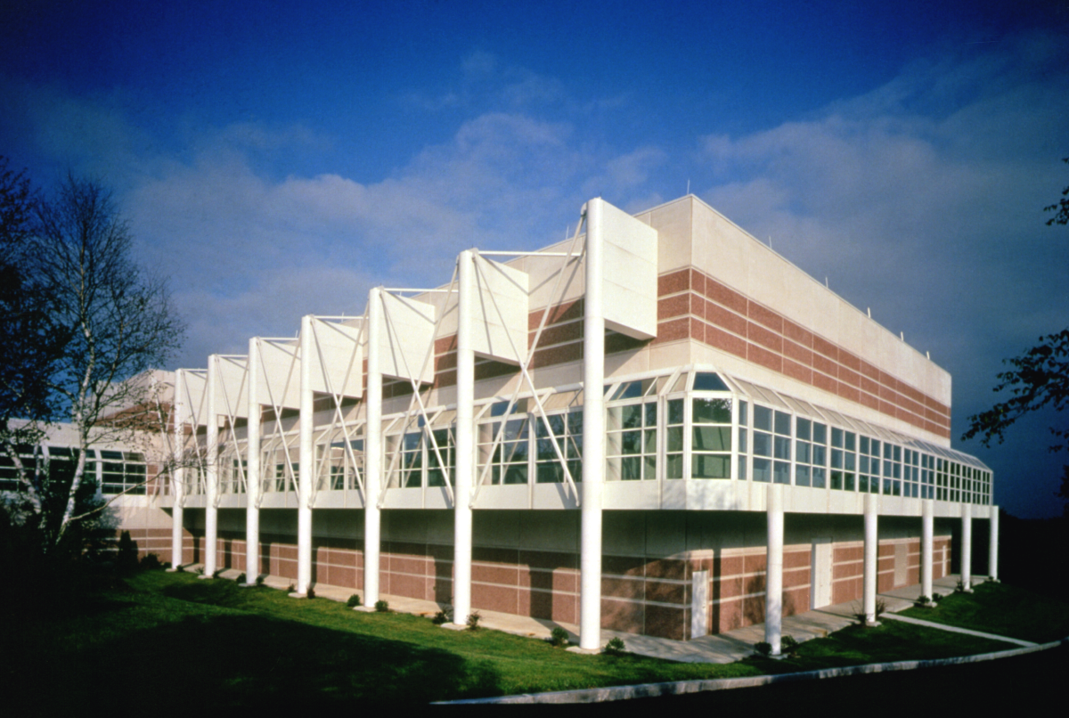


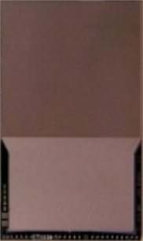
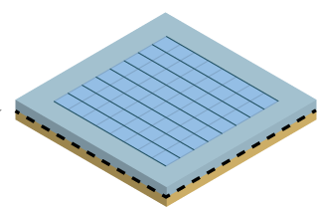

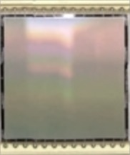
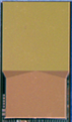
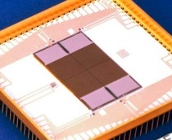
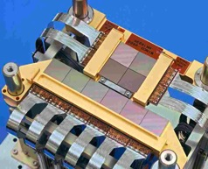
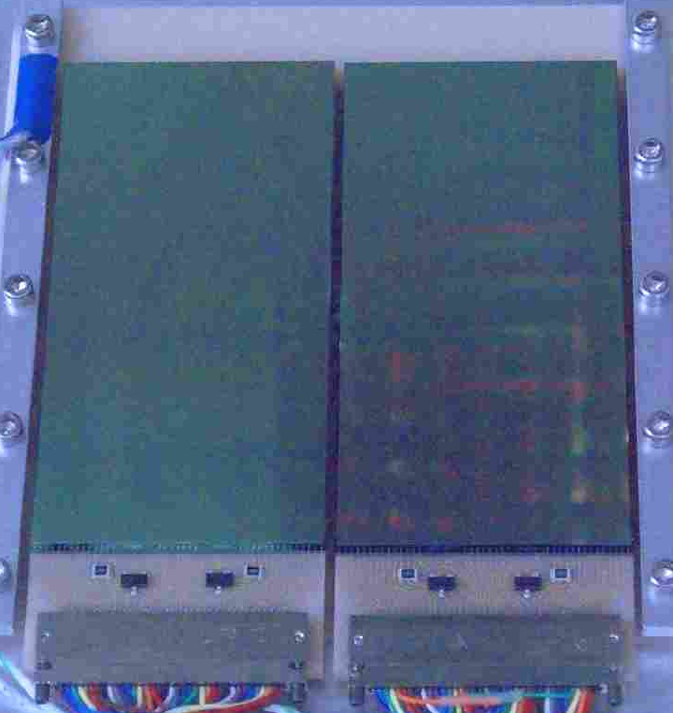
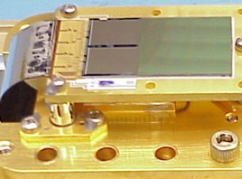
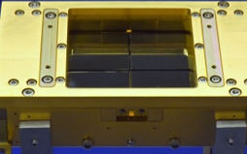
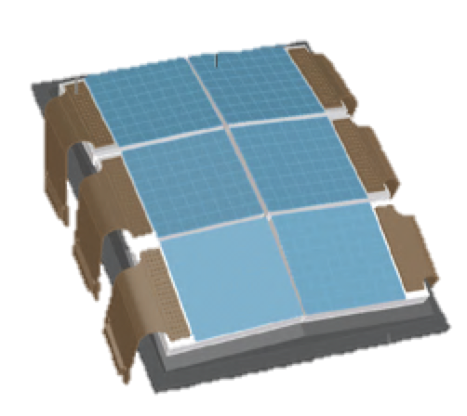
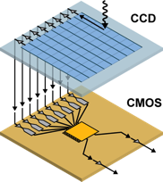
Development of Large-Format
Charge Coupled Devices at Lincoln Laboratory
Electro-Optics
Advanced CCDs
>16 Mp (Si)
8 µm pixel >6 cm²
85% QE
<1e⁻ Read Noise
100 FPS
706
kpix
10 Mp
96 Mp
8 Mp Tile
64 Mp
40 kpix
353
kpix
Quad Array
SBV
Microelectronics Laboratory
GEODSS
Digital CCD Tile
100 pixels
Tech Transfer→Sarnoff (2004)
(SWIR)
SST
TESS (4x)
Ge-CCD
1970s
1980s
1990s
2000s
2010s
2020s
Ge-CCD
(X-Ray)
Sounding Rocket
WSMR (PSU)
Fast Readout CCD
Beginning of collaboration with MIT Kavli (CSR)
ASCA
(U.S., Japan)
Chandra
HETE-2
Suzaku
(U.S., Japan)
3D-CMOS
Soft X-Ray
REXIS
ISS-TAO
X-Ray Astrophysics
Notes:
This chart previously released in ATNS 2016 (Parrot Group Code 404996) slide 6
It has been redrawn

Slide 5

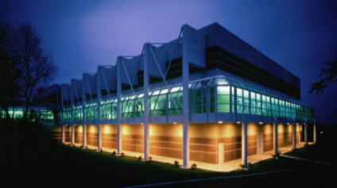
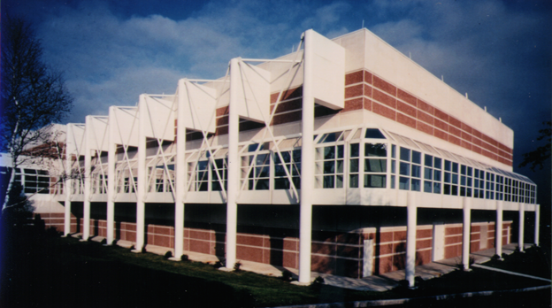
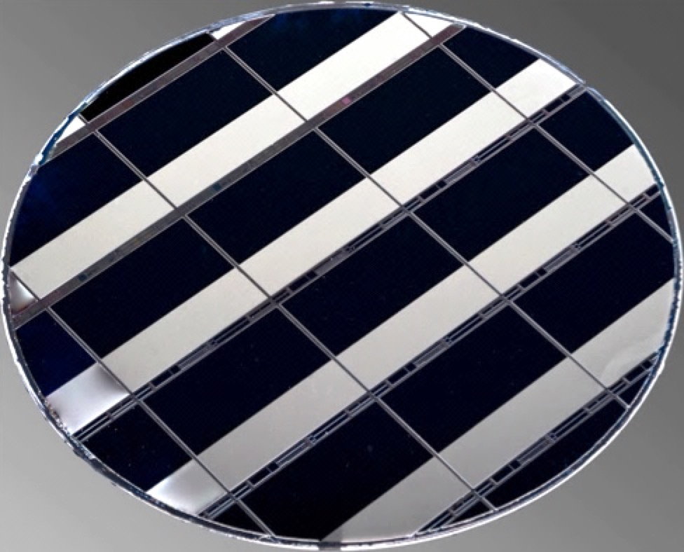
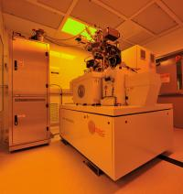
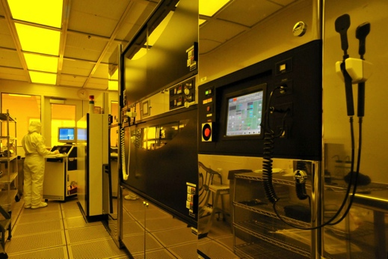
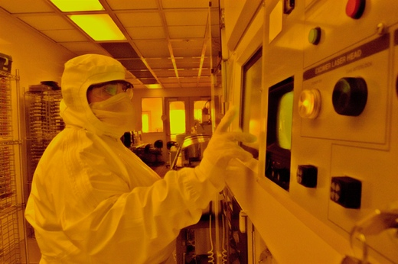
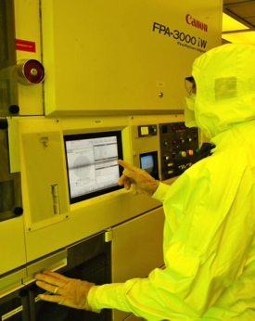
Lincoln Microelectronics Laboratory
Specially designed 70,000 square foot building
  First completed silicon in Spring 1993
  Converted to 150 mm wafer processing in 1996
  Converted to 200 mm wafer processing in Spring 2011
Clean Room space and staffing
  8,100 sq. ft. class-10 + 10,000 sq. ft. class-100
  50 full-time Engineers, and Technicians
  Three-shift operation, 6 am to 11 pm, 5 days/week
  Accredited Trusted Foundry
  DMEA trusted design certification
Application Areas
  Giga pixel CCD imagers
  Photon-counting APD arrays
  Single Flux Quantum electronics
    Nb-based superconducting circuits
  90-nm FDSOI CMOS
    Cryogenic, radiation tolerant, low-leakage options
  3-D circuit stacking, heterogeneous integration
200mm
Back Illuminated Wafers
Full Production Class CMOS Suite
Mix & Match and Stitching Lithography Capability
e-beam
Vistec
193 nm
ASML
248 nm
Canon
i-line
Canon
Notes:
Description of Lincoln’s Microelectronics Laboratory
All images have been previously released

Slide 6

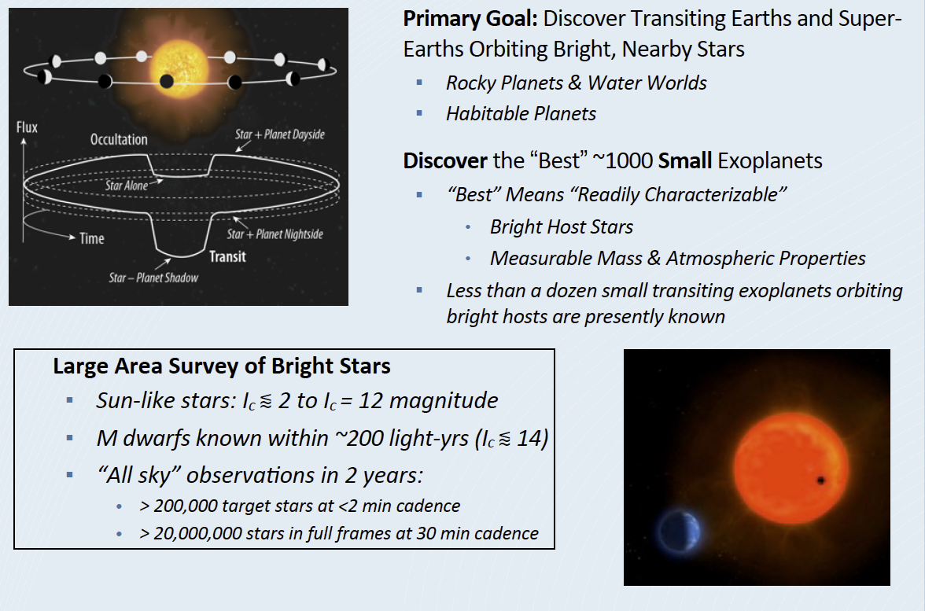
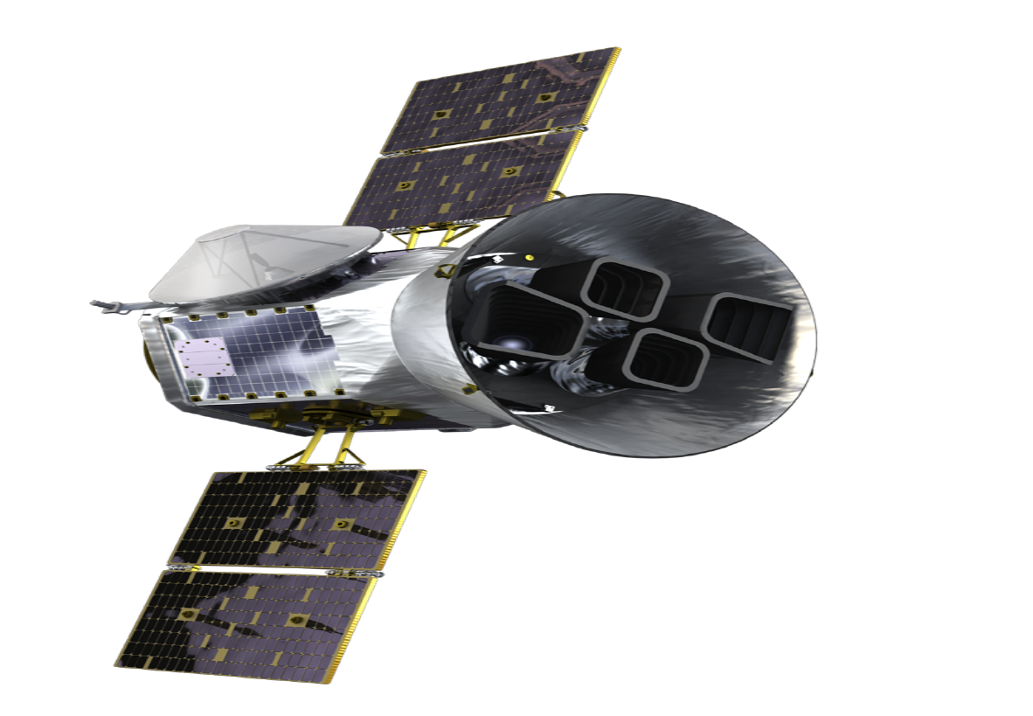
Transiting Exoplanet Survey Satellite (TESS)
Notes:
TESS is based on the transit technique for finding exoplanets. This is a simple technique for observing the dip in starlight when our line of sight lines up with a planets orbit
The primary objective of TESS is to discover hundreds of transiting planets smaller than Neptune with host stars bright enough for follow on spectroscopy to measure planetary masses and atmospheric compositions
Red stars, or M-dwarfs, are the most common in our solar neighborhood. About ¾ of the stars in our neighborhood are M-dwarfs.
The All Sky Observations are conducted by four cameras on the satellite. This covers a solid angle that’s 400x bigger than Kepler’s. The target stars are also 10x closer than Kepler’s, which means they are 100x brighter, and thus easier for follow up
Clearance Info:
Slide presented by George Ricker, TESS PI, at Precision Astronomy with CCDs, December 2016 Conference

Slide 7
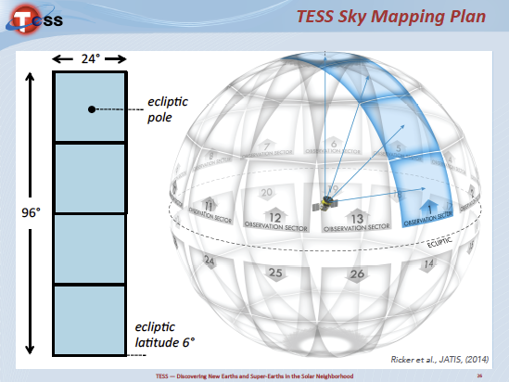
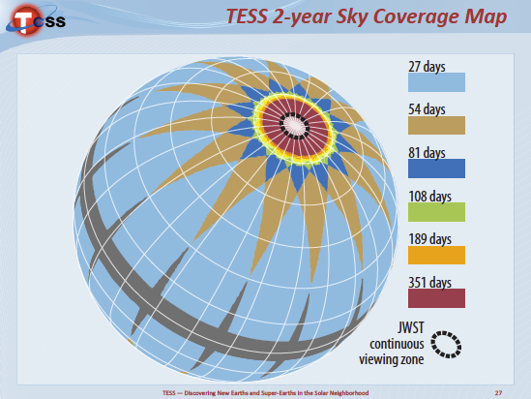
Large Area Survey of Bright, Cool, Dwarfs
https://www.youtube.com/watch?v=mpViVEO-ymc
Notes:
The left diagram shows the orientation of the camera fields of view
TESS operates in a step and stare mode, with 4 cameras spanning from ecliptic latitude to the poles covering a 24deg x 96deg segment
Every 27 days TESS moves to a new field. After 13 steps completing the first year and covering the northern hemisphere, the satellite flips and steps through southern hemisphere in the second year.
The diagram on the right shows the days of observation from the overlapping of fields after a 2 year survey.
At the poles, the sectors overlap for sensitivity to smaller and longer period planets in JWST continuous viewing zone
The youtube video gives more detail about the mission
Clearance Info
Slides presented by George Ricker, TESS PI, at Precision Astronomy with CCDs, December 2016 Conference

Slide 8
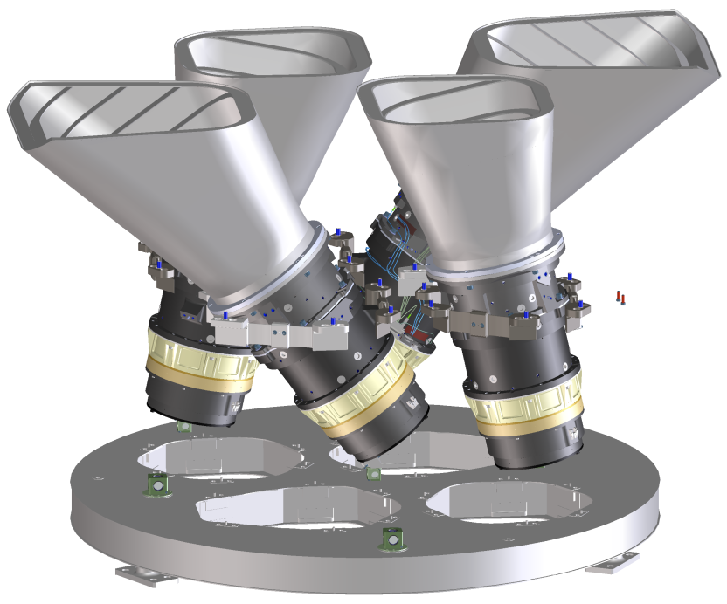
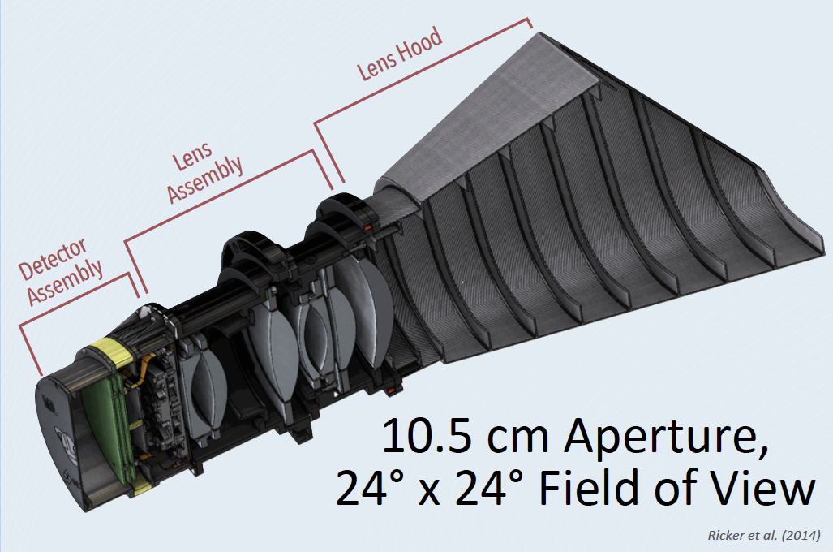
TESS WFOV CCD Cameras
Camera Assembly Layout
Wide Field of View CCD Camera
Notes:
Camera description
Each of the four cameras has a 105mm open aperture design with 7 optical elements
All four cover a 2304 deg^2 Field of View
There are four identical lenses with a f/1.4 custom design
Each lens forms a 24x24deg unvignetted image on 4 CCDs. At nominal focus, the 50% ensquared energy half width is 15 micron, and 90% within 4x4 pixels.
Each lens has a lens hood to reduce the effect scattered light from the Earth and the Moon
Each camera has 4 CCDs (16 Mpix + frame store) and electronics in 3 boards
Clearance Info:
Diagrams on this chart previously presented by George Ricker, TESS PI, at Precision Astronomy with CCDs, December 2016 Conference – slide 21 (left) and slide 24 (right)

Slide 9
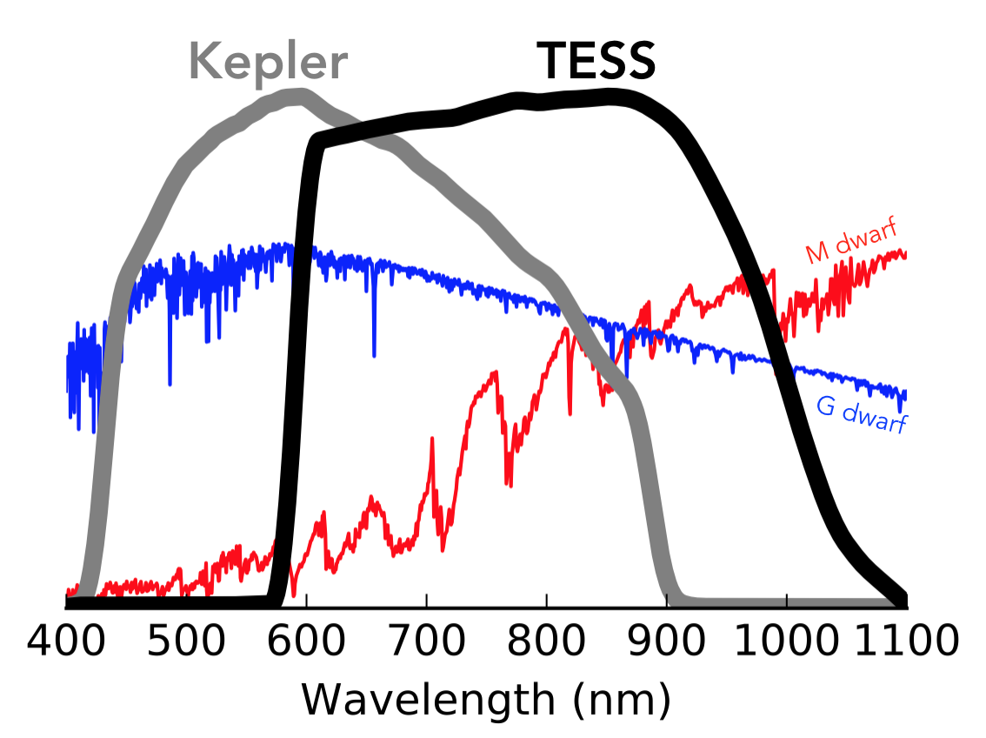
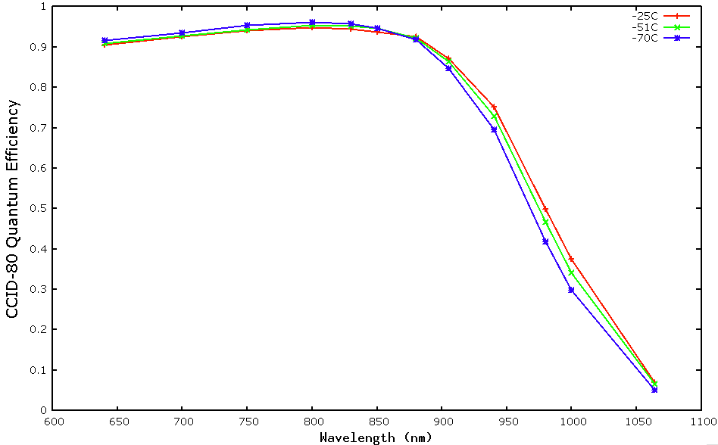
TESS Detector Requirements
TESS Bandpass
Sensitivity to cooler stars (M-type)
  Cool stars are more abundant, stable
  Transit depth inversely proportional to stellar radius
  Habitable zone
    Region compatible with orbital period < sensor stare time
Photometric precision of 200 parts per million
  Telescope aperture and optical throughput
  Detector QE
Systematic noise < 60 parts per million
  Low read noise and dark current
  Stable temperature on orbit
Measured CCD Quantum Efficiency
Peak QE >95%
100
90
-25°C
80
-70°C
-50°C
70
60
50
40
30
QE ≥ 30% at 1 µm
20
10
Measured CCID-80 results
A. Krishnamurthy
600
700
800
900
1000
1100
Wavelength (nm)
Ricker et al. (2014), Sullivan et al. (2015)
Notes:
* In words, here are the high level detector requirements and comparison to Kepler
A bandpass filter on L2 sets the CCD response to 600nm – 1000nm (Si cutoff, bandpass limit). 400-nm width for practical optical design
Silicon CCDs have excellent linearity and dynamic range for bright objects and a long space flight heritage
The TESS Instrument effective area is ~ 60cm^2 (check this)
This includes the throughput of optical elements, AR coatings on all elements
Clearance Info:
Plots on this chart previously presented by George Ricker, TESS PI, at Precision Astronomy with CCDs, December 2016 Conference – slide 11 (top) and slide 44 (bottom)
QE data measured by MIT campus and published A. Krishnamurthy, J. Villasenor, S. Kissel et al., "An optical test bench for the precision characterization of absolute quantum efficiency for the TESS CCD detectors", Journal of Instrumentation 12(05), pg. C05013, (2017); doi:10.1088/1748-0221/12/05/C05013

Slide 10
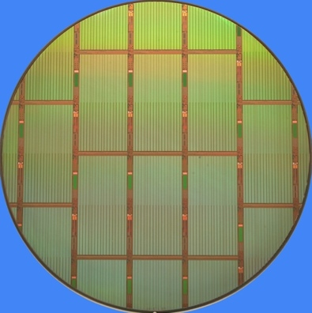
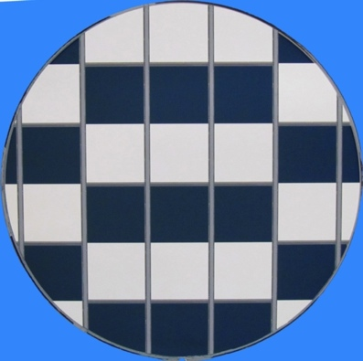
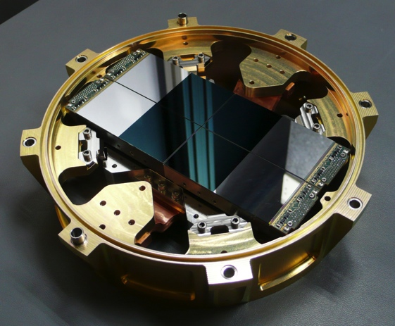
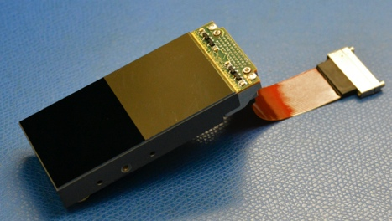
Fully Depleted Back-Illuminated CCD for TESS: CCID-80
200-mm Front- and Back-Illuminated Wafers
Parameter | Specification
Format | 2048(H) x 2048(V) Frame Transfer
Physical Pixels | 2048 x 4132 [ 32 x 64 mm die ]
Pixel Size | 15µm x 15µm
Output Ports | 4 single stage MOSFET
Charge Injection | Three-phase CI register at top
Silicon Thickness | 100µm high resistivity (>5kohm-cm)
Depletion Control | Detector bias
Package Type | 3-side abuttable
Quantity | > 26 flight grade devices
Three-Side Abuttable
Package (GLS)
Focal Plane Assembly (GLS)
Notes:
2k x 4k CCD on 200-mm wafers. Stitched in 1D
The frame store allows rapid shutter less readout in 4 msec
The CCDs produce a continuous stream of images with exposure time of 2sec
2 sec integration time
Frame store and Fast frame shift to minimize smear
Single stage amplifier is adequate
Will talk about detector bias
Single stitch between top and bottom
The packaged CCD is 64mm tall
Clearance Info: Previously cleared
SPIE chart 5 and Ricker chart 17

Slide 11
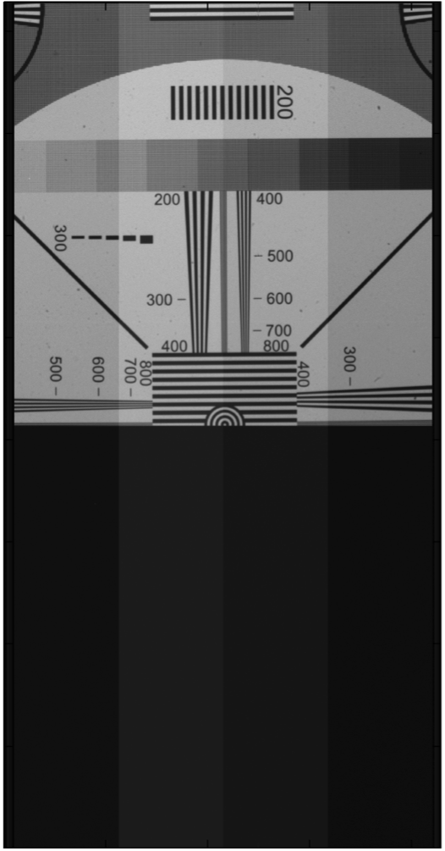
Back-Illuminated Test Results
2k pixels
 | Performance | Specification | Achieved
✔ | Well Capacity | > 150,000 e- (goal) | > 200,000 e-
✔ | Conservation of Bloomed Charge | Best Effort | ~100x full well
✔ | Conversion Gain | < 10 µV/e- | 8 µV/e-
✔ | Read Noise @ 625 kHz | < 20 e- | < 10 e-
✔ | Dark Current @ -30°C | < 8 e-/pix/sec | < 2.5 e-/pix/s
✔ | Device Thickness | 100 µm (-10/+15µm) | 95 – 115 µm
✔ | Depletion-depth control | Substrate bias | Functional
✔ | Targeted Spectral Range | 600-1000 nm | 70% @ 950 nm
✔ | Flight Quantity Needed | 26 | >70 Candidates for packaging
4k pixels
Wafer Probe
Full Frame Imaging
T = 0°C
t_{int} = 1s + 4.5s readout
Notes:
Presented at SPIE chart 13 and also Ricker chart 18
Testing at 0deg, -30C, -70C operation
Integrated light shield over frame store
Excellent cosmetics
Clock voltages were tuned at LL and MKI to achieve the best CCD performance.
At Lincoln the objective was for detector screening and defect estimation with benchtop electronics
At MKI the objective was to achieve the best CCD performance with focal plane electronics
Charge conservation for I<4

Slide 12
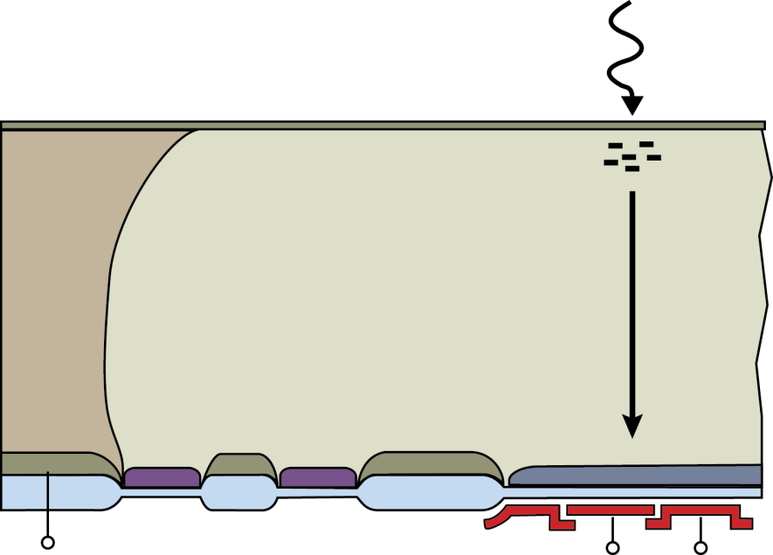
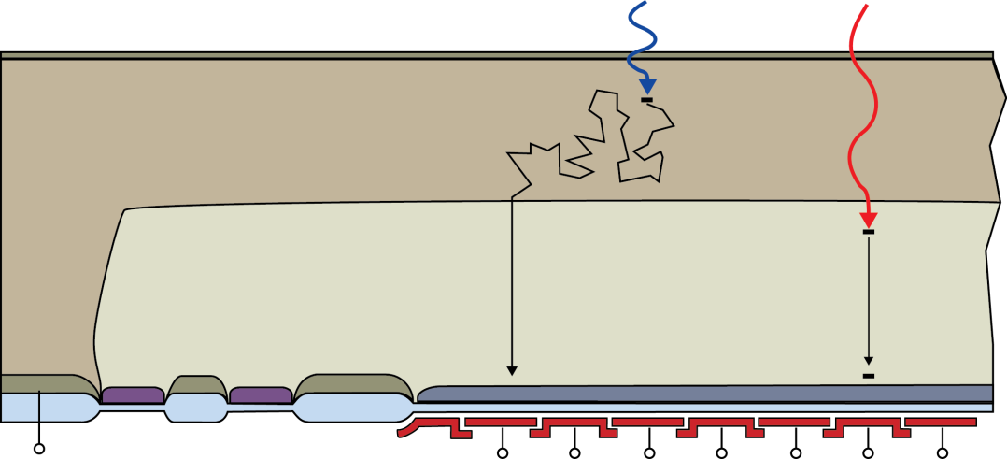
Aspects of Thick (100 µm) Deep Depletion Detector
Anti-reflection coatings optimized for broadband sensitivity
Thicker silicon enables near-IR response
  Specialized material with resistivity >5000 ohm-cm
  Deep depletion operation requires design, process, and test modifications
Charge Spreading Influenced by Depletion
Undepleted
(neutral)
100µm
Fully depleted
high-resistivity p-Si
Depletion Layer
p+
Buried Channel
Guard Rings
Substrate bias
(V<0)
CCD
Notes:
The graphics on this slide are basic textbook drawings
Methods to ensure full depletion
Thin device
High-resistivity substrate
High clock voltages
Bias back-surface p+ negative

Slide 13
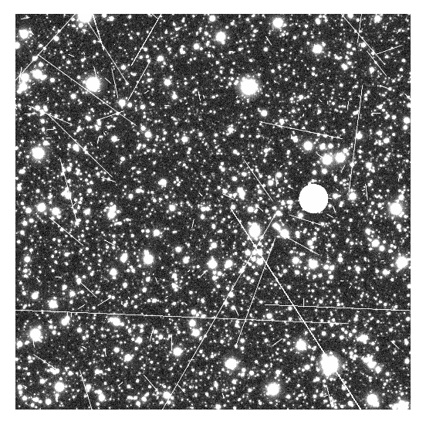
Precision Photometry in a Crowded Star Field
Simulated ½ Hour
Stacked Image
2.8°
Sullivan et al. arXiv:1506.03845v4
Notes:
Those were cartoon. This is a more realistic scenario
This is a small subset of one image from one CCD -- a 7.8 deg^2 portion of a Full Frame Image. The stack consists of 900 TESS images with 2sec integration time
TESS is doing precision photometry in a very crowded star field. Important to have a tight PSF, but also to contain the bright stars without blooming or affecting the signals from nearby target stars
The CCDs produce a continuous stream of images with exposure time of 2 sec. FPGA sums in groups of 60 to create 2 minute effective exposure. Full frame images are stacked every 30 min
The simulated full frame stacked image at the upper right was presented at the TESS PDR by G. Ricker
Clearance Info/Paper Reference:
The Transiting Exoplanet Survey Satellite: Simulations of planet detections and astrophysical false positives
Peter W. Sullivan, Joshua N. Winn, Zachory K. Berta-Thompson, David Charbonneau, Drake Deming, Courtney D. Dressing, David W. Latham, Alan M. Levine, Peter R. McCullough, Timothy Morton, George R. Ricker, Roland Vanderspek, Deborah Woods
arXiv:1506.03845v4
Charge diffusion results measured at Lincoln Lab and comparable to those presented in published work J. Villasenor, G. Prigozhin, J.Doty, C. Lage, S.Yazdi, G. Ricker, doi: 10.1088/1748-0221/12/04/C04025
A bias of -20V is sufficient to fully deplete this device, but overdepletion is desirable
to minimize lateral diffusion which can blur images and in turn affect the photometric precision
by increasing an area (and, hence, readout and background noise) associated with a given object
of interest. For this reason much larger negative bias voltages have been applied.
As explained in the next slide, we can achieve sharper images with larger negative substrate voltage, but we also discovered an unexpected dramatic increase of the full well capacity beyond a certain threshold voltage.

Slide 14
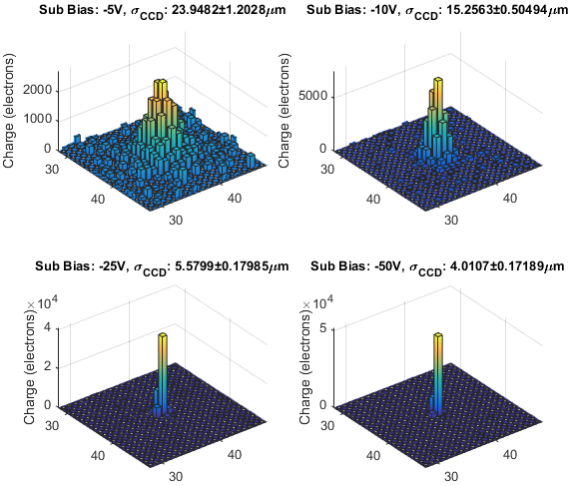
Increased Charge Confinement Achieved with Over Depletion
TESS needs precision photometry in a crowded star field
Charge profile measured with 660nm LED to optimize substrate bias
Sub Bias: -5V
σ: 24µm
Sub Bias: -10V
σ: 15µm
Sub Bias: -25V
σ: 5.6µm
Sub Bias: -50V
σ: 4.0µm
Notes:
The simulated full frame stacked image at the upper right was presented at the TESS PDR by G. Ricker
The image shows a 7.8 deg^2 portion of a Full Frame Image. The stack consists of 900 TESS images with 2sec integration time
Paper Reference:
The Transiting Exoplanet Survey Satellite: Simulations of planet detections and astrophysical false positives
Peter W. Sullivan, Joshua N. Winn, Zachory K. Berta-Thompson, David Charbonneau, Drake Deming, Courtney D. Dressing, David W. Latham, Alan M. Levine, Peter R. McCullough, Timothy Morton, George R. Ricker, Roland Vanderspek, Deborah Woods
arXiv:1506.03845v4
Charge diffusion results measured at Lincoln Lab and comparable to those presented in published work J. Villasenor, G. Prigozhin, J.Doty, C. Lage, S.Yazdi, G. Ricker, doi: 10.1088/1748-0221/12/04/C04025
A bias of -20V is sufficient to fully deplete this device, but overdepletion is desirable
to minimize lateral diffusion which can blur images and in turn affect the photometric precision
by increasing an area (and, hence, readout and background noise) associated with a given object
of interest. For this reason much larger negative bias voltages have been applied.
As explained in the next slide, we can achieve sharper images with larger negative substrate voltage, but we also discovered an unexpected dramatic increase of the full well capacity beyond a certain threshold voltage.

Slide 15
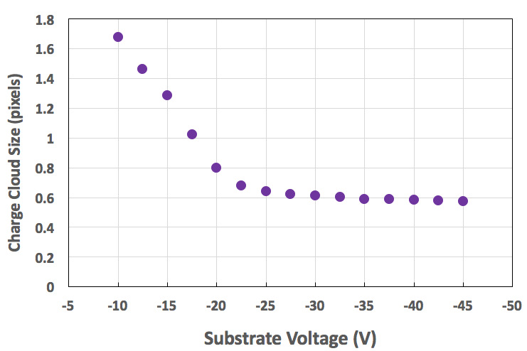
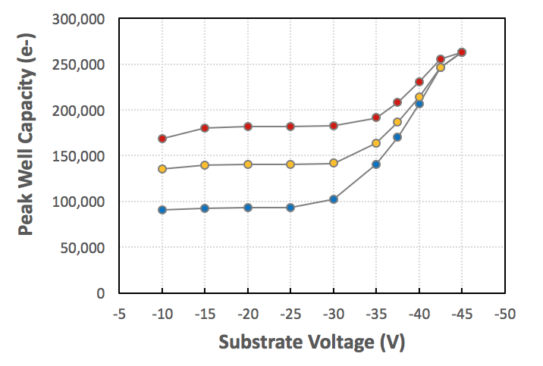
Optimizing CCD Voltages to Meet Requirements with Thick Detectors
For Minimum Charge Cloud Size
V_{sub} above -25V
(Virtual knife edge technique)
For High Full Well Without Charge Loss
V_{sub} below -35V
(Pulsed sub-pixel LED technique)
Full Well (e-)
below -35V
Charge lost to surface
above -25V
above 150ke-
9.8V
Peak Well Capacity (e-)
9V
below 1 pixel
8V clock swing
660nm LED
Vertical Low = -8V
J. Villasenor, et al J. Inst v. 12, 2017
Notes:
These measurements done at MKI
Labels will be redrawn to meet Lincoln publication standards
These data from published work
Reach-through effect in deep depletion TESS CCDs
J. Villasenor, G. Prigozhin, J.P. Doty, C. Lage, S. Yazdi, G. Ricker and R. Vanderspek
Published 28 April 2017 • Journal of Instrumentation, Volume 12, April 2017
Precision Astronomy with Fully Depleted CCDS (PACCD2016)
Also presented by TESS member J. Villasenor in a poster at the Precision Astronomy with CCDs, December 2016 Conference

Slide 16
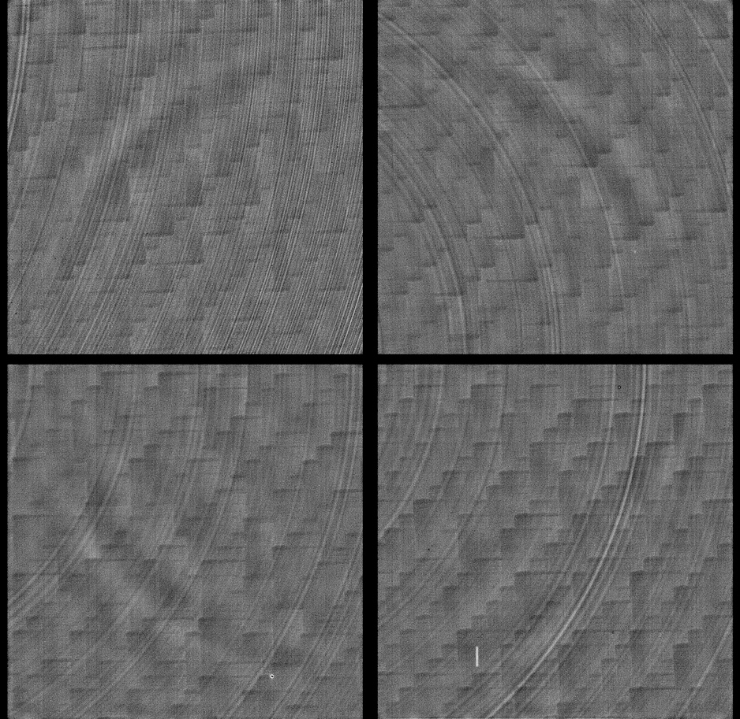
Stretched Non-Uniformity
TESS Focal Plane Array Flat Field (4 CCDs)
Tree Rings (FZ Si impurities)
Backside Laser Anneal (stepped pulses)
Image Processing Artifact
Total non-uniformity across FPA falls well within requirements budget
Notes:
Diagrams on this chart previously presented by George Ricker, TESS PI, at Precision Astronomy with CCDs, December 2016 Conference – slide 43
CCD cosmetics are excellent. Generally 0-2 blocked or hot columns per CCD

Slide 17
NASA X-Ray Astrophysics Missions
Keck Observatory, JPL, 2008., NASA ISS007-E-10807, 2003.
Notes:
Repeat of Chart #3
Here we describe a future technology needed for Lynx
Chandra launch 1999
Current and Future Si sensors in X-ray Astronomy
• Every X-ray observatory launched in the past 20 years has flown CCDs
• Many advantages of this technology for X-ray imaging spectroscopy
1. High QE over soH X-ray bandpass
2. Efficient (>99%) charged-par7cle rejec7on
3. Moderate energy resolu7on (E/ΔE~50 at 5.9 keV)
4. Small pixels well-matched to PSF of X-ray op7cs
• Mode of opera7on different than op7cal/IR imager
1. Operate in single photon coun7ng mode – detect individual photons
2. Con7nuous readout of sensor to avoid pileup (frame 7me – 100s of ms
to secs)
3. Only X-ray events telemetered to ground
• Challenges for megapixel sensors for next genera7on X-ray observatories
• Desire frame rates of 102-103 of frames per second with low noise
• Adequate radia7on tolerance
• High speed windowing with liWle or no dead 7me
• Very high-performance backside treatment for complete charge
Collec7on

Slide 18
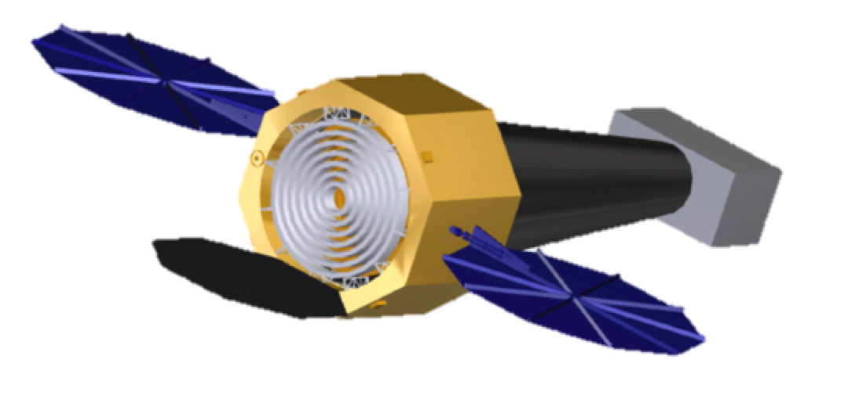
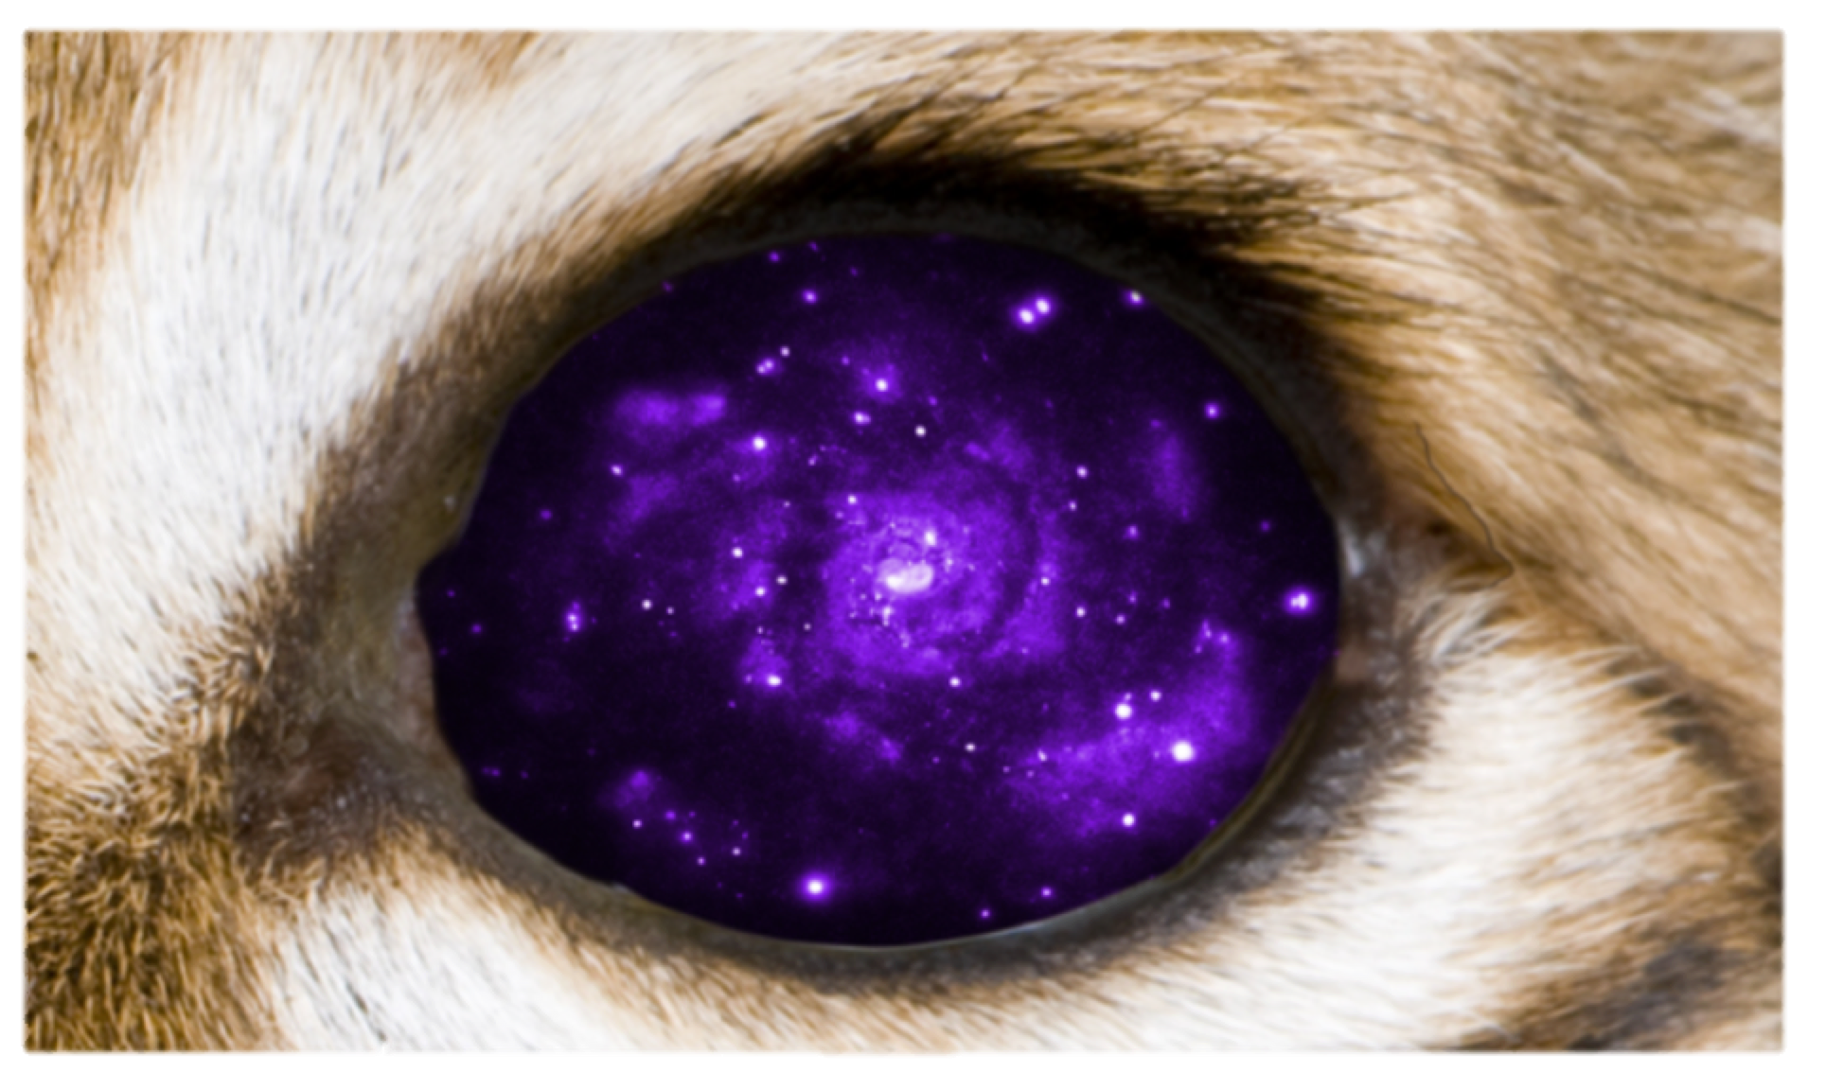
Beyond Chandra to Lynx
Candidate NAS 2020 Decadal Survey Mission
Revealing the Invisible Universe
L
Y
N
X
Next-generation X-ray mirrors
~1200 kg for 2.3m² collection area
[Chandra: 1500 kg for 0.08m²]
Sub-arcsec imaging over 15x15 arcmin field
www.astro.msfc.nasa.gov/lynx
Key Science Goals goals (TBR)
Find first massive black holes
Understand co-evolution of dark & baryonic matter
Explain connection between black holes and galaxy evolution
Chandra Successor
  30x collecting area (2 m²), same PSF (0.5”) or better
  Similar focal length
  High Definition Imager
  Grating Spectrometer
  Micro-calorimeter
Ref: Weisskopf (MSFC), Vikhlinin (SAO) et al., SPIE, PhysPAG2015, HEAD2015
Notes:
The Digital CCD Advanced Devices Lincoln Line Program (2237-10) supported the development of detectors. One application is the proposed NASA Lynx mission
These images from NASA website https://wwwastro.msfc.nasa.gov/lynx/
Similar in Science goals to Chandra, Lynx will observe X-ray sources throughout the cosmos and help scientists learn about the processes that govern stellar and cosmic evolution
It is expected to be a 5 year mission with launch projected for 2030 and several orbit options in consideration.
Comparable angular resolution to Chandra (0.5 arcsec or better)
Increased photon throughput
50x more effective area and 10x larger solid angle for sub-arcsec imaging
500x higher survey speed
Increased sensitivity (50x)
Chandra mirror shells are 2.5cm thick.
New mirror is a modular construction of densely packed thin segments. Offers lower mass, same angular resolution, same focal length as Chandra
Wide-Field Imaging:
50x more effective area due to mirror and QE improvements
10x larger solid angle for fine imaging because of shorter mirrors and Wolter Schwarzschild optical scheme
A 4 million second Chandra deep field (4Msec) will be done in 80 thousand seconds (80ksec) => 50x shorter time
(From Vikhlinin, PhysPAG 2015)
===========================
JWST will detect ~2 million galaxies/deg^2 at its sensitvity limit (Windhorst et al.)
This corresponds to:
0.03 galaxies per 0.5arcsec X-ray Surveyor beam (not confused)
3 galaxies per ATHENA 5 arcsec beam (confused)
X-ray confusion limit:
ATHENA: 2.5 x 10^-17 erg/s/cm^2 (5x worse than current depth of Chandra Deep Field)
X-ray Surveyor will reach 1 x 10^-19 erg/s/cm^2 (2 orders of magnitude better than ATHENA)
=> Each X-ray Surveyor source will be associated with a unique JWST-detected galaxy
PAG = Program analysis Group

Slide 19
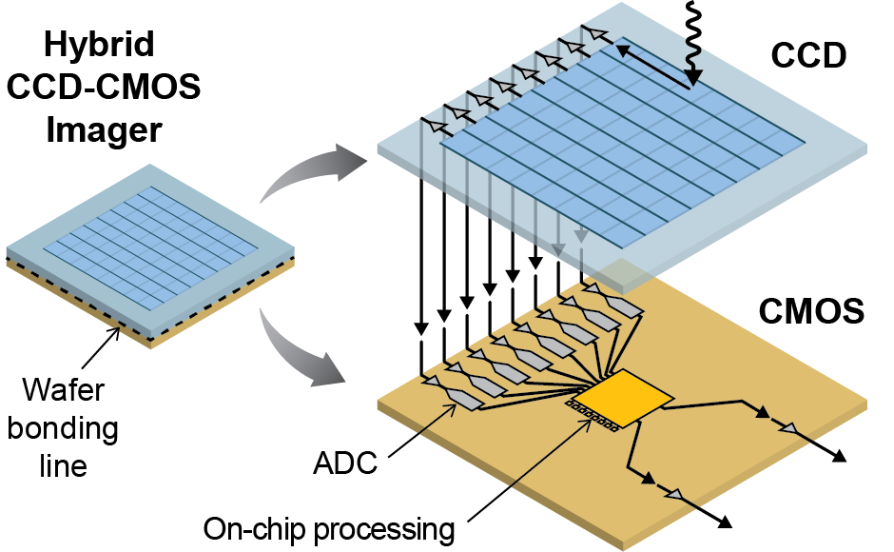
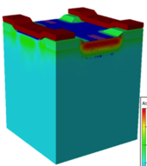
Digital CCD Technology for
Lynx High Definition X-ray Imager (HDXI)
HDXI Parameters/Requirements
Energy Range | 0.2-10keV QE > 90% (0.3-6keV) QE > 10% (0.2-9keV)
Field of View | 22’ x 22’ 4k x 4k pixels
Pixel size | ≦ 16 x 16 µm 0.33 arcsec
Read noise | ≦ 4e-
Energy resolution (FWHM) | 37 eV @ 0.3keV 120 eV @ 6keV
Frame rate | > 100 fps (full frame) > 10,000 fps (windowed)
Radiation tolerance | 10 years at L2
Hybrid CCD/CMOS Sensor
Scientific Grade CCD
  High speed, high-responsivity on-chip amplifier
Compact, short, highly parallel readout and digitization video signal chain
Direct integration of CCD-to-CMOS
Customized backside process (MBE)
High responsivity output
jFET or SiSeRO
Source
Gate
Drain
Buried
Sense Gate
High-Speed differential digital outputs
Notes:
“Best of Both Worlds” Sensor
Large Area
Massively parallel readout. Not difficult – we routinely make 64- or more channel CCD
CCD technology is engineered for low voltage operation and compatibility with CMOS logic levels (2-3V)
Massively parallel video chain provides high CCD frame rates with modest analog-to-digital conversion rates, thus band limiting noise
Direct integration via tight pitch, low parasitic wafer-to-wafer bonding process
Clearance Info:
Table on the Left is from documents on NASA’s website for Lynx https://wwwastro.msfc.nasa.gov/lynx/
Graphic on the right was previously cleared for ATNS2016 (Group code 404996) slide 11
The Digital CCD Advanced Devices Lincoln Line Program (2237-10) supported the development of detectors. One application is the proposed NASA Lynx mission
These requirements from documents at NASA website https://wwwastro.msfc.nasa.gov/lynx/
Digital CCD graphics previously cleared for ATNS

Slide 20
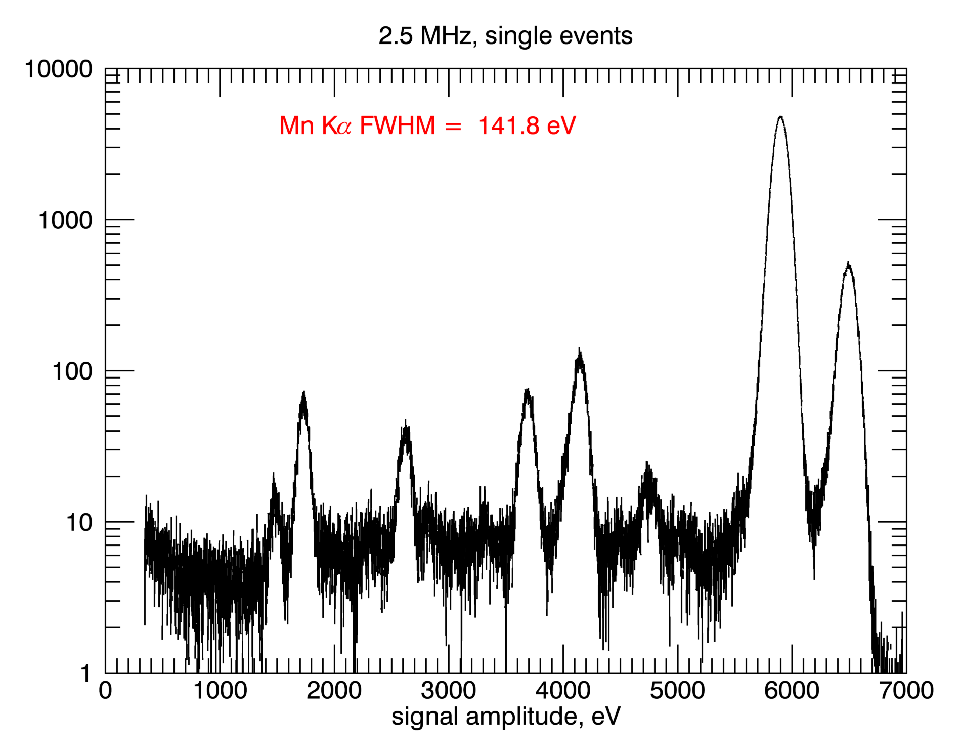
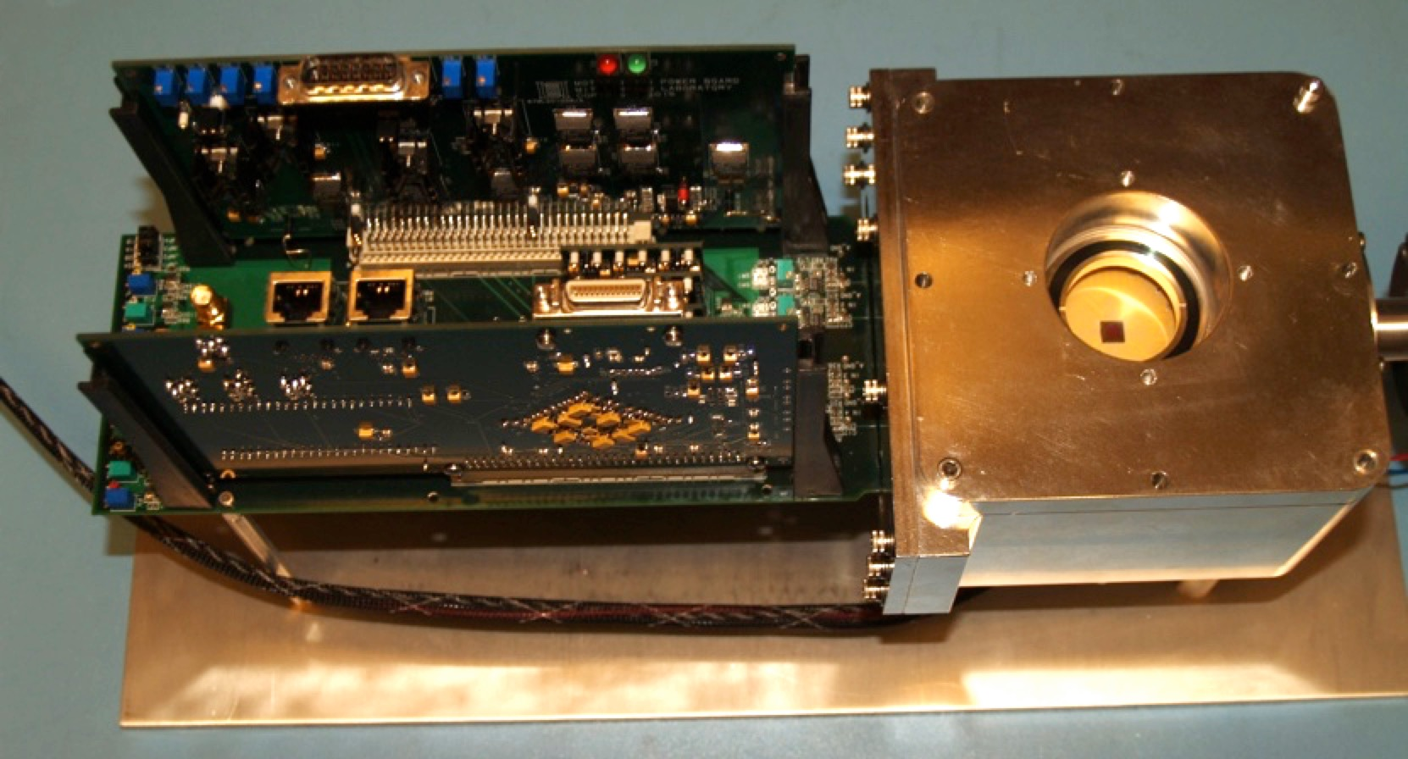



Preliminary Test CCD Imager Results
Evaluation Camera
Pixel rate | 1.25 to 5 MHz
Clock levels (par. & ser.) | +0.9 to -1.1V
CCD temp (°C) | -35°C
Responsivity | 17 µV/e-
Noise (e- RMS) | 6.4 @ 1.25 MHz 7 @ 2.5 mHz 10 @ 5.0 mHz
Parallel CTI @5.9keV | < 1.3 x 10⁻⁶ pixel⁻¹
Dark Current | 11 e- pixel⁻¹ s⁻¹
Mn Kα
FWHM = 141.8 eV
Mn Kβ
8µm
Ca
8µm
Si
100nm
Cl
Al
512x512, 8-µm pixel CCD operation at 2V
Notes:
Small pixel (8um)
CMOS Compatible operation
Clearance Info:
Previously released material for IEDM abstract submission Parrot Group Code 115230
The Digital CCD Advanced Devices Lincoln Line Program (2237-10) supported the development of detectors.

Slide 21






Recent MBE Backside Treatment for
REXIS Instrument on OSIRIS-REX
REXIS will map elements on the surface of asteroid Bennu
  Onboard OSIRIS-REx spacecraft
    Launch in 2016; Return in 2023
  Coded aperture for imaging single photon X-ray fluorescence
  Lincoln Lab CCDs with MBE and OBF
    MBE back illumination process for soft X-ray QE
    Direct deposit optical blocking filter improvement over previous free standing filters
  Student led experiment (MIT SSL, MKI, Harvard, CFA, GSFC)
REXIS CDIO Class
Ryu et al., SPIE 2014
2x2 Array of 1K x 1K
Frame Transfer CCDs
Clearly-resolved
characteristic lines
(Al, Si, ZnS, Fe, CaF)
from
fluorescent composite target
Low noise CCID-41
(REXIS EDU)
with MBE and 220nm OBF
CCD Development work supported by the OBF Strategic Astrophysics Technology
and the REXIS programs
Notes:
200eV soft X-rays have an absorption depth of 63nm in silicon
Clearance Info :
Data from MKI and paper below *Not Lincoln Data*
Branden Allen, Jonathan Grindlay, Jaesub Hong, Richard P. Binzel, Rebecca Masterson, Niraj K. Inamdar, Mark Chodas, Matthew W. Smith, Marshall W. Bautz, Steven E. Kissel, Joel Villasenor, Miruna Oprescu, Nicholas Induni, "The REgolith X-Ray Imaging Spectrometer (REXIS) for OSIRIS-REx: identifying regional elemental enrichment on asteroids", Proc. SPIE 8840, Optical Modeling and Performance Predictions VI, 88400M (27 September 2013); doi: 10.1117/12.2041715; http://dx.doi.org/10.1117/12.2041715

Slide 22

CCD Advancements for Next Generation Systems
TESS will find nearby small transiting planets
  Wide field of view photometric survey with deep depletion CCDs
  Four, 16 Mpix cameras with <10e- noise
  Detector fabrication and biasing optimized for broad QE and high well capacity without charge loss
  Launch 2018
Future NASA missions require large area, high frame rate, low noise sensors with very soft X-ray sensitivity (0.2keV)
  Lynx candidate mission exploits lightweight mirrors
  Lincoln is integrating CCDs with CMOS at high port density
    The Digital CCD is a ”best of both worlds” sensor technology
  Thin backside contact developed with MBE treatment
TESS Payload Integration Orbital ATK

