Slide 1
ESO ELT Adaptive Optics High-speed Wavefront Sensors Cameras and Control Electronics
Javier Reyes, Mark Downing, Enrico Marchetti
European Southern Observatory, ESO (http://www.eso.org)

Slide 2
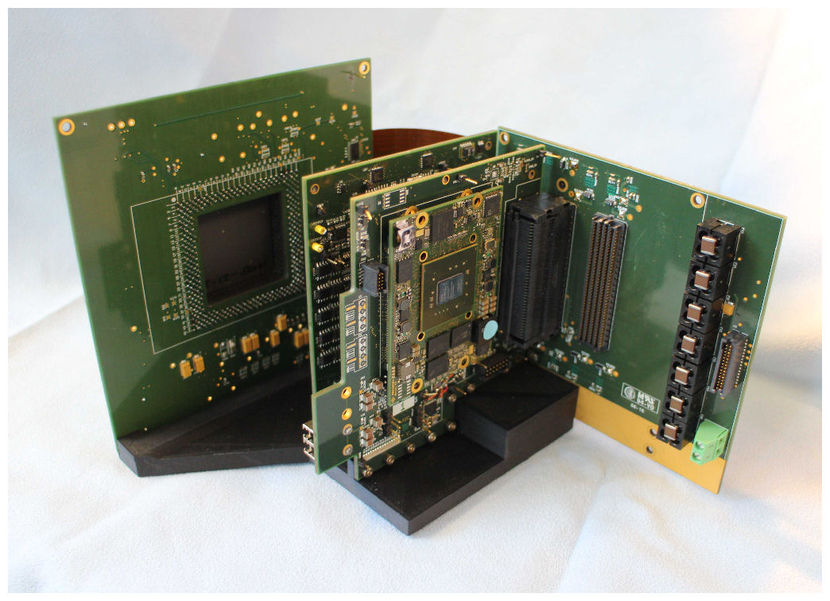
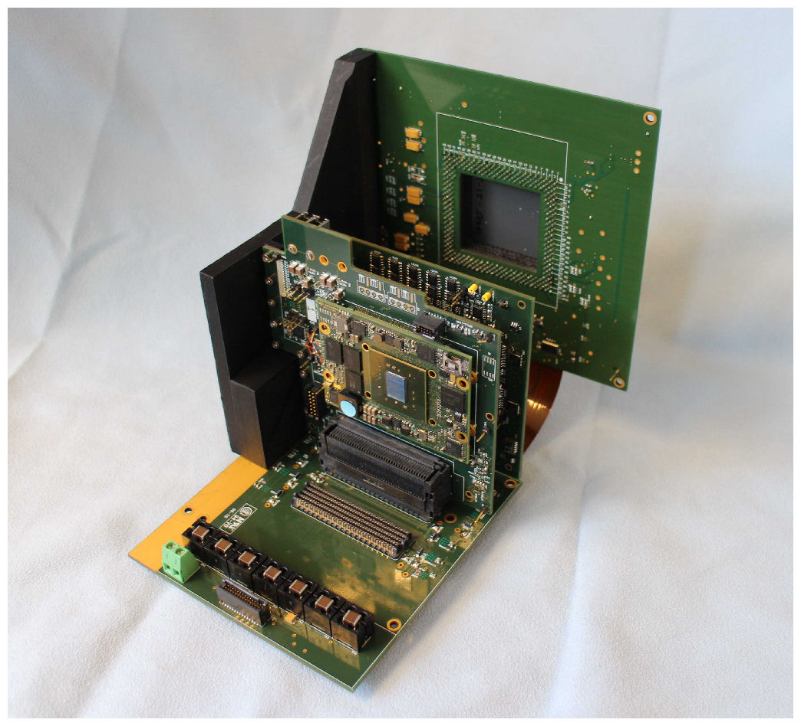
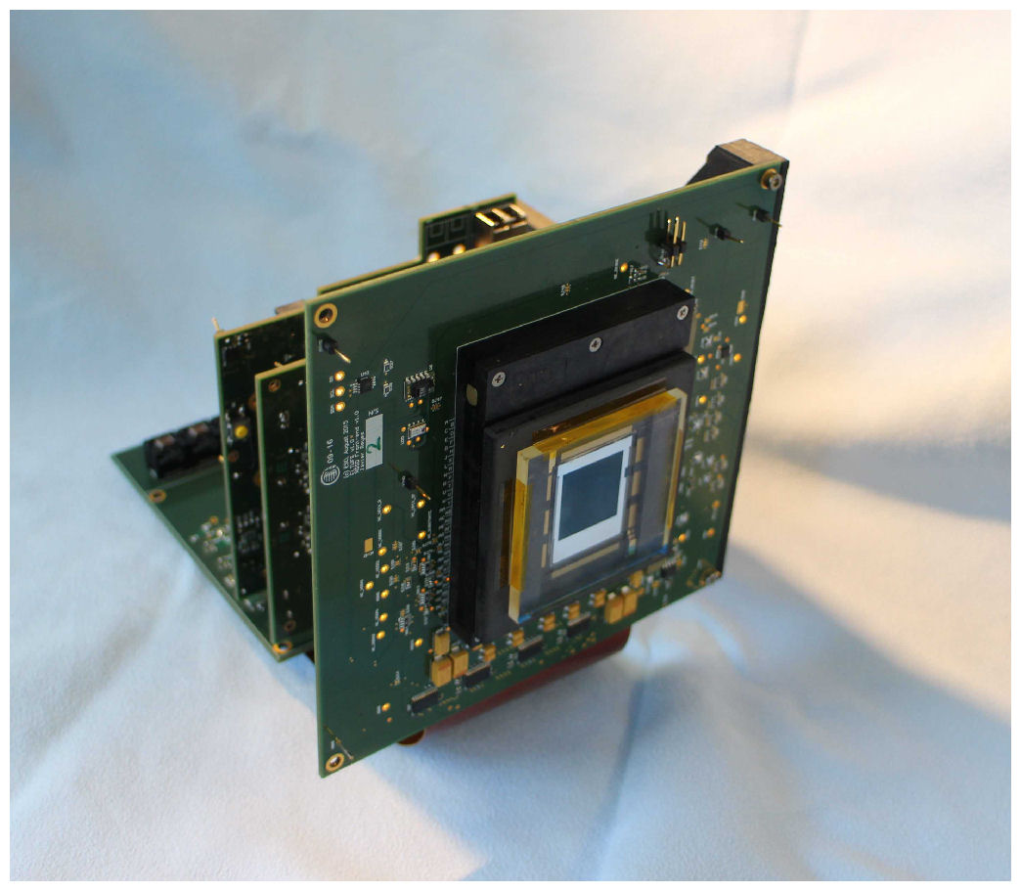
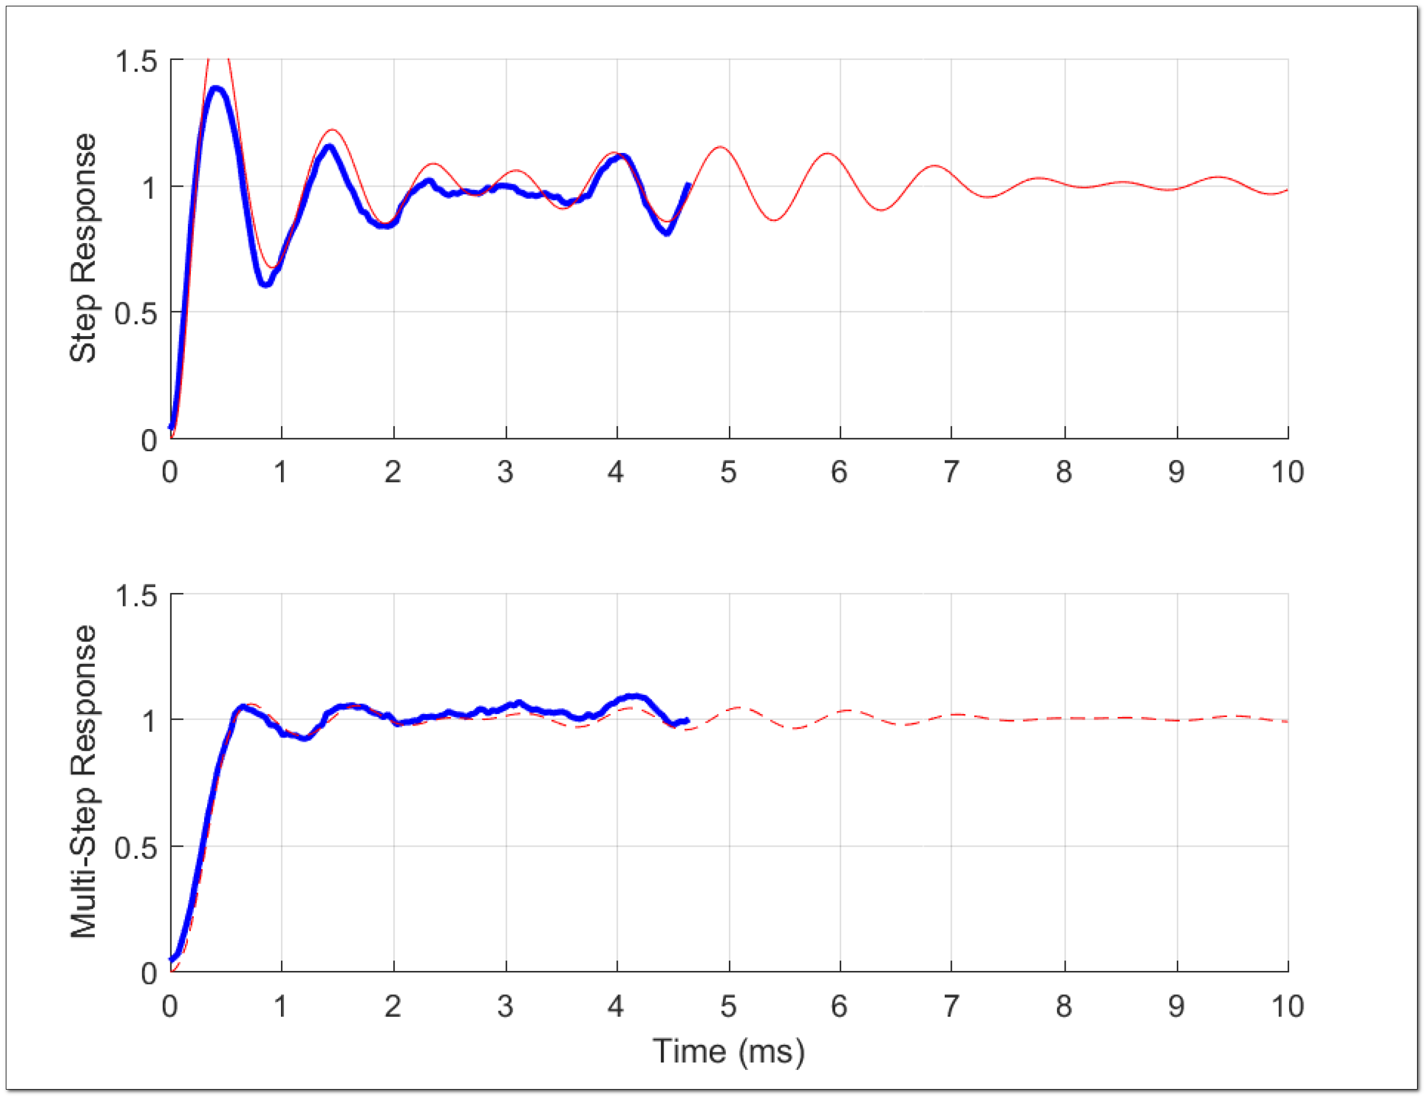
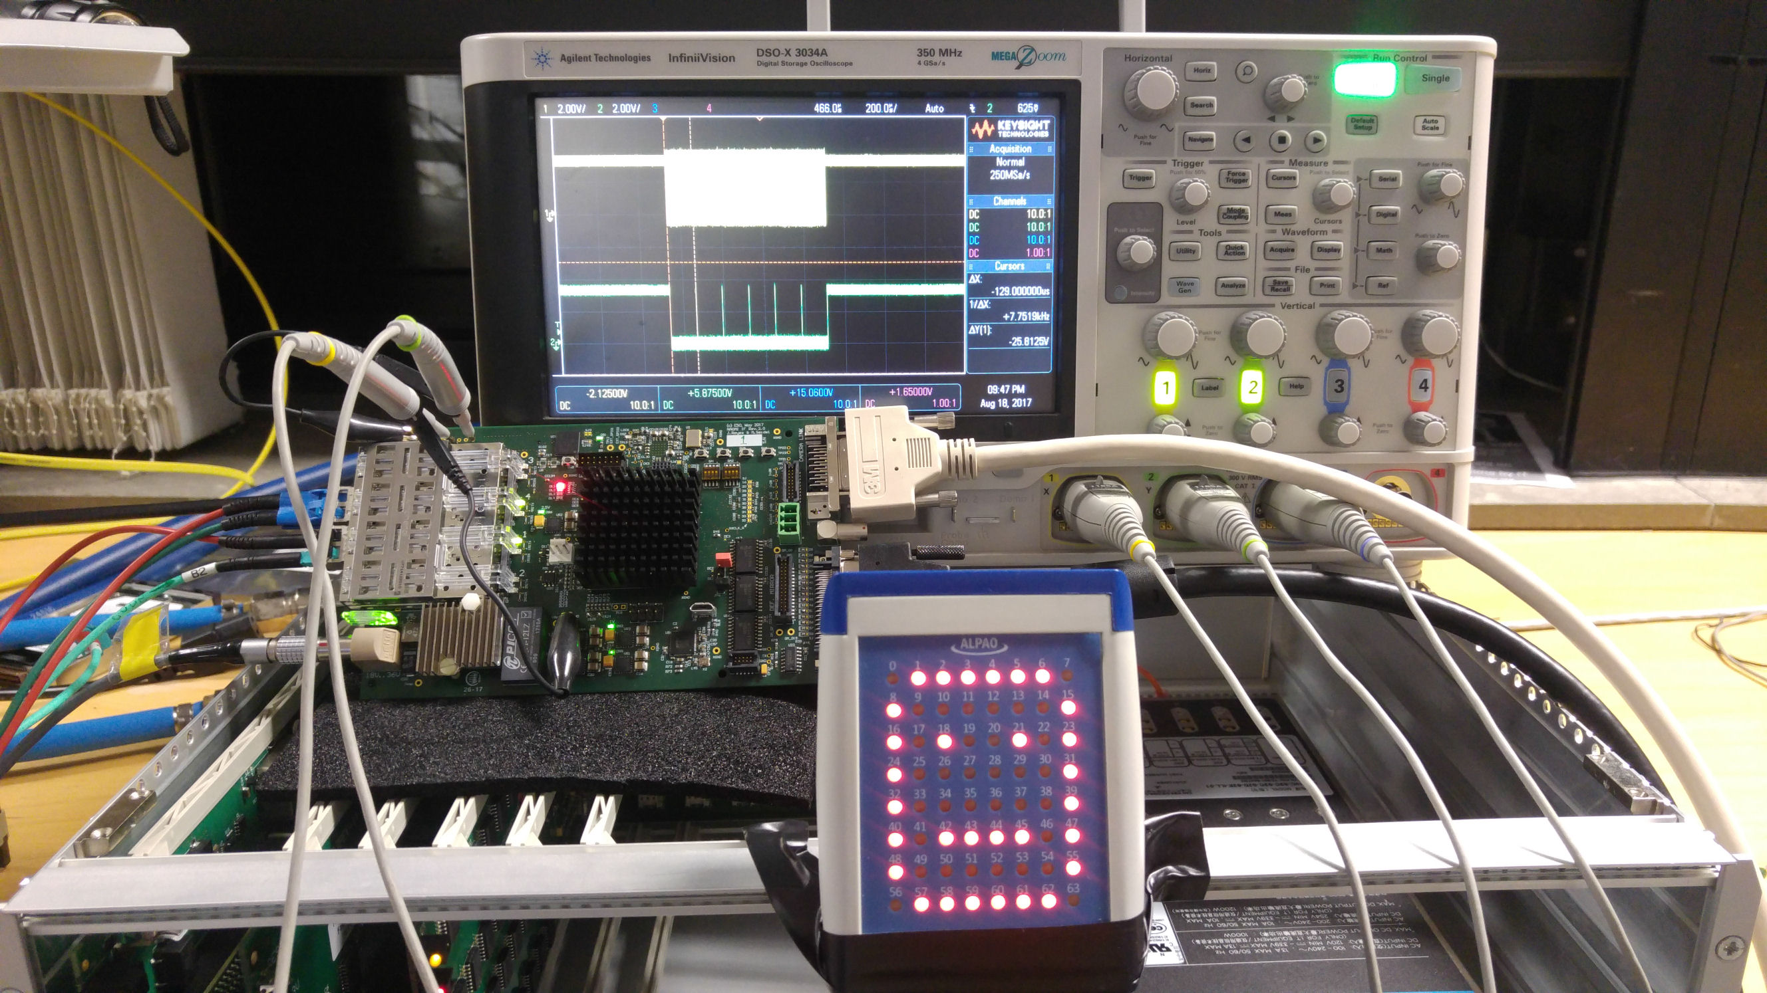
ESO ELT AOWFS cameras
Scientific Detector Conference 2017
NGSD controller
NAOMI RTC and deformable mirror interface
Switching-mode Power Supply for Scientific Detectors

Slide 3
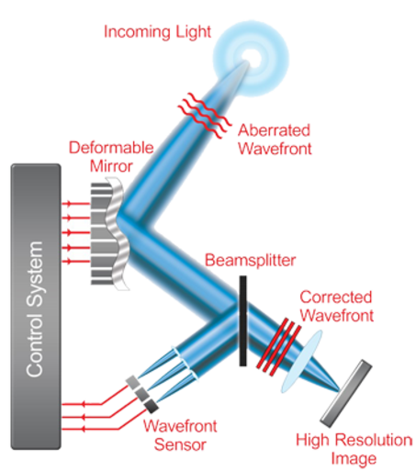
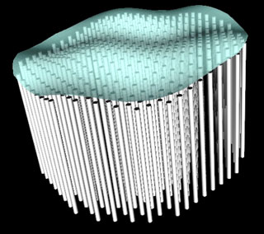
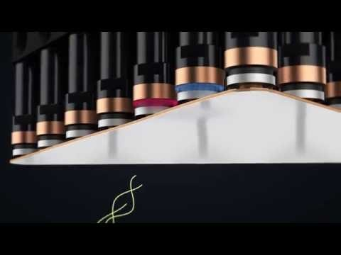
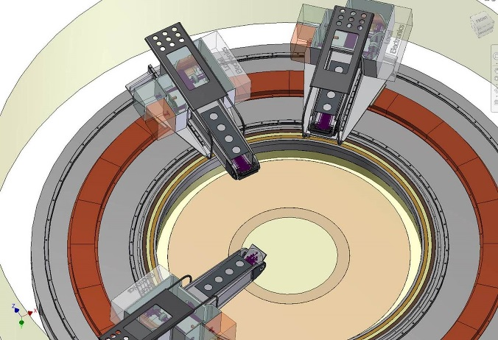
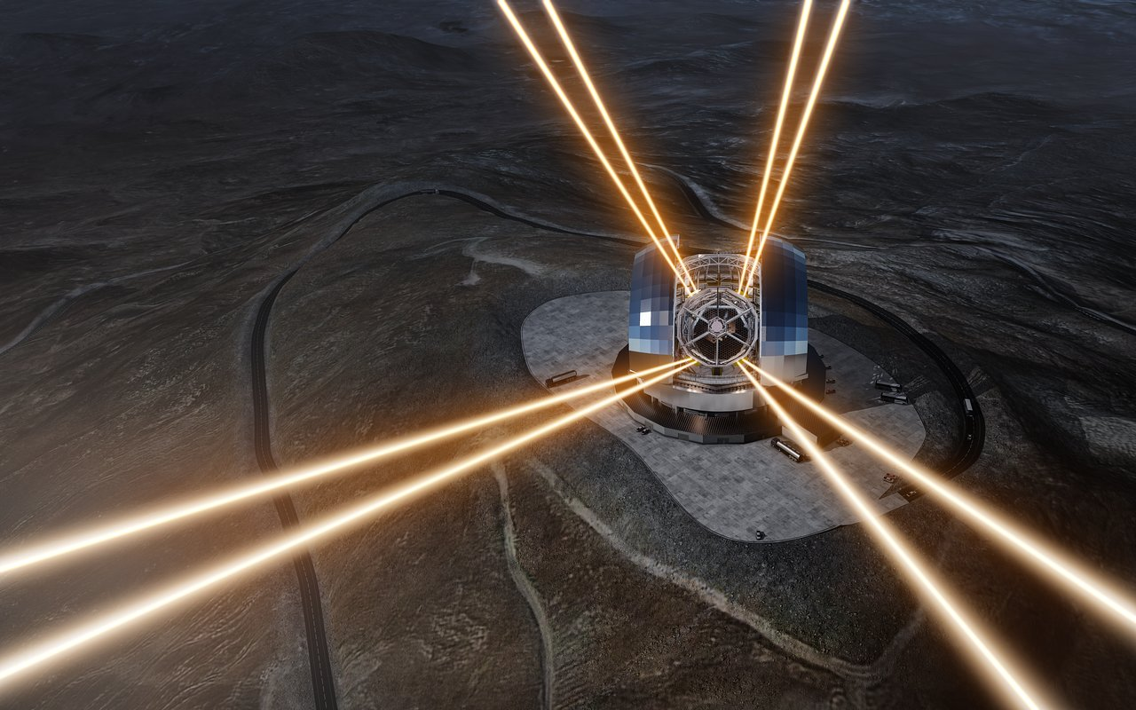
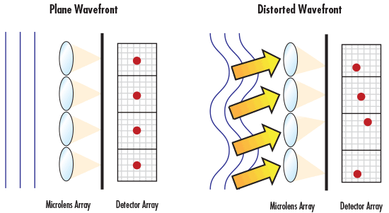
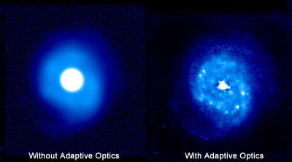
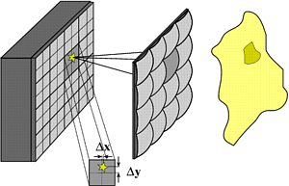
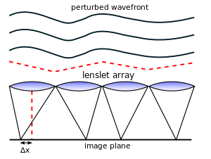
Adaptive Optics Cameras
Why Adaptive Optics?
Deformable mirror compensates the distorted wavefront, achieving diffraction-limited resolution
Incoming light
1
Deformable Mirror
Aberrated wavefront
Wavefront Sensor measures deviation of wavefront from a flat (undistorted) wave
Beamsplitter
3
Corrected
wavefront
Example: ESO Prefocal Station
3 x AO cameras Large Visible
3 x EMCCD cameras
Control System
Real-time Computer
ESO ELT Laser Guide Stars
2
Wavefront
Sensor
Camera
High Resolution
Image
Notes:
The three main components of an AO system are deformable mirror, the RTC and the Wavefront sensor cameras
This a very generic slide about AO to impress upon the idea that ELT requires AO to achieve diffraction limited performance

Slide 4
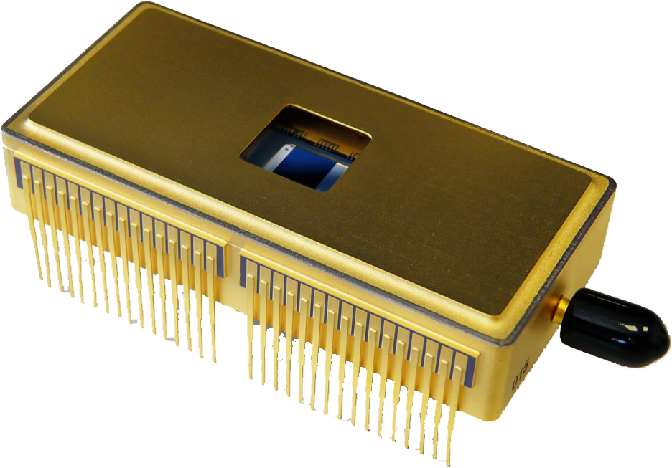
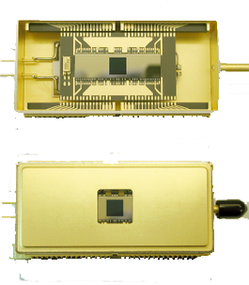
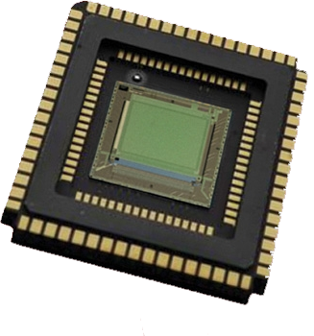
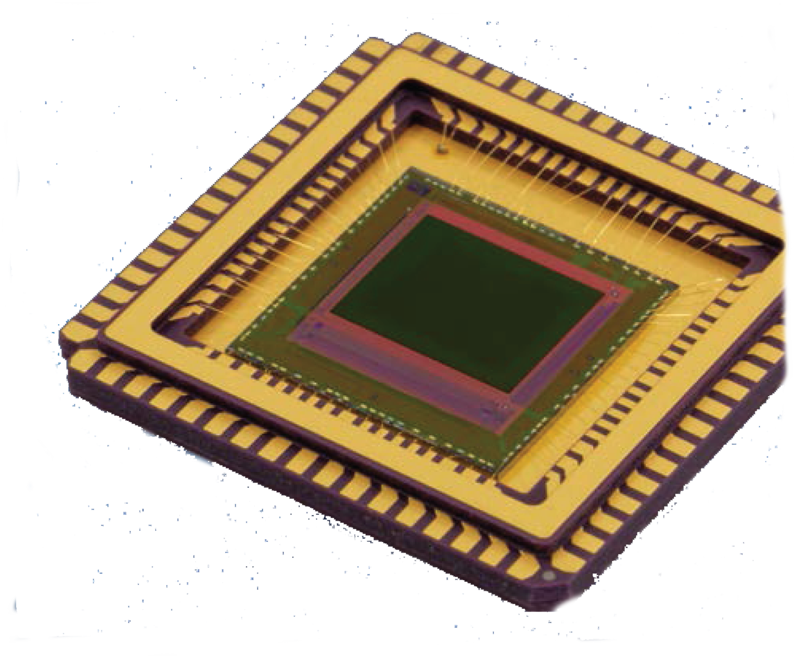
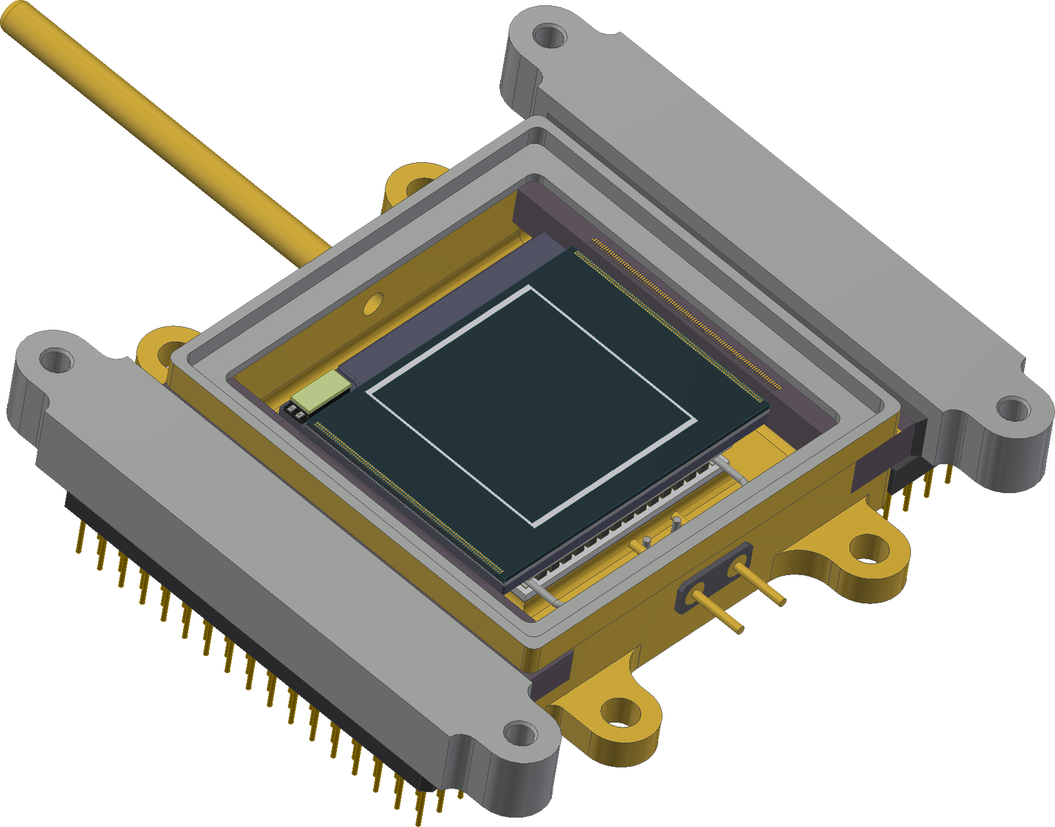
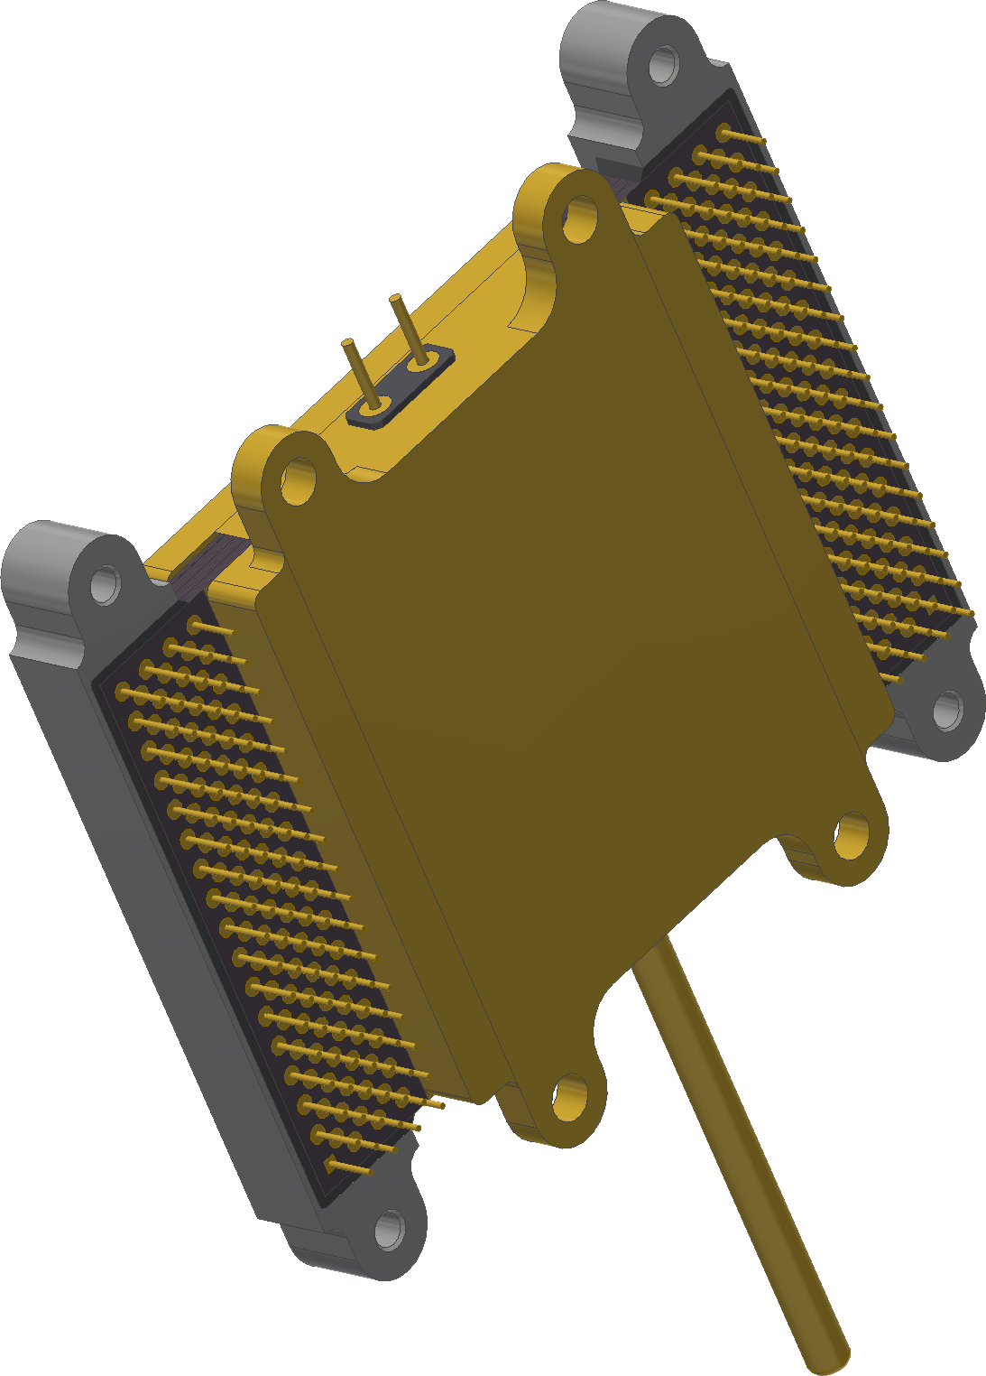
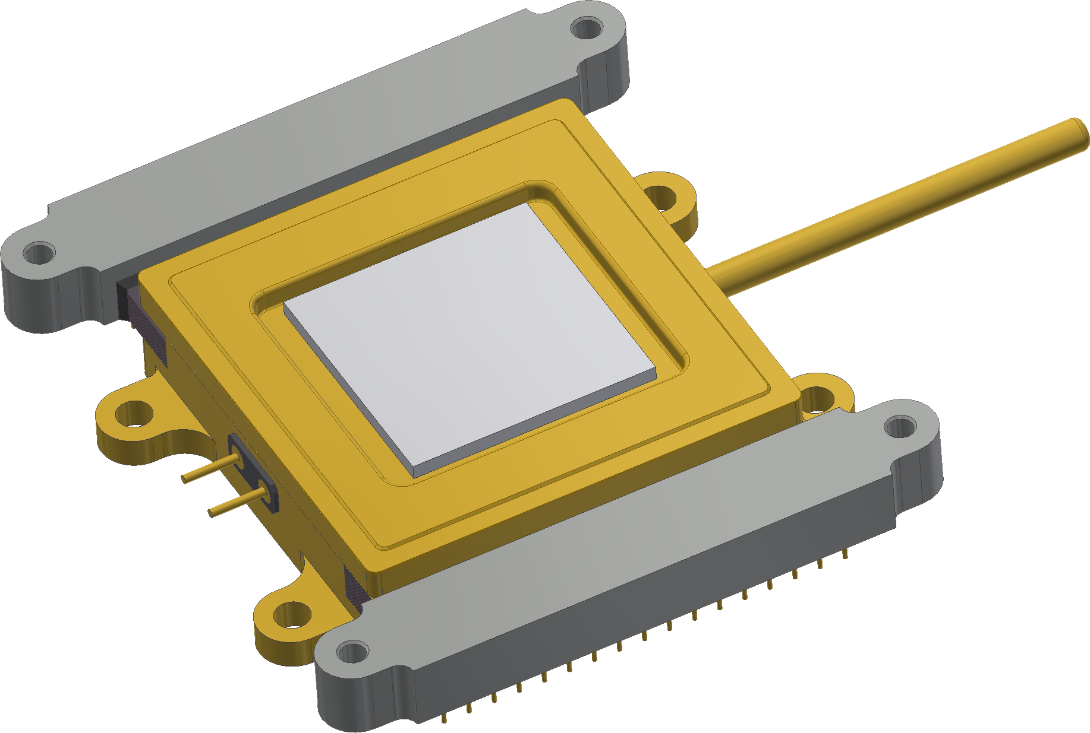
ESO ELT requirements
Vis CCD220???
x 9
NIR SAPHIRA
x 6
MICADO-SCAO
METIS-SCAO
HARMONI
SCAO
MAORY
HARMONI-LTAO
METIS-LTAO
PFS
Large CMOS Vis Imager
x 23
LVSM
Notes:
To the best to our knowledge these are the type of detector and cameras we need for the ELT
As you can see the amount of cameras and the diversity of detector is enormous
Big challenge
The rest of my presentation is about the current development of these three cameras

Slide 5
ELT AO WFS cameras
ALICE: CCD220
240 x 240 pixel image area
EMCCD
24μm square pixels
Sub-electron read-out noise
Back-illuminated (SS and DD)
Frame rates beyond 1000 fps (1kHz nominal)
L3Vision™
8 video outputs
Integral Compact Peltier package
x9
LISA: LVSM
Large size CMOS
800x800, 24µm pixels
Up to 700 fps
< 3 e- RON
Highly integrated readout
All analog processing on-chip:
Adjustable gain of x1/2/4/8 settable on the fly,
9/10 bit single slope ADCs,
24 LVDS outputs, 256 Mb/s per output (DDR2)
x23
FREDA: Saphira
HgCdTe 320 x 256 pixels
Avalanche photodiode (APD)
0.8 to 2.5μm range
32 outputs
<1 photon RMS with Fowler sampling
>10K frame/s
x6
Notes:
This is the summary of the cameras we have to design and produce
This illustrates the great variety and the very challenging times ahead

Slide 6
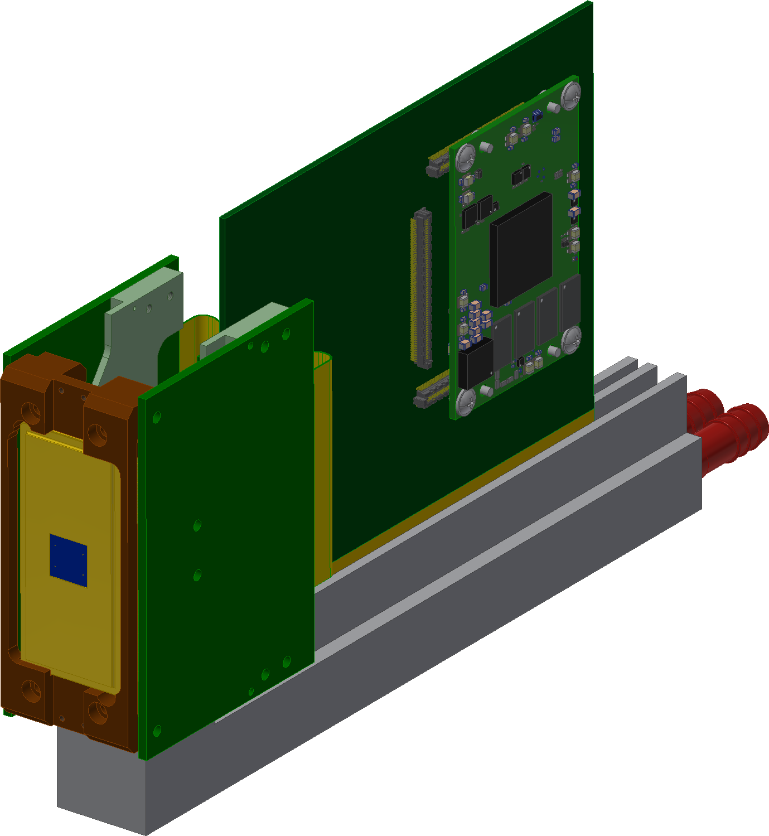
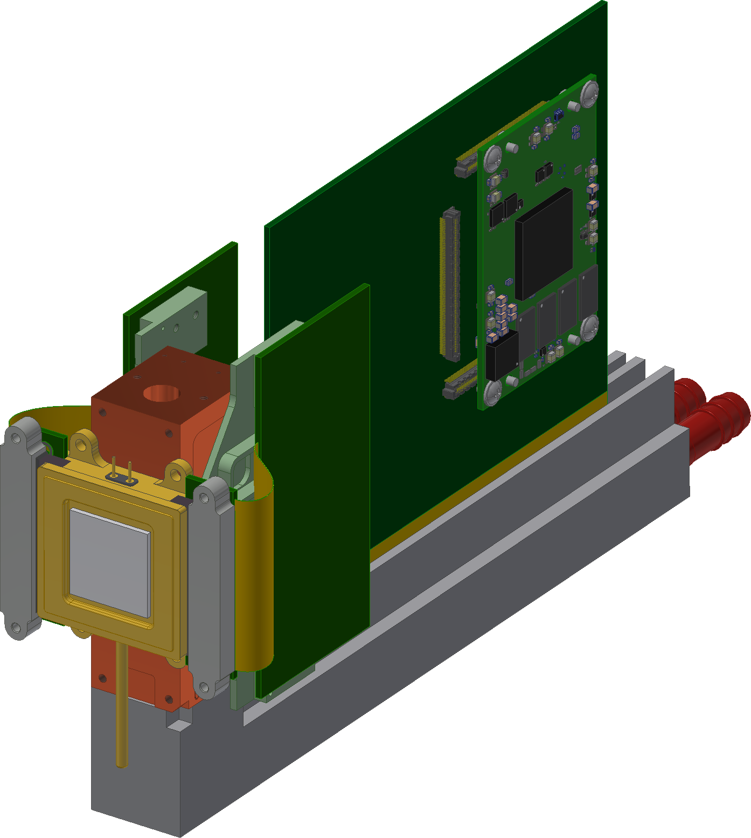
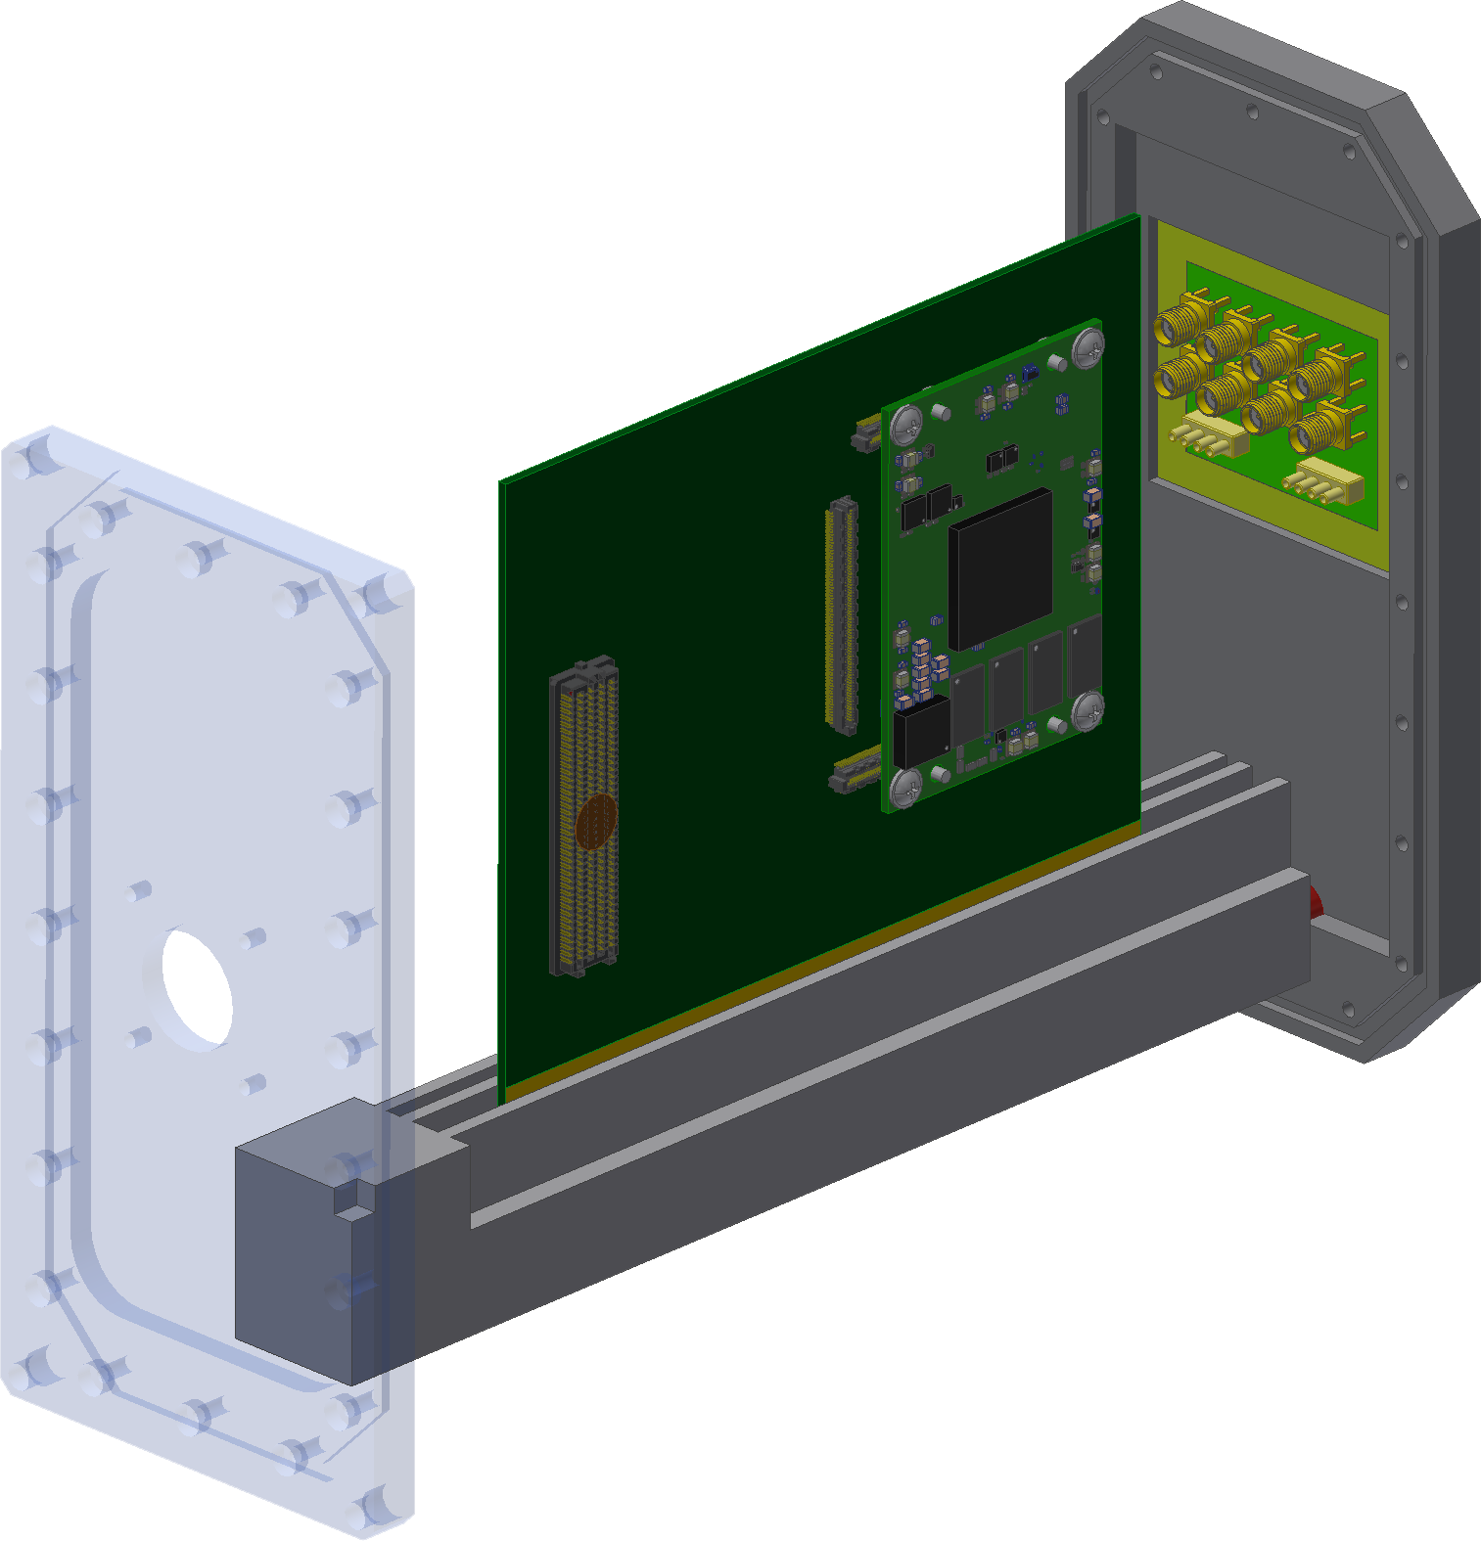
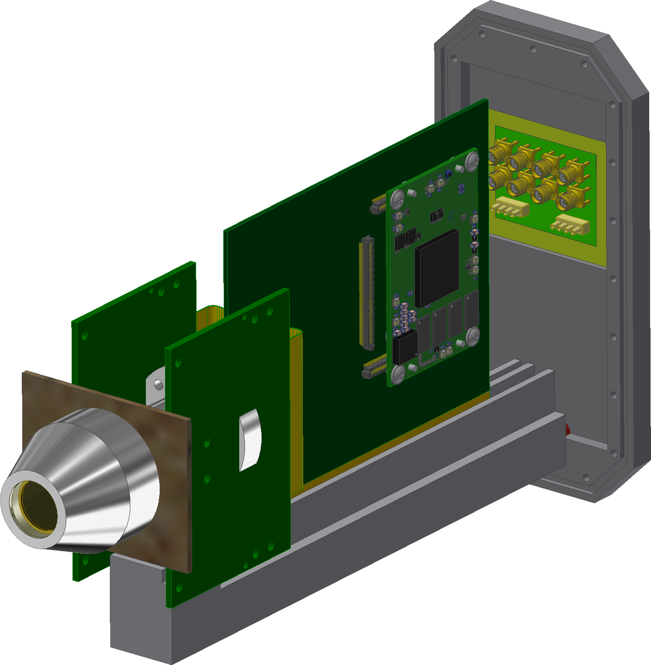
Three very different detectors
ELT AO WFS cameras SYNERGIES
… but not necessarily three very different cameras
ALICE
Camera backbone: detector independent
LISA
Common IF
Main Board
FPGA COTS
IF connector
FREDA
Notes:
Three very different detectors
BUT, not very different cameras
The way to achieve this is by exploring the Synergies and commonalities
Camera backbone detector independent

Slide 7
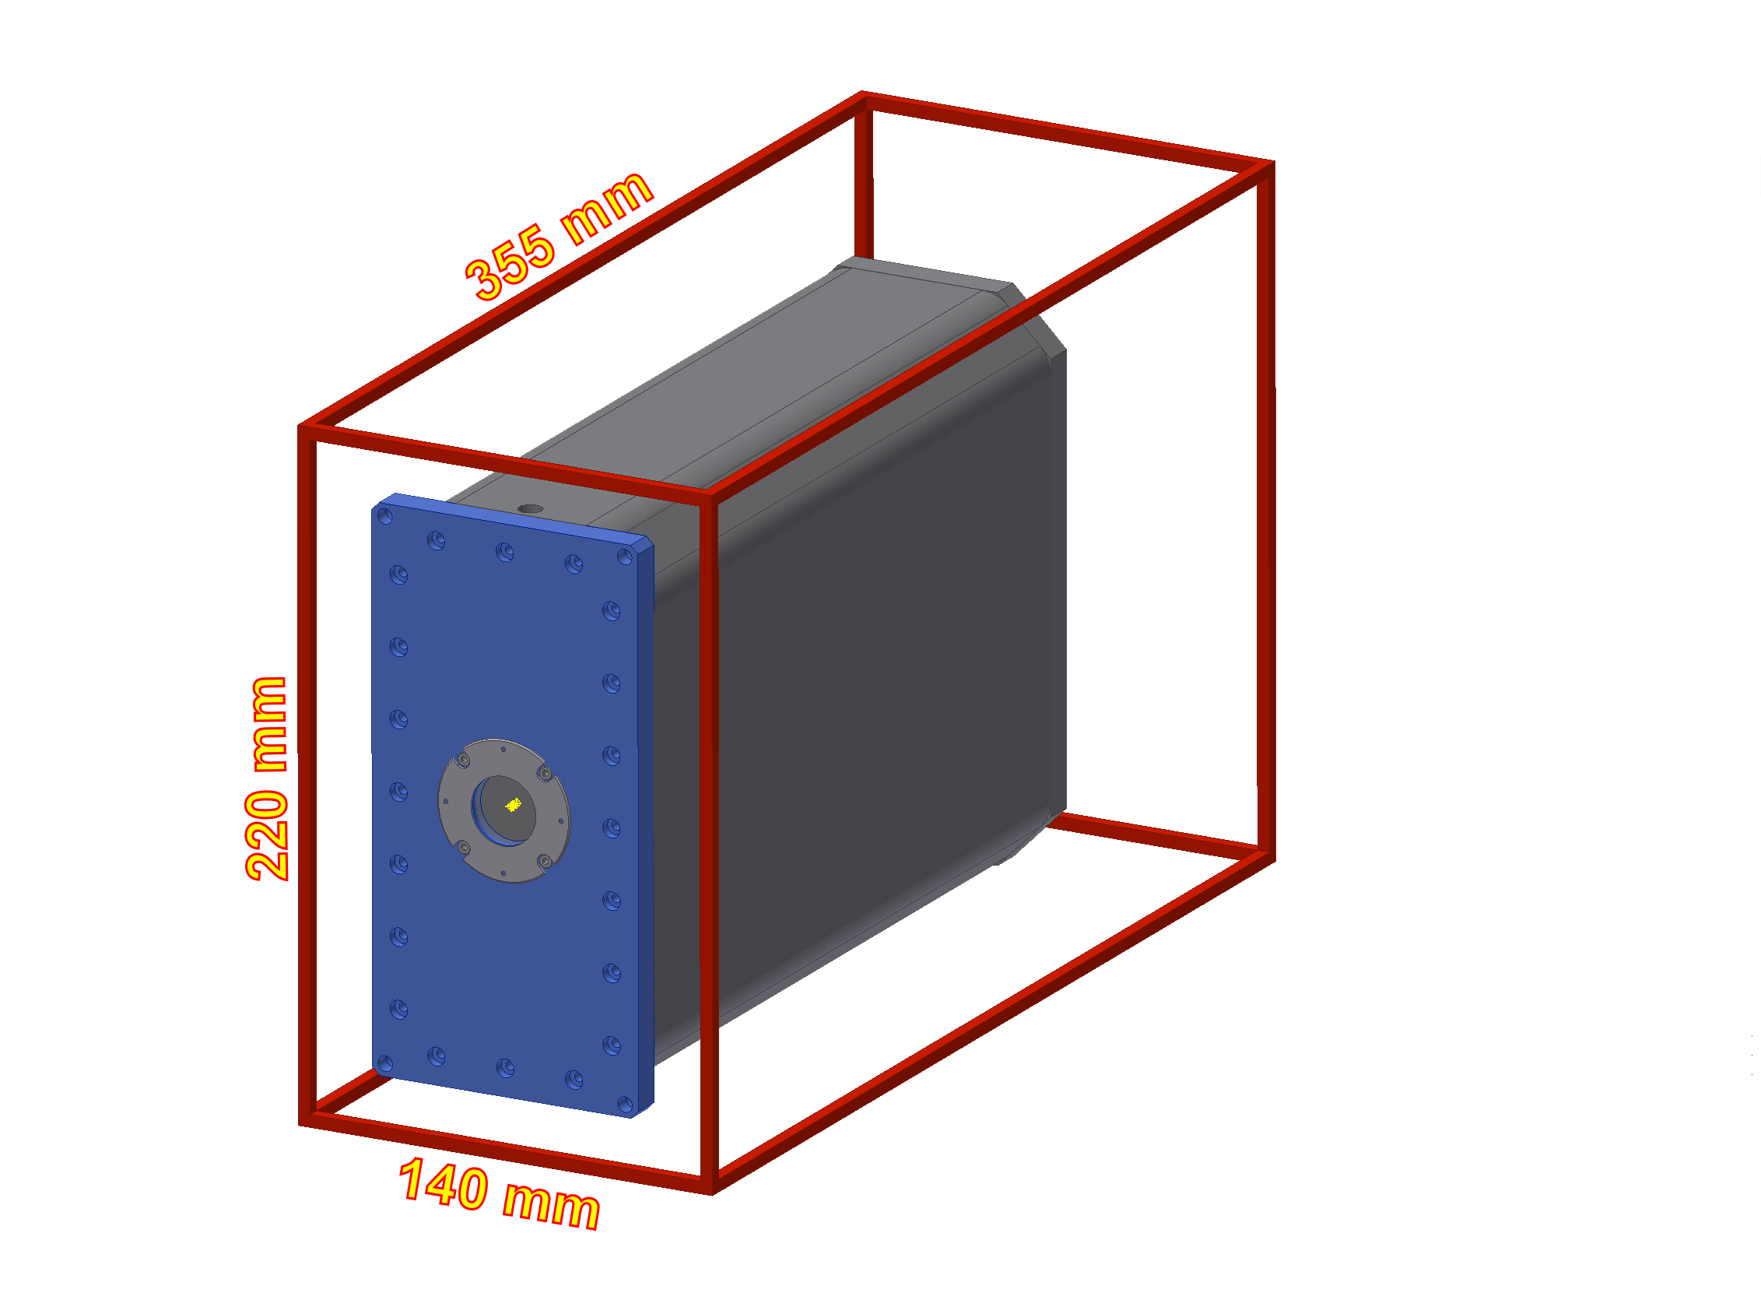
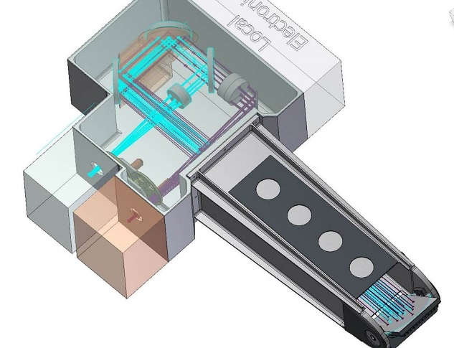
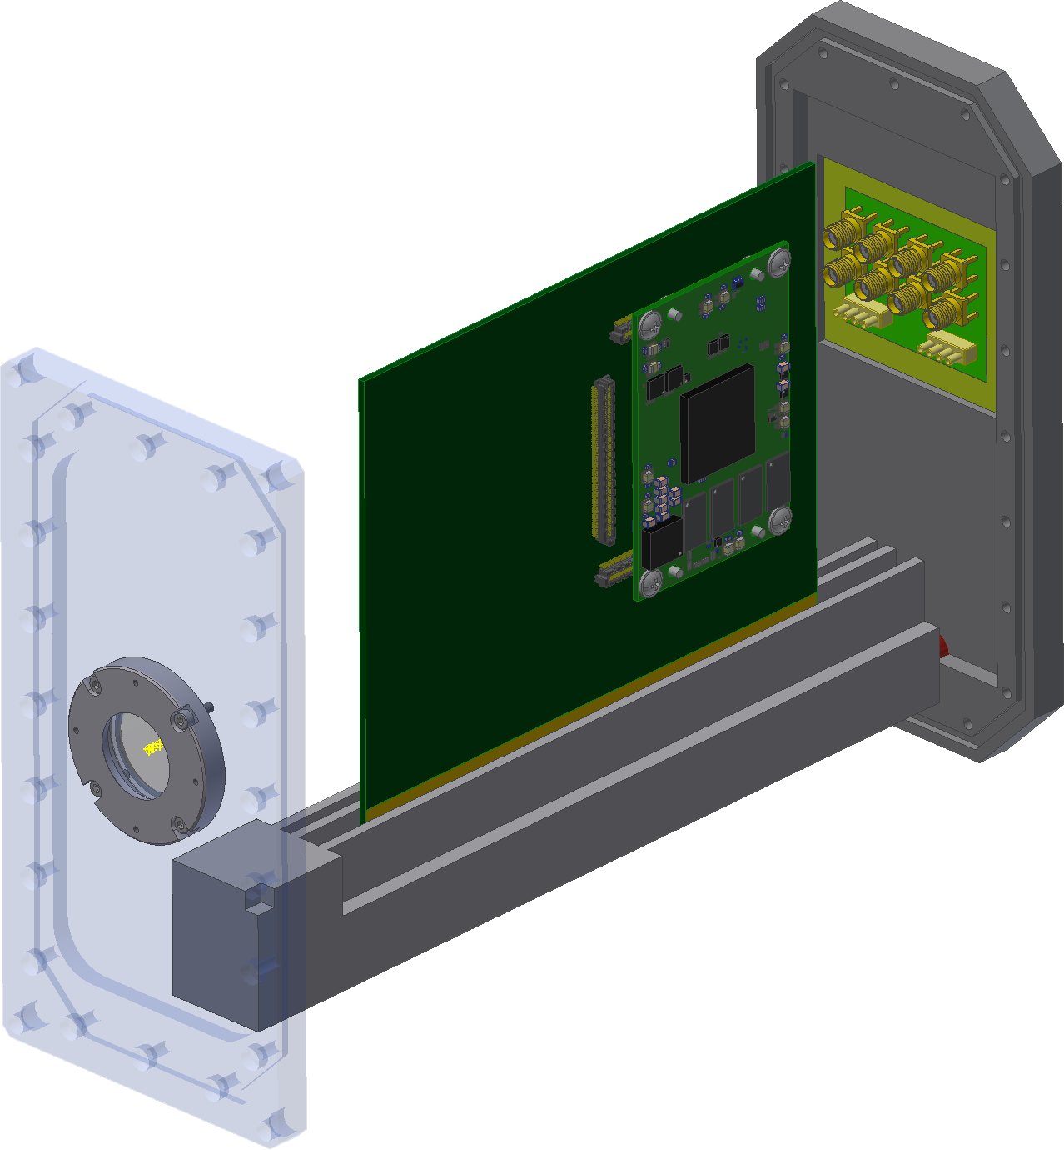
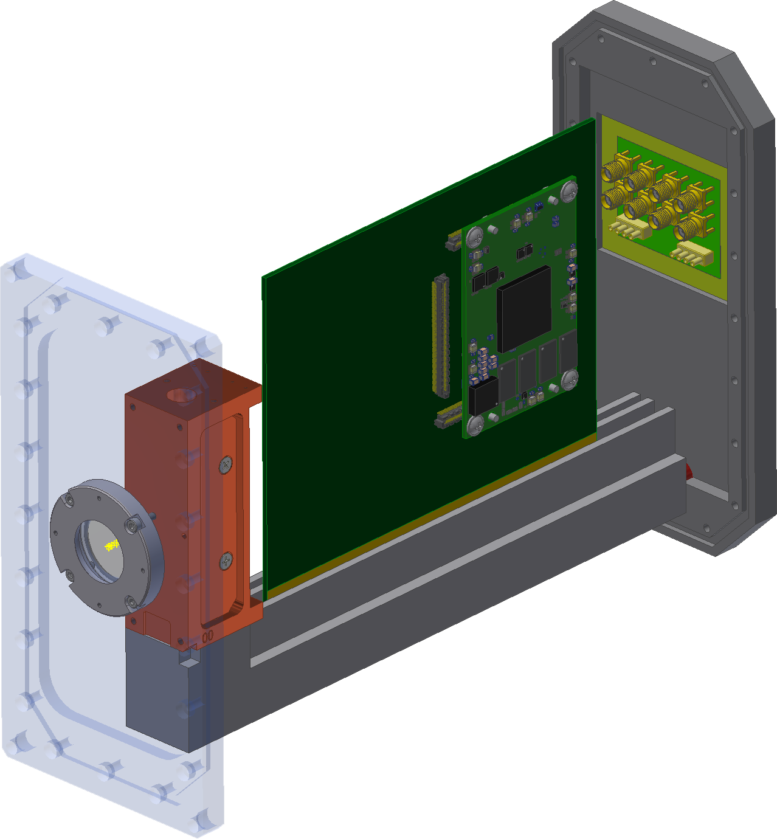
Volume of 220 x 140 x 355 mm
VOLUME ENVELOPE FOR THE AO CAMERAS
Current ESO AOWFS camera CCD220
Example: ESO Pre-focal Station
3 x AO cameras Large Visible
3 x CCD220 cameras
Notes:
VOLUME ENVOLOPE FOR THE AO CAMERAS
The volume allocated is slightly larger than what we currently have
We are confident that we can take advantage of the synergy…
FROM THAT POINT ON I AM GOING TO TALK ABOUT EVERY INDIVIDUAL CAMERA

Slide 8
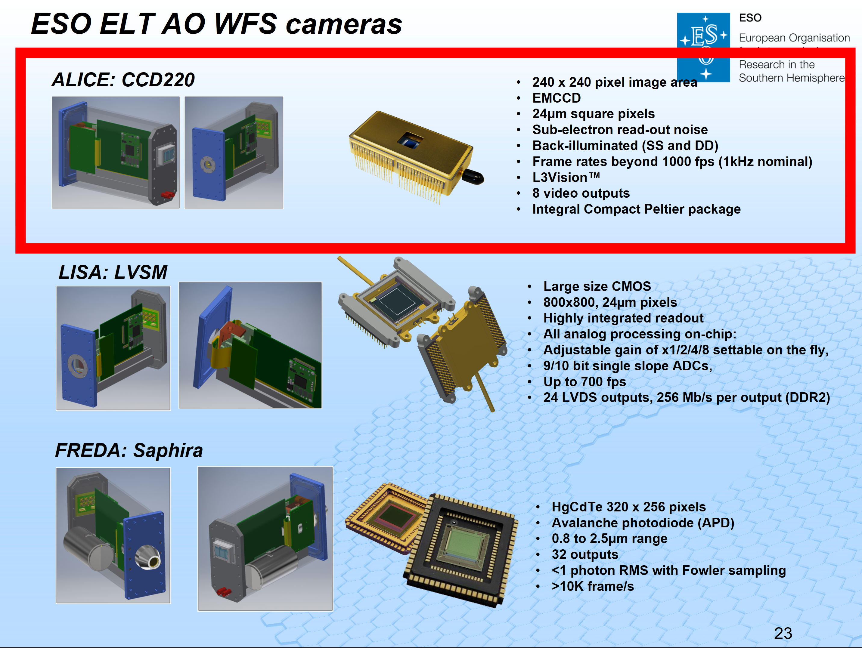
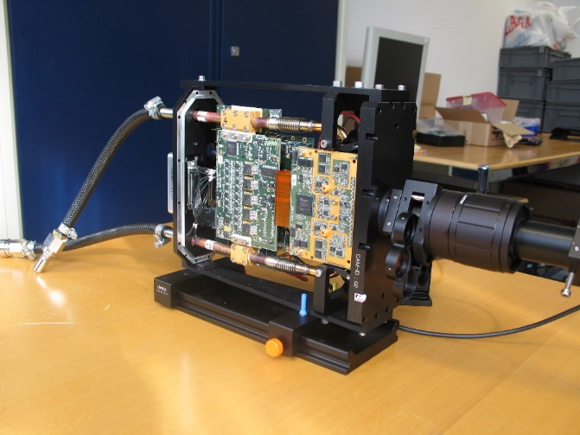
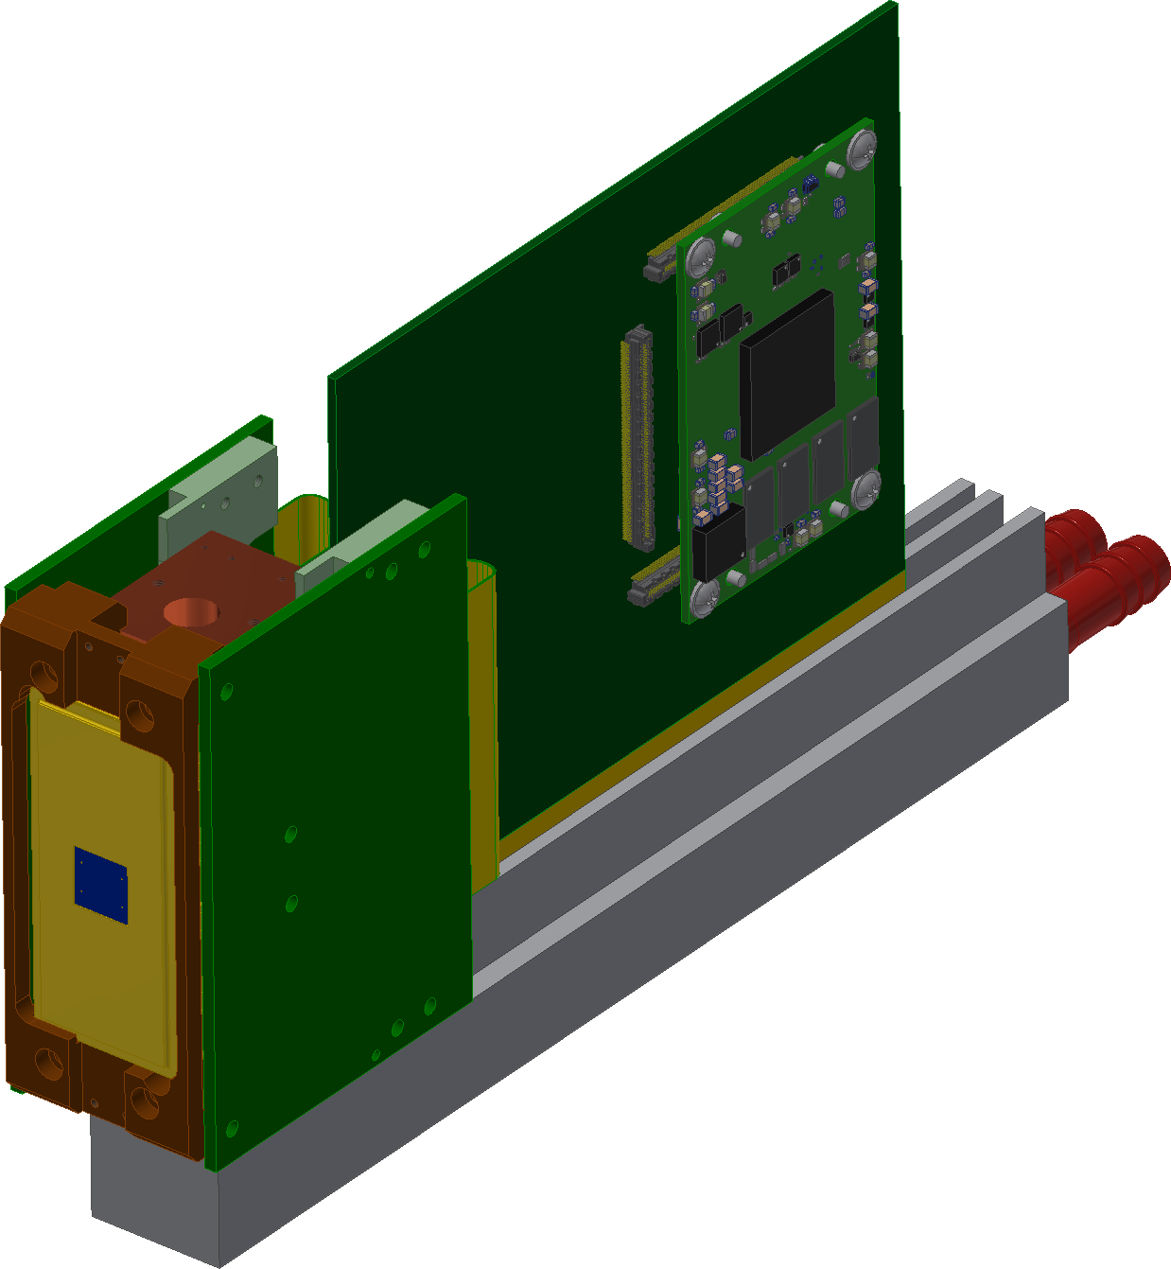
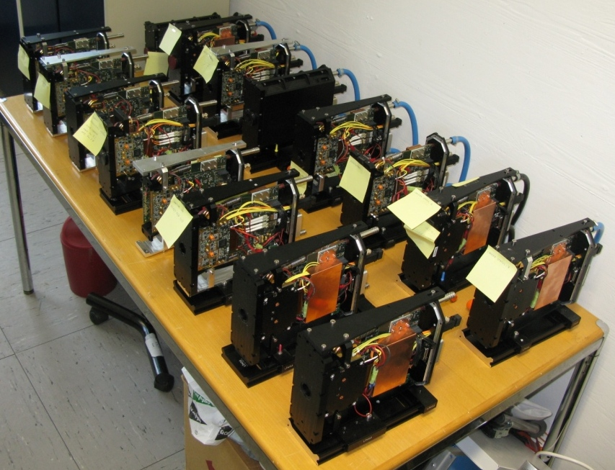
ALICE: AONGC UPGRADE
AONGC: The ESO standard AO camera
Teledyne-e2v CCD220 EMCCD
UPGRADE
AONGC AOWFS cameras mass
produced for the VLT
Notes:
ESO AONGC CCD220 is a very successful camera
In the case of ALICE we are after an upgrade of the current ESO AOWFS camera called AONGC
To which we include the new ESO ELT interfaces

Slide 9
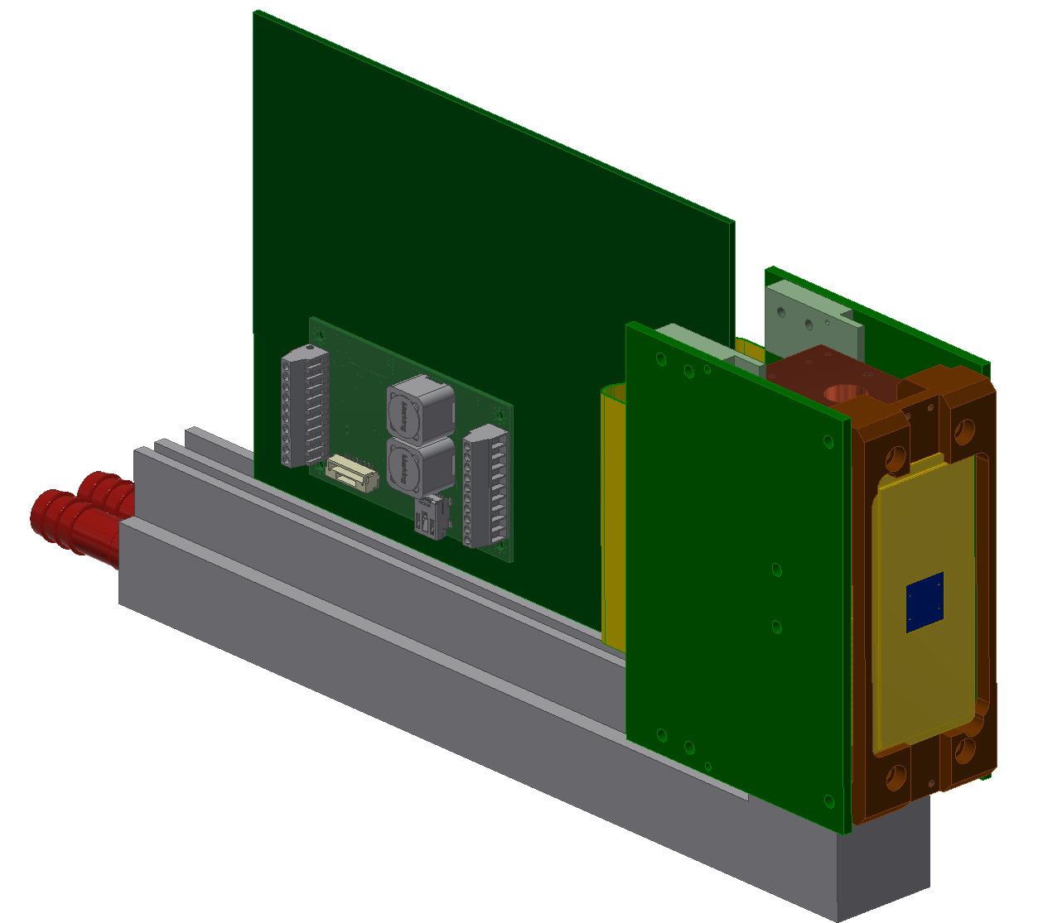
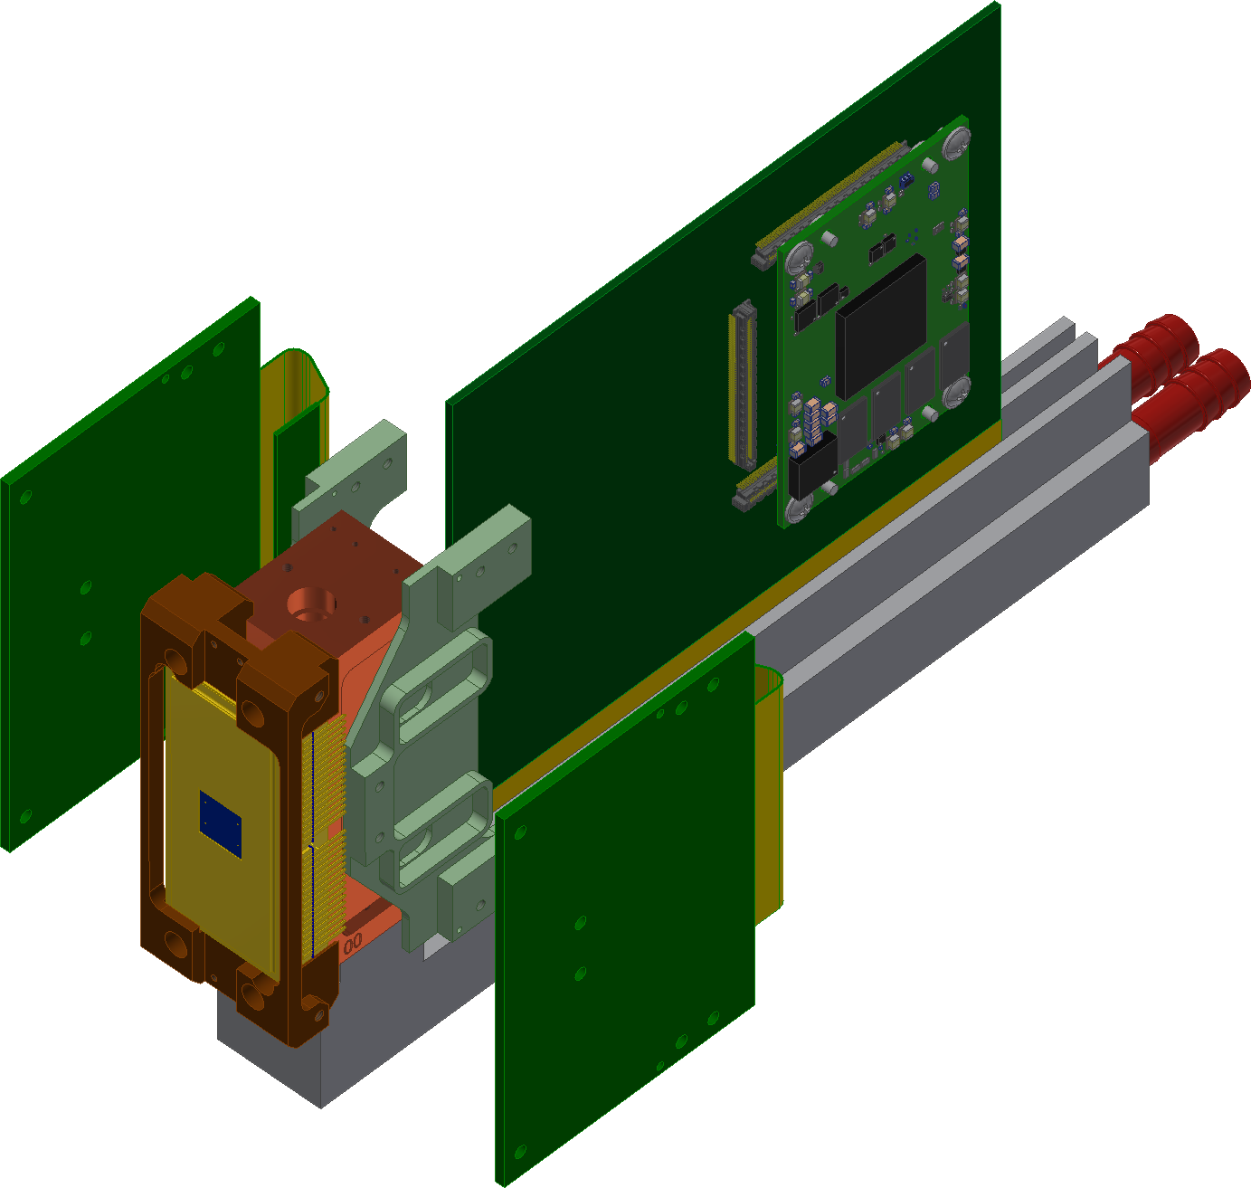
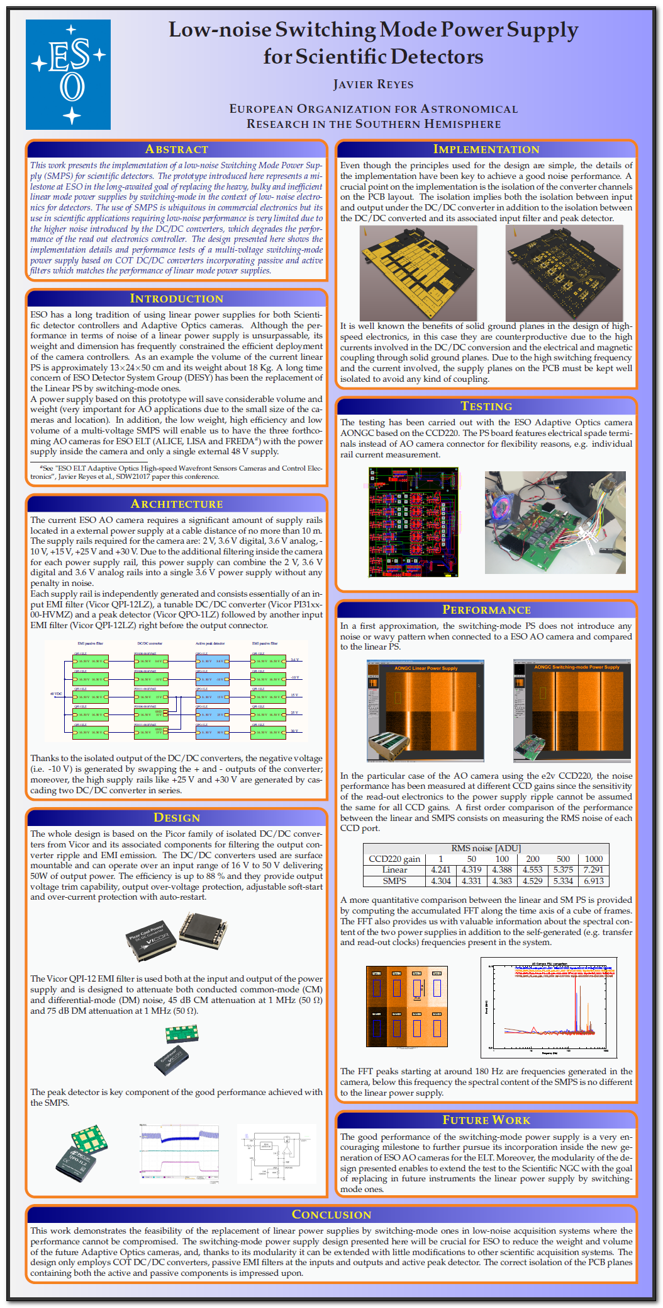
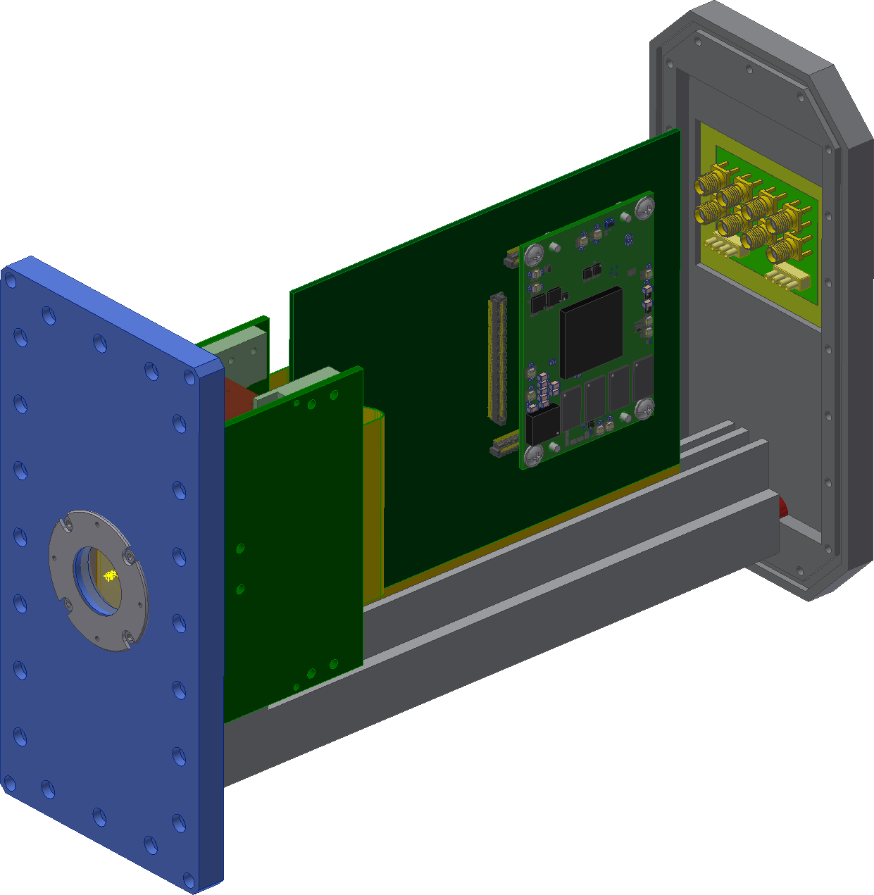
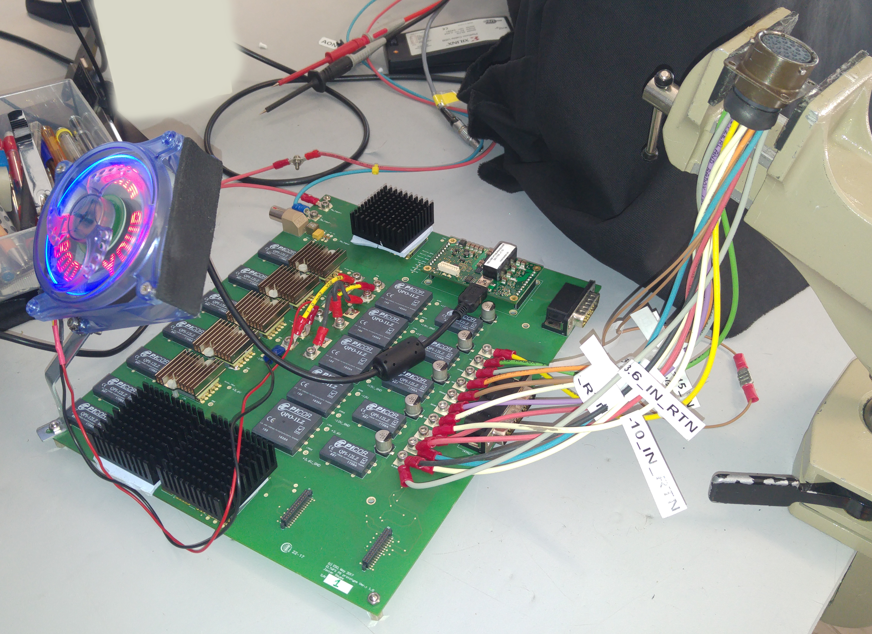
ALICE an AONGC IMPROVED CAMERA
Improved mechanics, simpler, less parts
ELT Interfaces: 10 GbE, PTP
Integrated Peltier
Single FPGA
Integrated power supply: 48 VDC input supply
COT Peltier controller
Switching-mode PS poster
Teledyne-e2v CCD220 EMCCD
Notes:
WHAT WE WANT TO HAVE IN ALICE CAMERA
AImproved mechanics
Improved mechanics, simpler
ELT Interfaces
Integrated Peltier
Single FPGA
Remote firmware programming
Integrated power supply

Slide 10
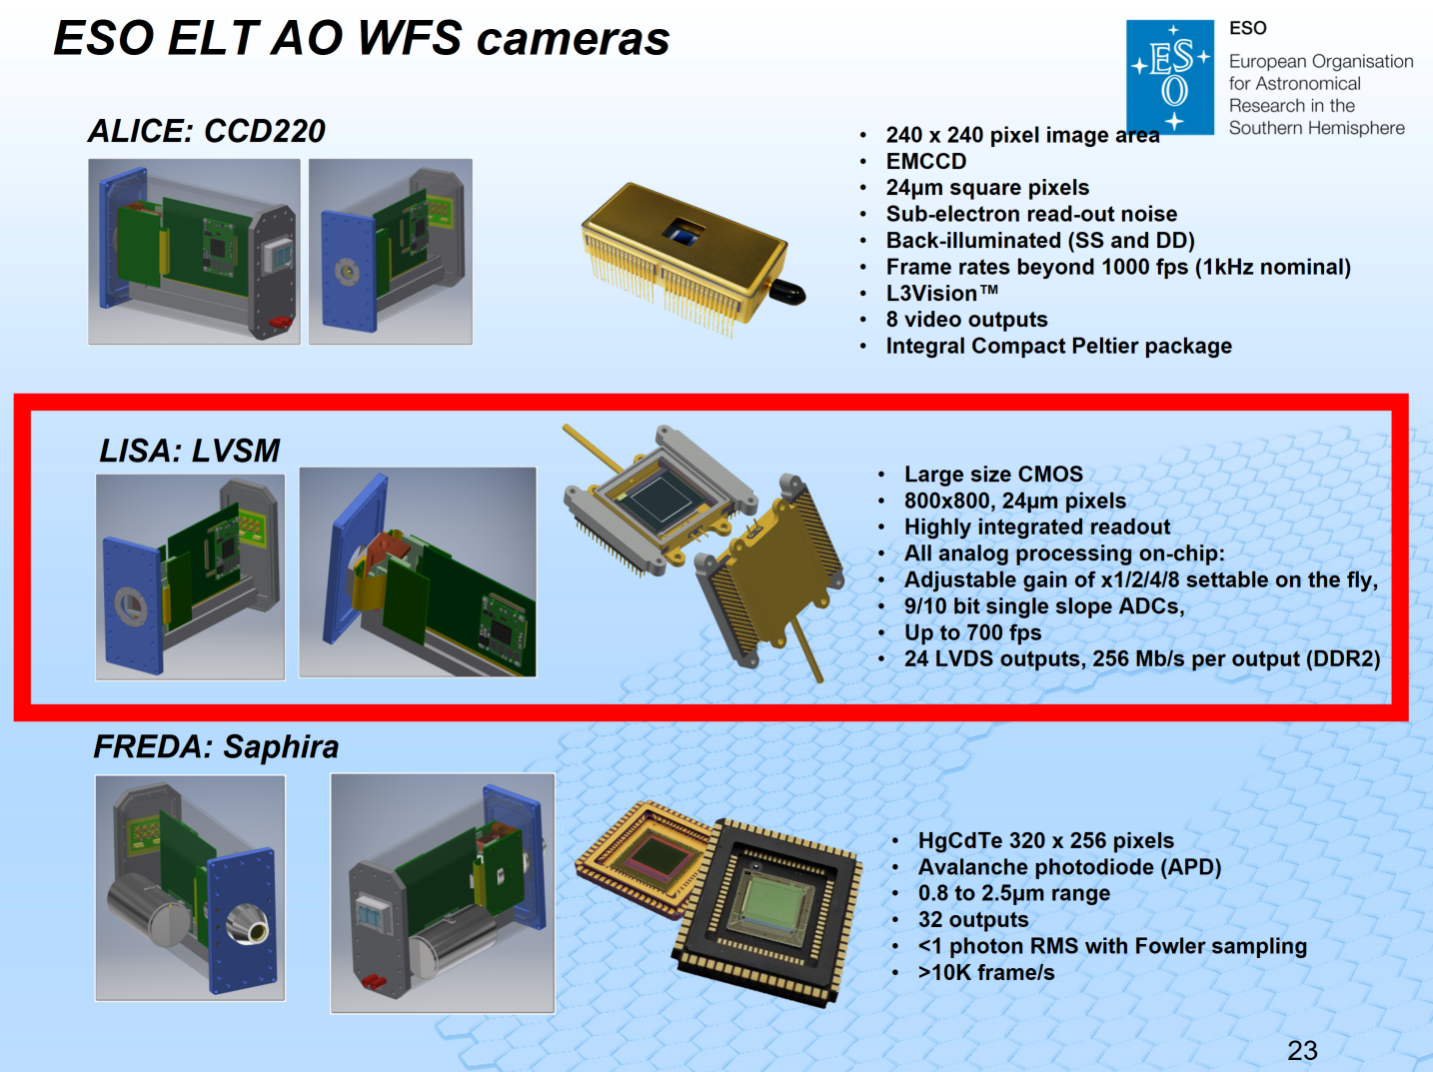
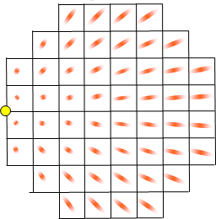
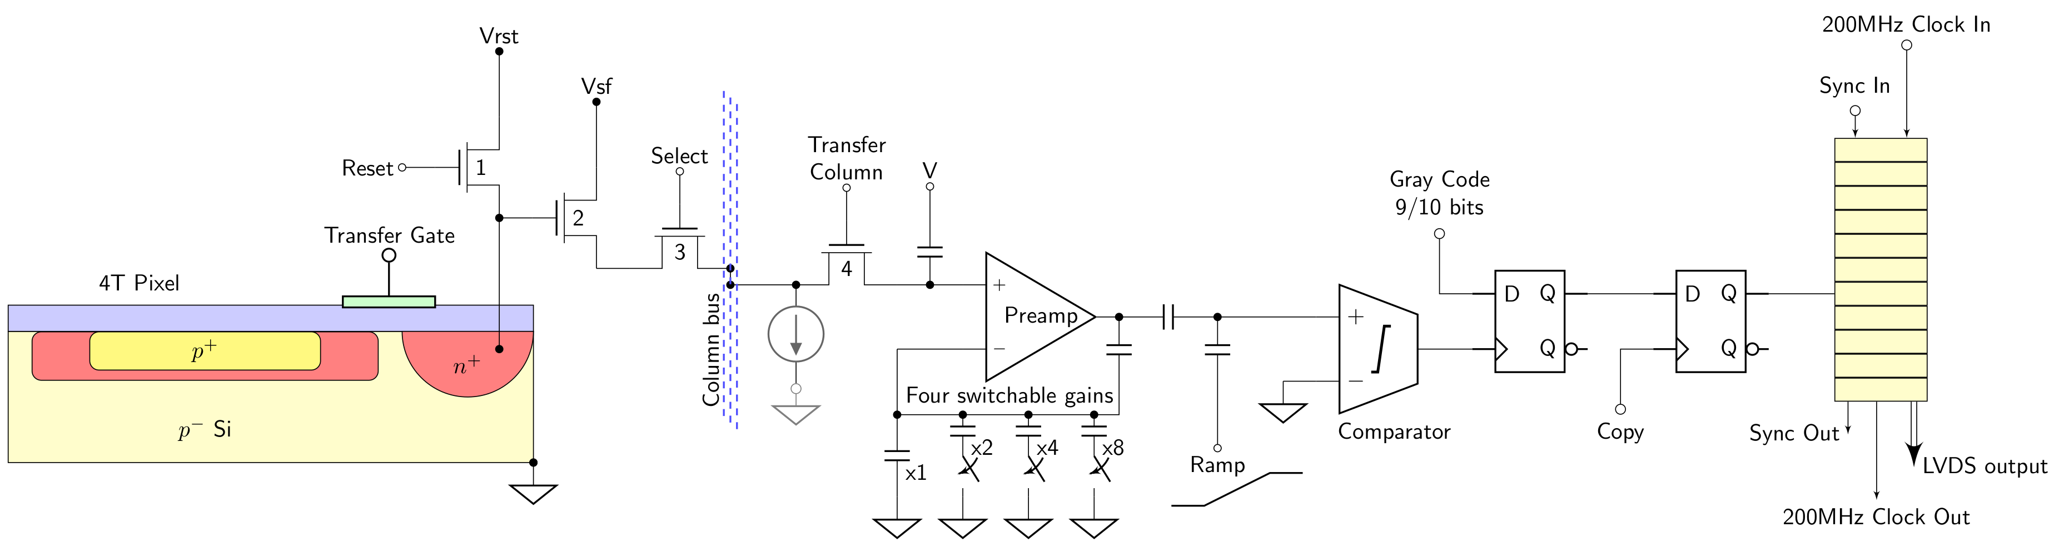
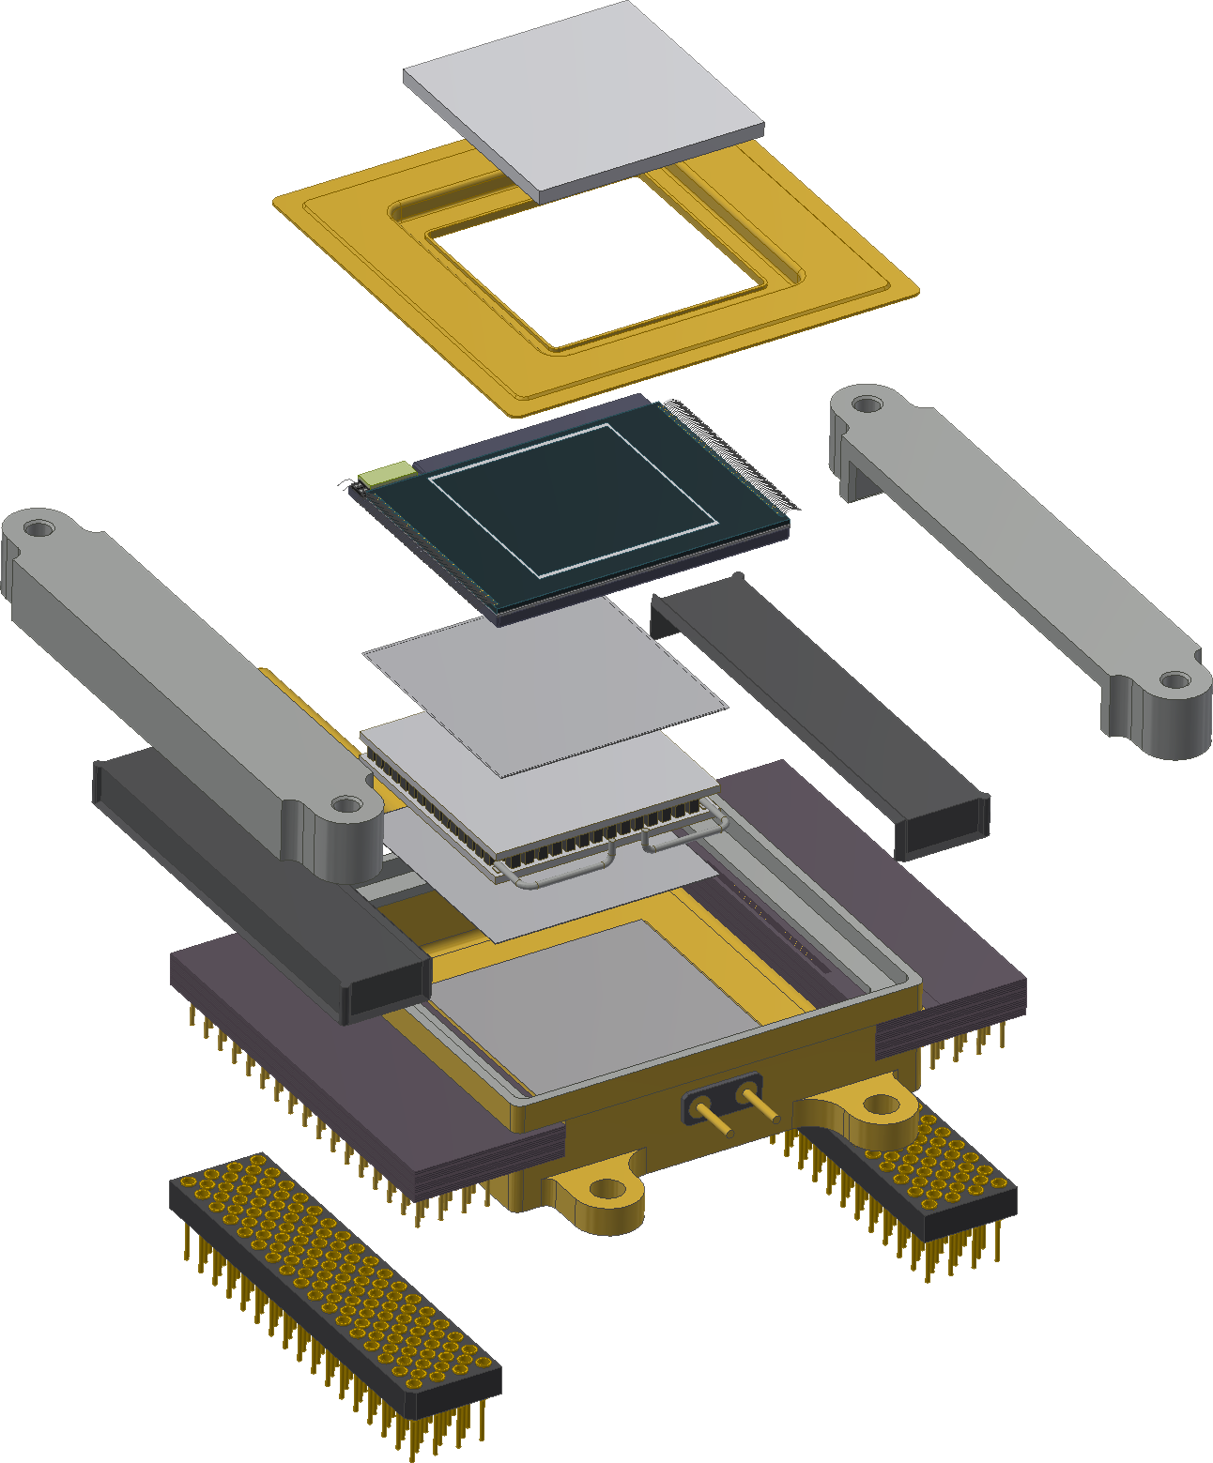
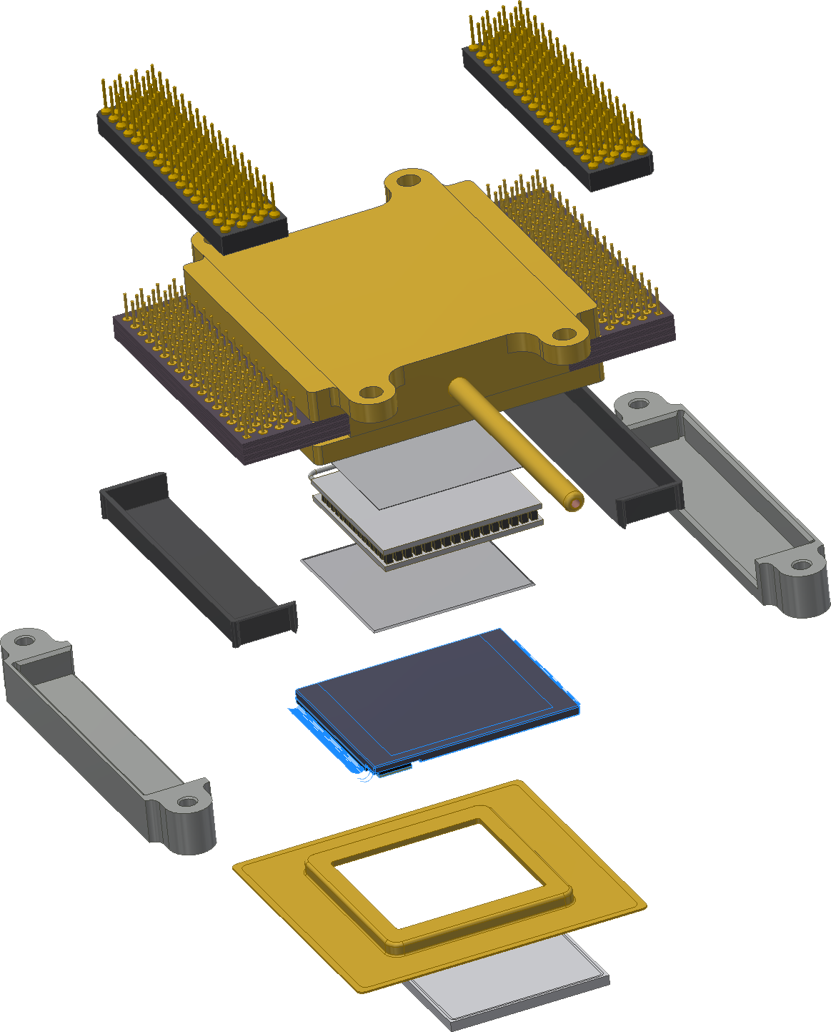
LISA: ESO AO CAMERA BASED ON LVSM
800x800, 24µm pixels
Up to 700 fps
< 3e- RON
Highly integrated readout
All analog processing on-chip:
Adjustable gain of x1/2/4/8 settable on the fly,
9/10 bit single slope ADCs,
24 LVDS outputs, 256 Mb/s per output (DDR2)
Teledyne-e2v LVSM
Under development
First chips end 2019/2020
Spot elongation
LVSM
M. Downing et al. yesterday’s talk
Notes:
Large CMOS imager needed to sample the spot elongation
Based on Teledyne-e2v LVSM presented yesterday
Electronics simplified because of digital output
Easy FPGA interface

Slide 11
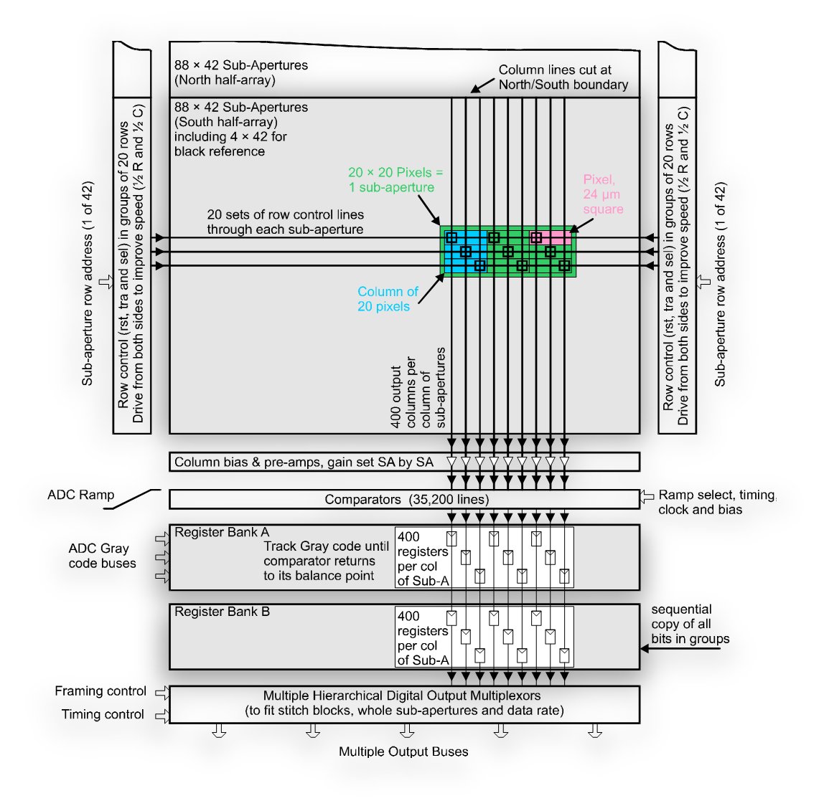
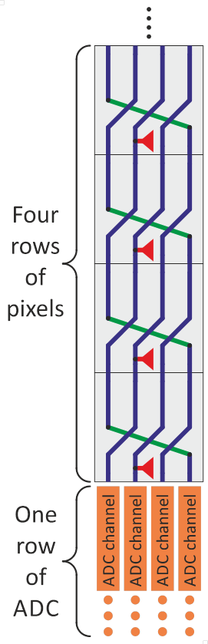
LISA: LVSM INTERFACE
LVSM similar architecture to NGSD but expected better performance
LVSM proposed connector
NGSD
LVSM
TOP: 116-pin
Bottom: 116-pin
Notes:
LVSM has similar architecture to NGSD
LVSM package with low-insertion PGA socket

Slide 12
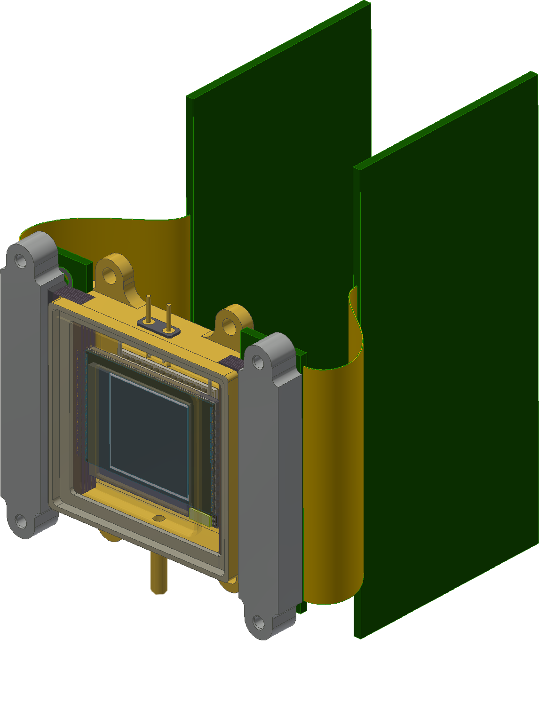
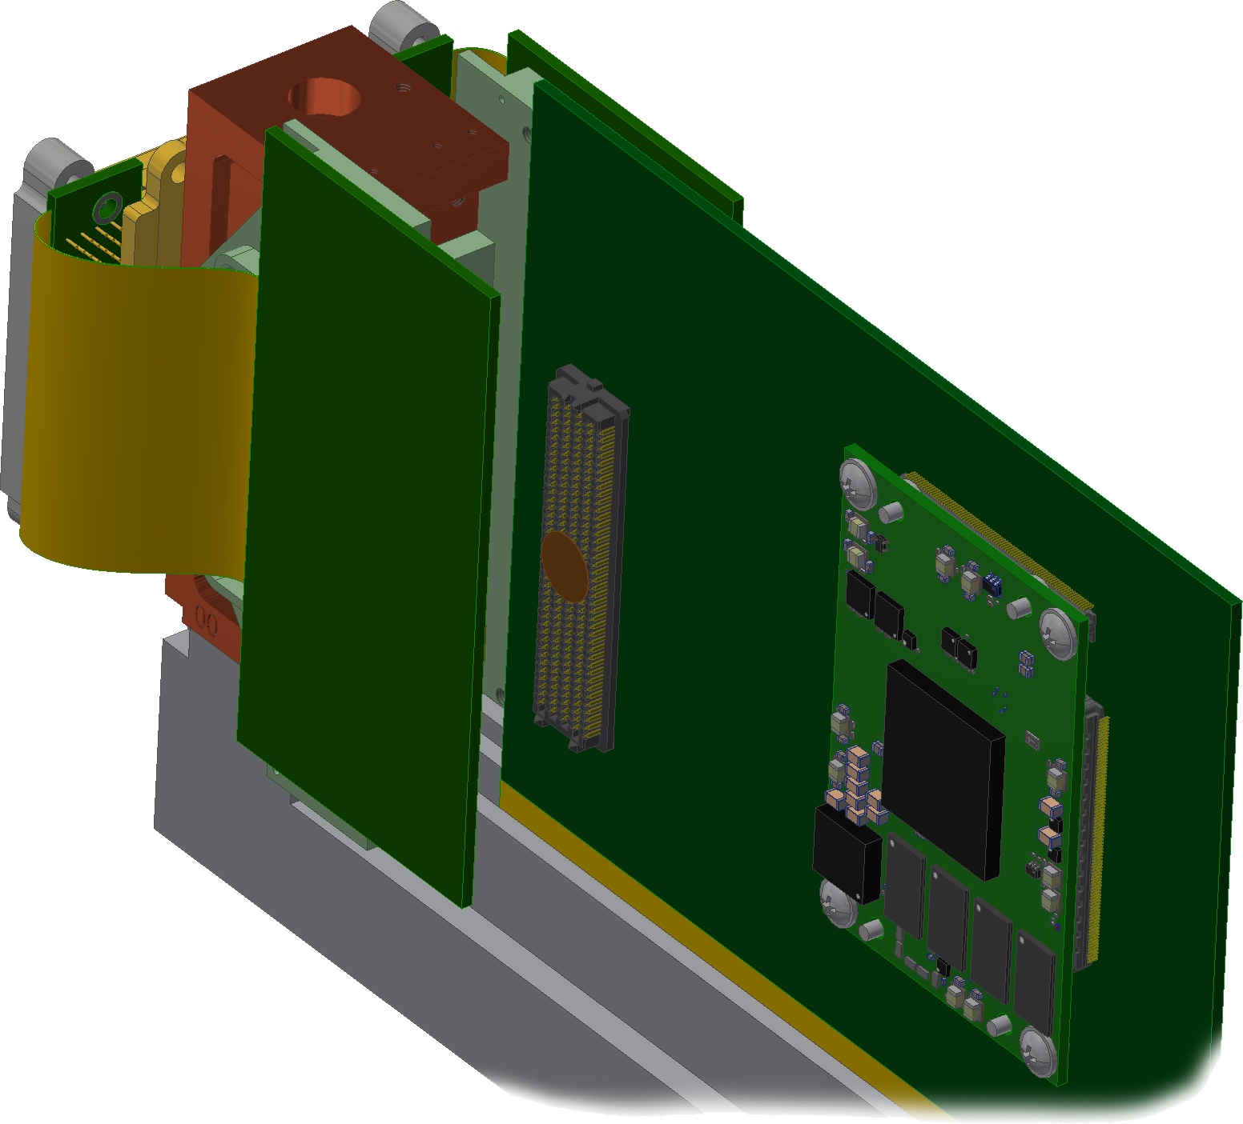
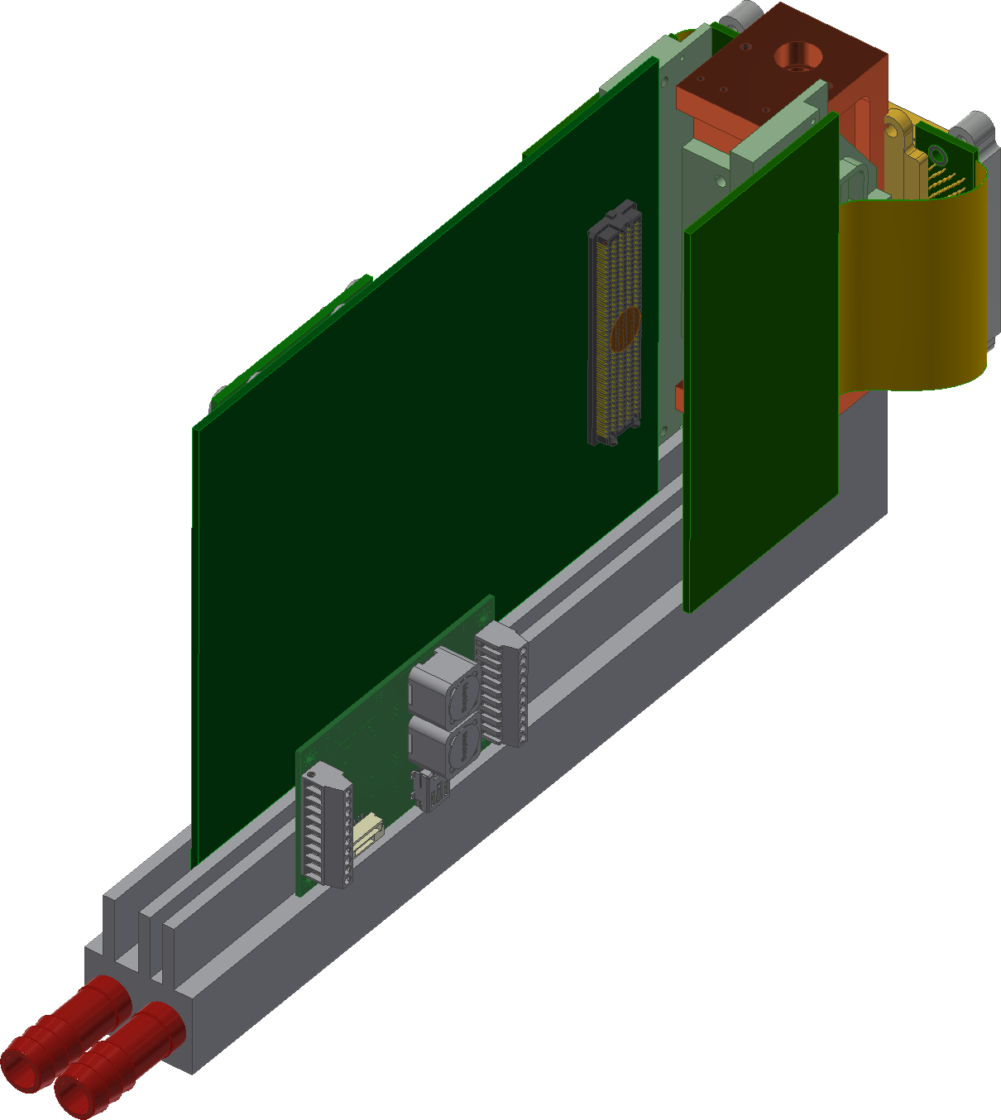
LISA FRONT-END BOARDS
LISA front-end boards
LVSM
24 LVDS data outputs connected to the FPGA
Same generic backbone
Main board
Peltier controller
Notes:
Very simple front-end boards with passive filtering and housekeeping functions
Front-end board to disconnect the detector without unplugging the PGA connector

Slide 13
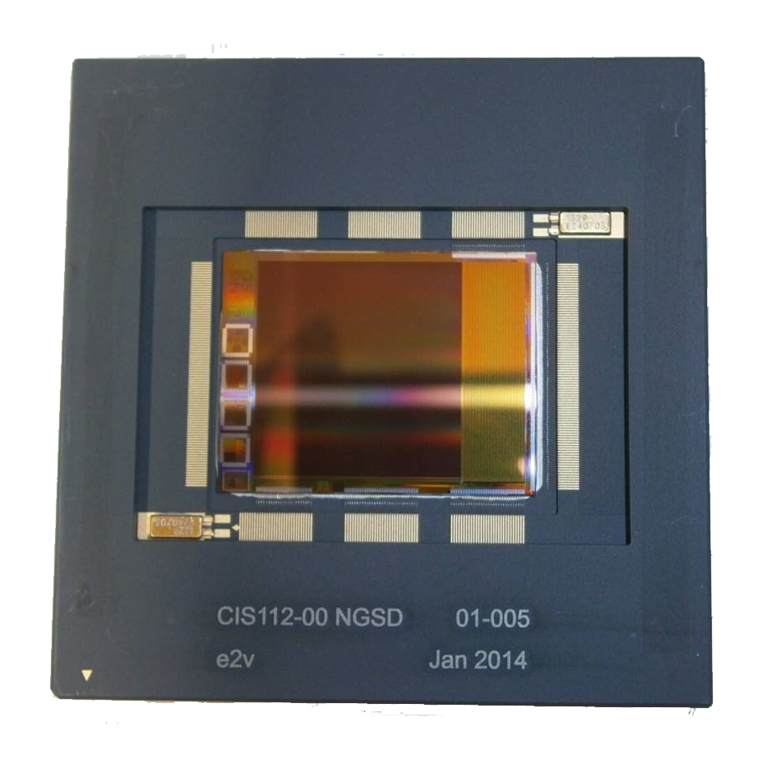
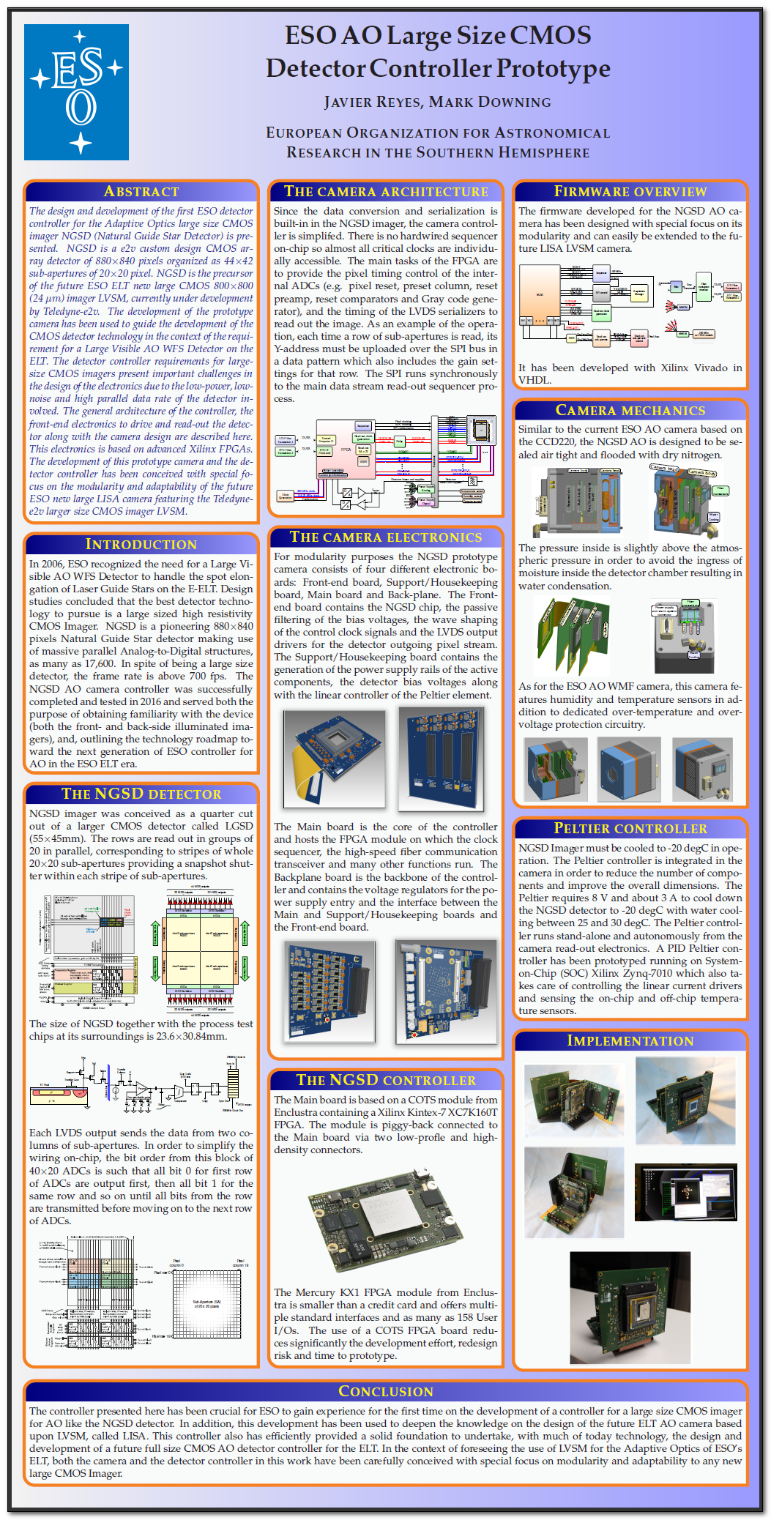
LISA precursor: NGSD prototype camera
LISA CAMERA PRECURSOR
NGSD
Very helpful to stablish the technology of future LISA camera
Notes:
The design of LISA with LVSM has a precursor based on NGSD
Poster ESO AO large size CMOS…

Slide 14



FREDA: ELT AO CAMERA FOR SAPHIRA
HgCdTe 320 x 256 pixels
Avalanche photodiode (eAPD)
0.8 to 2.5μm range
32 outputs
<1 photon RMS with Fowler sampling
>10K frame/s
Main board
LISA front-end boards
The most challenging camera
IDCA: Integrated Detector Cooler Assembly
Cryocooler
Notes:
FREDA IS THE CAMERA FOR THE SAPHIRA DETECTOR
We apply the same principle, camera backbone
The most challenging AO camera in our horizon
IDCA: Integrated Detector Cryostat Assembly
Very small dimensions

Slide 15





FREDA SAPHIRA CRYOSTAT
FREDA ADC board: 32 video channel acquisition system
4 x 4-ADC
Warm shield
Cold shield
Saphira
2nd stage ceramics
2 x 8-ADC
Detector carrier ceramics
Interface connectors
Front-view of FREDA
Camera within allocated dimensions
Cryocooler
Notes:
The IDCA consists of:
Detector carrier
2nd stage ceramics
The wirebonding between the two
Warm shield
Cold shield
The cryocooler inside the housing
The whole camera is still within the allocated volume
The Saphira Analogue front-end board features 32-video channels

Slide 16

ESO ELT MAIN CAMERA INTERFACES
10 Giga bit Ethernet (10 GbE)
The interface for control computer to camera will be 10 GbE UDP
UDP with IP unicast/multicast (UDP: User Datagram Protocol)
Goal is Real-Time Publish-Subscribe (RTPS)
Physical interface: 10 GbE
  SFP+ compliance
Data Link layer: Ethernet
MTU: 9,000 bytes
Network layer: IPv4
IP unicast support
IP multicast support
Transport layer: UDP
UDP multicast
It can be one-to-many or many-to-many image distribution
This represent a change at ESO for the communication to the camera. No longer to point-to-point
Precision Time Protocol
Very important on Adaptive Optics
Each camera needs to sample the sky at the same time
UDP, network protocol, we don’t know when the frame was acquired
Notes:
The main two interfaces we have to implement: 10GbE and PTP
Using a network protocol instead of point-to-point connection is challenging because of latency

Slide 17


10 Giga bit Ethernet UDP connection
Control computer to camera
Camera to RTC
OSI Model Layers
UDP: It isn't possible to guarantee delivery of a specific UDP packet on ANY platform
BUT!!!
Time-sensitive applications often use UDP because dropping packets is preferable to waiting for delayed packets, which may not be an option in a real-time system.
UDP payload example
Two SAs (800 pixels, 10-bit per pixel) can be in a 268 LWORDs in the UDP payload
UDP/IPv4: Pixel data in UDP payload
Preliminary test of latency and speed on Xilinx Virtex-7 FPGA.
Latency due to Link/Physical layer and propagation delay
Virtex-7 10 Gigabit Ethernet (PCS/PMA)
Latency: 313ns
Burst of 256 x 64-bit words
Notes:
1. It isn't possible to guarantee delivery of a specific UDP packet on ANY platform
2. But it is better to drop packets rather than adding latency

Slide 18

Very important on Adaptive Optics the synchronicity of a cluster of cameras
PTP: Precision Time Protocol
Each camera needs to sample the sky at the same time
UDP, network protocol, we don’t know when the frame was acquired
The slave clock requires four measured values t1, t2, t3, t4 to calculate delay and oset from master:
Each frame will have a time stamp in the UDP payload
Notes:
Each camera must sample the sky at the same time
On AONGC camera this is done with hardware line for synchronization
Network protocol, we don’t know when the sample of the sky was taken.
Each frame has stamp with the absolute time
Mechanism on the RTC to see if the control loop is healthy

Slide 19




Timestamping at the driver level is the optimal software solution but requires a modified network driver
PTP: Precision Time Protocol
New family of advance FPGA with PTP core
On NGSD camera prototype
Xilinx Ultrascale IEEE-1588 (PTP) GTH transceiver support in the core
Xilinx Kintex-7 FPGA
Xilinx Zynq UltraScale+ XCZU9EG-1FFVC900E
Notes:
Network protocol, we don’t know when the sample of the sky was taken.
Each frame has stamp with the absolute time
Mechanism on the RTC to see if the control loop is healthy
PTP to synchronize cameras

Slide 20



AO WFS Switching-Mode Power Supply
Switched-mode PS inside the camera
13 x 24 x 50 cm and about 18 Kg

Slide 21








High-speed feed through
Camera environment
The camera is designed to be sealed air tight and flooded with dry nitrogen
Pressure inside slightly above atmospheric pressure to avoid moisture ingress
All cameras features humidity and temperature sensors in addition to dedicated over-temperature and overvoltage protection circuitry.
Connectors
Camera feedthrough
A non-trivial problem at 10 Gbps and with the camera in a sealed, overpressured environment
Notes:
Not a trivial problem due to the high-speed
Not so good experience with fiber feedthroughs

Slide 22




AO WFS Camera Peltier driver
COTS Meerstetter Peltier controller:
COT: TEC-1091
DC Input 5-24 V / 4 A
Bipolar Output 0-21 V / ±4 A
Temperature Probe Input Pt100, Pt1000, NTC
Temp. Precision / Stability 0.01 °C or better
Communication RS485, RS232 TTL, USB
Dimensions (L x W x H) 65 mm x 38 mm x 14 mm
  Close the loop at -40..-50 degC for ALICE
  Close loop at -10 to -20 degC for LVSM
  Full control by RS232
  Full control by NGC software
COT Peltier controller
Note about the RTC
Very powerful FPGA with lots of DSPs
We have ruled out that the real time processing is done inside the camera FPGA
FULLY NGC compatible: I/F, tools
AONGC GUI
Notes:
TO DO: Put 3D model of the camera with highlighted Peltier
In spite of being a very attractive solution, centroiding calculation is not done inside the FPGA
Wrong place to do it: not flexible, power dissipation, expensive real-state…
Hostile design flow for algorithms

Slide 23
Summary
Three new AO camera for the ELT under development
Very different detectors BUT not very different cameras
ALICE: CCD220
LISA: Large size CMOS Teledyne-e2v LVSM
FREDA: Selex Shapira
Identical camera backbone + detector specific front-end
Support for the new ELT interfaces: 10 GbE UDP and PTP

Slide 24
Many THANKS to the photon huggers and SDW organizers

