Slide 1
A 1k x 1k Class MOVPE HgCdTe LmAPD Array Optimized for
Low Background Space Astronomy
Presentation to Science Detector Workshop 2017
27 September, 2017
Donald N. B. Hall
Institute for Astronomy, University of Hawai`i
and
Dani E. Atkinson, Shane M. Jacobson and Ian M. Baker

Slide 2
Goals
In photon starved applications the sensitivity of current solid state infrared (1 - 5μm) arrays is limited by read noise.
The unique linear avalanche properties of HgCdTe promise to overcome this by multiplying charge in the unit cell before readout without introducing the excess noise intrinsic to other linear avalanche detectors.
These advantages have now been demonstrated for ground based adaptive optics wavefront sensing with Selex SAPHIRA APD arrays operating at up to kHz frame rates with sub-electron read noise.
Our current investigation seeks to extend these advantages to low background astronomy, providing sub-electron read noise at low dark current of a few e-/ks/pix with sufficient linear avalanche gain for photon counting.
Major challenges involve suppressing ROIC glow and achieving low dark current at the bias voltages required for useful avalanche gain.

Slide 3
Evolution of Selex SAPHIRA for Astronomy
The initial SAPHIRA 320 X 256 @24µM pitch SAPHIRA, developed by Selex in partnership with ESO (Gert Finger), utilized LPE HgCdTe.
The switch to MOVPE HgCdTe greatly enhanced the astronomical potential of the array – providing both higher quality material and also the significant benefits associated with bandgap engineering.
The MOVPE Mark 3 SAPHIRA was
adopted by the ESO Gravity
experiment and has been deployed
by UH at the NASA IRTF, the
Palomar 1.5 meter (Robo-AO) and
the Subaru Telescope (SCExAO)
The MOVPE Mark 13 & 14 are
currently the SAPHIRAs of choice –
good QE 0.8 to 2.5 um.
Mark 15 – 19 have been completed
and characterized - learning curve.
MOVPE Mark 20 now in process.

Slide 4
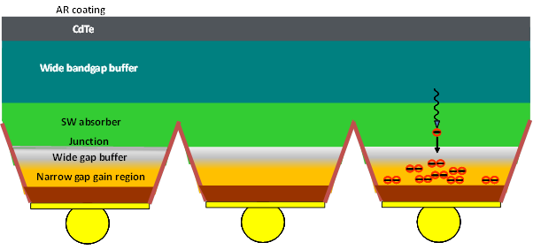
Characteristics of the SAPHIRA
The SAPHIRA format is 320 X 256 @24um pitch.
The absorption layer is sensitive from 0.8 to 2.5 um with the multiplication layer sensitive to 3.5 um to increase avalanche gain.
The SAPHIRA can be read out at up to 10 MHz pixel rate using 4, 8, 16 or, usually, 32 outputs. These read adjacent pixels in a row and sub-arrays can be any multiple of 32 x 1.
The ME911 ROIC has only global reset while the ME1000 offers line-by-line reset with read-reset and read-reset-read capability.

Slide 5
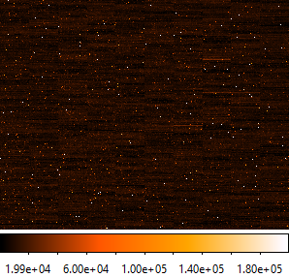
SAPHIRA Mark 13 & 14 Arrays.
The Mark 13 & 14 extended short wave coverage from 1.4 µm down to 0.8 µm with good QE while providing superb cosmetic quality at much higher avalanche bias and gain – gain ~100X at ~15 volts bias and ~600X at ~20 volts bias.
.

Slide 6
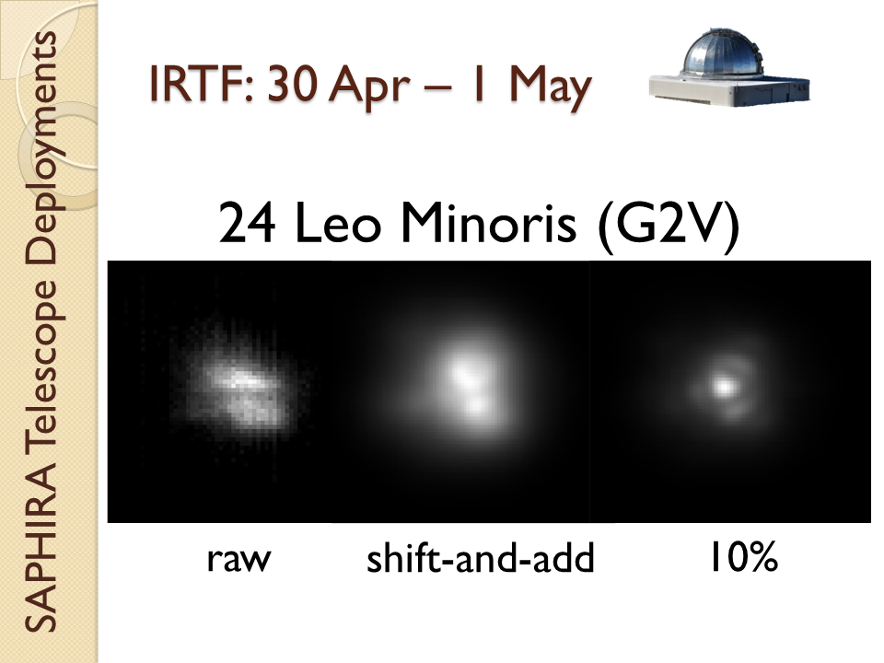
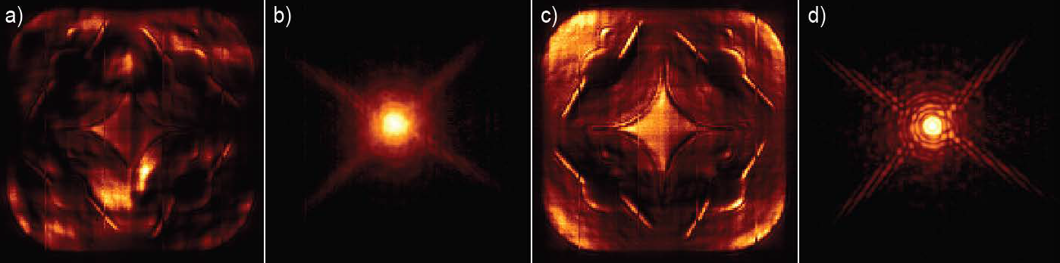
NSF SAPHIRA for AO WF Sensing.
First light on NASA IRTF 30 April, 2014
Deployed with Robo-AO on Palomar
60-inch and now Kitt Peak 84-inch.
Also deployed to SCExAO system on Subaru for speckle lifetime measurements, speckle nulling coronography and pyramid WF sensing.
In 2018 a SAPHIRA camera will go to Keck to support an NSF ATI funded investigation of pyramid WF sensing

Slide 7
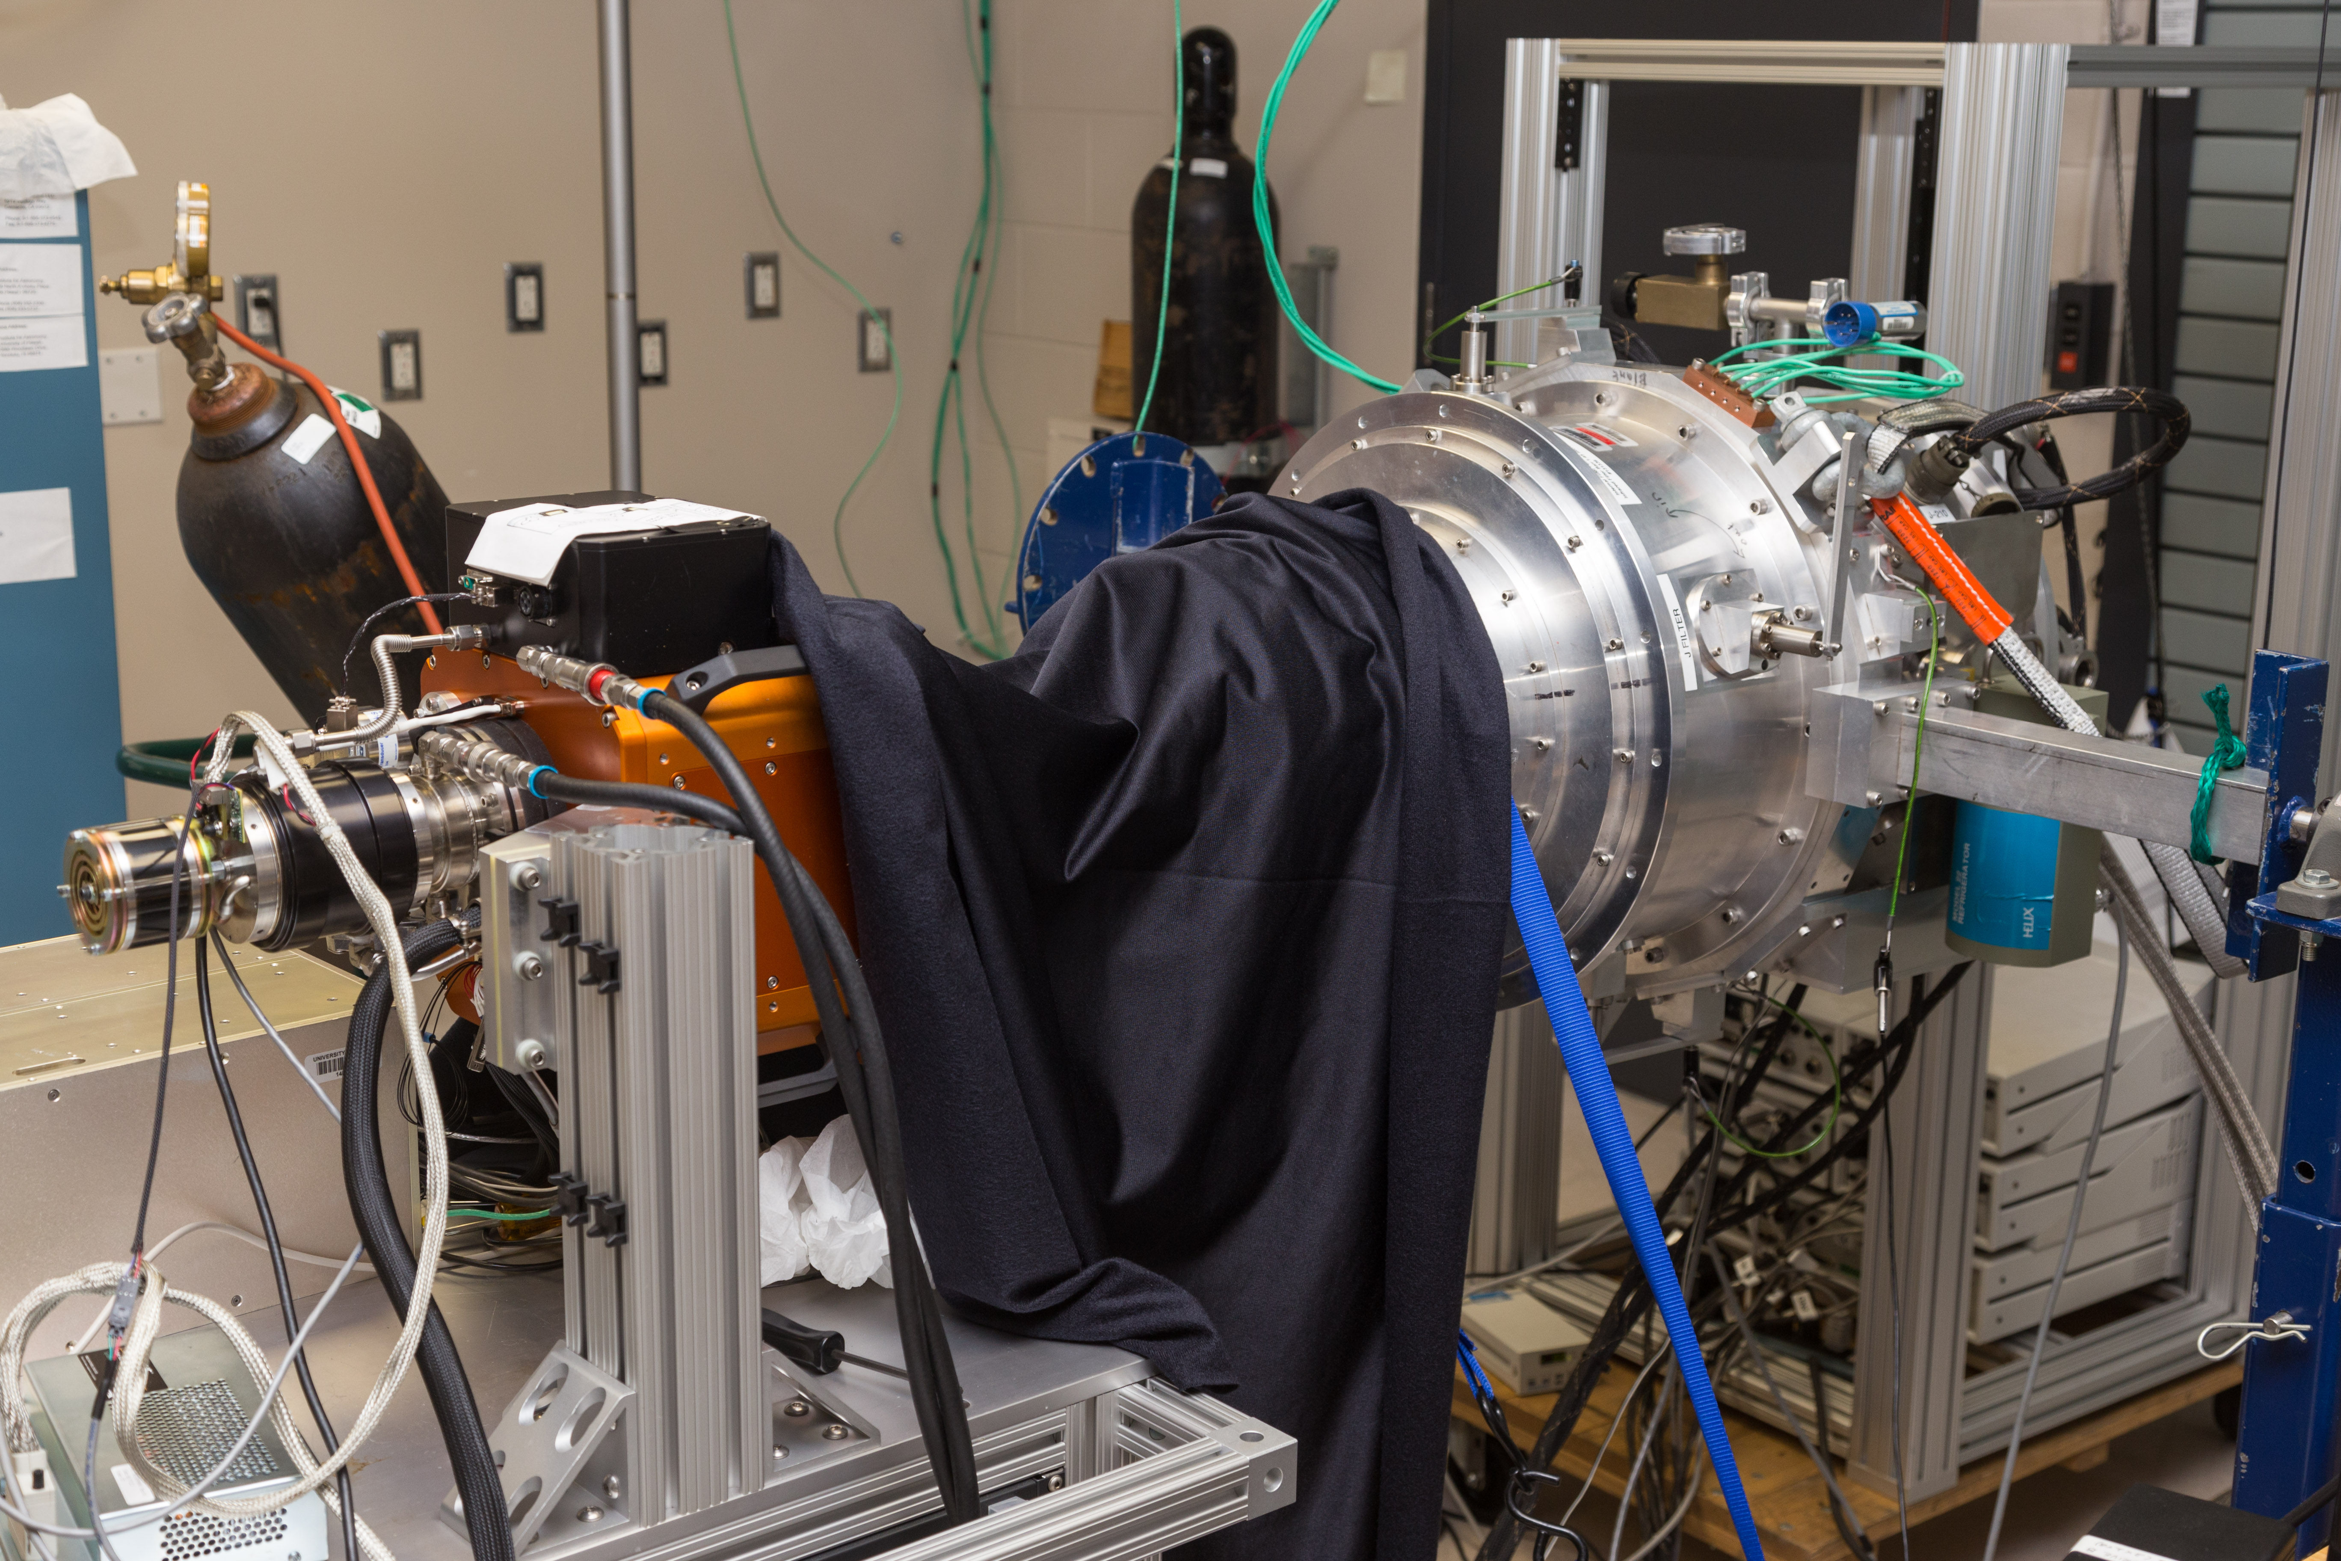
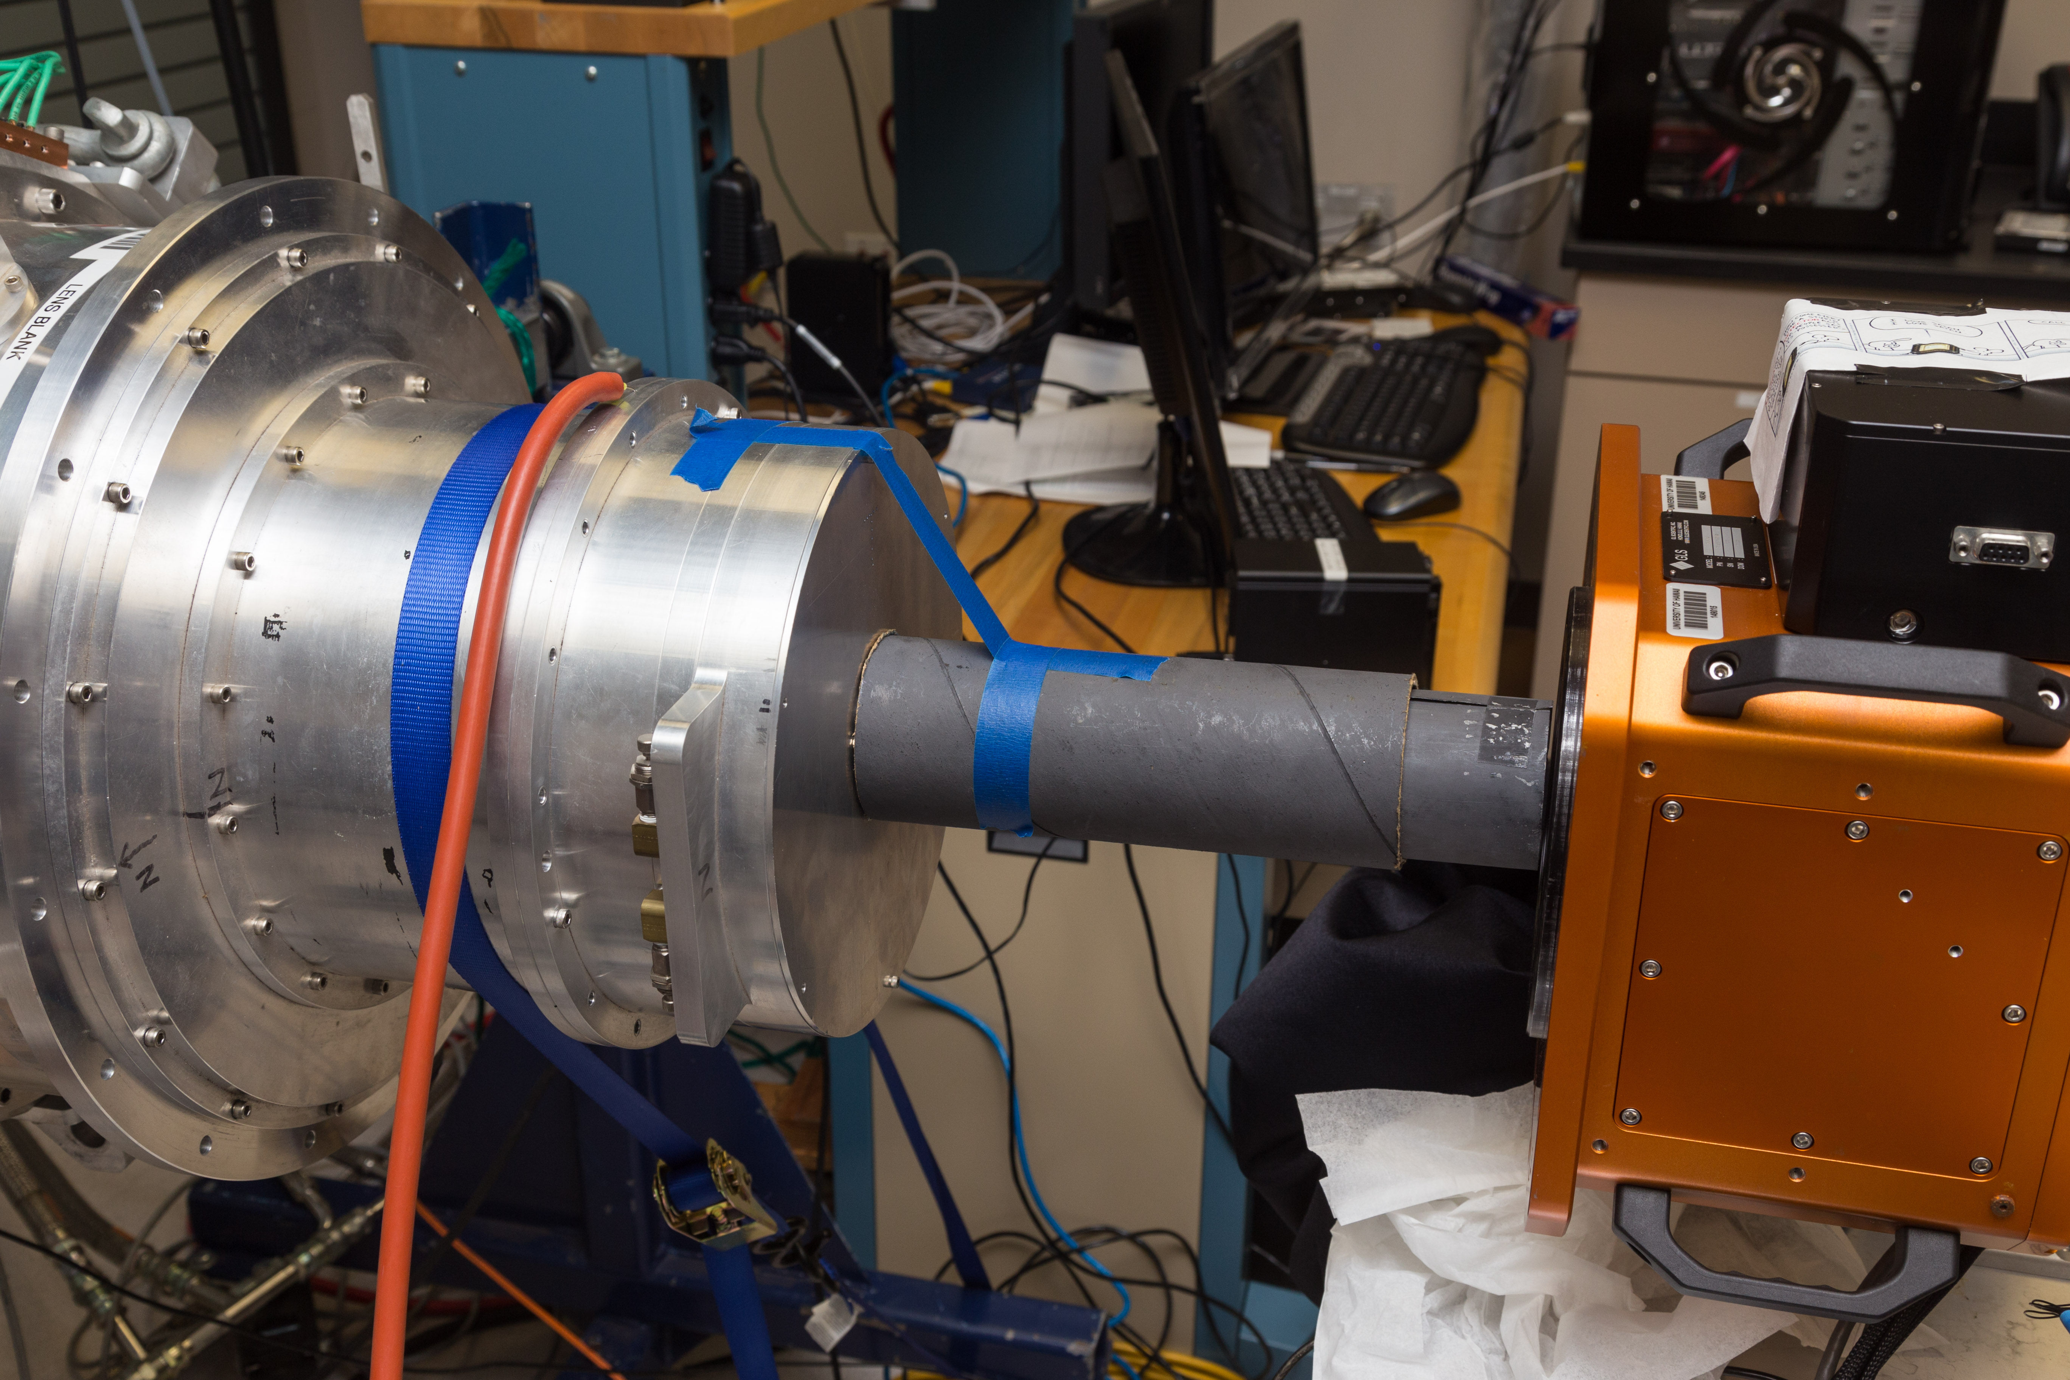
Glow Imaging of SAPHIRA & ME1001 ROIC
The SAPHIRA in the GLS Stirling Cycle Cryostat (NSF Travelling
Camera #1 - gold) aligned with an H4RG-15 in JWST ULBCam
(aluminum) to provide “glow” images at a scale of 10.7 μm per
H4RG-15 pixel, a magnification ~ X 2.5 times in J & H Bands.

Slide 8
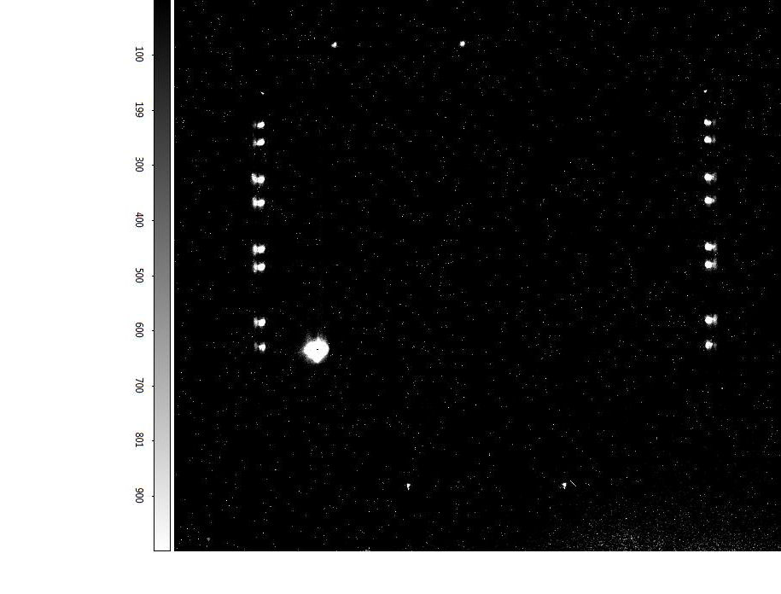
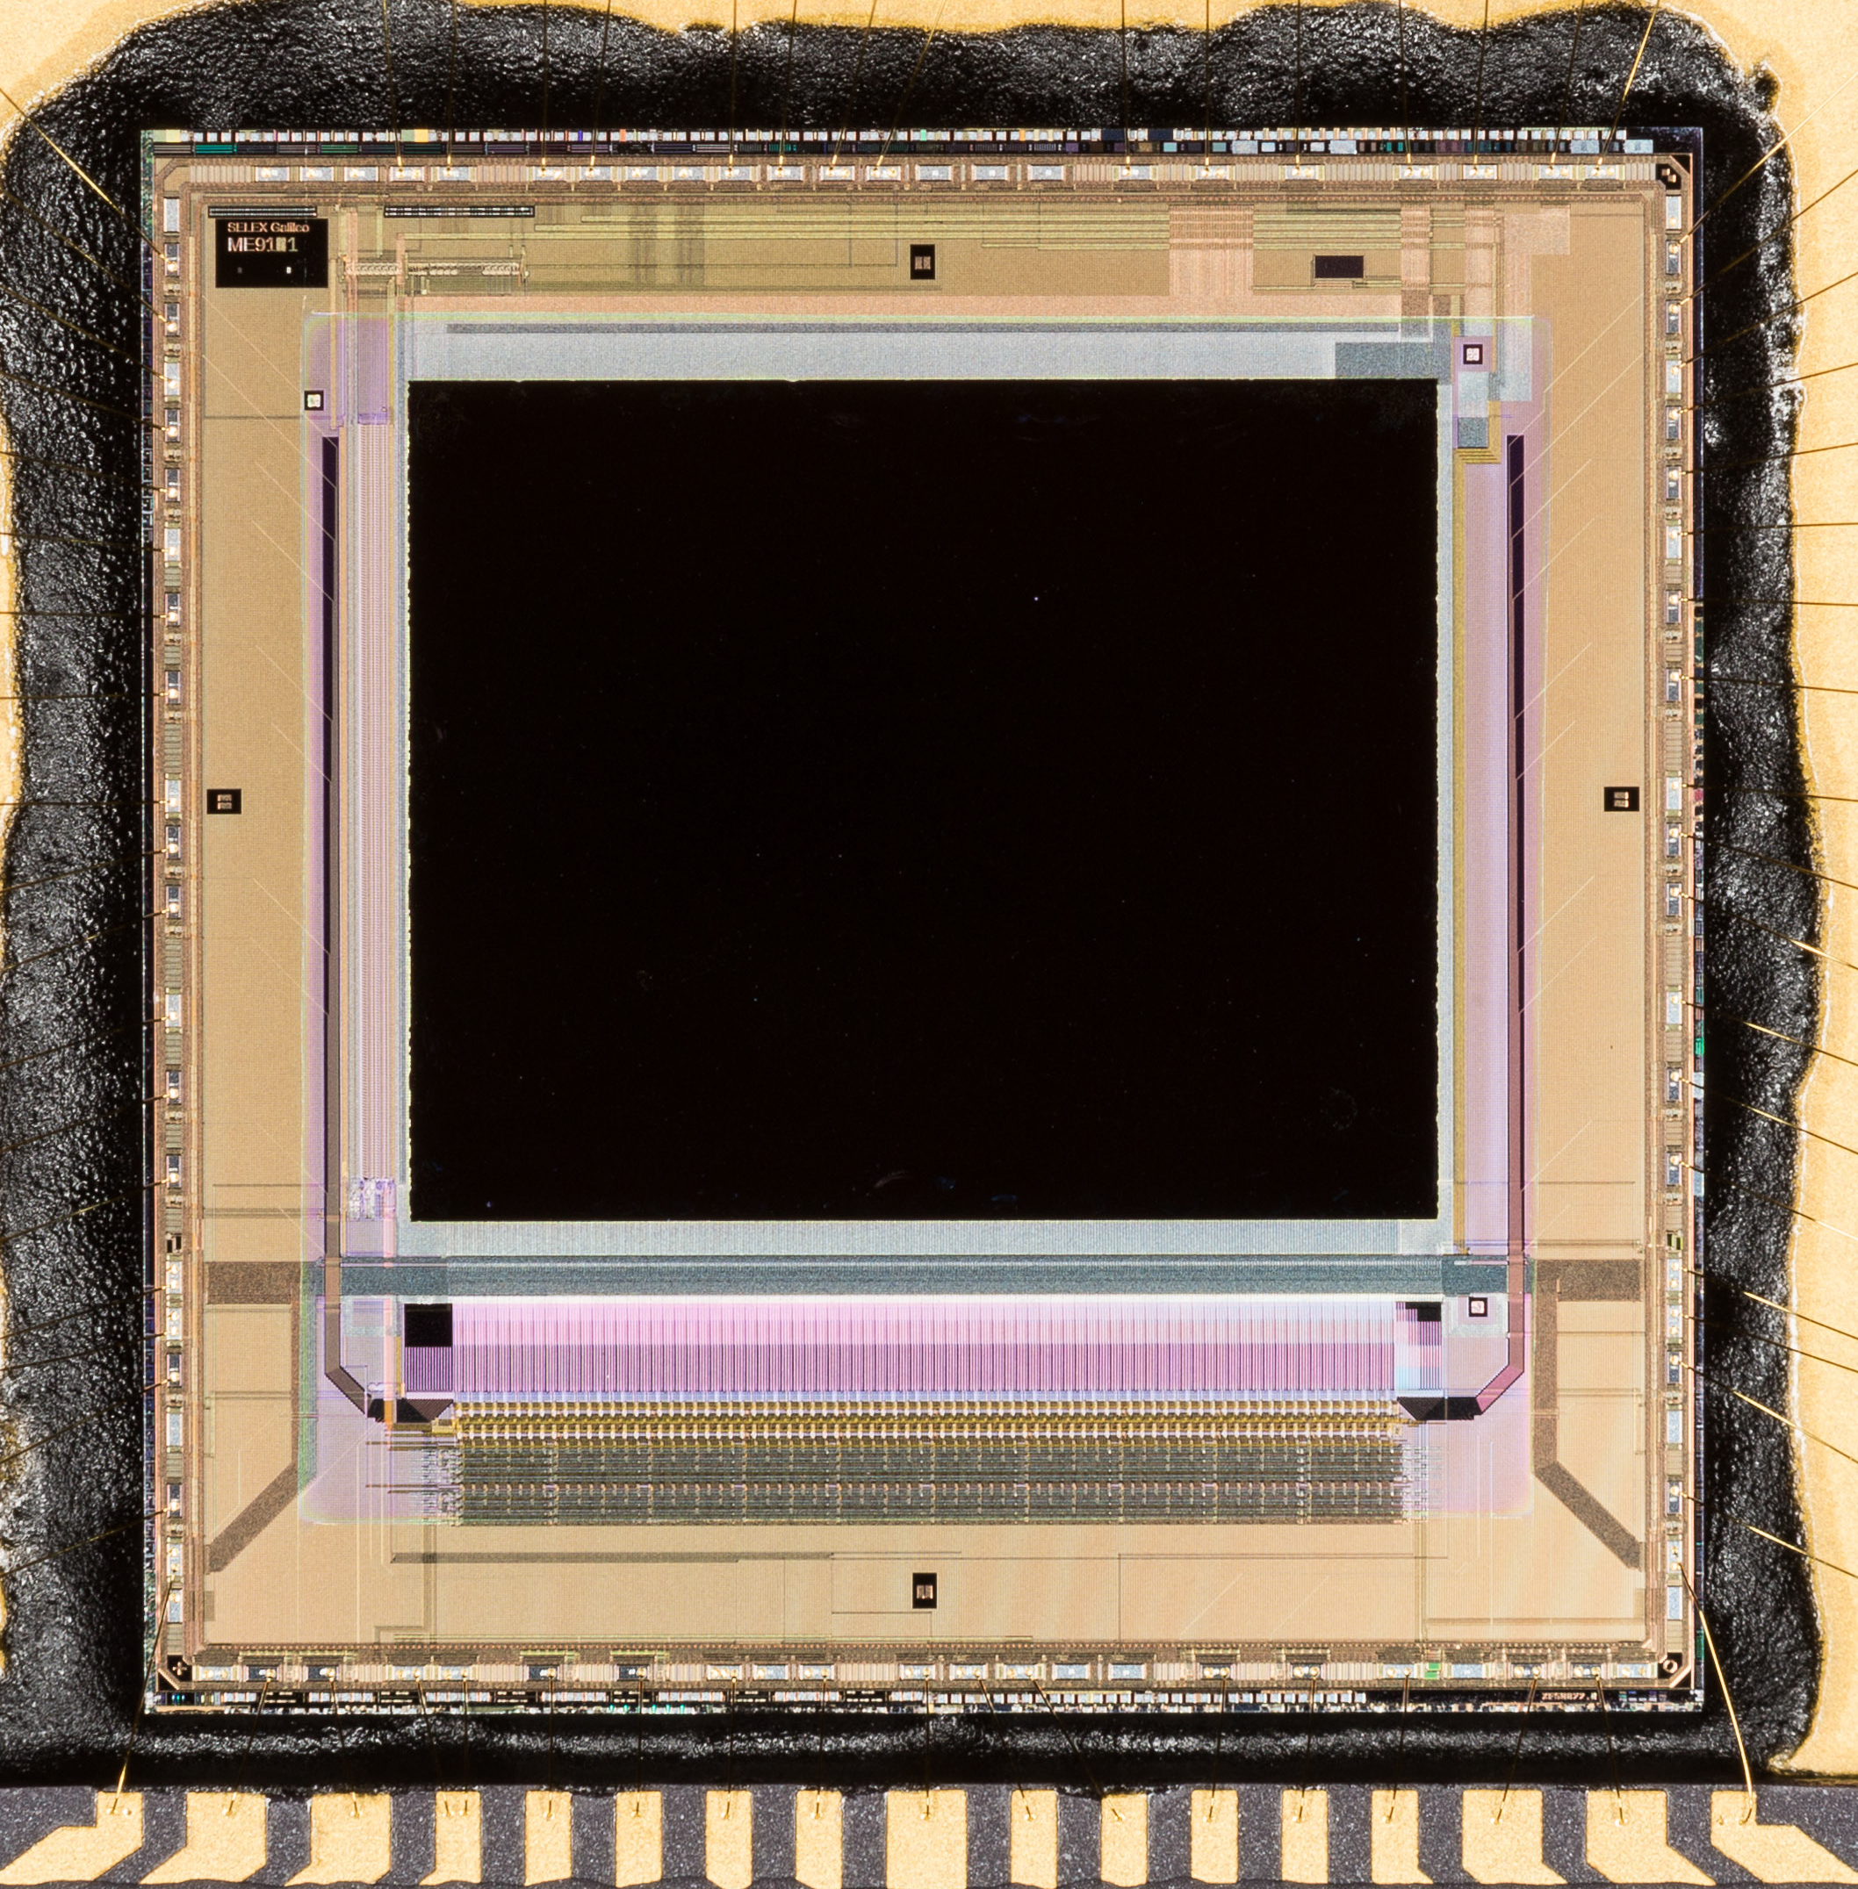
SAPHIRA J-Band ROIC Glow.
A J-Band “glow” image (left) of a SAPHIRA array. The glow is hot
electron emission with Teff ~ 3,000K from MOSFETs. The vertical
lines of glow points and the pairs at top and bottom are output
amplifiers. The brightest source is due to a floating gate.

Slide 9
Glow Reduction in the ME1001 ROIC.
The floating gate glow source due to a mask error in the ME911 ROIC was suppressed in selected Mark 13 & 14 ME1001 SAPHIRAs (lower left) by a dot of black tape and, in the ME1001 ROIC (lower right), by circuit metal layer modifications – allowing much longer glow exposures.
The greatly reduced glow has enabled much more stringent upper limits to be placed on dark current.

Slide 10
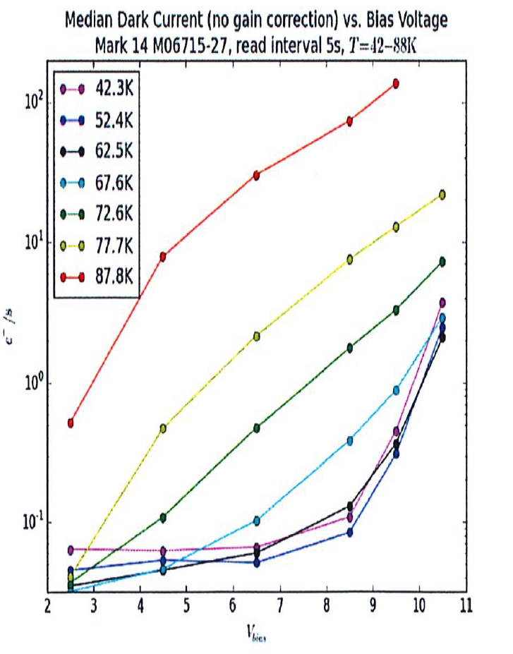
Tunneling Current in Mk 13 & 14 MOVPE.
The dominant tunneling currents in MOVPE HgCdTe all involve a “trap” level intermediate between the valence and conduction bands.
Tunnel-tunnel current involves tunneling both into and out of the trap.
It is independent of temperature but rises rapidly with bias voltage.
Thermal-tunnel current involves thermal excitation into the trap followed by tunneling up to the conduction band.
It is strongly
dependent on both
temperature and
avalanche bias.
Glow dominates dark current for T<62.5K and bias < 8.5 volts.

Slide 11
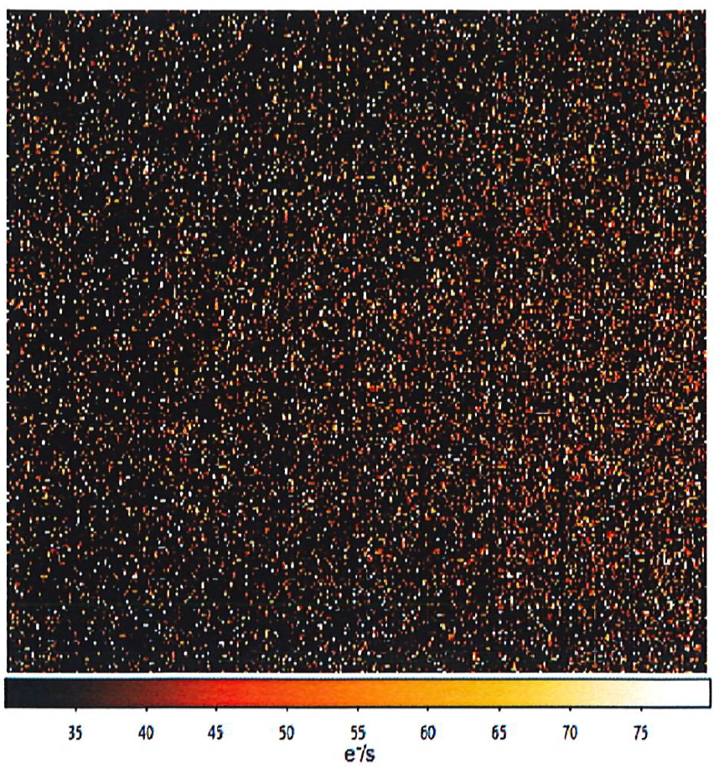
Thermal-Tunnel Current Onset Voltage.
The onset voltage of tunnel-tunnel current ranges varies by more than 3 volts from one pixel to another.
For the best pixels, the onset is delayed beyond a voltage of 8.5 volts, corresponding to an avalanche gain of order 5.

Slide 12
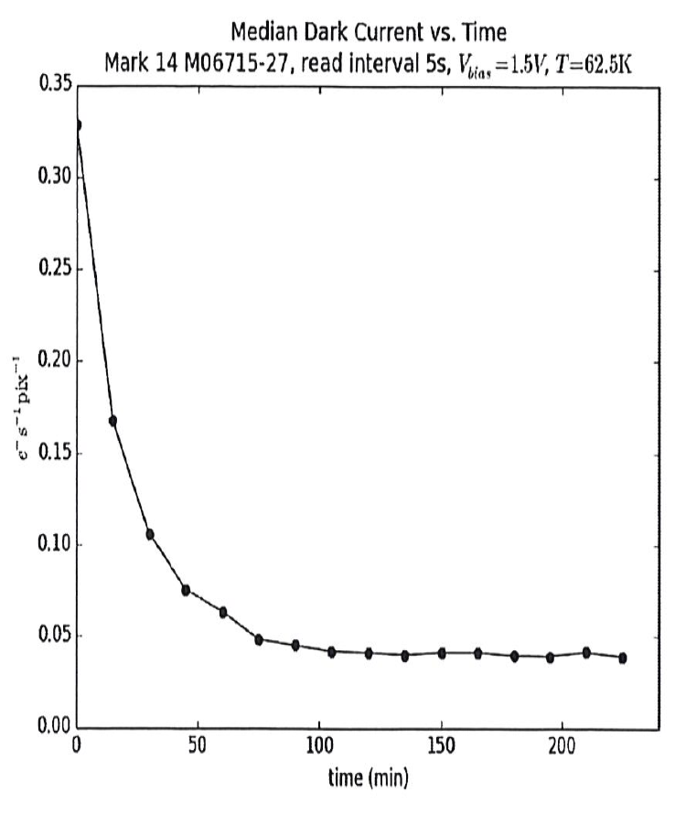
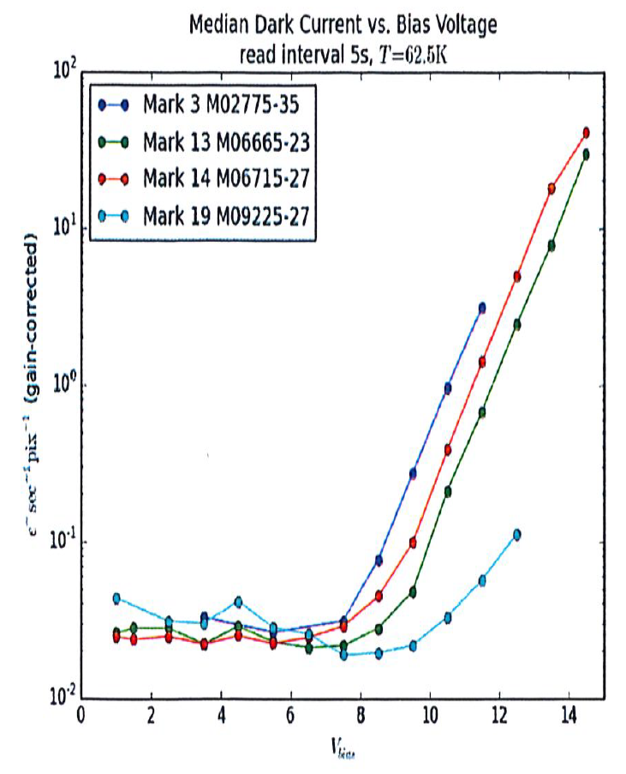
Median Dark Current with Reduced Glow.
With minimum operating voltages and reading the full SAPHIRA frame only every 5 seconds during 15 minute ramps, the median dark current up to 8 volts bias settles to 0.04 e-/s/pix after two hours and is then stable to + 0.001 e-/s/pix.

Slide 13
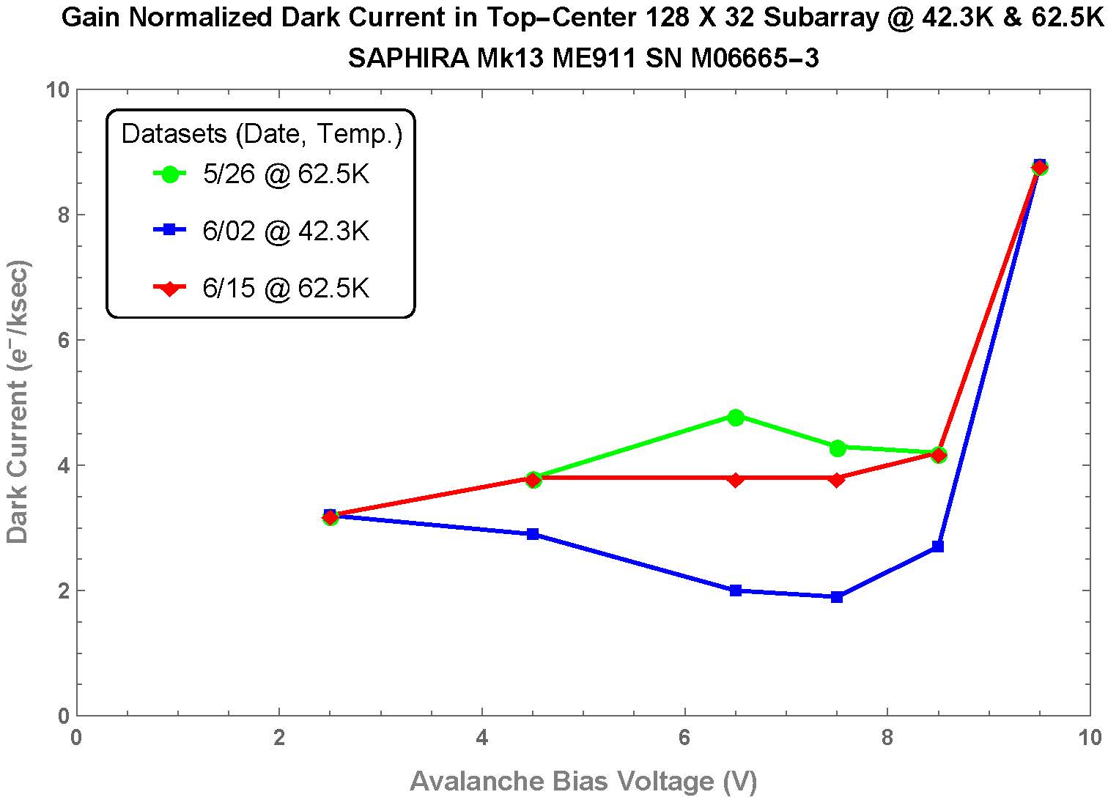
Median Dark Current with Minimized .Glow
By reading only the first 32 rows of the SAPHIRA at 30 second intervals and minimizing operating voltages over four 4-hour ramps, we measure dark current of 0.004 e-/s/pix at 62.5K and 0.003 e-/s/pix at 42.3K up to 8.5 volts (gain > 5) I the highest onset voltage pixels.
These values indicate a glow component of 0.003 e-/s/pix and a dark current < 0.002 e-/s/pix

Slide 14
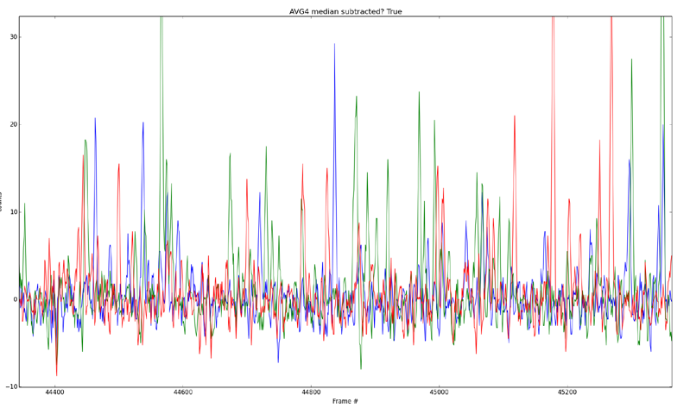
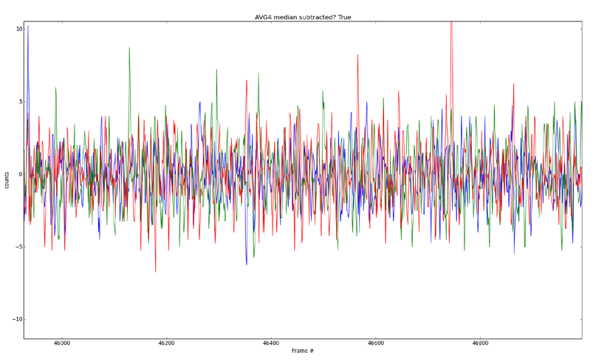
Photon Counting
LED ON
I <=------------------------------ 19 msec ------------------- ----------=> I
LED OFF
Detect individual photon events.
Glow suppression will eliminate events for LED off.
Pizza Box controller will reduce read noise.

Slide 15
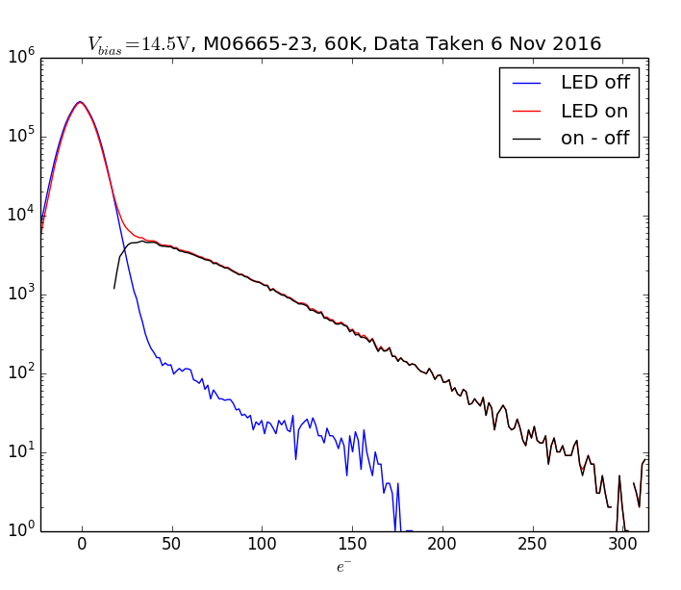
Avalanche Pulse Height Distribution.
We are able to count individual avalanche events with reasonable efficiency.
However the pulse height distribution shows no sign of a peak at the nominal gain or multiples of it.
The exponential drop off is
similar to the that of the
EMCCD.

Slide 16
A Megapixel class MOVPE APD Array for Low Background Observations
The reduction of upper limits on Mk 13 & 14 SAPHIRA APD dark current to 0.002 e-/s/pix makes MOVPE HgCdTe arrays attractive candidates for low background astronomical observations.
NASA APRA has funded UH, teamed with SELEX Galileo and Leonardo, to develop such a megapixel 1k x 1k class array optimized for low background space astronomy.
To reduce physical size and achieve higher yield of MOVPE die, pixel pitch needs to be reduced from the SAPHIRA value of 24um .
A SAPHIRA 640 x 512@12um pitch (with only every second row and column hybridized to the ROIC) exhibited poor yield and performance.
15um pitch looks optimum and is being verified as part of the current Mark 20 run.
At 15 mm square, the active area and package are comparable to a 512 x 512@24um AO WF sensor being developed by another team.

Slide 17
Goals for Low Background e-APD Array
Minimize ROIC Glow.
Minimize operating voltages (except common). These are positive and < 3.5 volts (Compatibility with ASIC controllers.
Add reference pixels (replace APD with comparable capacitor to COMMON) and Reference Outputs.
Double Interleaved Reference Pixels?
Suppress Random Telegraph Noise.
Three-side close buttable – all electrical interconnects (including 16 or 32 signal outputs) on one side.
Three year program. Goals are: ROIC in Year 1, Engineering grade arrays in Year 2 and Science grade arrays in Year 3.

