Slide 1
ESO NIR detector characterization for the ELT era
Elizabeth M. George
ESO Detector Group

Slide 2
Past: NIR detector characterization for the VLT era
21 H2RG detectors in 13 different environments
1 Hawaii2 for MAD
1 Hawaii2RG for SPIFFI - 2005
4 Hawaii2RG for HAWKI - 2007
1 Hawaii2RG for X-SHOOTER
1 Hawaii2RG for IRDIS in SPHERE
1 Hawaii2RG for IFS in SPHERE
3 Hawaii2RG for KMOS
1 Hawaii2RG for GRAVITY spectrometer
1 Hawaii2RG for GRAVITY acquisition camera
1 Hawaii2RG for MATISSE – 2018 delivery
3 Hawaii2RG for CRIRES mosaic – 2018 delivery
1 Hawaii2RG for CRIRES slit viewer – 2018 delivery
2 Hawaii2RG for SPIFFIER/ERIS/NIX – 2019 delivery
Notes:
Each detector tested per instrument, different tests run on each detector.

Slide 3
Past: NIR detector characterization for the VLT era
21 H2RG detectors in 13 different environments
Each detector tested and used in a unique way—Different:
Test conditions
Optimization
Datasets
Operation parameters
Controllers
Applications
Reference pixel subtraction
1 Hawaii2 for MAD
1 Hawaii2RG for SPIFFI - 2005
4 Hawaii2RG for HAWKI - 2007
1 Hawaii2RG for X-SHOOTER
1 Hawaii2RG for IRDIS in SPHERE
1 Hawaii2RG for IFS in SPHERE
3 Hawaii2RG for KMOS
1 Hawaii2RG for GRAVITY spectrometer
1 Hawaii2RG for GRAVITY acquisition camera
1 Hawaii2RG for MATISSE – 2018 delivery
3 Hawaii2RG for CRIRES mosaic – 2018 delivery
1 Hawaii2RG for CRIRES slit viewer – 2018 delivery
2 Hawaii2RG for SPIFFIER/ERIS/NIX – 2019 delivery
Notes:
Each detector tested per instrument, different tests run on each detector.

Slide 4
Future: ELT first light NIR detectors
MICADO + HARMONI = ~1/4 Billion NIR pixels.
MICADO
MICADO
HARMONI
17 identical
4k x 4k detectors
68 identical
2k x 2k detectors
HARMONI

Slide 5
Testing philosophy
Comprehensive
QE
Cosmetics
IPC
Reciprocity Failure
Picture Frame
Channel offsets
Persistence
Cross-talk
Full well
Dark Current
Read noise
Linearity
?

Slide 6
Testing philosophy
Comprehensive
Standardized
QE
Cosmetics
IPC
Reciprocity Failure
Picture Frame
Channel offsets
Persistence
Cross-talk
Full well
Dark Current
Read noise
Linearity
?

Slide 7
Testing philosophy
Comprehensive
Standardized
Searchable/Linkable
QE
Cosmetics
IPC
Reciprocity Failure
Picture Frame
Channel offsets
Persistence
Cross-talk
Full well
Dark Current
Read noise
Linearity
?

Slide 8
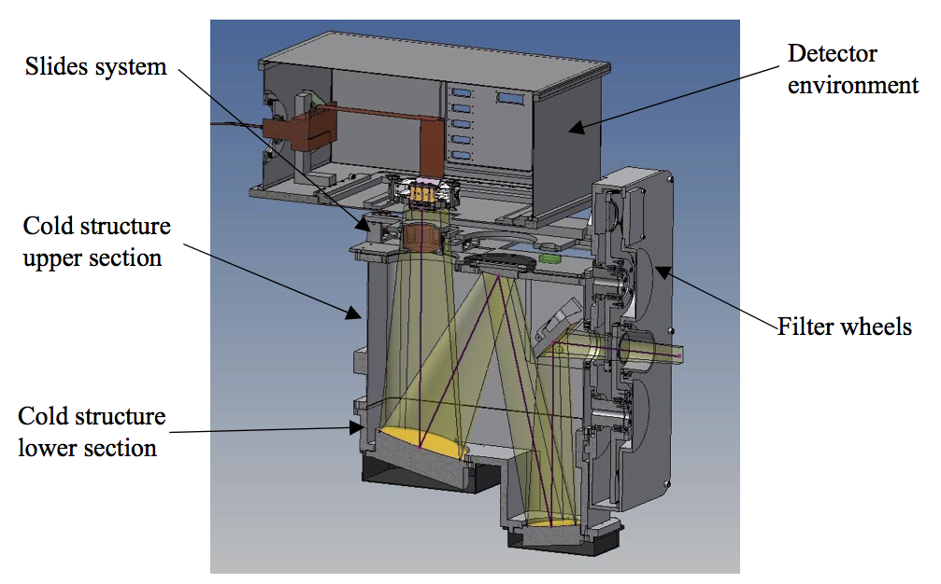
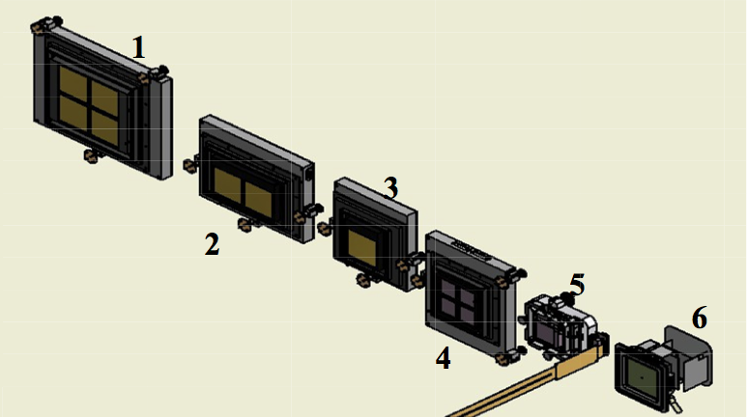
FIAT and the ESO Archive
Notes:
FIAT is like a VLT instrument
Detector to be tested; 1. 2x2 H4RG with 15μm pixels, 2. 2x1 H4RG with 15μm pixels, 3. 1 H4RG with 15μm pixels, 4. 2x 2H2RG, 5. 1H2RG, 6. 1H4RG with 15μm pixels in the MOONS configuration.

Slide 9
FIAT and the ESO Archive
How is this useful?
FIAT
raw data
ESO Archive
Astronomers
ESO Quality Control
Detector Engineers
Instrument Teams
Calibration Scientists
Analysis Pipeline
Us
You
Notes:
HOW IS THIS USEFUL?

Slide 10
KMOS and the ESO Archive
KMOS
raw data
ESO Archive
Astronomers
ESO Quality Control
Detector Engineers
Instrument Teams
Calibration Scientists
Analysis Pipeline
Us
You
Notes:
KMOS storytime!

Slide 11
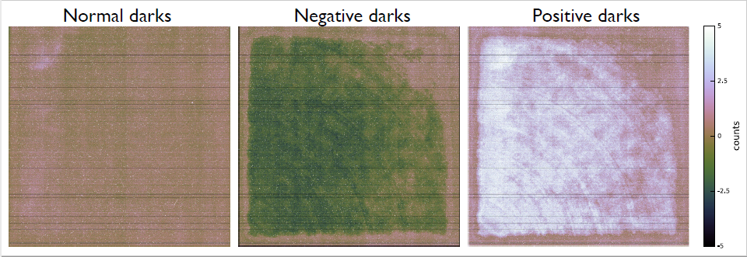
Mysterious KMOS Darks
Notes:
WHO RECOGNIZES THIS?

Slide 12
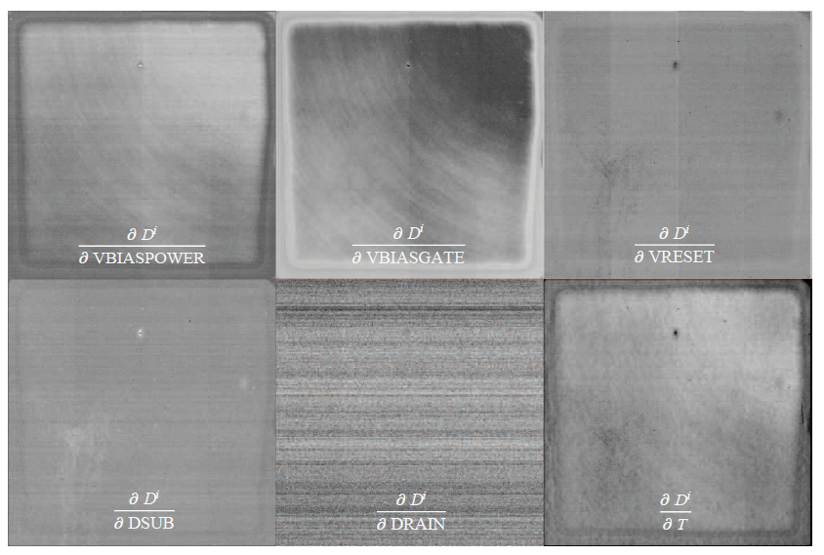
JWST NIRSpec detector PCA
PCA test on H2RG controlled by SIDECAR ASIC – with reference pixel correction
Reproduced from: Rauscher et al. 2013 “Principal Components Analysis of a JWST NIRSpec Detector Subsystem”

Slide 13
JWST NIRSpec detector PCA
PCA test on H2RG controlled by SIDECAR ASIC – with reference pixel correction
Reproduced from: Rauscher et al. 2013 “Principal Components Analysis of a JWST NIRSpec Detector Subsystem”

Slide 14
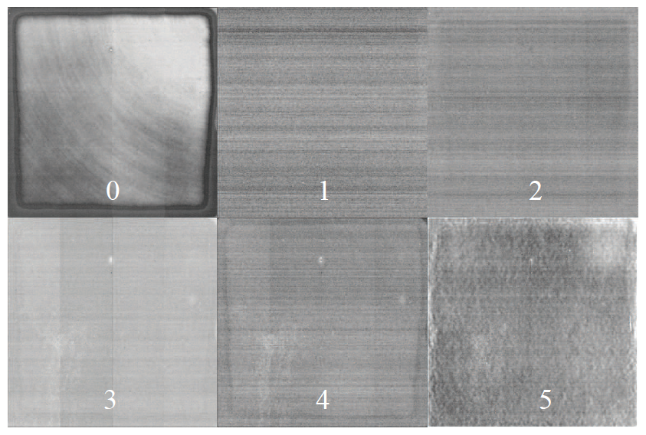
JWST NIRSpec detector PCA
PCA test on H2RG controlled by SIDECAR ASIC – with reference pixel correction
Reproduced from: Rauscher et al. 2013 “Principal Components Analysis of a JWST NIRSpec Detector Subsystem”

Slide 15
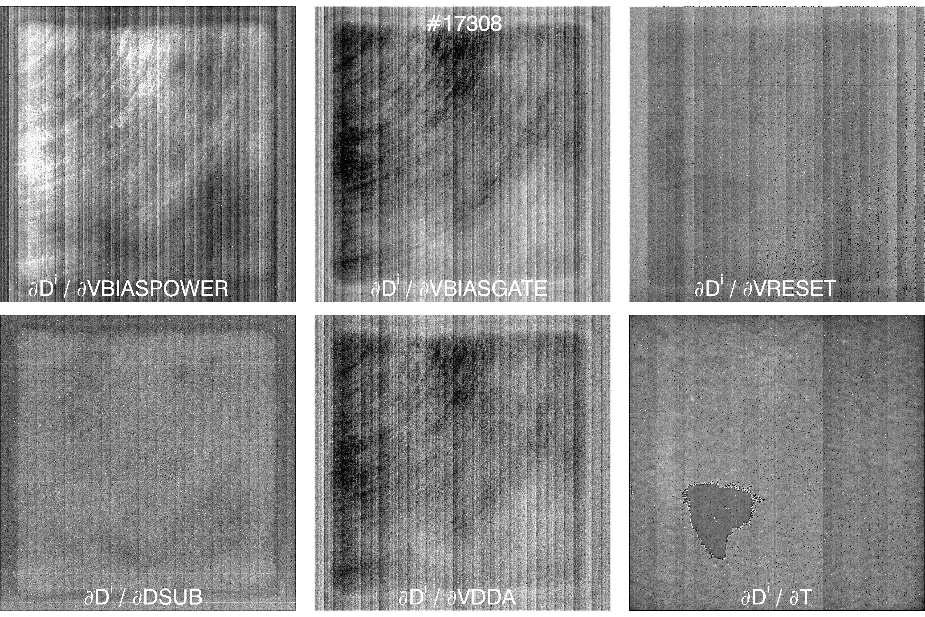
CRIRES+ detector PCA
PCA test on H2RG controlled by NGC – no reference pixel correction

Slide 16
CRIRES+ detector PCA
PCA test on H2RG controlled by NGC – no reference pixel correction
No picture frame

Slide 17
CRIRES+ detector PCA
PCA test on H2RG controlled by NGC – no reference pixel correction

Slide 18
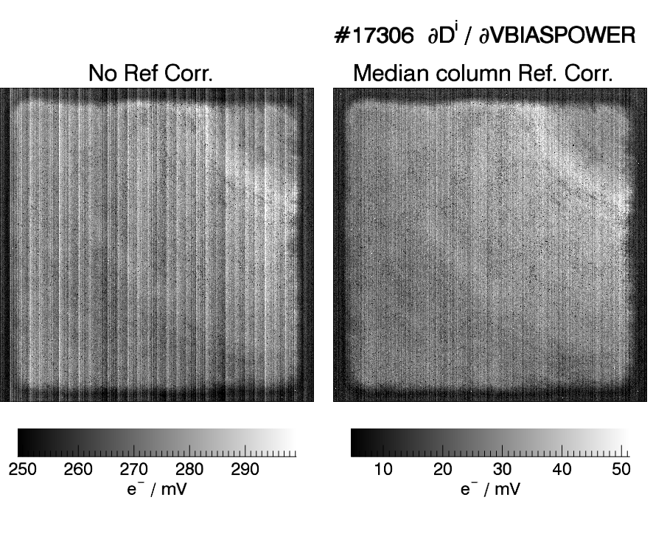
CRIRES+ PCA – Bias stability requirements
< 1 e- Picture frame in 99% pixels:
No reference pixel subtraction:
< 3 µV RMS
With reference pixel subtraction:
< 15 µV RMS
Notes:
WHAT CAN WE OBSERVE THAT TRACKS BIAS CHANGES?

Slide 19
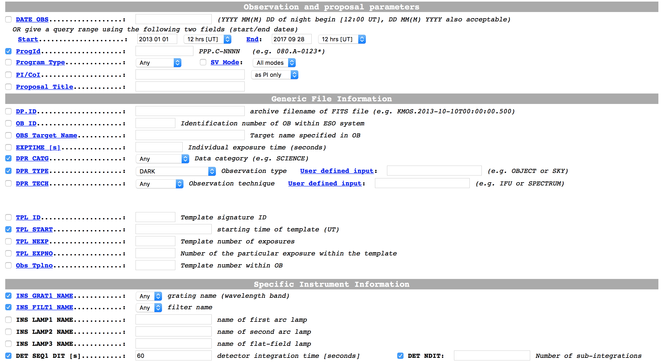
ESO Archive

Slide 20
ESO Archive
..............
..............
..............
..............
..............
..............
..............
..............
..............
..............
..............
..............
..............
..............
..............
Notes:
Example: SINFONI-- 46,328 darks and 78,575 flats

Slide 21
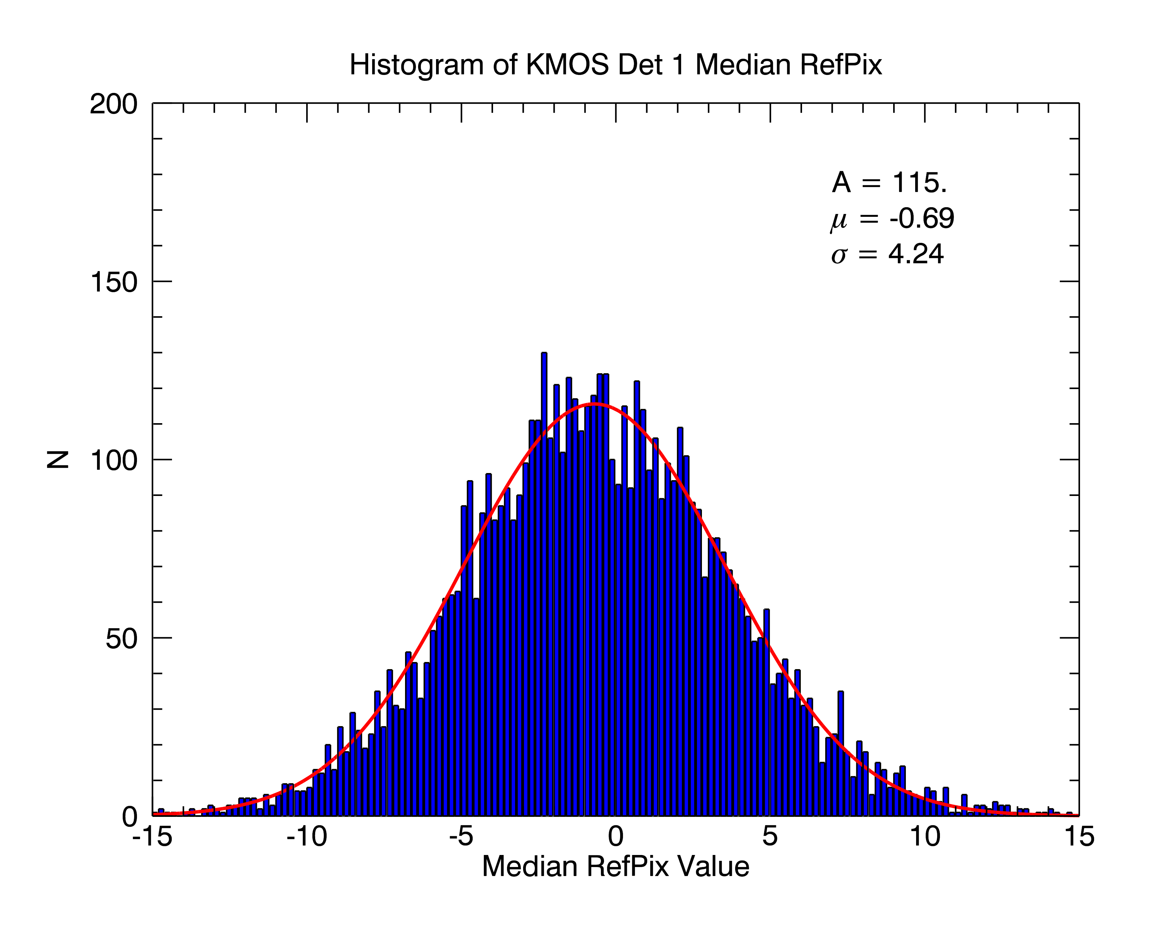
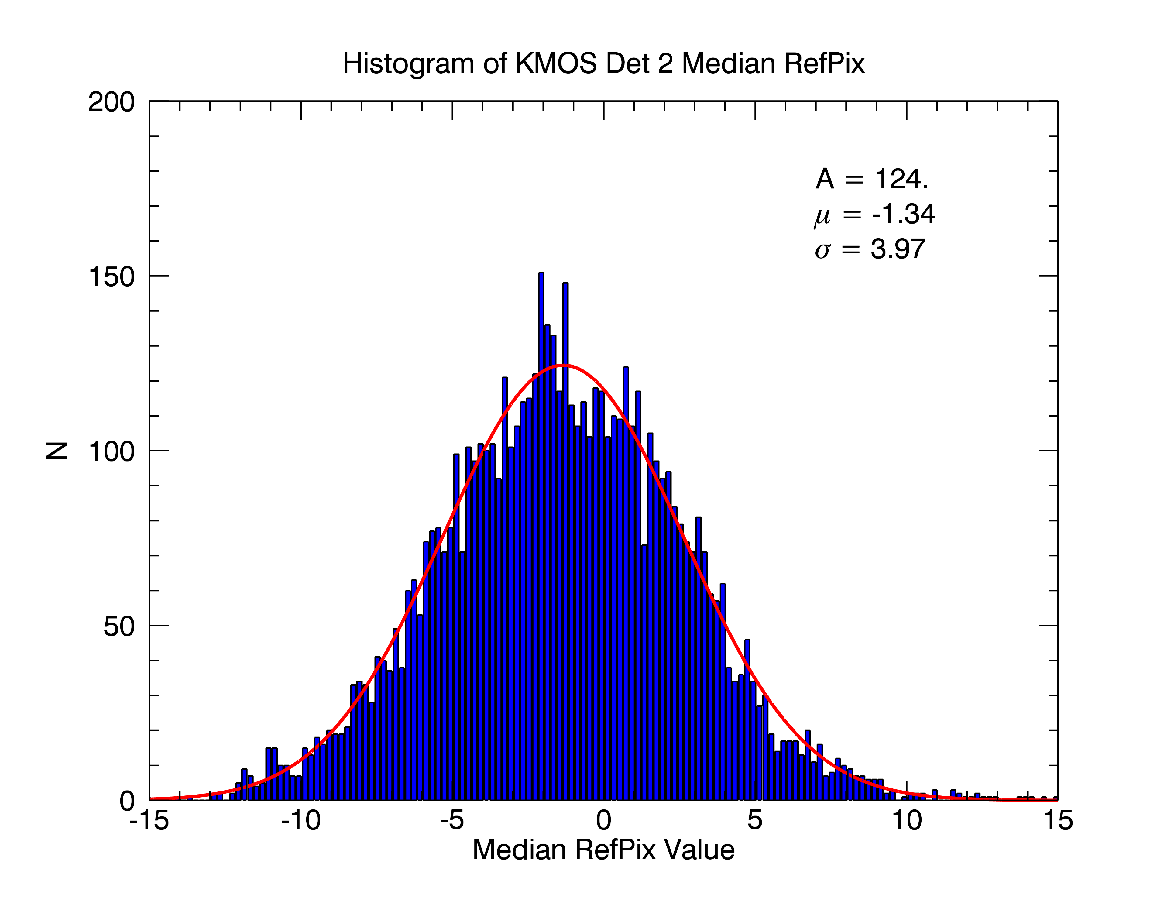
Statistical analysis of >7000 KMOS darks

Slide 22
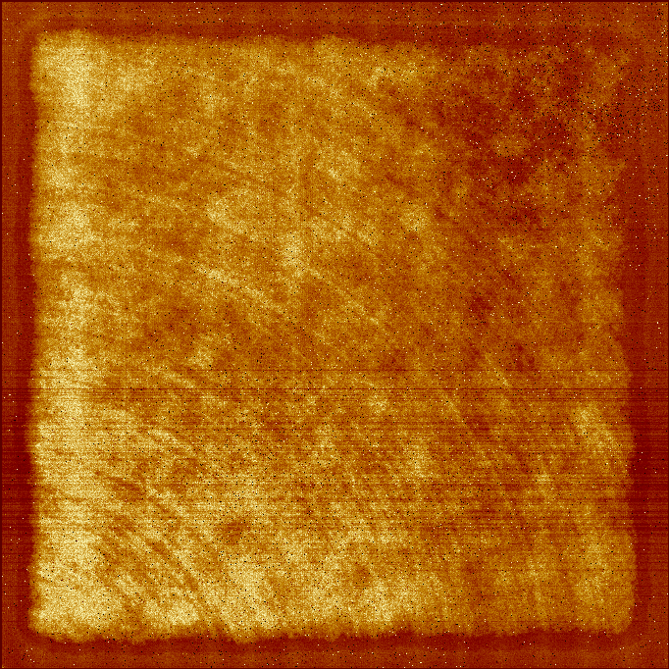
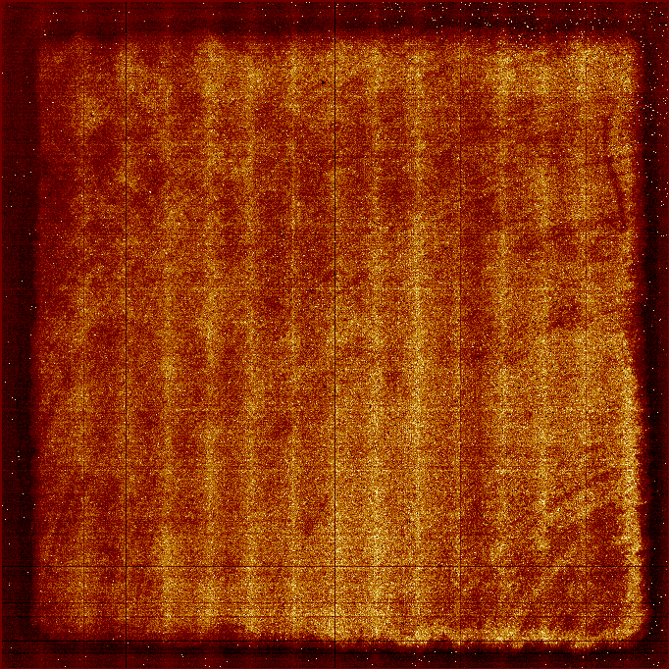
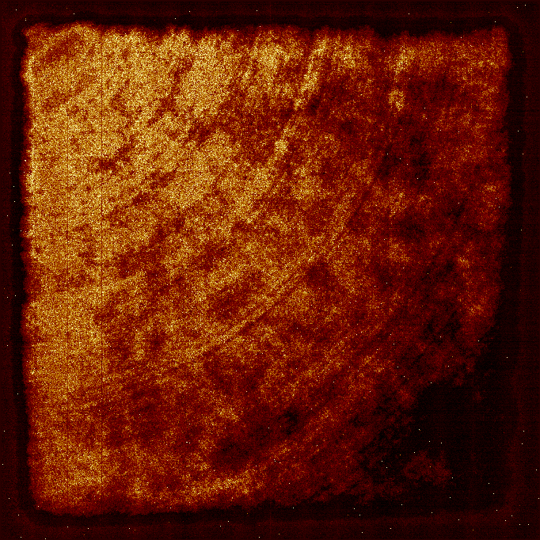
Statistical analysis of >7000 KMOS darks
Detector 1
Detector 2
Detector 3
dPix/dRefpix
dPix/dRefpix
dPix/dRefpix

Slide 23
Statistical analysis of >7000 KMOS darks
Detector 1
Detector 2
Detector 3
Analysis
Pipeline
dPix/dRefpix
dPix/dRefpix
dPix/dRefpix

Slide 24
H2RG at the telescope
21 H2RG detectors in 13 different environments – 2 different controllers
1 Hawaii2 for MAD
1 Hawaii2RG for SPIFFI – 2005 – IRACE
4 Hawaii2RG for HAWKI – 2007 – IRACE
1 Hawaii2RG for X-SHOOTER –2009 – IRACE
1 Hawaii2RG for IRDIS in SPHERE – 2014 – NGC
1 Hawaii2RG for IFS in SPHERE – 2014 – NGC
3 Hawaii2RG for KMOS – 2013 – NGC
1 Hawaii2RG for GRAVITY spectrometer
1 Hawaii2RG for GRAVITY acquisition camera
1 Hawaii2RG for MATISSE – 2018 delivery
3 Hawaii2RG for CRIRES mosaic – 2018 delivery
1 Hawaii2RG for CRIRES slit viewer – 2018 delivery
2 Hawaii2RG for SPIFFIER/ERIS/NIX – 2019 delivery
6 H2RG controlled by IRACE in 3 cryostats
5 H2RG controlled by NGC in 3 cryostats
Notes:
Each detector tested per instrument, different tests run on each detector.

Slide 25
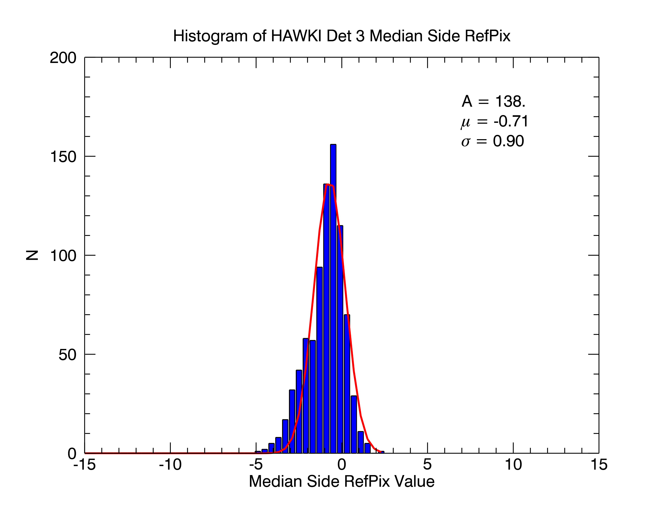
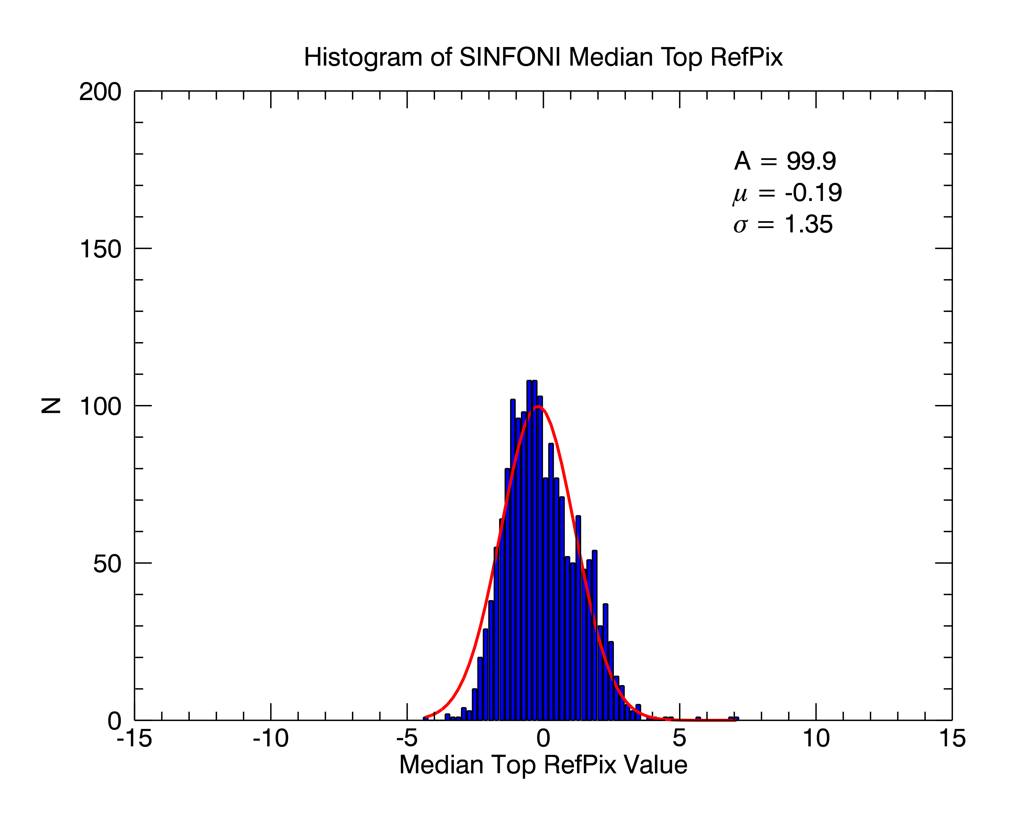
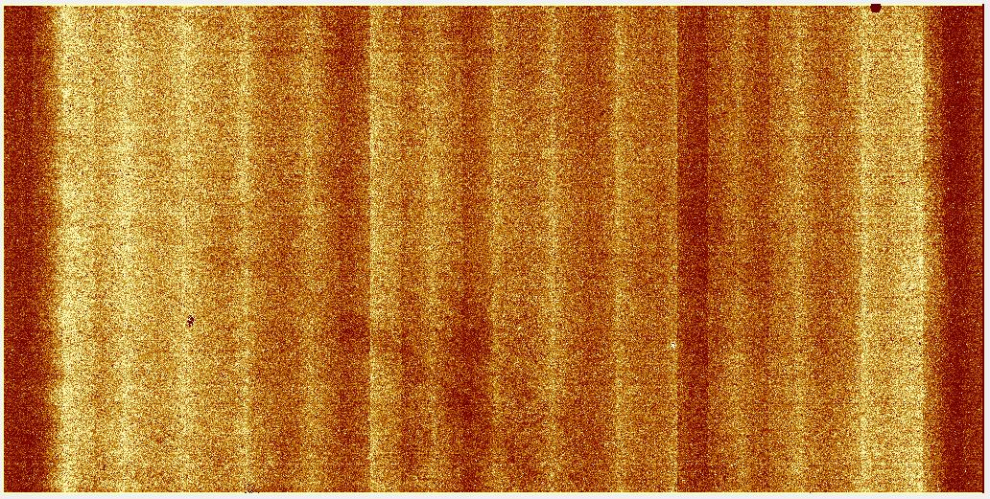
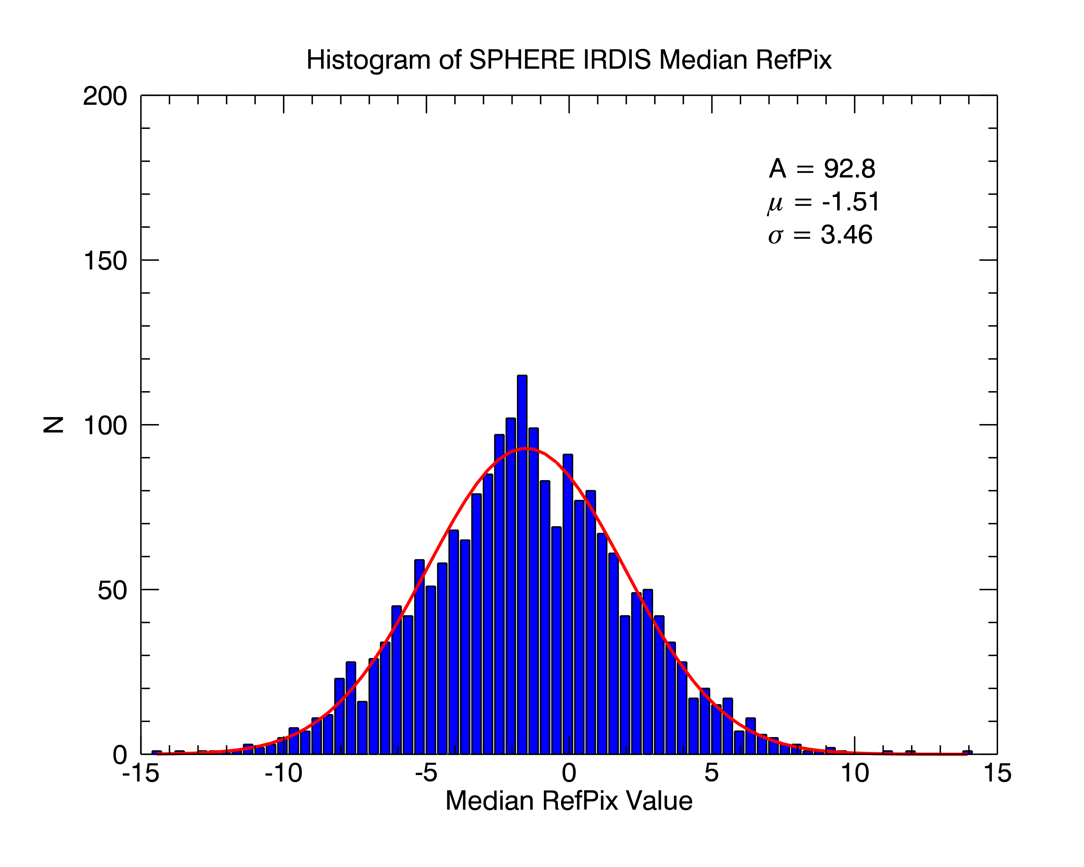
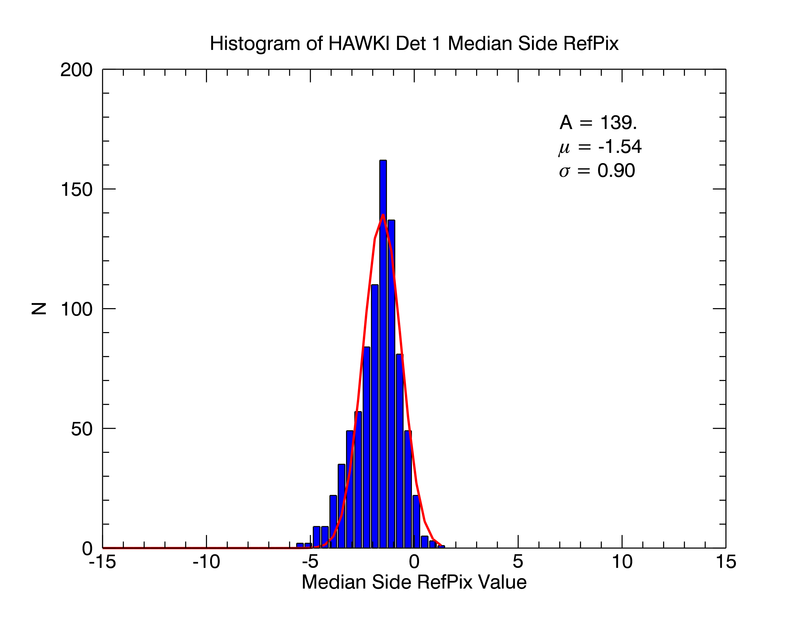
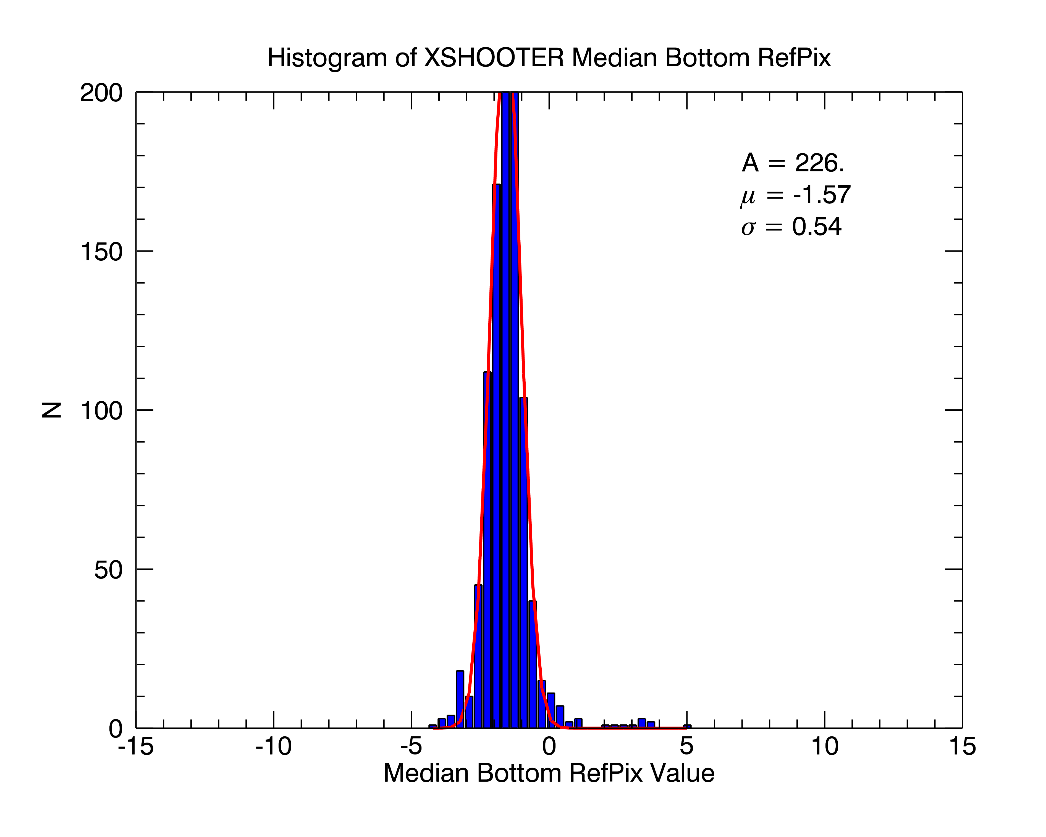
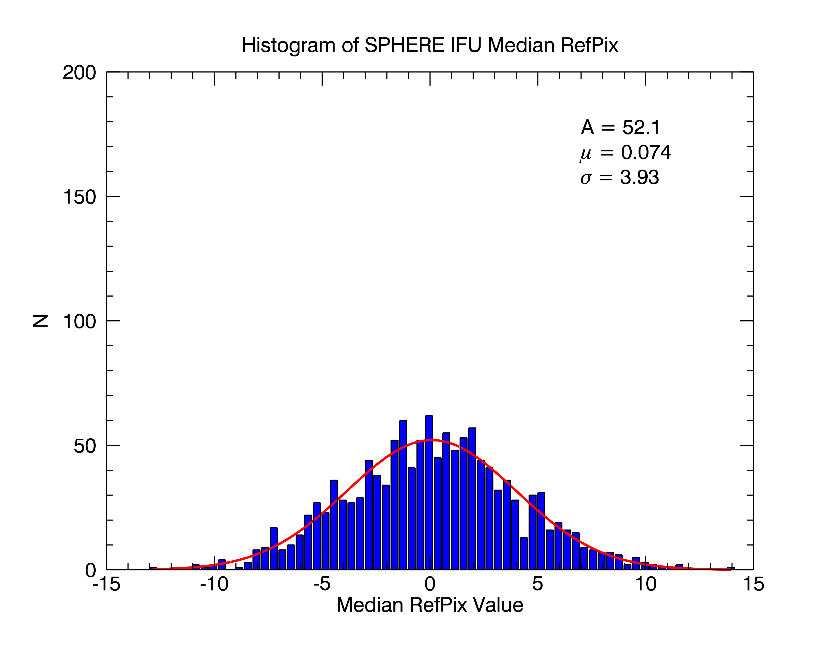
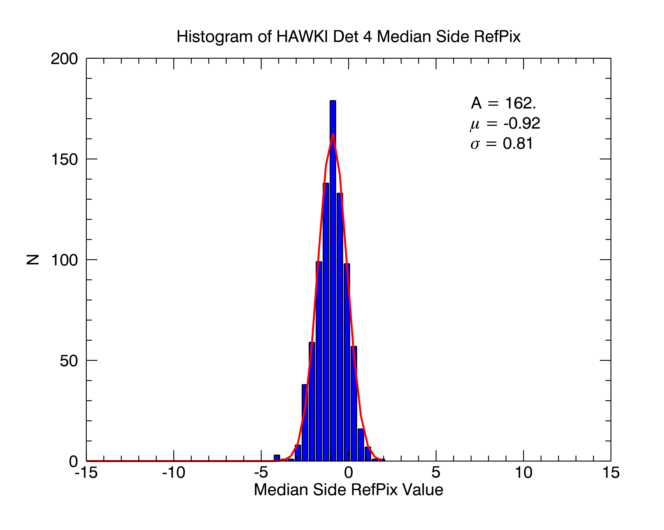
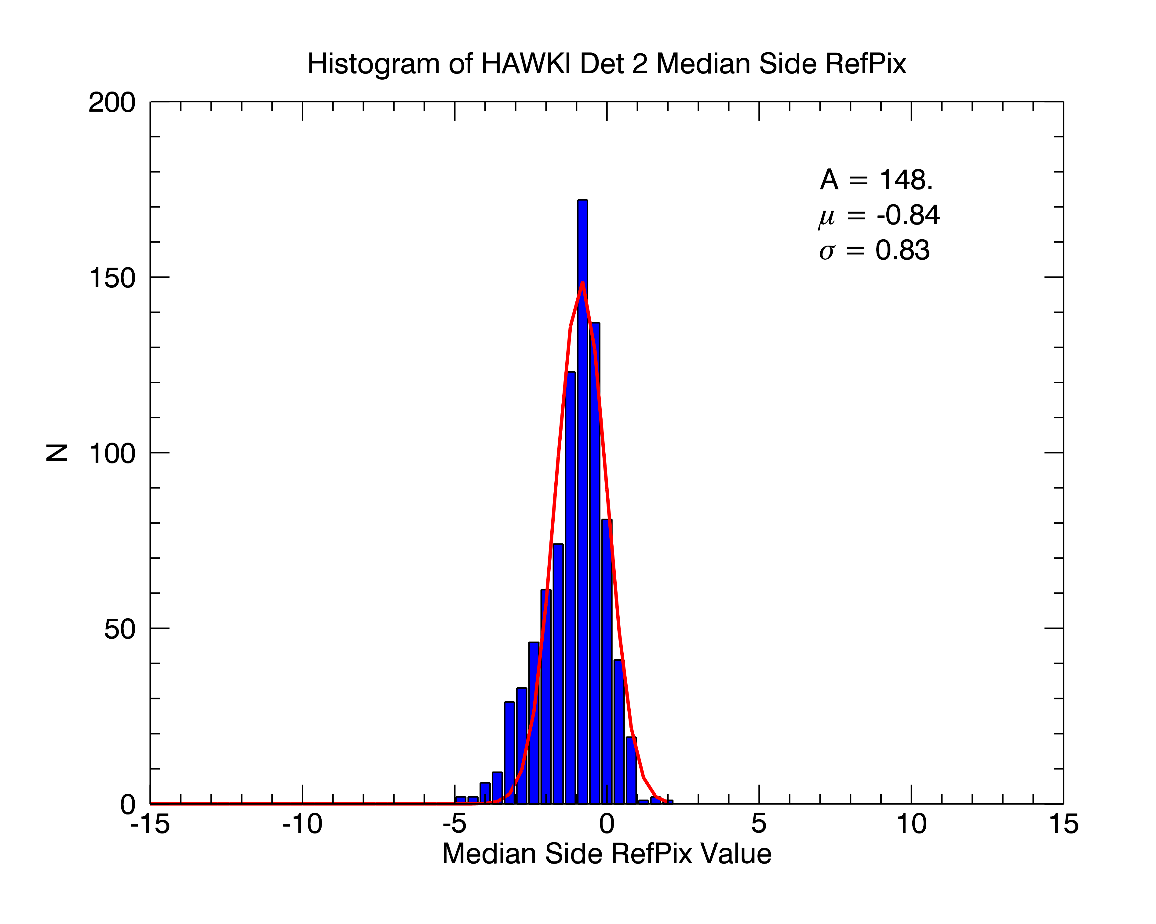
NGC vs. IRACE
𝛔_{ref} ~ 4 ADU
𝛔_{ref} ~ 0.9 ADU
KMOS 1
SPIFFI
SPHERE
IFU
KMOS 2
XSHOOTER
KMOS 3

Slide 26
How was this useful?
Have a correction for the picture frame.
Discovered a controller problem.
Set specifications on bias stabilities.

Slide 27
FIAT Detector Data
Comprehensive
Standardized
Searchable/Linkable
QE
Cosmetics
IPC
Reciprocity Failure
Picture Frame
Channel offsets
Persistence
Cross-talk
Full well
Dark Current
Read noise
Linearity
?

Slide 28
Building a Detector Model
ACN
QE
IPC
Cosmetics
Picture Frame
Reciprocity Failure
Channel offsets
Persistence
“Epoxy” pattern
Full well
Cross-talk
Read noise
Dark Current
?
Linearity

Slide 29
Building a Detector Model
Reference pixel correction
Wavelength
ACN
QE
Read Speed
IPC
Cosmetics
Bias Voltage Variations
Picture Frame
Reciprocity Failure
?
Channel offsets
?
Temperature Variations
Persistence
“Epoxy” pattern
Full well
Temperature
Cross-talk
Read noise
Bias voltages
Dark Current
Exposure
?
Linearity
?
Fluence
?

Slide 30
ELT NIR Detector Characterization
ELT requires a statistically relevant number of identical detectors
Tested in the same way
Monitored over time
Make a model of detector behavior
Use for Optimization
Use for calibration/analysis pipeline
Learn about detectors!

Slide 31
Credits
Trevor Mendel (MPE)
Derek Ives (ESO)
Simon Tulloch (ESO)
Leander Mehrgan (ESO)
Matthias Seidel (ESO)
…..and the rest of the ESO detector group.

