Slide 1



A photon-counting detector for exoplanet missions
Don Figer¹, Joong Lee¹, Brandon Hanold¹, Brian Aull², Jim Gregory², Dan Schuette²
¹Center for Detectors, Rochester Institute of Technology
²MIT Lincoln Laboratory
CfD
Notes:
This paper summarizes progress of a project to develop photon-counting detectors for NASA exoplanet missions through a radiation testing program. The project, funded by NASA ROSES TDEM, uses a 256x256 pixel silicon Geiger-Mode Avalanche Photodiode (GM-APD) per pixel, each individually bump-bonded to a silicon readout circuit. Each pixel independently registers the arrival of a photon and can be reset and ready for another photon within 100 ns. The pixel has built-in circuitry for independently counting photo-generated events. The readout circuit is multiplexed to read out the photon arrival events. The signal chain is inherently digital, allowing for noiseless transmission over long distances. The detector always operates in photon counting mode and is thus not susceptible to excess noise factor that afflicts other technologies. It continues operating with shot-noise limited performance up to extremely high flux levels, >10^6 photons/second/pixel, and delivers signal-to-noise ratios on the order of thousands for higher fluxes. Its performance is expected to be maintained at a high level throughout mission lifetime in the presence of the expected radiation dose.

Slide 2
Detector Properties and SNR
Notes:
Signal to noise ratio depends on detector properties. By reducing detector read noise, SNR increases. Also, the time to achieve a fixed SNR decreases. For photon-starved applications, zero read noise is very important.
2

Slide 3
Exoplanet Imaging Example
The exposure time required to achieve SNR=1 is much lower for a zero read noise detector.
Notes:
The table gives exposures times to produce SNR=1 for a typical planet detection space mission. Note the dramatic reduction in time required for a zero noise detector. R=100 is assumed, and the effective planet flux is about 10 photons/hour per pixel. The nearby starlight is suppressed at the 10^-10 level by optical nulling. Zodiacal light contributes about 0.0015 electrons/s/pixel.

Slide 4
Photon-Counting Detectors
Photon-counting detectors detect individual photons.
They typically use an amplification process to produce a large pulse for each absorbed photon.
These types of detectors are useful in low-light and high dynamic range applications
  nighttime surveillance
  daytime imaging
  faint object astrophysics
  high time resolution biophotonics
  real-time hyperspectral monitoring of urban/battlefield environments
  orbital debris identification and tracking
Notes:
This slide gives the reasons why we use Geiger-Mode Avalanche Photodiodes (GM-APDs) for photon counting.

Slide 5
Operation of Avalanche Photodiode
Linear
on
Geiger
mode
mode
on
Linear
Geiger
quench
mode
mode
Current
avalanche
Current
Current
Current
off
off
arm
V_{dc} + ΔV
V
V
br
br
Voltage
Voltage
Notes:
5
The GM-APD is held above breakdown. An avalanche occurs when a free charge enters the high field region. The avalanche is quenched by a circuit that brings the voltage below breakdown.

Slide 6
Performance Parameters
Photon detection efficiency (PDE)
  The probability that a single incident photon initiates a current pulse that registers in a digital counter
Dark count rate (DCR)
  The probability that a count is triggered by dark current
Single photon input
APD output
time
Discriminator
level
time
Digital comparator output
time
time
time
Successful
single photon
detection
Photon absorbed but insufficient gain – missed count
Dark count – from dark current
Notes:
6
PDE and DCR are two of the most important characterization parameters for GM-APDs.

Slide 7
Avalanche Diode Architecture
Notes:
7
This cartoon is a schematic cross-section of a GM-APD. It shows the low field region where photons are converted into electron-hole pairs and the high field region where electrons are accelerated.

Slide 8
Zero Read Noise Detector ROIC
8
Notes:
This is a floorplan and picture of the 256x256 ROIC for the Moore project.
8

Slide 9
Zero Noise Detector Project Goals
Operational
  Photon-counting
  Wide dynamic range: flux limit to >10⁸ photons/pixel/s
  Time delay and integrate
Technical
  Backside illumination for high fill factor
  Moderate-sized pixels (25 μm)
  Megapixel array
Notes:
The Moore detector will have extraordinary capabilities in a competitive device and pixel size format. It will be capable of delivering high dynamic range and ultra-fast imaging.

Slide 10
Zero Noise Detector Specifications
Optical (Silicon) Detector Performance
Parameter | Phase 1 Goal | Phase 2 Goal
Format | 256x256 | 1024x1024
Pixel Size | 25 µm | 20 µm
Read Noise | zero | zero
Dark Current (@140 K) | <10⁻³ e⁻/s/pixel | <10⁻³ e⁻/s/pixel
QEª Silicon (350nm,650nm,1000nm) | 30%,50%,25% | 55%,70%,35%
Operating Temperature | 90 K – 293 K | 90 K – 293 K
Fill Factor | 100% | 100%
ªProduct of internal QE and probability of initiating an event. Assumes antireflection coating match for wavelength region.
Notes:
The proposed performance for the optical (silicon) Moore detector is shown in the table. In Phase 1, we will fabricate and test a moderate-size detector, and in Phase2, we will do the same for a large detector.

Slide 11
Zero Noise Detector Specifications
Infrared (InGaAs) Detector Performance
Parameter | Phase 1 Goal | Phase 2 Goal
Format | Single pixel | 1024x1024
Pixel Size | 25 µm | 20 µm
Read Noise | zero | zero
Dark Current (@140 K) | TBD | <10⁻³ e⁻/s/pixel
QEª (1500nm) | 50% | 60%
Operating Temperature | 90 K – 293 K | 90 K – 293 K
Fill Factor | NA | 100% w/o μlens
ªProduct of internal QE and probability of initiating an event. Assumes antireflection coating match for wavelength region.
Notes:
The proposed performance for the infrared (InGaAs) Moore detector is shown in the table. In Phase 1, we will fabricate and test a single test structure, and in Phase2, we will do the same for a large detector. Note that we will likely only pursue an optical OR infrared detector in Phase 2, depending on the maturity of both paths.

Slide 12
Zero Noise Detector Project Status
A 256x256x25μm diode array has been bonded to a ROIC.
An InGaAs array has been hybridized and tested.
Testing is underway.
Depending on results, megapixel silicon or InGaAs arrays will be developed.
Notes:
The slide describes the status of the Moore project.

Slide 13
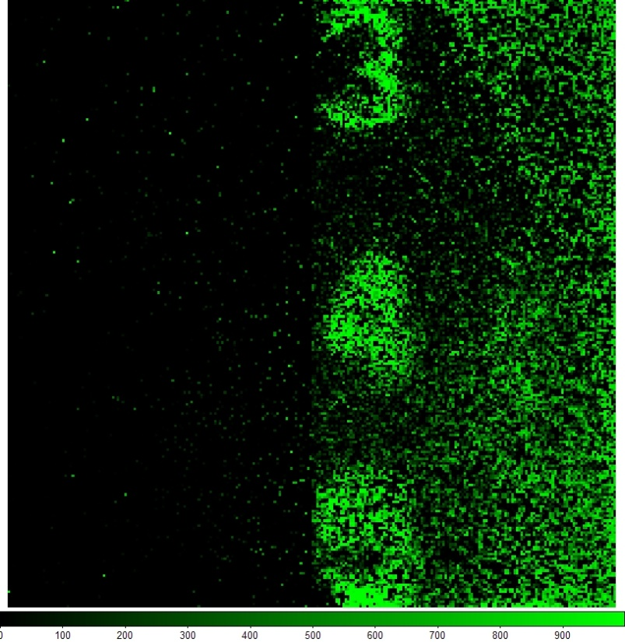
Air Force Target Image
Notes:
This is an image taken with a GM APD biased above breakdown. The image is created by placing an air force target on top of the detector and illuminating with a light source. The image was taken with the detector at room temperature and exposed to ambient light levels. It was formed by summing 1000 expose sequences in which only one photon can be counted per sequence. The event flip-flop for each pixel is read out after each expose sequence and saved for later processing. The events generated by dark current are mitigated by setting a small exposure time in which the APDs are above breakdown and able to achieve a GM avalanche.

Slide 14
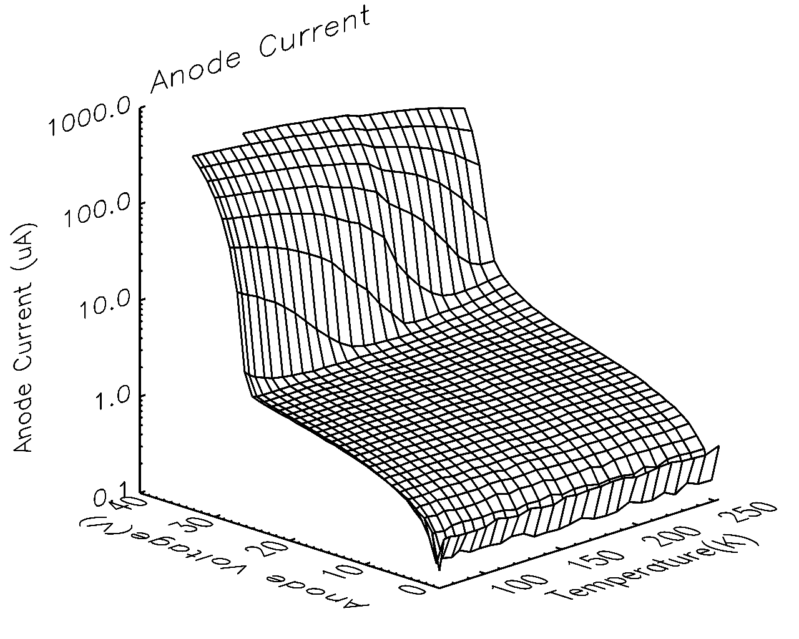
Anode Current vs. V_{bias} and T
Notes:
This is a plot of the anode current vs anode voltage and temperature. It shows the breakdown voltage of the GM APDs and how that breakdown voltage changes vs temperature. Breakdown happens when the anode current sharply increases denoting when the electric field is large enough to accelerate the electron hole pair to the point that they can achieve impact ionization.

Slide 15
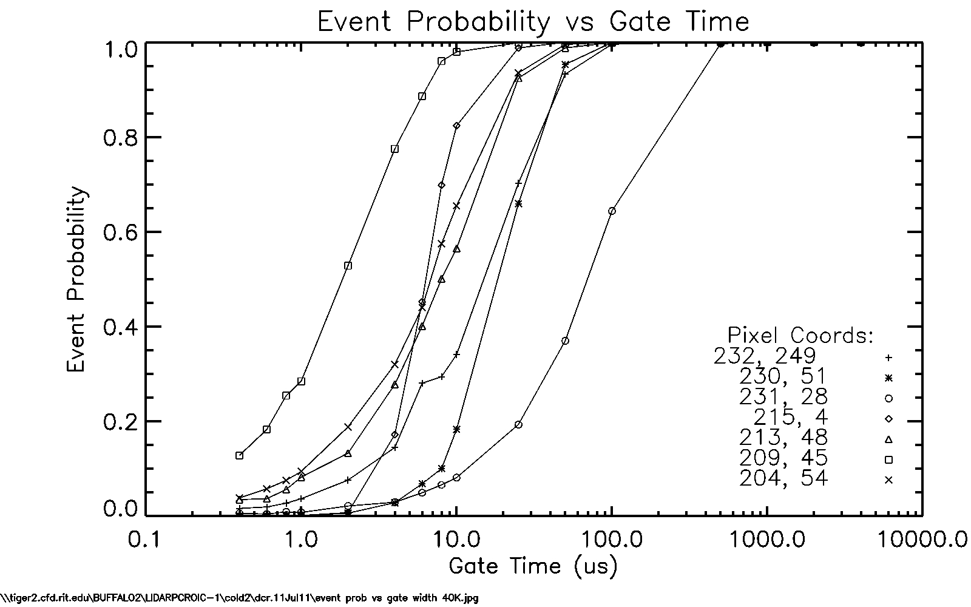
Dark Current
Notes:
This plot shows the event probability vs increasing gate time for a number of pixels. Gate time is defined as the time in which the APDs are able to initiate an avalanche great enough to register and event in the readout circuit. Essentially it is the exposure time. We expect the event probability (i.e. the probability that an event will be generated in a given exposure time) to increase with gate time until the gate time is long enough that either the photon flux or dark current will always generate an event. At this point the pixel is saturated. The event probability due to dark current can be reduced by cooling the detector so that the photon flux has a much greater probability to generate an event. We have identified pixels with what looks like leakage current induced events. This behavior causes the event probability to sharply rise to 1 after a particular gate time. This is because the leakage current is linear, reproducible and will trigger an event when the accumulated charge passes the threshold point of the CMOS trigger circuit.

Slide 16
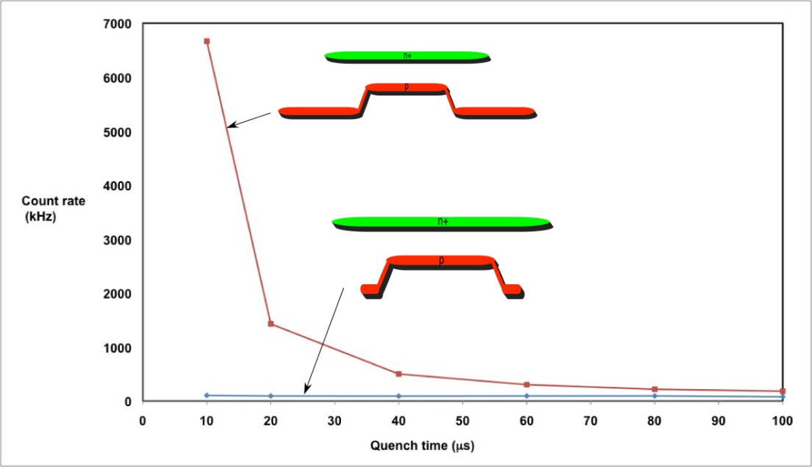
GM APD High/Low Fill Factor
Notes:
Previous testing results for HFF vs. LFF device dark count rate as a function of quench time.

Slide 17
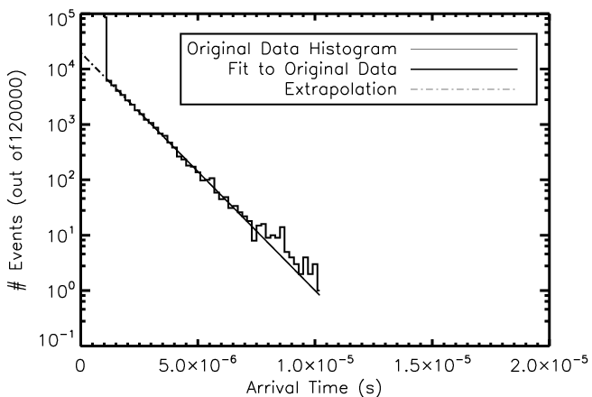
GM APD Self-Retriggering
Simulated Histogram of Avalanche Arrival Times
Notes:
Self-retriggering occurs when photons are generated by the recombination of carriers in an avalanche and are absorbed in the device. This absorption liberates a carrier that induces another avalanche when the device is reset. These carriers have a high probability of causing immediate avalanches.
The number of events in the first bin represents all the cases in which the avalanche occurred while the arm pulse was held high.
Using a fit of the histogram (excluding the first bin), the fit is extrapolated back to the beginning of the arm pulse.
The discrepancy between the expected and actual counts represents the first-bin avalanches caused by self-retriggering.

Slide 18
Radiation Testing Program Overview
Notes:
This section describes the radiation test program.

Slide 19
Building Radiation Testing Program
Simulate on-orbit radiation environment
  choose relevant mission parameters: launch date, mission length, orbit type, etc
  Determine radiation spectrum (SPENVIS)
Transport radiation particles through shielding to estimate the radiation dose on the detector (GEANT4)
Choose beam properties
Design/fab hardware
Obtain baseline data (pre-rad)
Expose to radiation
Obtain data (post-rad)
Notes:
19
This slide outlines the steps in building the radiation testing program.

Slide 20
Mission Parameters
2015 launch date, 5 and 11 year mission durations
Radiation flux depends on relative phasing with respect to solar cycle
Choose representative mission parameters specific to each type of orbit
  L2
  Earth Trailing Heliocentric
  Distant Retrograde Orbits (DRO)
  Low Earth Orbit (LEO) – 600 km altitude (TESS)
Solar protons
  ESP model
  Geomagnetic shielding turned on
Trapped e- and p+
  Inside radiation belt
  AP-8 Min (proton) model
  AE-8 Max (electron) model
  Over-predicts flux at high confidence level setting (from SPENVIS HELP page)
Notes:
To simulate the radiation flux on the detector, relevant mission parameters need to chosen first. The 4 types of orbits are chosen based on the orbits for the proposed missions.
Based on the mission parameters, the trajectory over the life mission can be calculated. Using that information, radiation models can be used to calculate the flux on the detector.

Slide 21
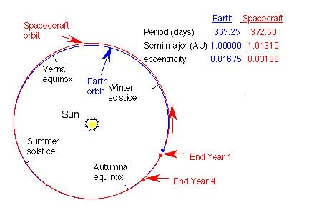
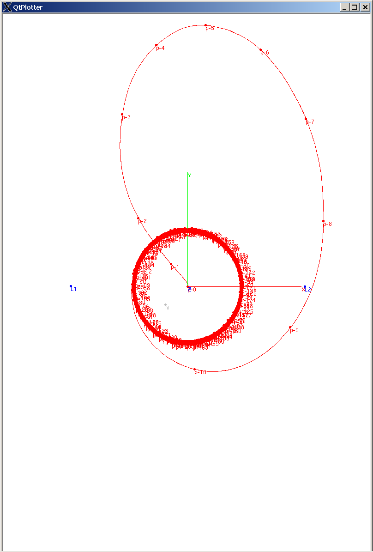
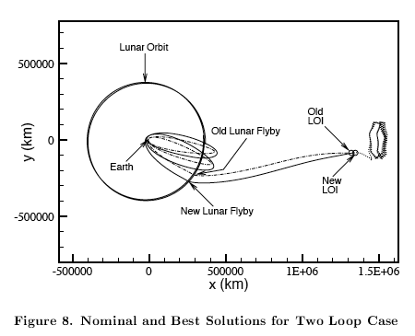
Orbits
DRO
Sun-Earth Rotating Frame
Earth
Trailing
Earth Launch
C3 ~ 0.05 km²/s²
185 km altitude
28.5° inclination
Earth DRO
700,000 ± ~50,000 km
radius from Earth
Propagated ~10 years
SIRTF
DRO Insertion
~196 Days + L
Delta-V ~150 m/s
L2
Sun
Earth
WMAP
GIMLI
Top View
(North Ecliptic View)
Notes:
These are the models of three types of possible orbits, based on past or propsed missions, for the exoplanet mission.

Slide 22
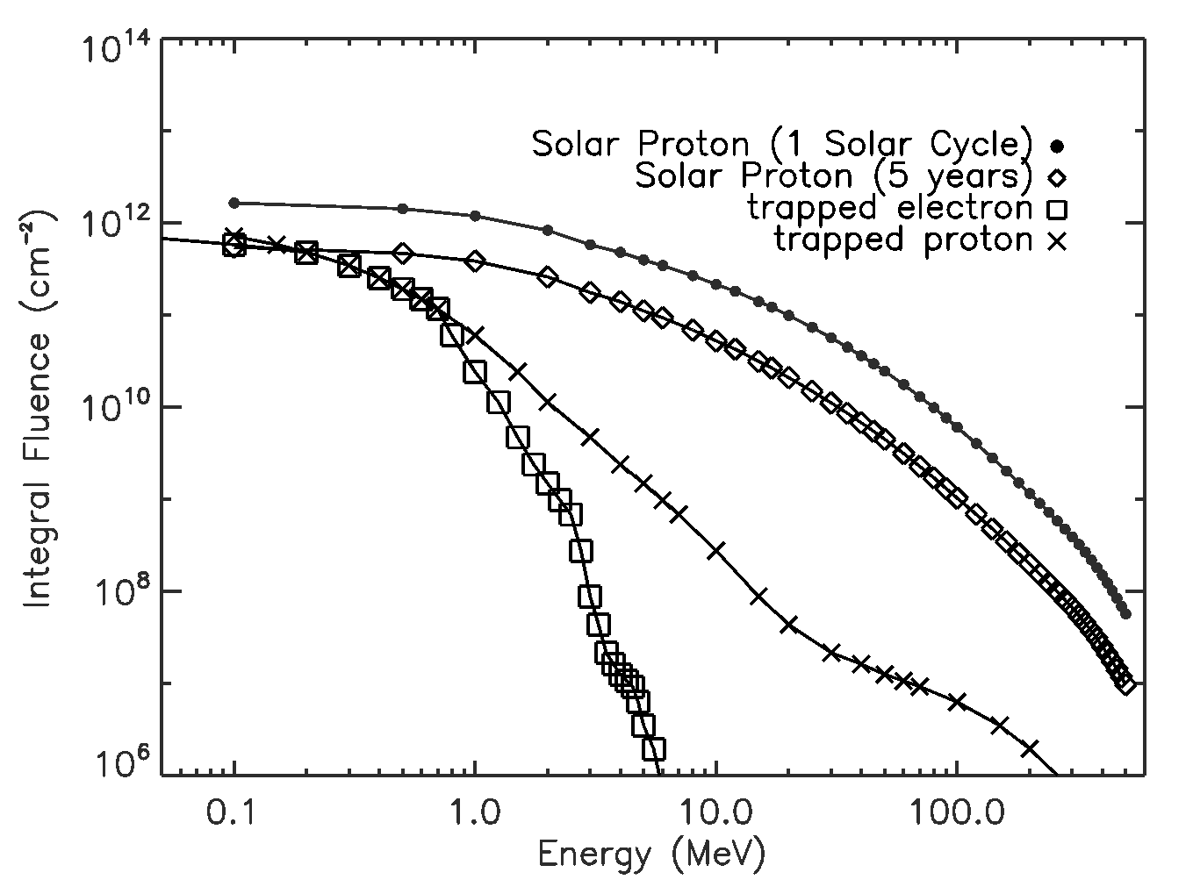
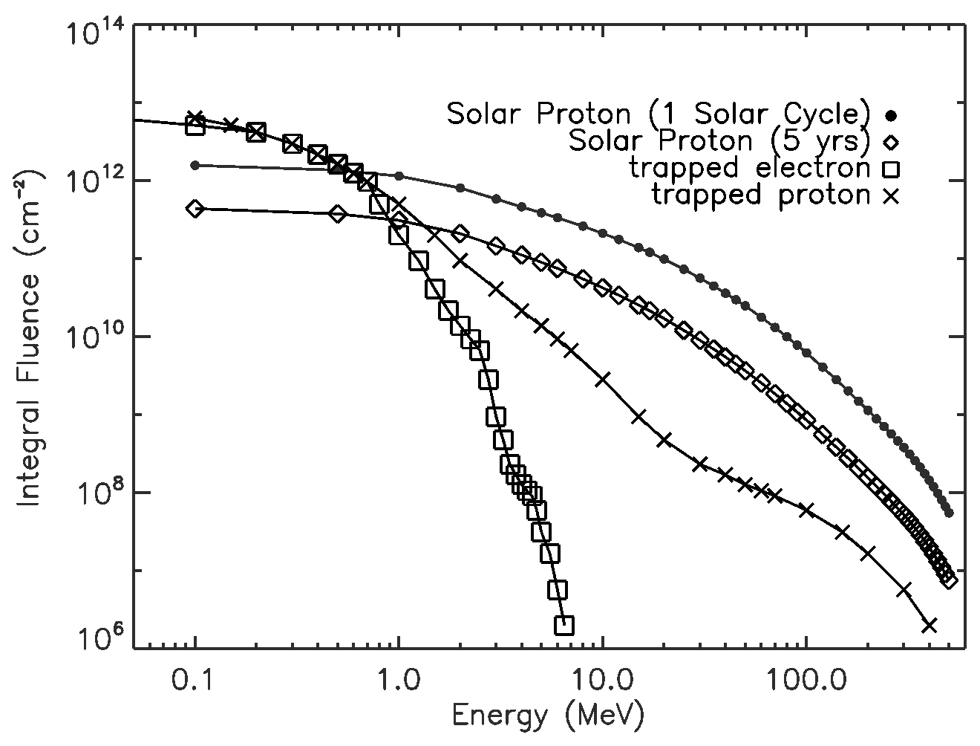
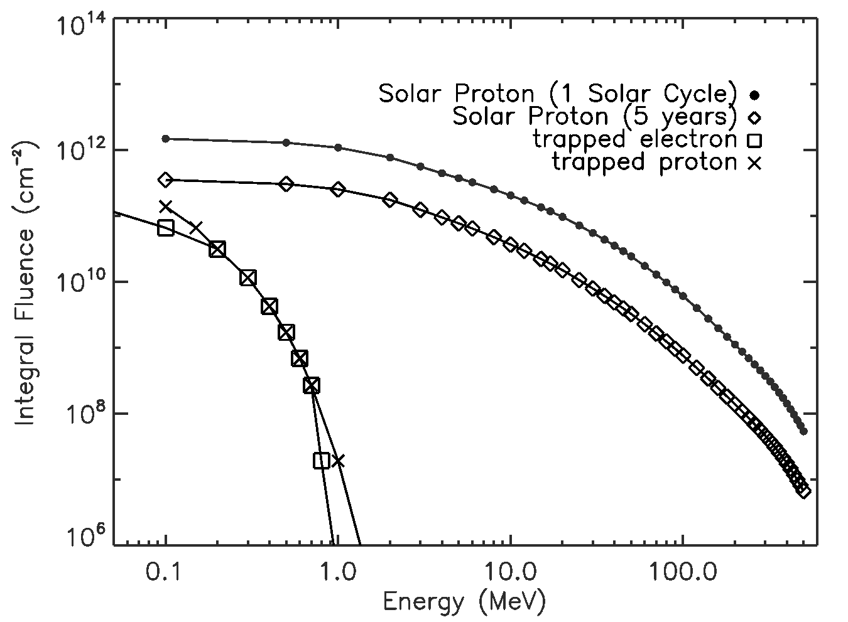
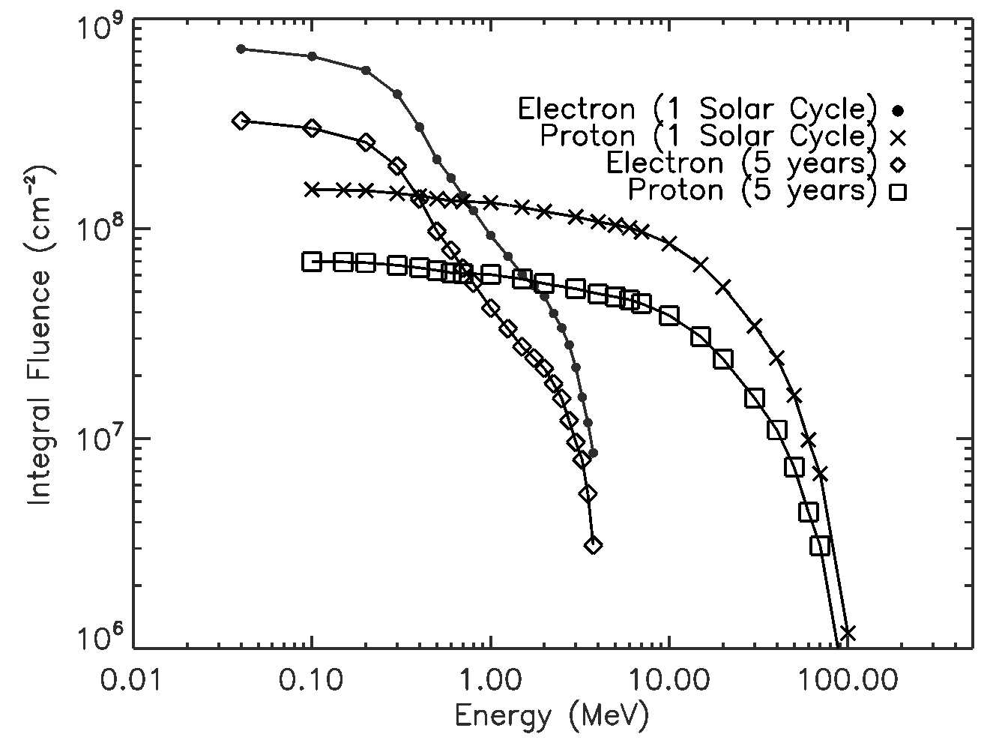
Integrated Particle Fluence
DRO
L2
LEO
Earth Trailing
Notes:
Particle fluences at different orbits are comparable to or lower than those of L2. These plots show the trapped protons, electrons, and solar particles over the life of the mission. For the DRO, L2, Earth Trailing missions, the transfer trajectory to the final orbit is the same for the 5 and 11 year missions. Hence, the flux of trapped protons and electrons are the same for both 5 and 11 year missions. The difference in the trapped proton and electron flux for the three missions is due to their different transfer trajectories. For the LEO orbit, the geomagnetic shielding blocks out the solar protons, so there is only trapped proton and electron flux.

Slide 23
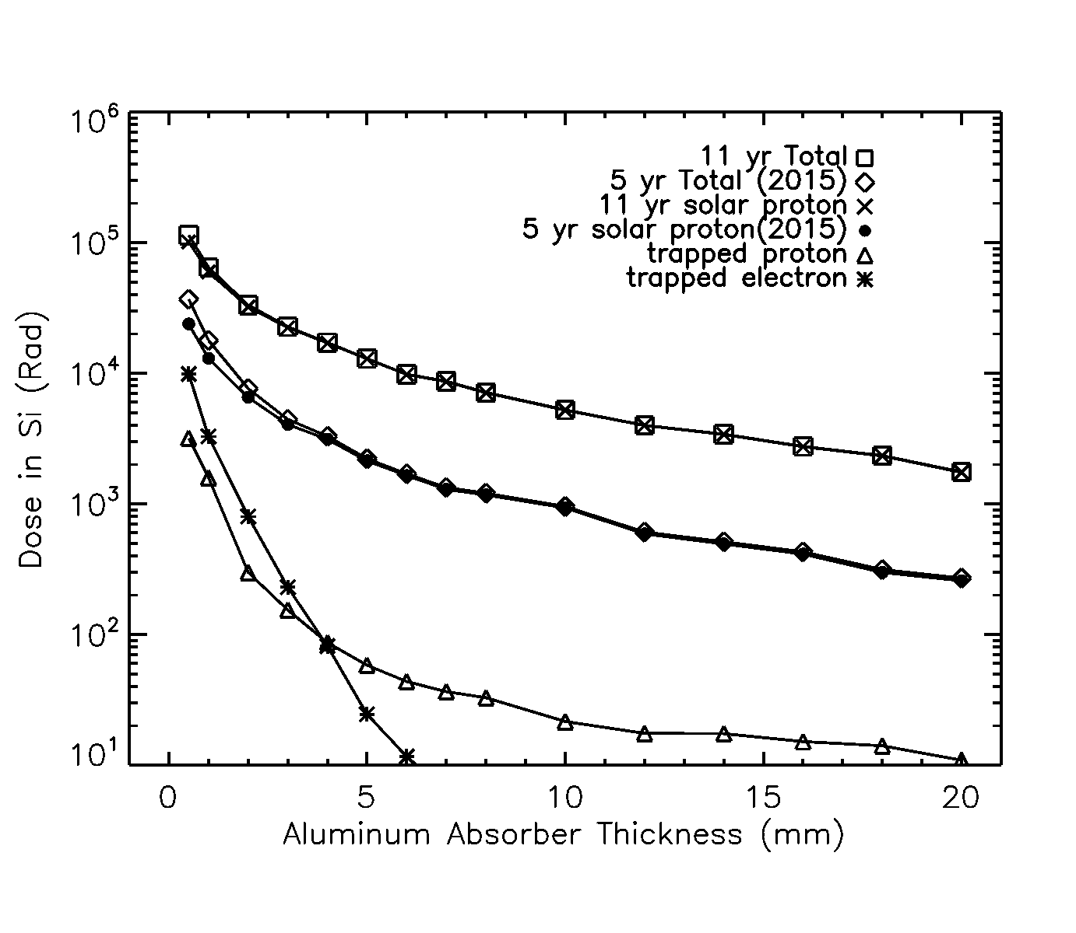
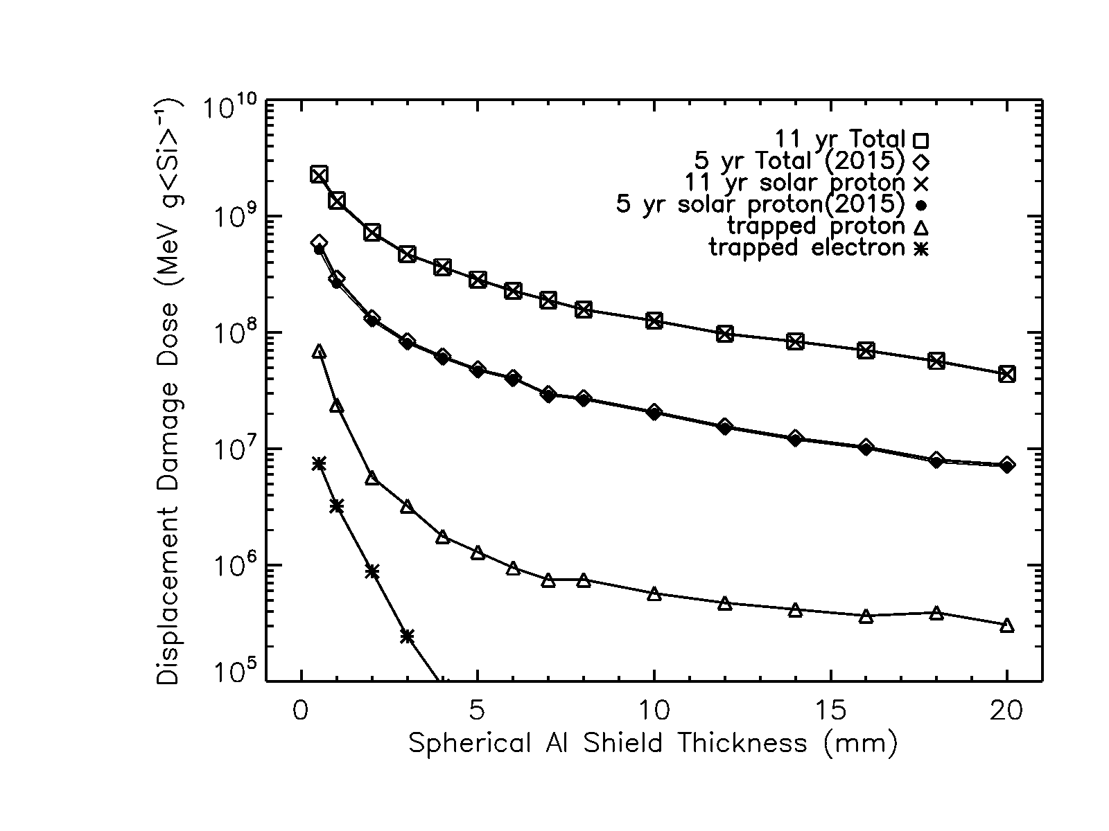
Total Ionizing Dose and Non-Ionizing Dose (at L2)
Notes:
We used GEANT4 based transport code Mulassis
Silicon target enclosed with spherical aluminum shielding
Radiation dose due mostly to solar protons
For 1cm Al shielding
Total Ionizing dose of 1 (5) krad for 5 (11) yr mission
Displacement damage (non-ionizing) dose of 2e7 (1e8) MeV/g for 5 (11) yr mission
Note that 1 Rad is equal to 6.25e7 MeV/g
Non-ionizing damage is caused by nuclear displacement, inelastic scattering, etc. and has a much lower cross section.

Slide 24
Radiation Testing Program
Now that we know the radiation dose the detector is likely to see, we need to build a radiation testing program that is going to simulate the radiation exposure on orbit
We need to choose right beam parameters
Energy, dose rate, particle species
Then, choose radiation facility based on factors above as well as our hardware setup requirements
Vacuum, cryogenics, electrical
We make measurements of relevant quantities pre-, during, post-irradiation to characterize change in detector performance
Notes:
24
All the relevant information about the radiation exposure on orbit is known. Based on those findings as well as practical considerations, we need to make choices for the radiation testing.

Slide 25
Beam Parameters
We want to expose the device to 50 krad (Si).
Due to practical considerations, we can only irradiate the device with a mono-energetic beam.
A device subjected to 50 krad would see 1.18e9 MeV/g of displacement damage dose (DDD) on orbit at L2.
Ideally, a 50 krad exposure to the proton beam should also yield a DDD of 1.18e9 MeV/g to simulate condition on orbit.
For 60 MeV proton beam, the corresponding DDD to a 50 krad exposure is 1.26e9 MeV/g.
Notes:
For radiation testing, the Total Ionizing Dose (TID) is commonly used to quantify the radiation damage. We will expose the device to 50 krad, or 10 times the dose of a 11 year mission. We choose 60 MeV for the radiation beam, as that energy preserves the proportionality between the TID and DDD on orbit, i.e. we expose the device to 10 times the DDD on orbit, also.

Slide 26
Beam Parameters
60 MeV happens to be where the proportionality between TID and DDD on-orbit is preserved
  This depends on thickness of shielding. But if we choose energy around 60 MeV, the proportionality should be more or less preserved.
Dose Rate
  MIL Std 883 Test Method 1019 recommends 50 to 300 rad/sec, although this is for gamma ray beam
  50 rad/sec will still allow us to complete a radiation exposure run in reasonable amount time (~17 min.)
  It makes sense to follow this as higher the rate more chance the device breaks and for dosimetry reasons
Notes:
We will irradiate device at a moderate dose rate per recommendation of MIL Std 883 Test Method 1019, so that we don’t break the device and still finish radiation testing in a reasonable amount of time.

Slide 27
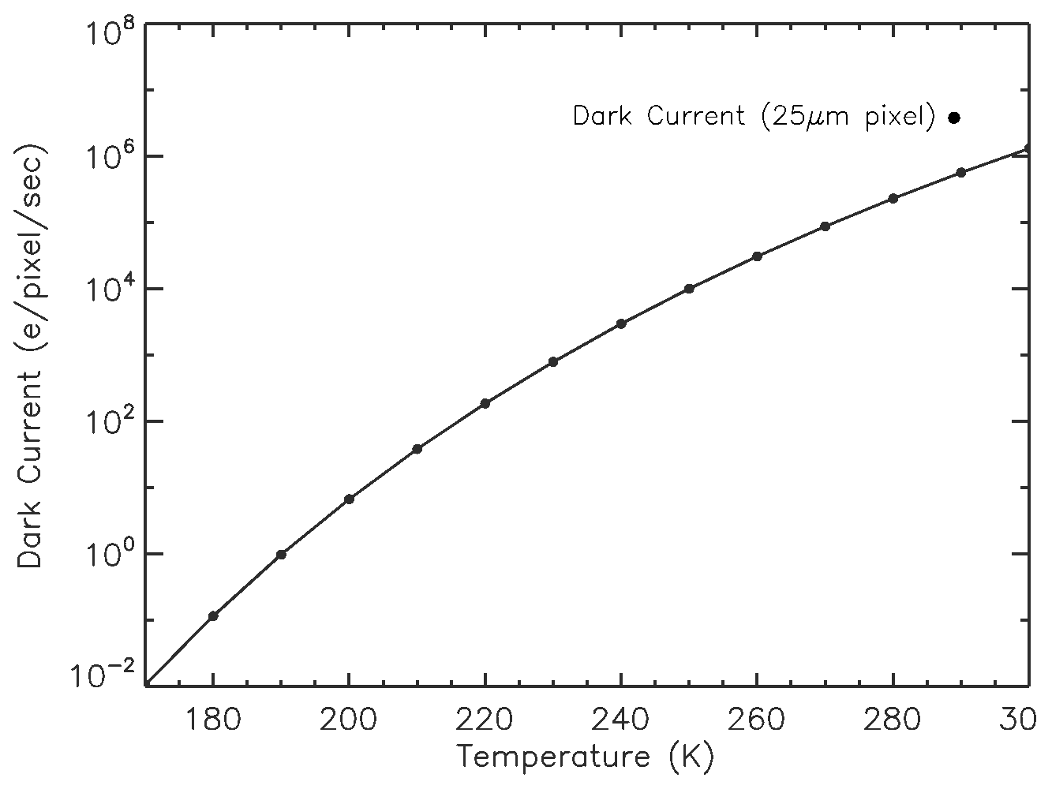
Estimate of Induced Dark Current
K_{DE} = J_{D}/E_{D} =q/(A*ρ)*K_{dark}= 2.09 nA/cm²/MeV at 300 K
  This gives conversion formula to convert E_{D} to current density
  K_{dark}=(1.9±0.6)×10⁵ carriers/cm³/sec per MeV/g for silicon (Srour 2000)
    This is for one week after exposure
  A = 6.25*10⁻⁶ cm²
  ρ = 2.33 g/cm³
  q = 1.6*10⁻¹⁹ C
For 50 krad exposure to 60 MeV proton beam is E_{D} is 16.05 MeV
Mean Dark Current = K_{DE} × E_{D} = 33.5 nA/cm² at 300 K
Or, Mean Dark Current = 2.25 fA/pixel = 14000 e⁻/pixel/sec at -20 °C (one week after exposure)
Notes:
In general, radiation induced dark current in silicon device is a displacement damage dose quantity, independent of the type of device. Using a formula in paper by Srour, an estimate of the radiation induced dark current expected after radiation testing can be calculated.

Slide 28
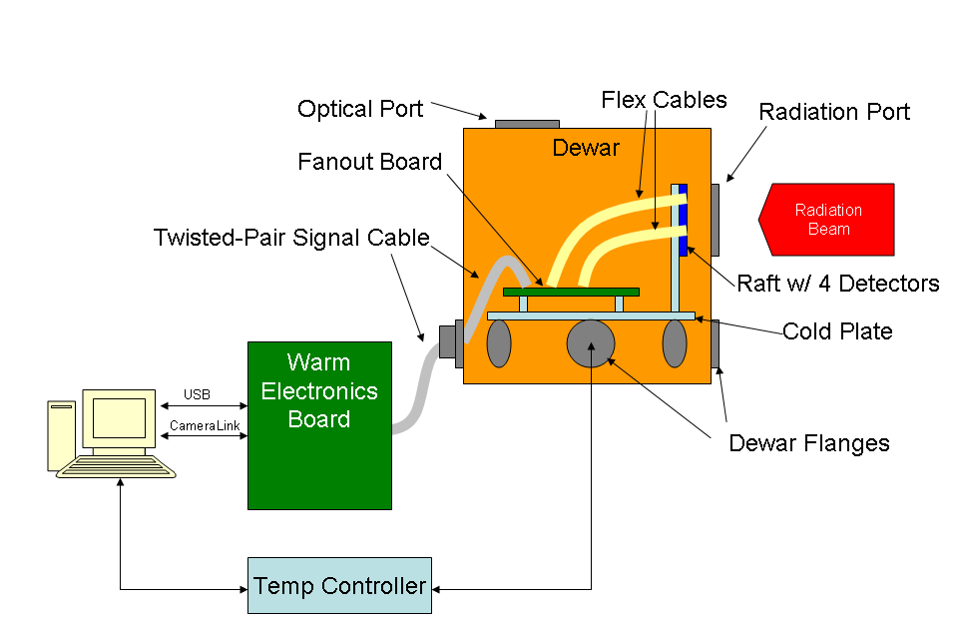
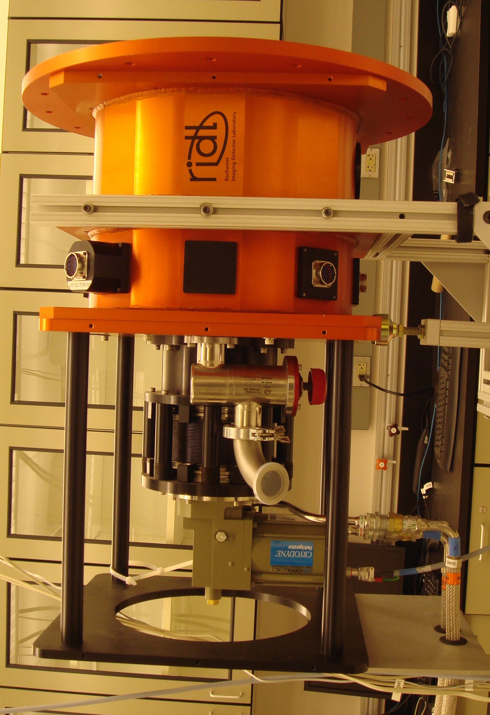
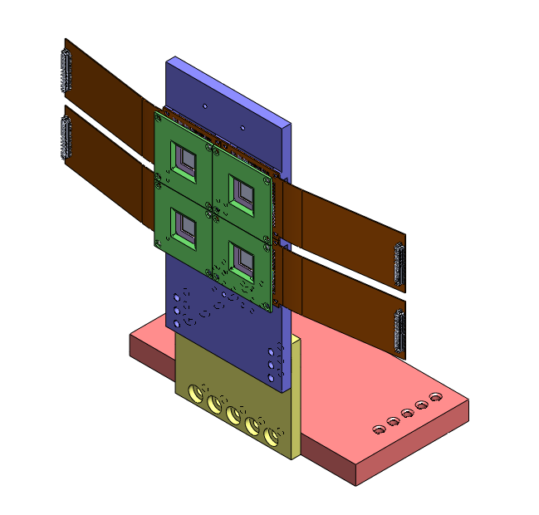
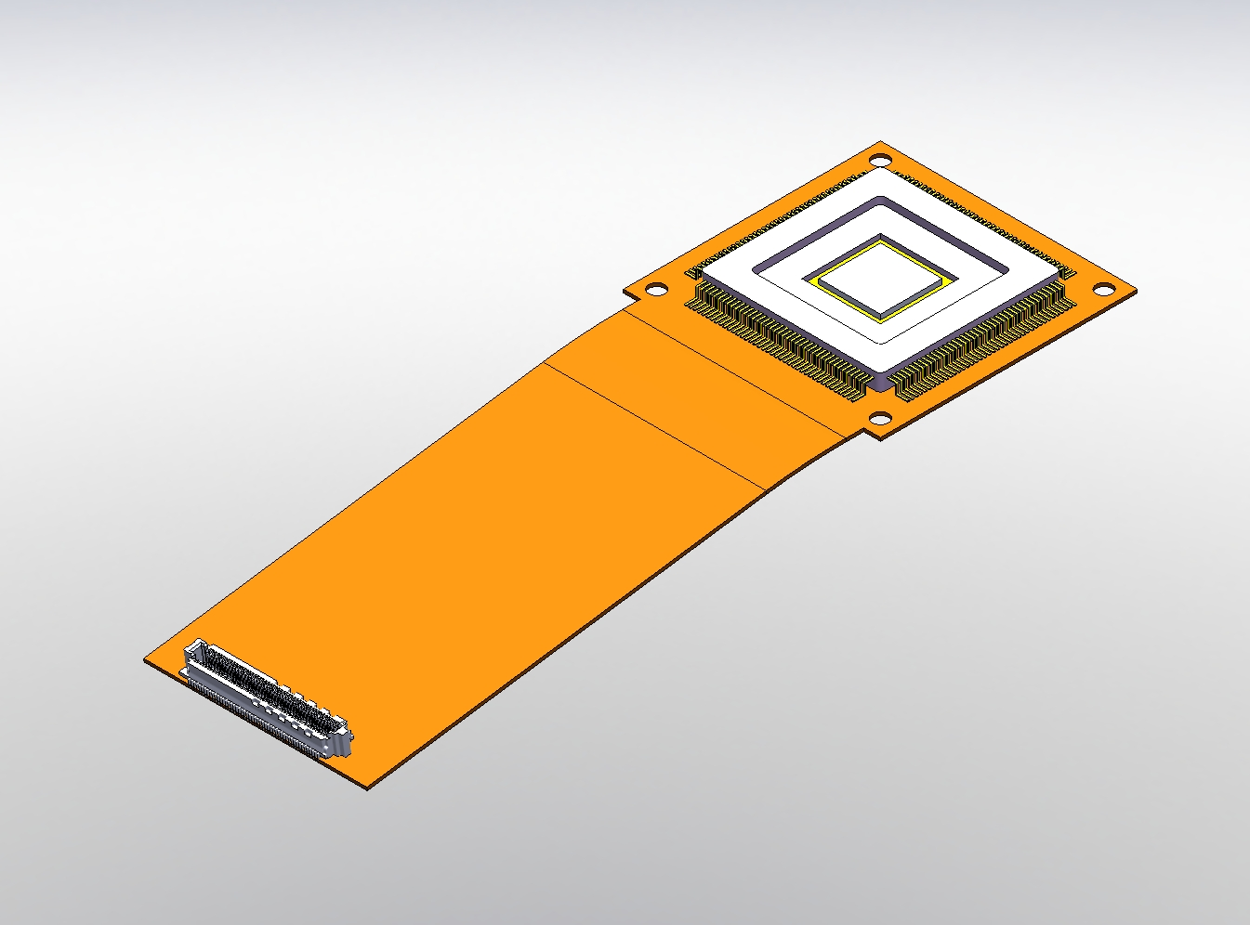
Test Hardware
Notes:
In general, radiation induced dark current in silicon device is a displacement damage dose quantity, independent of the type of device. Using a formula in paper by Srour, an estimate of the radiation induced dark current expected after radiation testing can be calculated.

Slide 29
Conclusions
We have developed, and are testing, a 256x256 photon-counting imaging array detector.
After lab characterization, we will expose four devices to radiation beam and then re-test.
Notes:
To simulate the radiation flux on the detector, relevant mission parameters need to chosen first. The 4 types of orbits are chosen based on the orbits for the proposed missions.
Based on the mission parameters, the trajectory over the life mission can be calculated. Using that information, radiation models can be used to calculate the flux on the detector.

Slide 30
Detector Virtual Workshop
Year-long speaker series dedicated to future advanced detectors
Talks streamed and archived
Email if interested in being on distribution list:
figer@cfd.rit.edu
Notes:
To simulate the radiation flux on the detector, relevant mission parameters need to chosen first. The 4 types of orbits are chosen based on the orbits for the proposed missions.
Based on the mission parameters, the trajectory over the life mission can be calculated. Using that information, radiation models can be used to calculate the flux on the detector.

