Slide 1
GRST Drain
Sense Node
RG Drain
SF Drain
GRST Drain
Sense Node
RG Drain
SF Drain
OUT to readout
OUT to readout
pinning implant (p⁺)
pinning implant (p⁺)
GRST
TG
RG
SF
R_SEL
GRST
TG
RG
SF
R_SEL
n⁺
n⁺
n⁺
n⁺
n⁺
n⁺
n⁺
n⁺
n⁺
n⁺
n⁺
n⁺
photodiode implant (n)
photodiode implant (n)
pixel p-well (p⁺)
pixel p-well (p⁺)
pixel p-well (p⁺)
pixel p-well (p⁺)
epitaxy (p)
epitaxy (p)
substrate (p⁺⁺)
substrate (p⁺⁺)

Slide 2
GRST Drain
Sense Node
RG Drain
SF Drain
OUT to readout
pinning implant (p⁺)
GRST
TG
RG
SF
R_SEL
n⁺
n⁺
n⁺
n⁺
n⁺
n⁺
photodiode implant (n)
pixel p-well (p⁺)
pixel p-well (p⁺)
epitaxy (p)
substrate (p⁺⁺)

Slide 3
GRST Drain
Sense Node
RG Drain
SF Drain
GRST Drain
Sense Node
RG Drain
SF Drain
OUT to readout
OUT to readout
pinning implant (p⁺)
pinning implant (p⁺)
GRST
TG
RG
SF
R_SEL
GRST
TG
RG
SF
R_SEL
n⁺
n⁺
n⁺
n⁺
n⁺
n⁺
n⁺
n⁺
n⁺
n⁺
n⁺
n⁺
photodiode implant (n)
photodiode implant (n)
pixel p-well (p⁺)
pixel p-well (p⁺)
pixel p-well (p⁺)
pixel p-well (p⁺)
epitaxy (p)
epitaxy (p)
substrate (p⁺⁺)
substrate (p⁺⁺)

Slide 4
GRST Drain
Sense Node
RG Drain
SF Drain
OUT to readout
pinning implant (p⁺)
GRST
TG
RG
SF
R_SEL
n⁺
n⁺
n⁺
n⁺
n⁺
n⁺
photodiode implant (n)
pixel p-well (p⁺)
pixel p-well (p⁺)
epitaxy (p)
substrate (p⁺⁺)

Slide 5


GRST Drain
Sense Node
RG Drain
SF Drain
OUT to readout
pinning implant (p⁺)
GRST
TG
RG
SF
R_SEL
n⁺
n⁺
n⁺
n⁺
n⁺
n⁺
photodiode implant (n)
pixel p-well (p⁺)
pixel p-well (p⁺)
e⁻
epitaxy (p)
h⁺
e⁻
e⁻
e⁻
h⁺
h⁺
h⁺
substrate (p⁺⁺)

Slide 6
GRST Drain
Sense Node
RG Drain
SF Drain
OUT to readout
pinning implant (p⁺)
GRST
TG
RG
SF
R_SEL
n⁺
n⁺
n⁺
n⁺
n⁺
n⁺
photodiode implant (n)
pixel p-well (p⁺)
pixel p-well (p⁺)
epitaxy (p)
substrate (p⁺⁺)

Slide 7
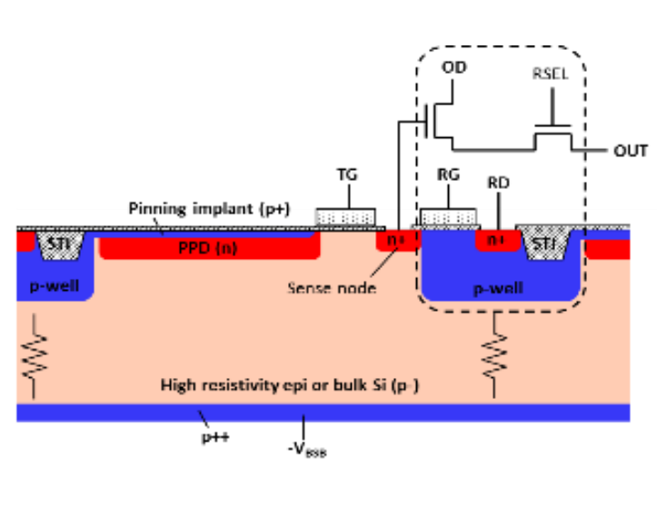
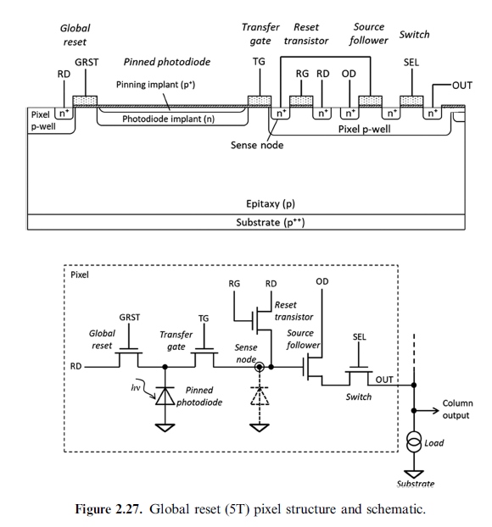


> 9eV photon
> 9eV photon
> 9eV photon
UV photon
Effect of >9 eV radiation:
Positive charge in SiO₂
Partially compensates negative passivation charge
Weaker backside electric field
Higher surface recombination
Reduced UV quantum efficiency
Native SiO₂ Layer
Back Side
h⁺
h⁺
h⁺
UV photon
e⁻
e⁻
e⁻
visible photon
MBE-grown
p⁺ Si layer
Back Side
Field Free Region
Detector Region
Dead Region
(> 10 nm)
Electric Field Region
Pixel Structure
Front Side
Silicon
5T Pixel Structure
Front Side

Slide 8
Before Backside Processing
After Backside Processing
UV photon
Back Side
visible photon
UV photon
visible photon
Detector Region
Dead Region
(> 10 nm)
Anti-reflection Coating
Backside Passivation (MBE)
Dead Region (< 5 nm)
Silicon
Detector Region
5T Pixel Structure
5T Pixel Structure
Front Side

Slide 9

Uneven Polished Surface
Bulk Removal and Polishing
Field Free Region (diffusion charge transport)
Field Free Region
Field Free Region
Bulk Removal and Polishing
Field Free Region
Electric Field Region (drift charge transport)
Electric Field Region
Electric Field Region
Electric Field Region
5T Pixel Structure
5T Pixel Structure
5T Pixel Structure
5T Pixel Structure
Front Side Mount and Protection
Front Side Mount and Protection
Front Side Mount and Protection
HNA Etching Bath
HNA Etching Bath
Uneven Polished Surface
Uneven Polished Surface
Even Etched Surface
Even Etched Surface
Field Free Region
Field Free Region
Field Free Region
Field Free Region
Electric Field Region
Electric Field Region
Electric Field Region
Electric Field Region
5T Pixel Structure
5T Pixel Structure
5T Pixel Structure
5T Pixel Structure
Front Side Mount and Protection
Front Side Mount and Protection
Front Side Mount and Protection
Front Side Mount and Protection
Anti-reflection Coating
Anti-reflection Coating
Back Side
Backside Passivation Layer
Backside Passivation Layer
Backside Passivation Layer
Field Free Region
Field Free Region
Field Free Region
Electric Field Region
Electric Field Region
Electric Field Region
5T Pixel Structure
5T Pixel Structure
5T Pixel Structure
Front Side
Front Side Mount and Protection
Front Side Mount and Protection

Slide 10
Uneven Polished Surface
HNA Etching Bath
Detector Region
Bulk Removal and Polishing
Even Etched Surface
Anti-reflection Coating and Structures
Back Side
Detector Region
Detector Region
Backside Passivation
Detector Region
5T Pixel Structure
5T Pixel Structure
5T Pixel Structure
5T Pixel Structure
Front Side
Front Side Mount and Protection
Front Side Mount and Protection

Slide 11
Before Backside Processing
After Backside Processing
UV photon
Back Side
visible photon
UV photon
visible photon
Detector Region
Dead Region
(> 10 nm)
Anti-reflection Coating
Backside Passivation (MBE)
Dead Region (< 5 nm)
Silicon
Detector Region
5T Pixel Structure
5T Pixel Structure
Front Side

Slide 12
> 9eV photon
> 9eV photon
> 9eV photon
UV photon
Effect of >9 eV radiation:
Positive charge in SiO₂
Partially compensates negative passivation charge
Weaker backside electric field
Higher surface recombination
Reduced UV quantum efficiency
Native SiO₂ Layer
Back Side
h⁺
h⁺
h⁺
e⁻
e⁻
e⁻
MBE-grown
p⁺ Si layer
Field Free Region
Electric Field Region
Pixel Structure
Front Side

