Slide 1
University Astronomy
Professor Don Figer
Stellar Structure III

Slide 2
Review
There are four equations of stellar structure
  conservation of mass, m(r)
  conservation of energy, L(r)
  hydrostatic equilibrium, ρ(r)
  energy transport, T(r)
There are three additional ingredients
  equation of state, P(ρ,T)
  optical depth (τ)
  energy generation rate, ε(ρ,T)
We can combine the ingredients and equations to determine the stellar structure under a set of simplifying assumptions.

Slide 3
heat transport

Slide 4
Schwarzchild Criterion
Consider a parcel of gas in a star.
If the temperature of the parcel exceeds that of its surroundings, then the gas in the parcel will have less density than its surroundings.
The parcel will be buoyant.
It will drift upwards to a location of even cooler (and more dense) gas.
If it transfers its energy to its surroundings more quickly than it rises, then it will sink back down. If not, it will continue to rise.
The balance between these two effects (rising and transferring heat) is at the “adiabatic limit,” where heat is transferred without bulk motion.

Slide 5
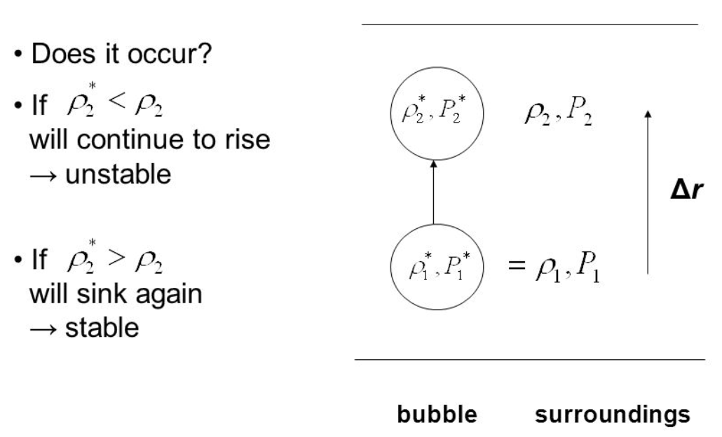
Schwarzchild Criterion

Slide 6
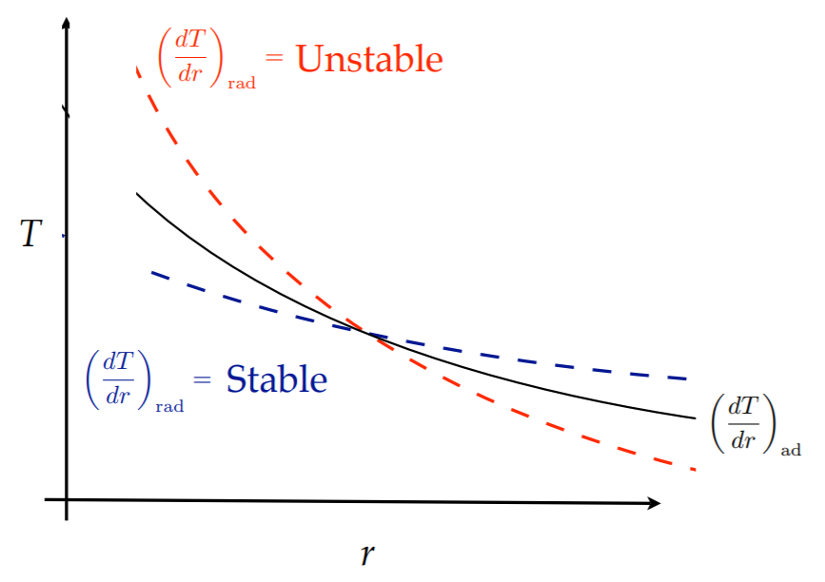
Schwarzchild Criterion
(convection)

Slide 7
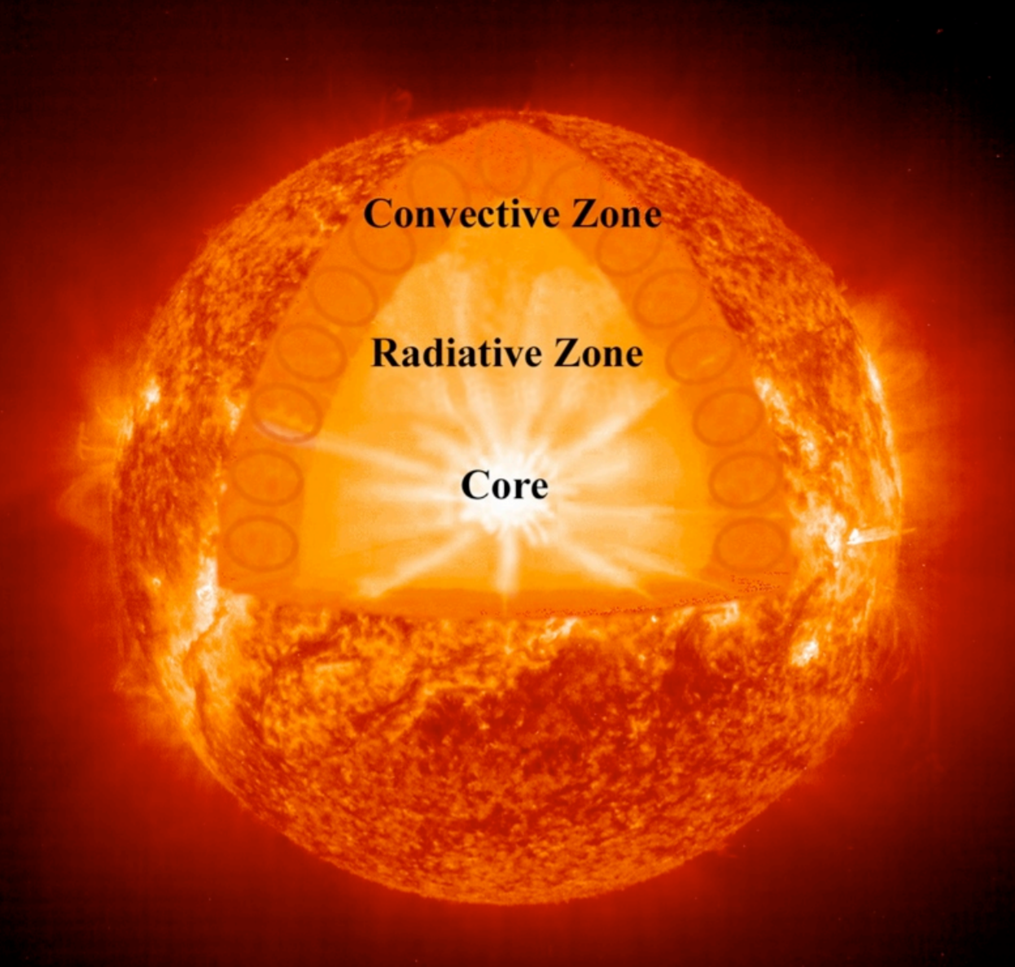
Transport in the Sun

Slide 8
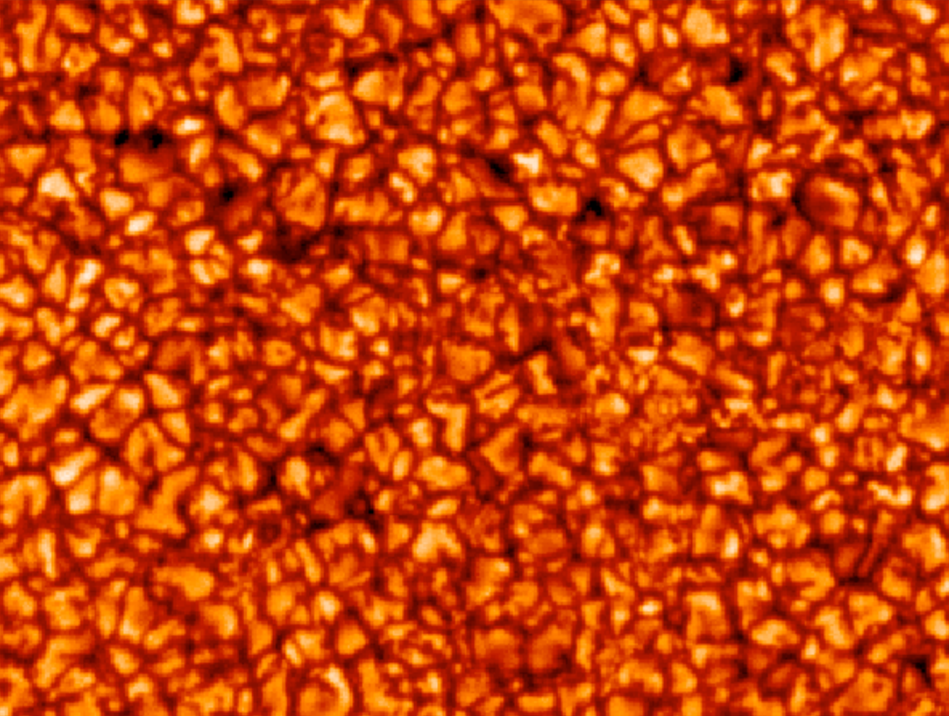
Convection and Granules

Slide 9
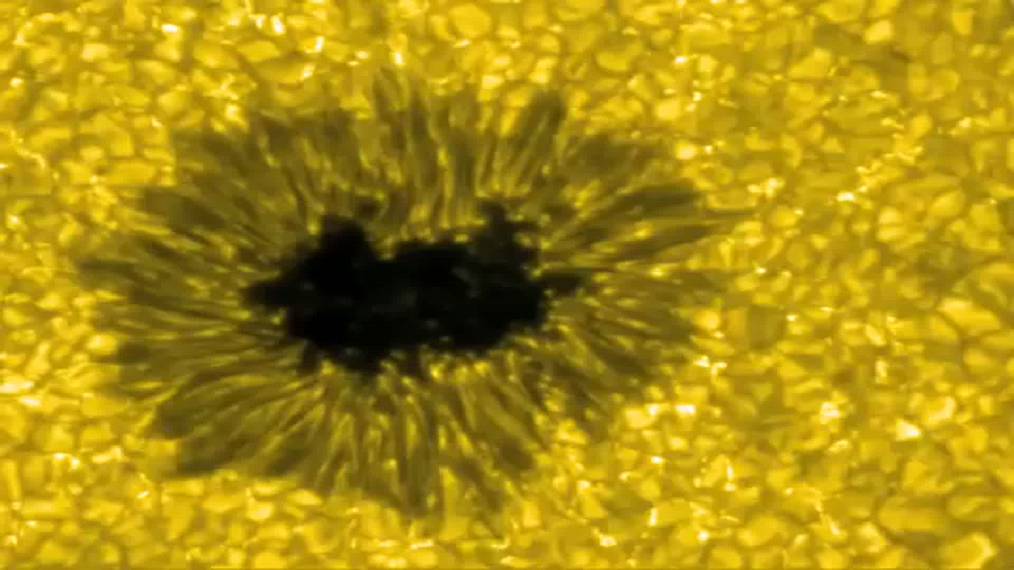
Convection Movie

Slide 10
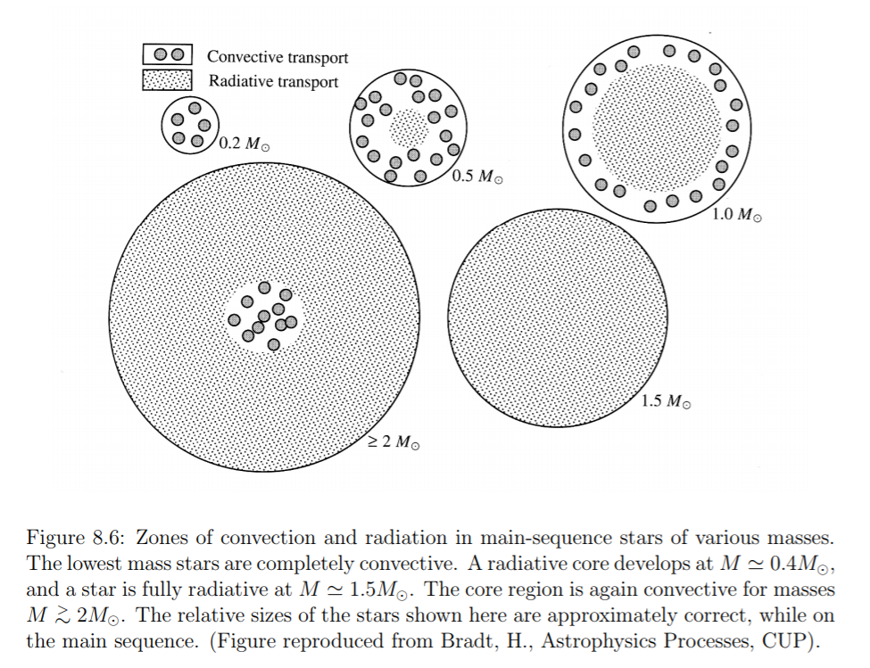
Radiative vs. Convection Transport

Slide 11
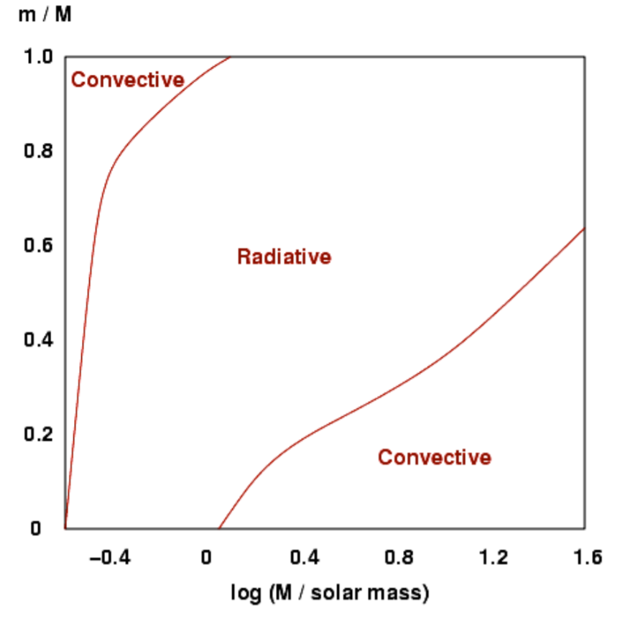
Heat Transfer vs. Mass

Slide 12
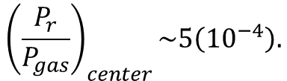
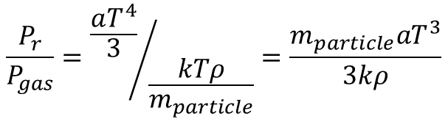
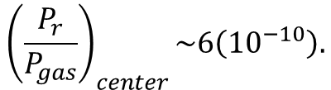
Is Radiation Pressure Small?
Earlier, we assumed that P_{r}<<P_{gas}. Was that a reasonable assumption?
$$\frac{P_{r}}{P_{gas}}={\frac{aT^{4}}{3}}/{\frac{kTρ}{m_{particle}}}=\frac{m_{particle}aT^{3}}{3kρ}$$
In center of the Sun, T~15(10⁶) K, ρ~10⁵ kg/m³, m=m_{p}/2.
$${\left(\frac{P_{r}}{P_{gas}}\right)}_{center}\sim 5\left({10}^{−4}\right).$$
At photosphere, T~5800 K, ρ~10⁻² kg/m³, m=m_{p}.
$${\left(\frac{P_{r}}{P_{gas}}\right)}_{center}\sim 6\left({10}^{−10}\right).$$

Slide 13
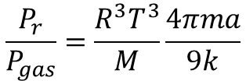


Radiation Pressure vs. Mass
Replace density with average density of star.
$$ρ_{average}=M/V=M/{\left({4πR}^{3}/3\right)}$$
$$\frac{P_{r}}{P_{gas}}=\frac{R^{3}T^{3}}{M}\frac{4πma}{9k}$$
Virial Theorem give T~M/R.
$$\frac{P_{r}}{P_{gas}}∝M^{2}$$
So, radiation pressure is more important for more massive stars.

Slide 14
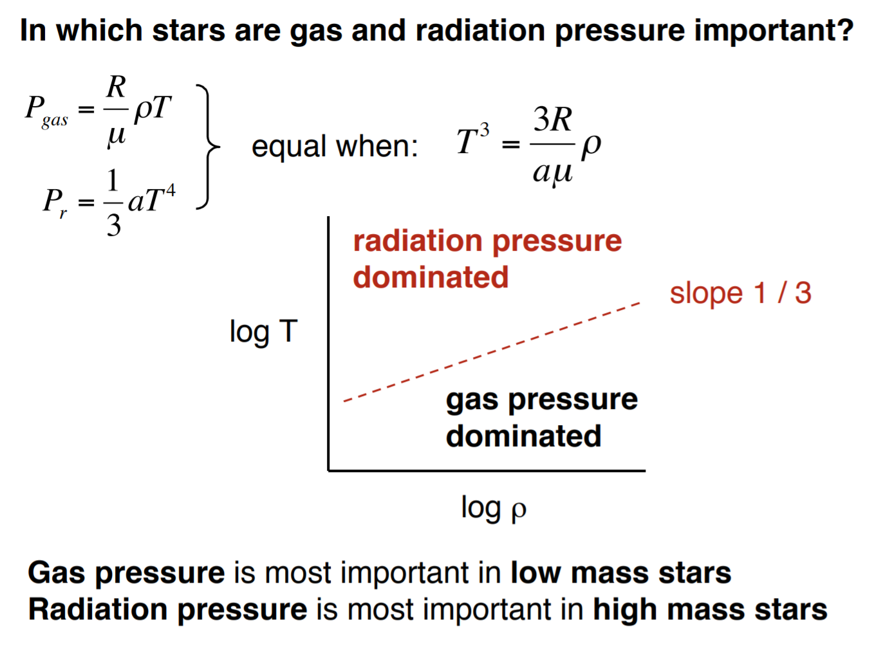
Radiation Pressure vs. Mass

Slide 15
energy generation

Slide 16
Energy Generation in Stars
Stars typically generate energy by converting hydrogen into helium.
The liberated energy is equivalent to 27 MeV, which is equal to the difference in rest mass energy of a helium nucleus and four hydrogens.
ΔE=ΔMc²=(4*1.0081 AMU*1.67(10⁻²⁷ kg) − 4.0039 AMU*1.67(10⁻²⁷ kg))*c²=27 MeV.
The total initial rest mass energy is 4*938.3 MeV, so ΔE/E=0.007=0.7%.

Slide 17
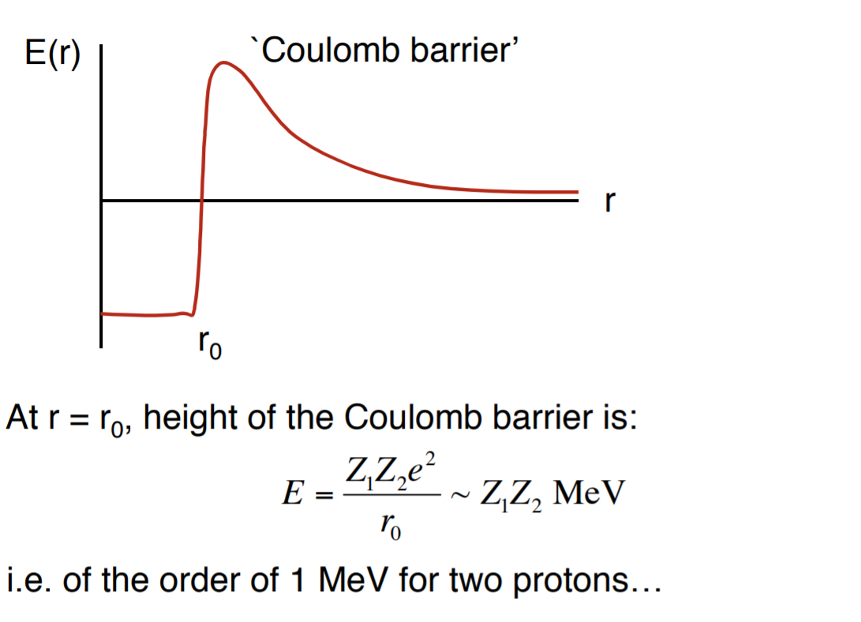
Quantum Tunneling

Slide 18
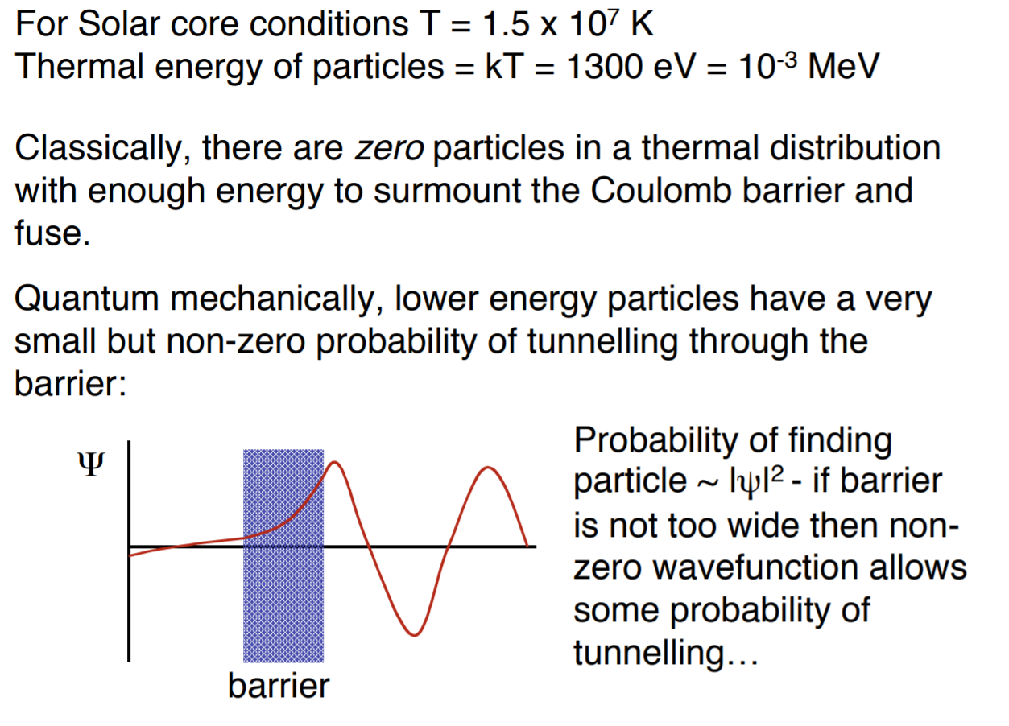
Quantum Tunneling

Slide 19
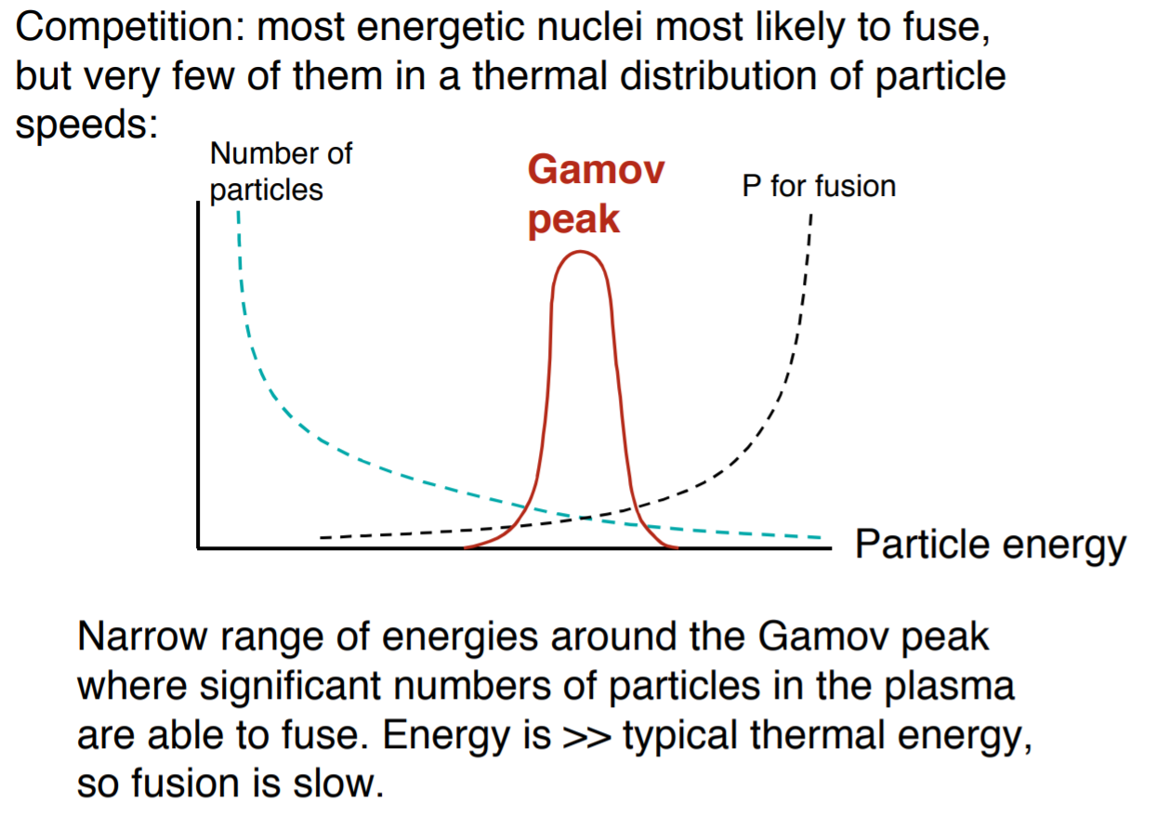
Gamov Peak

Slide 20
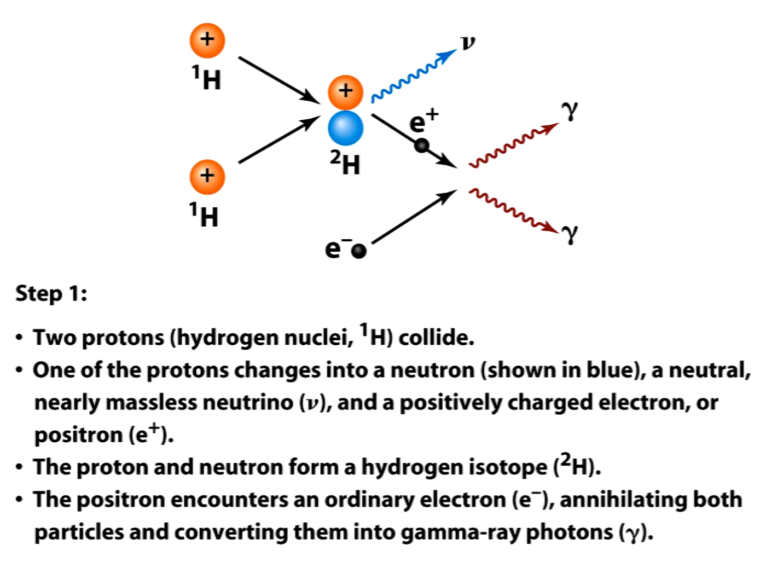
PP Chain

Slide 21
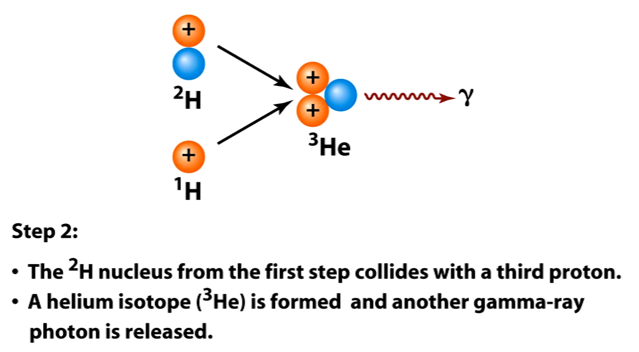
PP Chain

Slide 22
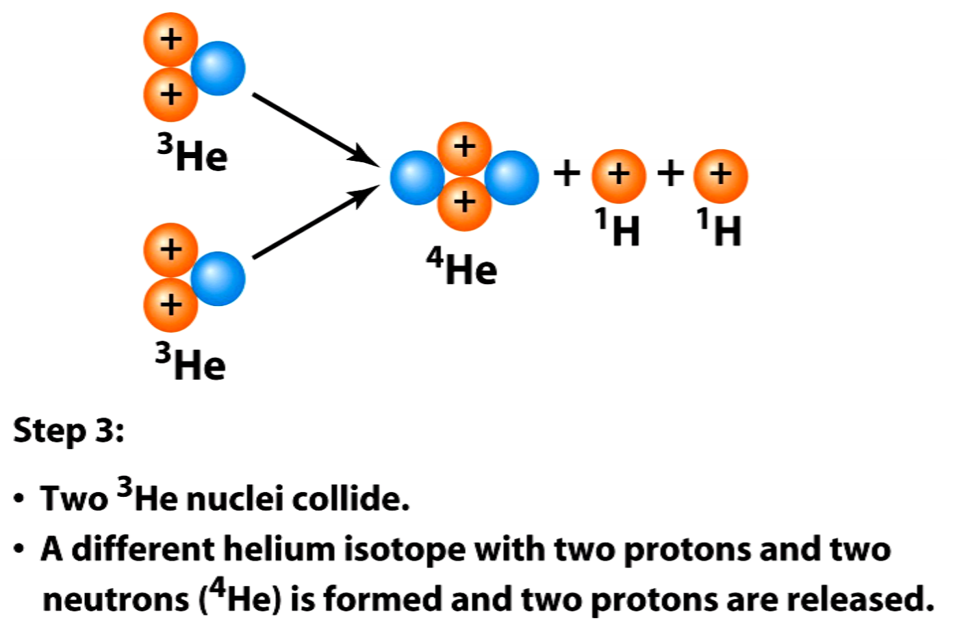
PP Chain

Slide 23
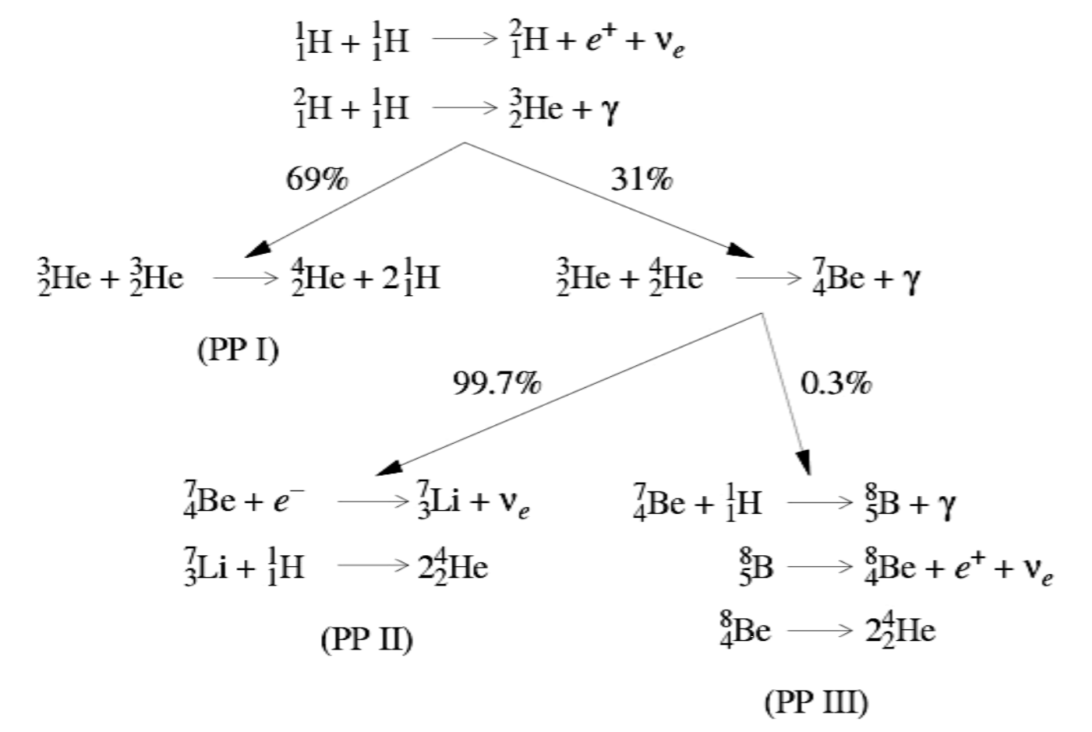
PP Chain

Slide 24
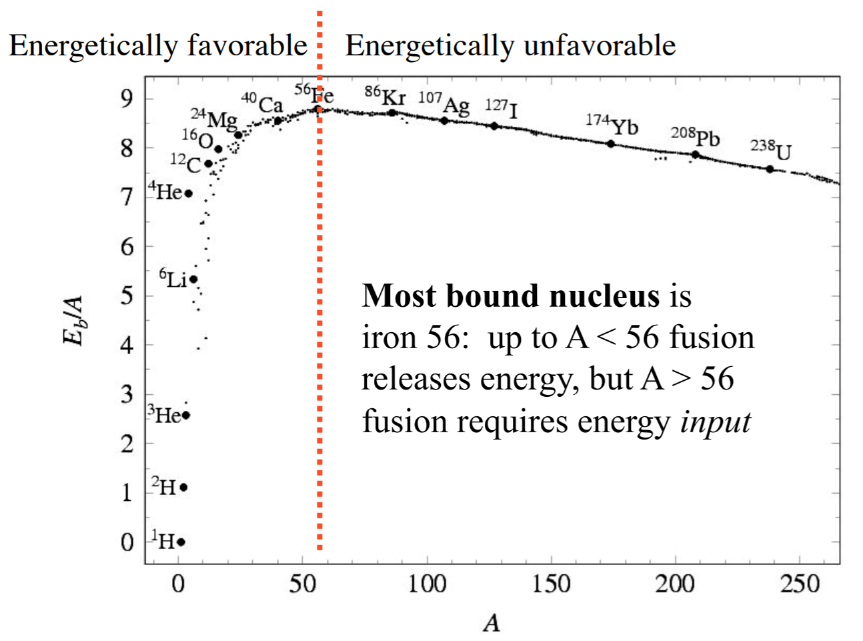
Binding Energy
Fusion liberates energy to the left of the red line. Iron is the most bound nucleus. Energy has to be added to fuse Fe to heavier elements.
Fusing H to He liberates the majority of the energy from H to Fe.
Notice that once H fuses to He, there is no way back to Li, Be, B.

Slide 25
other effects

Slide 26
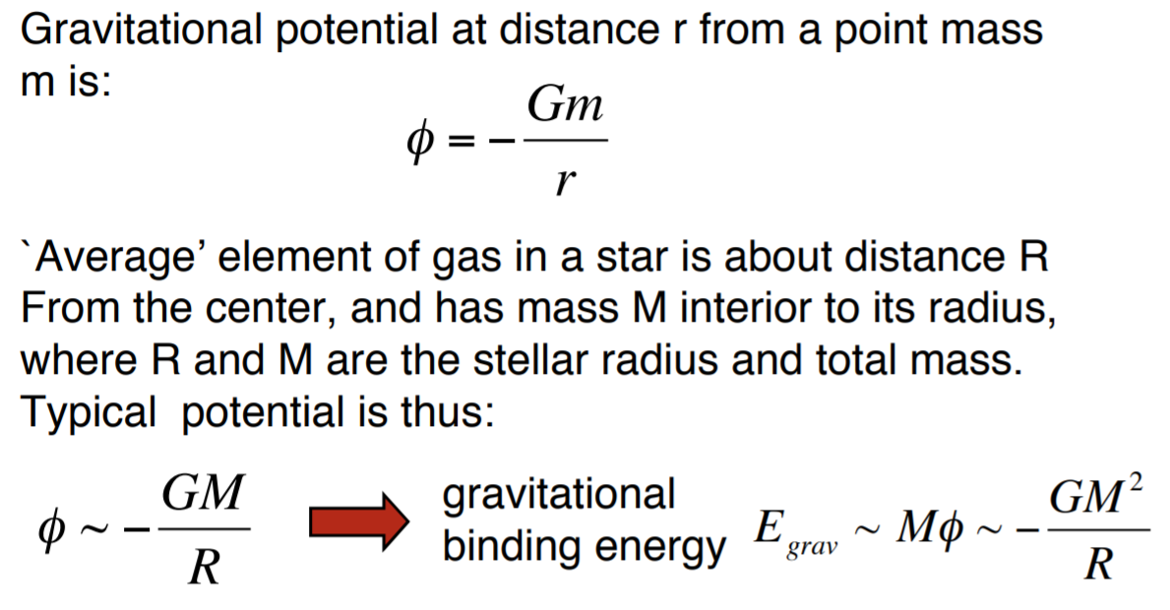
Rotation Not Important?

Slide 27
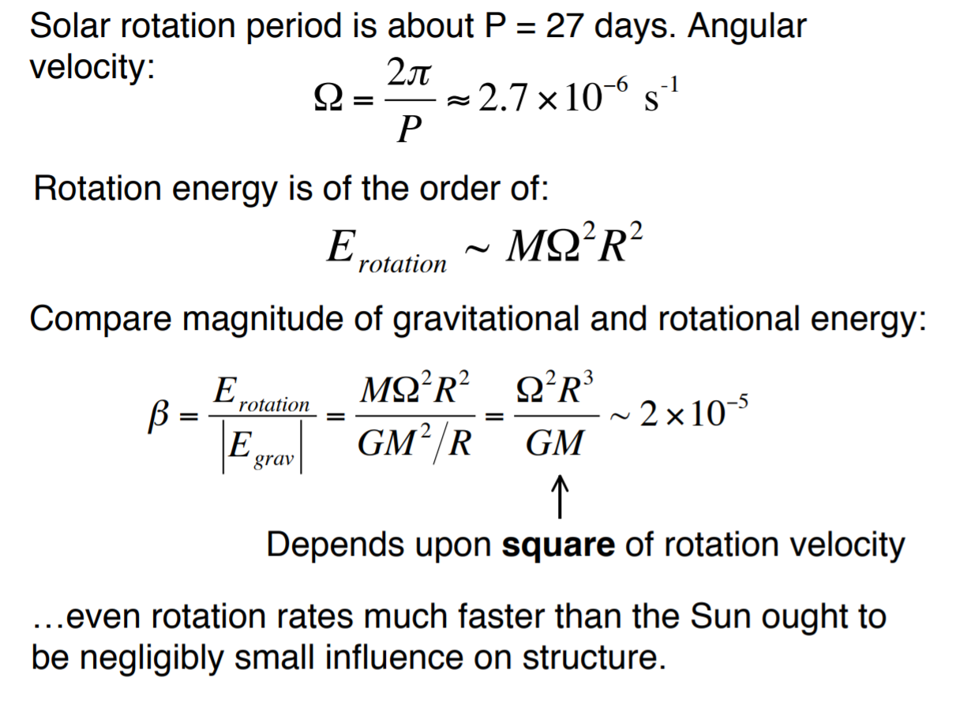
Rotation Not Important?

Slide 28
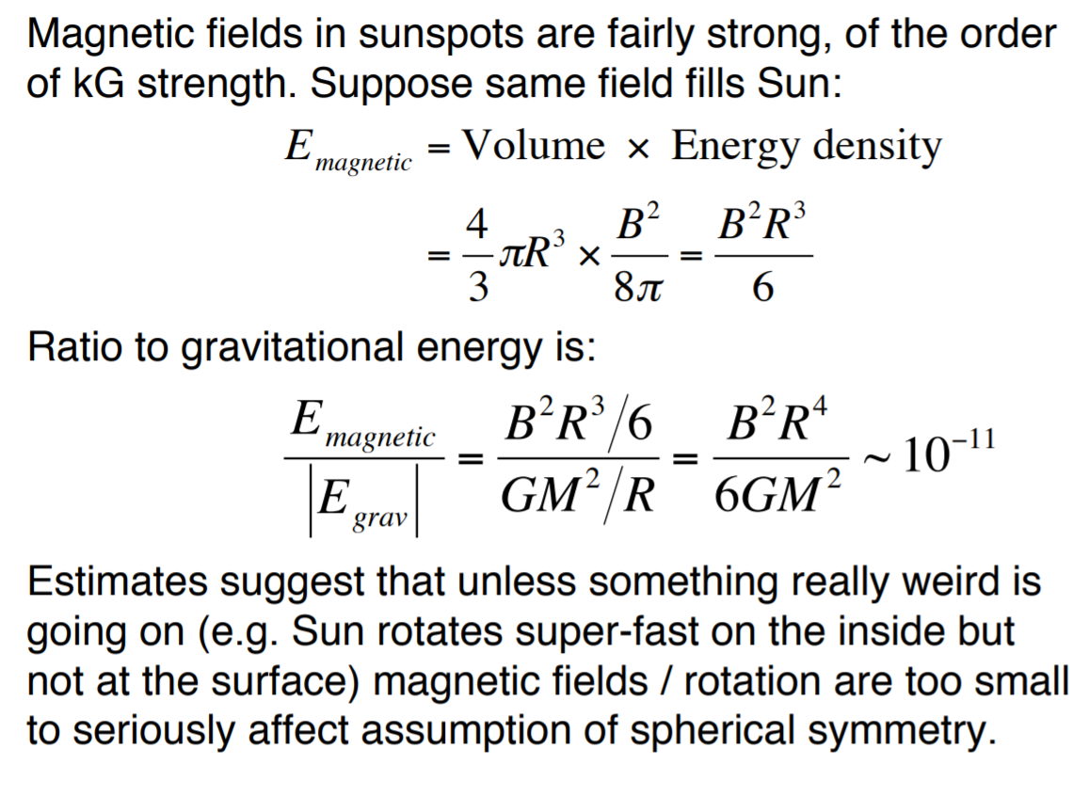
B Field Not Important?

Slide 29
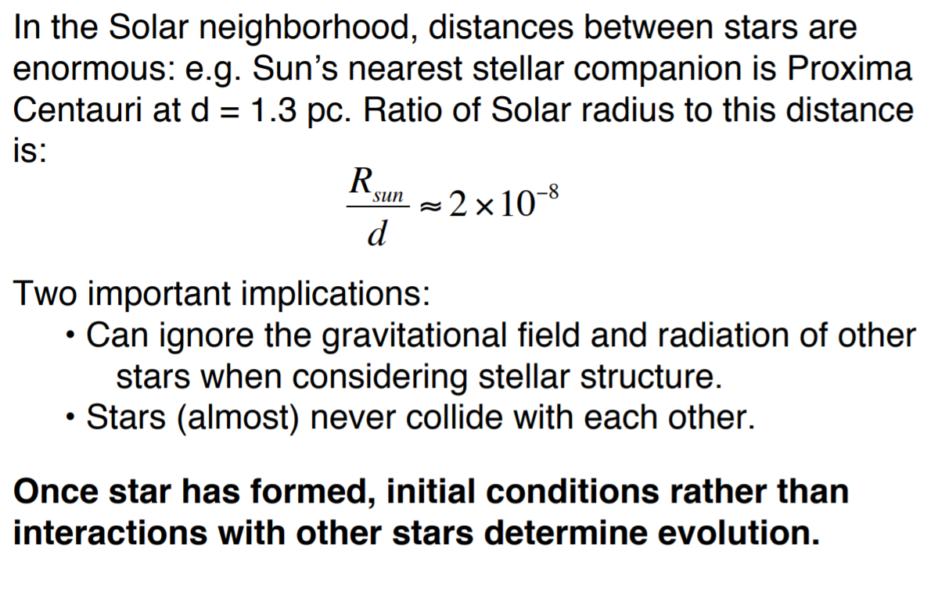
Nearby Stars Not Important?

Slide 30
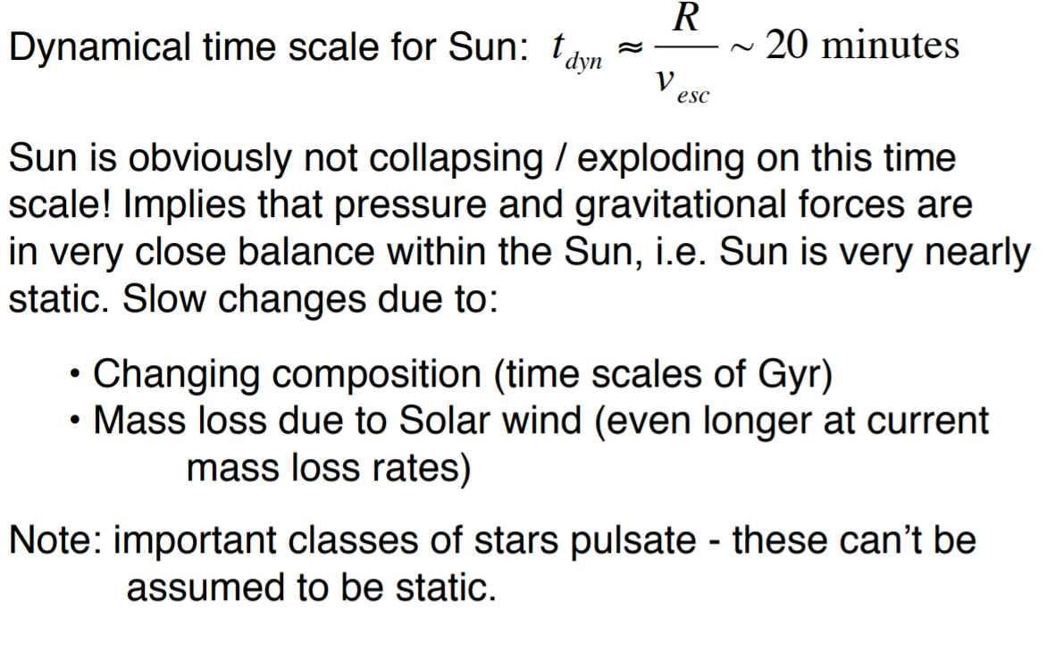
Dynamics Not Important?

Slide 31
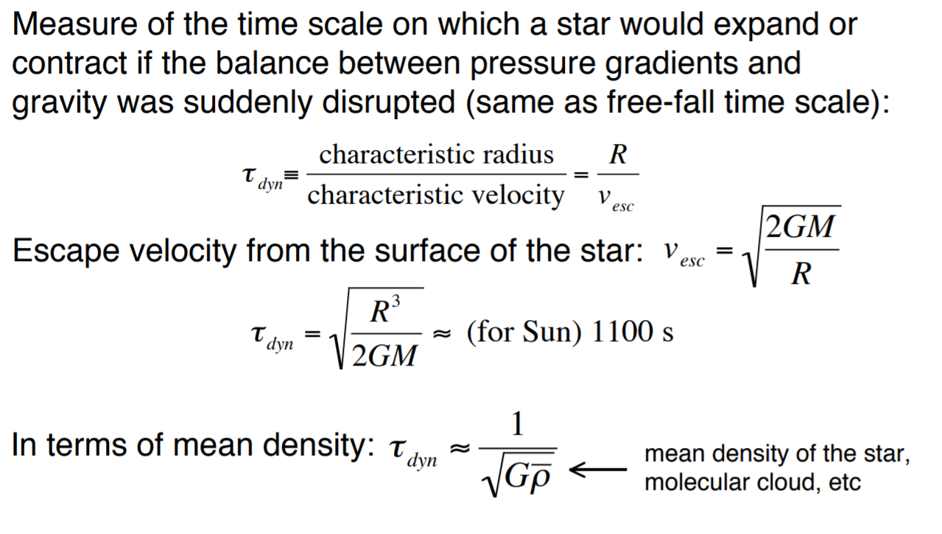
Dynamical Timescale

Slide 32
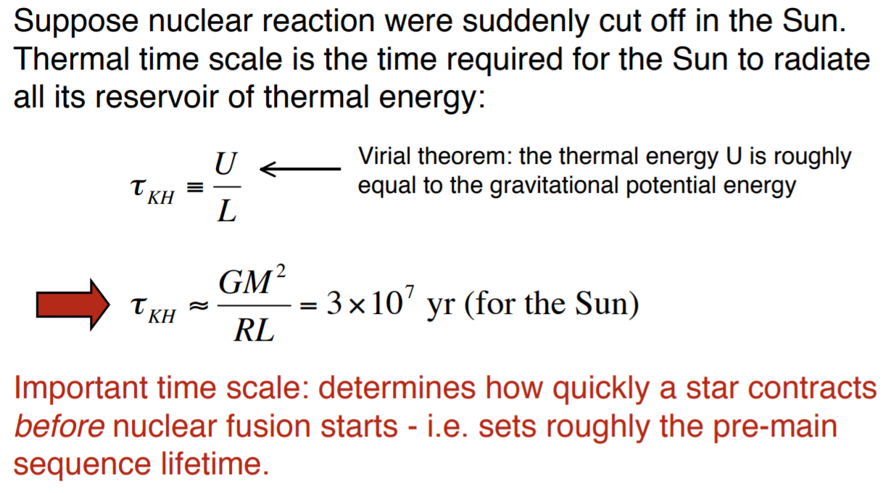
Kelvin-Helmoltz Timescale

Slide 33
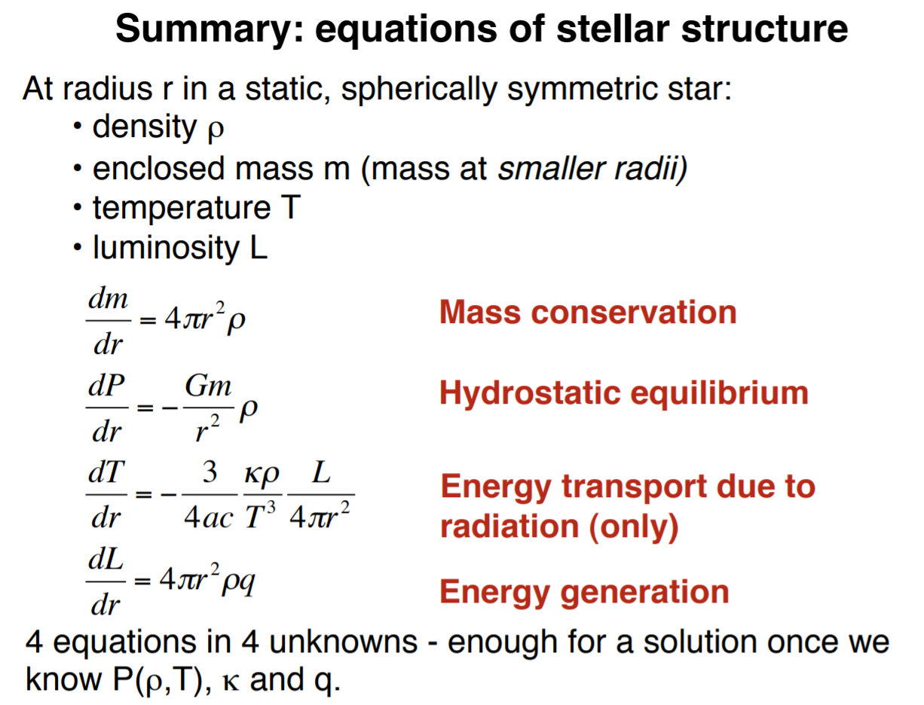
Review

