Slide 1
University Astronomy
Professor Don Figer
Motion of the Sky

Slide 2
Aims and outline for this lecture
explore how objects move in the sky
  sun
  stars
  ecliptic
  zodiac
  planets
  retrograde and prograde motion
review laws of motion for orbital bodies

Slide 3
motion on the sky

Slide 4
Question
In what direction would you face to see Star A when it is highest in the sky?
a) north
b) south
c) east
d) west
e) directly overhead
vote!

Slide 5
Answer
In what direction would you face to see Star A when it is highest in the sky?
a) north
b) south
c) east
d) west
e) directly overhead

Slide 6
Question
What is the altitude of a star that rises due East when it is highest in the sky?
a) the latitude
b) 45 degrees minus lat
c) 90 degrees minus lat
d) the declination
vote!

Slide 7
Answer
What is the altitude of a star that rises due East when it is highest in the sky?
a) the latitude
b) 45 degrees minus lat
c) 90 degrees minus lat
d) the declination

Slide 8
Question
What is the azimuth of the star indicated by the arrow?
a) 135 degrees
b) 45 degrees
c) the longitude
d) RA minus 45 degrees
vote!

Slide 9
Answer
What is the azimuth of the star indicated by the arrow?
a) 135 degrees
b) 45 degrees
c) the longitude
d) RA minus 45 degrees

Slide 10
Question
At what time will Star B be highest in the sky (see picture on next slide)?
a) morning
b) noon
c) afternoon
d) midnight
vote!

Slide 11
Question

Slide 12
Answer
At what time will Star B be highest in the sky?
a) morning
b) noon
c) afternoon
d) midnight

Slide 13
Ecliptic Plane
The ecliptic plane is defined by a circle through which the Sun appears to travel in the sky over the course of a year.
The plane is tilted by 23.5 degrees with respect to the Earth’s orbital plane.

Slide 14
Ecliptic Plane and Zodiac
The constellations along the ecliptic make up the zodiac.
Your “sign” is the constellation behind the Sun when you were born.
Today’s zodiac is off by roughly one constellation, due to precession of the equinoxes.

Slide 15
Precession of the Equinoxes
The NCP traces a circle in the sky once every 26,000 years.
NCP is near Polaris.
In 12,000 years, it will point near Vega.
Positions of equinoxes shift.

Slide 16
Precession Caused by Gravity

Slide 17
Ecliptic Plane and Solar System Bodies
Most objects in the Solar System appear to travel along the ecliptic plane because those objects orbit in roughly the same plane.
This is why other planets appear in constellations of the Zodiac.

Slide 18
Ecliptic Plane and Equinoxes
The ecliptic and celestial equator cross at two points called “equinoxes.”
The word equinox means equal time for day and night.
Autumnal equinox ~ Sep 20.
Vernal equinox ~ Mar 20
Other points are solstices.
The word solstice means the point when “sol” is highest and lowest.

Slide 19
Sun’s Path in Sky
Daytime is longer in summers.
Daytime and nighttime are equal on equinoxes.
The sun reaches its lowest height in the sky on winter solstice.
The variation of maximum height for the sun is greater for locations toward the Earth’s poles.

Slide 20
Question
At what latitude will sun no longer set during summer?
a) 23.5 degrees
b) 0 degrees
c) 90 degrees
d) 66.5 degrees
vote!

Slide 21
Answer
At what latitude will sun no longer set during summer?
a) 23.5 degrees
b) 0 degrees
c) 90 degrees
d) 66.5 degrees

Slide 22
Seasons
Seasons occur because temperature varies.
Temperature is related to the amount of solar flux absorbed by the Earth.
This is a maximum during the summer.

Slide 23
Question
Why is it cold in January in northern latitudes?
a) Earth is farthest from sun
b) sun is lower in the sky
c) the orbital velocity of the Earth is highest
d) that is ski season
vote!

Slide 24
Answer
Why is it cold in January in northern latitudes?
a) Earth is farthest from sun
b) sun is lower in the sky (less areal flux)
c) the orbital velocity of the Earth is highest
d) that is ski season

Slide 25
motion of planets in the sky

Slide 26
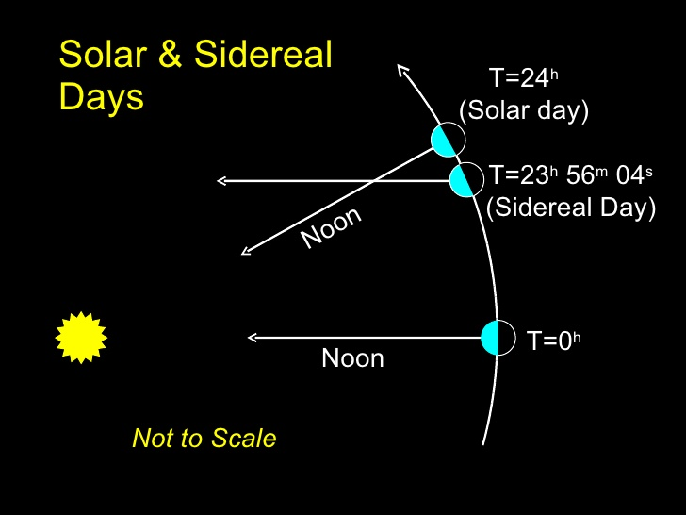
Time
Earth revolves around sun and rotates around axis.
  rotation results in diurnal motion of stars
  revolution results in sun’s apparent motion relative to stars
Solar day is time between meridian crossings of sun.
Sidereal day is time between meridian crossings of stars.

Slide 27
Local Sidereal Time
Local Sidereal Time (LST) is the RA of an object on the meridian.
Hour Angle (HA) is the angle in the direction of right ascension between an object and the meridian. HA_{obj}=LST-RA_{obj}

Slide 28
Motions of Objects in Sky
The Sun moves eastward relative to the stars by about one degree per day.
The stars rise earlier by about four minutes each night, giving rise to “seasonal” constellations. For example, Orion is a winter constellation in the north.
The Moon moves eastward relative to the stars by about 13 degrees per day, traversing 360 degrees in about 27.5 days. It moves about 12 degrees relative to the Sun, so it takes approximately 29.5 days to complete a set of phases (synodic, or lunar, month).
The planets move relative to stars because of their orbital motion and Earth’s orbital motion. Can induce “retrograde” motion.

Slide 29
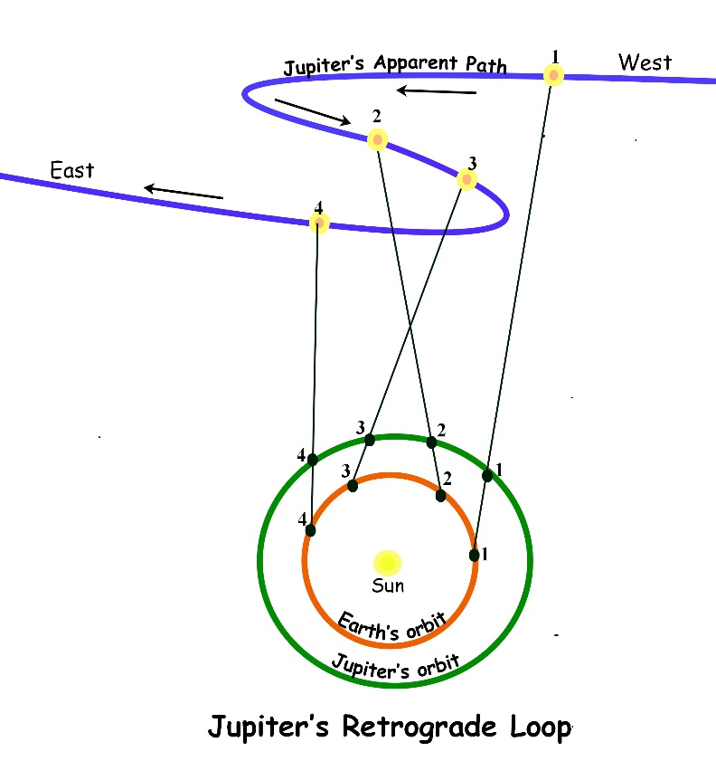
Prograde and Retrograde Motion
During a night, planets move from east to west, just like the stars.
From night to night, the planets move relative to the stars.
Usually, they move west to east relative to the stars (prograde).
Sometimes, they move east to west (retrograde).

Slide 30
Retrograde Motion of Mars

Slide 31
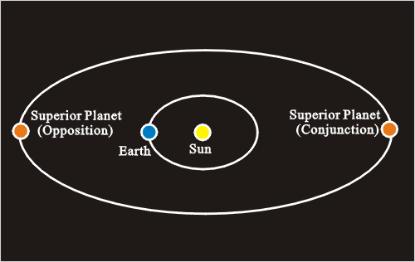
Conjunction and Opposition

Slide 32
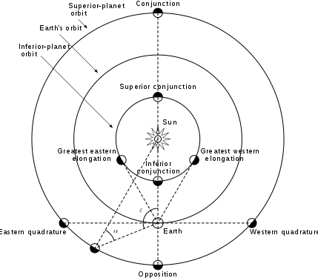
Conjunction and Opposition

Slide 33
Sidereal Period
The sidereal period is the time it takes for an object to orbit another with respect to the fixed coordinate system of the stars.
So, for Earth, the sidereal period is 365.25636 days.
Our calendar only has 365 days in it, so we add a day every leap year.

Slide 34
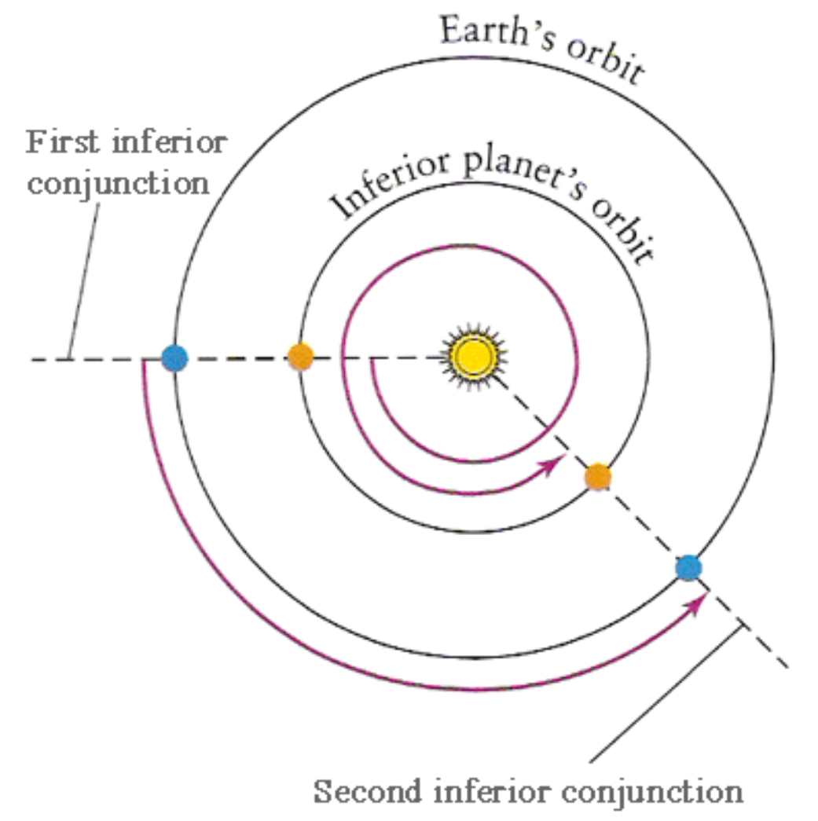
Synodic Period

Slide 35
Kepler’s Laws of Orbital Motion
1st Law: planets travel on elliptical orbits with the Sun at one focus.
2nd Law: A line drawn from the Sun to a planet sweeps out equal areas in equal time intervals.
3rd Law: The squares of the sidereal orbital periods of the planets are proportional to the cubes of the semimajor axis of their orbits.

Slide 36
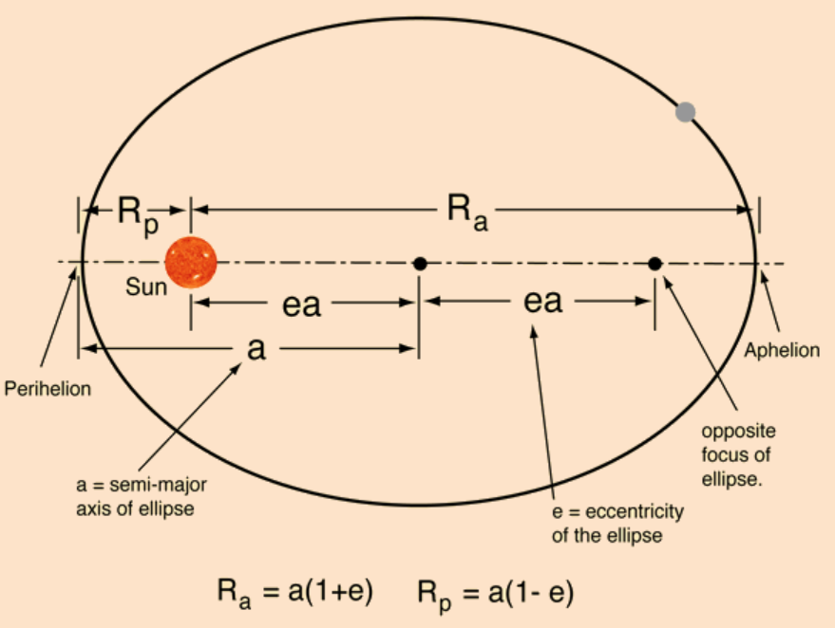
Keplerian Model
Kepler realized that orbits are elliptical (1st law).
Planets sweep equal areas in equal time (2nd law).
The square of the orbital period is proportional to the cube of the distance to the Sun (3rd law).
Notes:
B68 is thought to be in hydrostatic equilibrium, such that the outward radiation pressure balances the inward force of gravity. The cloud should contract as it radiates gravitational energy converted into kinetic energy.
The green contours are measurements of Av estimated by NIR color excesses (Alves et al. 2001).
The molecular line widths are very small, ~0.1 km/s, suggesting T~10 K. For the molecular maps, the color scale corresponds to thermal emission, and the contours correspond to molecular emission.
https://www.cfa.harvard.edu/~clada/pubs_html/b68_vel.html

Slide 37
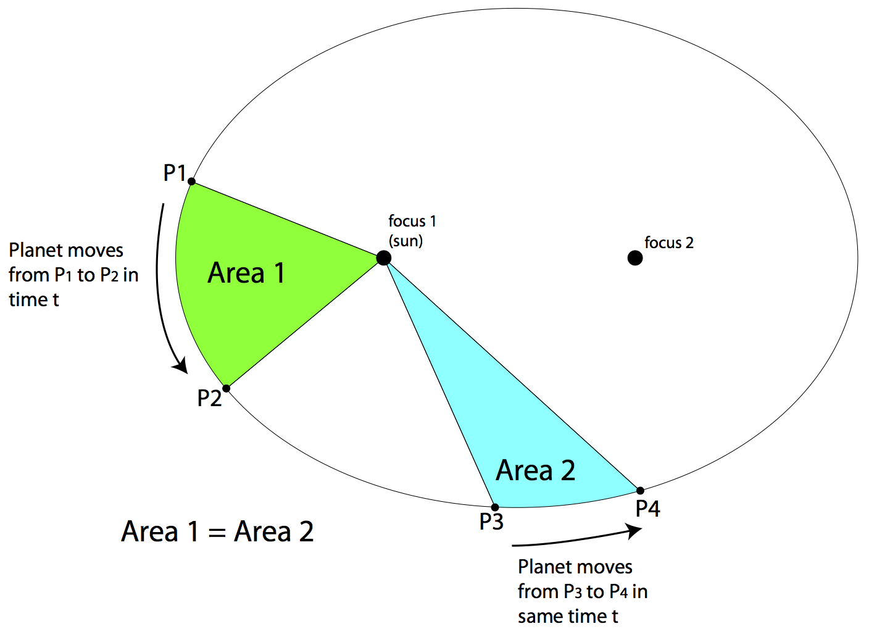
Kepler’s 2nd Law
Notes:
B68 is thought to be in hydrostatic equilibrium, such that the outward radiation pressure balances the inward force of gravity. The cloud should contract as it radiates gravitational energy converted into kinetic energy.
The green contours are measurements of Av estimated by NIR color excesses (Alves et al. 2001).
The molecular line widths are very small, ~0.1 km/s, suggesting T~10 K. For the molecular maps, the color scale corresponds to thermal emission, and the contours correspond to molecular emission.
https://www.cfa.harvard.edu/~clada/pubs_html/b68_vel.html

Slide 38
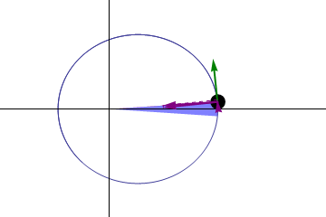
Kepler’s 2nd Law
Notes:
B68 is thought to be in hydrostatic equilibrium, such that the outward radiation pressure balances the inward force of gravity. The cloud should contract as it radiates gravitational energy converted into kinetic energy.
The green contours are measurements of Av estimated by NIR color excesses (Alves et al. 2001).
The molecular line widths are very small, ~0.1 km/s, suggesting T~10 K. For the molecular maps, the color scale corresponds to thermal emission, and the contours correspond to molecular emission.
https://www.cfa.harvard.edu/~clada/pubs_html/b68_vel.html

Slide 39
Kepler’s 3rd Law (P²∝a³)
Notes:
B68 is thought to be in hydrostatic equilibrium, such that the outward radiation pressure balances the inward force of gravity. The cloud should contract as it radiates gravitational energy converted into kinetic energy.
The green contours are measurements of Av estimated by NIR color excesses (Alves et al. 2001).
The molecular line widths are very small, ~0.1 km/s, suggesting T~10 K. For the molecular maps, the color scale corresponds to thermal emission, and the contours correspond to molecular emission.
https://www.cfa.harvard.edu/~clada/pubs_html/b68_vel.html

Slide 40
distances and angles

Slide 41
Heliocentric Parallax
Parallax is the apparent shift of an object due to viewpoint.
As an example, watch your thumb shift with respect to objects far away as you view it from each eye.
The angular shift depends on distance.
We can use this effect to estimate distance to nearby stars by viewing them when the Earth is on opposite sides of the Sun.

Slide 42
Distance vs. Parallax

Slide 43
Parsec
A parsec is the distance at which an object has one arcsecond of parallax. “Parallax of one arcsec”
The star nearest to the sun, Proxima Centauri, has a parallax of 0.76 arcseconds. What is its distance?

Slide 44
homework

Slide 45
Homework
2.1, 2.3, 2.5, 2.6 (consider equations 2.17 and 2.8)
What is the name of the part of the eye that limits the amount of light that enters it?
Consider a photon with vacuum wavelength of 550 nm. What is its energy in a typical glass?
In which wavelength regime is the atmosphere most transparent?
Use the Wien displacement law to calculate the wavelength for which the cosmic microwave background is at a peak, assuming that it is represented by a blackbody with T=2.7 K.

Slide 46
Homework

Slide 47
Homework

