Slide 1
University Astronomy
Professor Don Figer
Exoplanets II

Slide 2
direct imaging technique

Slide 3
Direct Imaging Method
The most obvious way to see a planet is to take a picture of it (“direct imaging”).
It turns out that this is difficult to do because planets are relatively close to their host stars, and those stars are about a billion times brighter than the planet.
This technique usually involves a way to block the light from the star (coronagraphy).

Slide 4
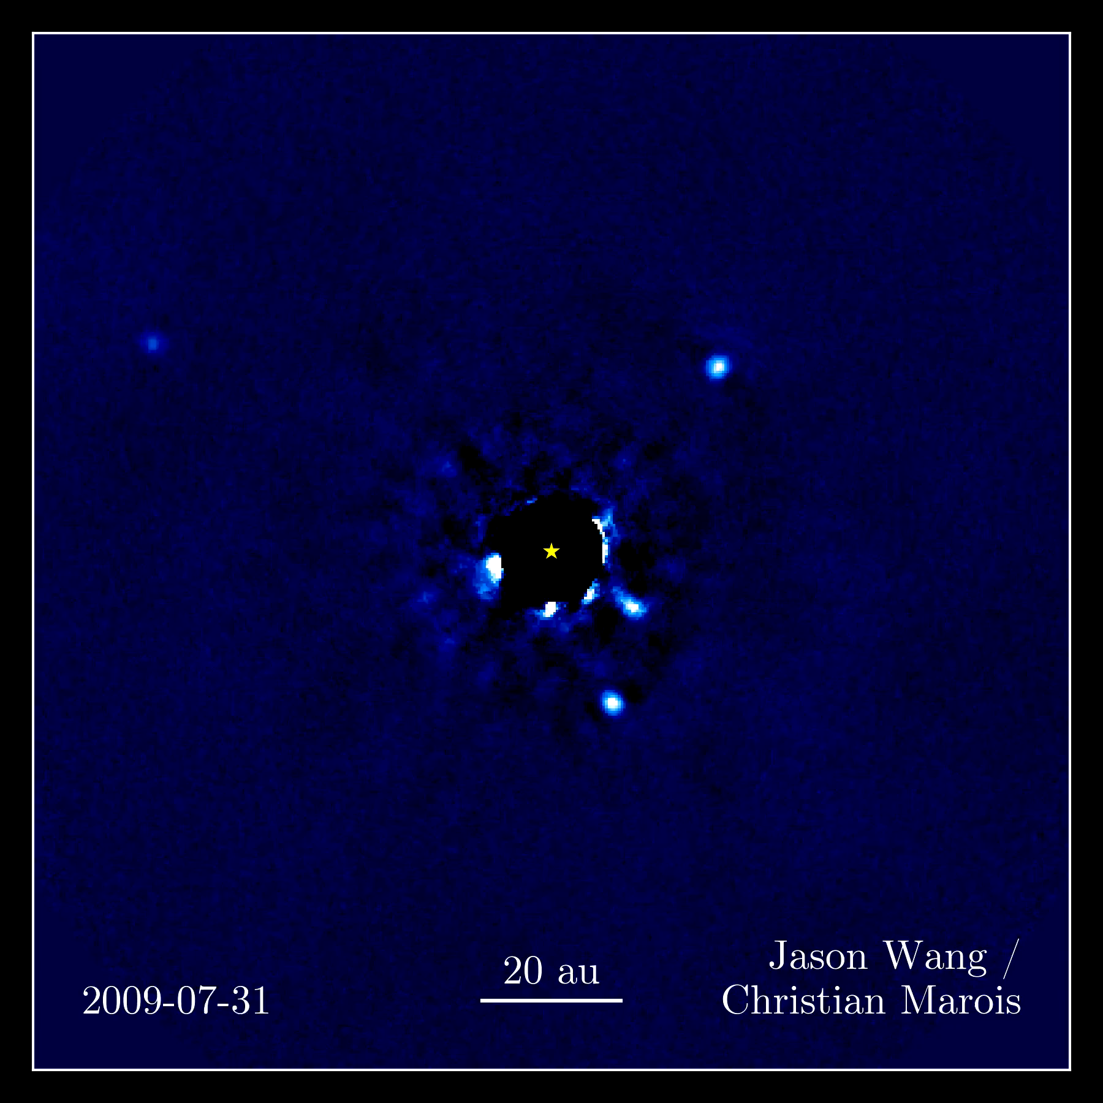
HR 8799 b-e (~6-10 M_{J})

Slide 5
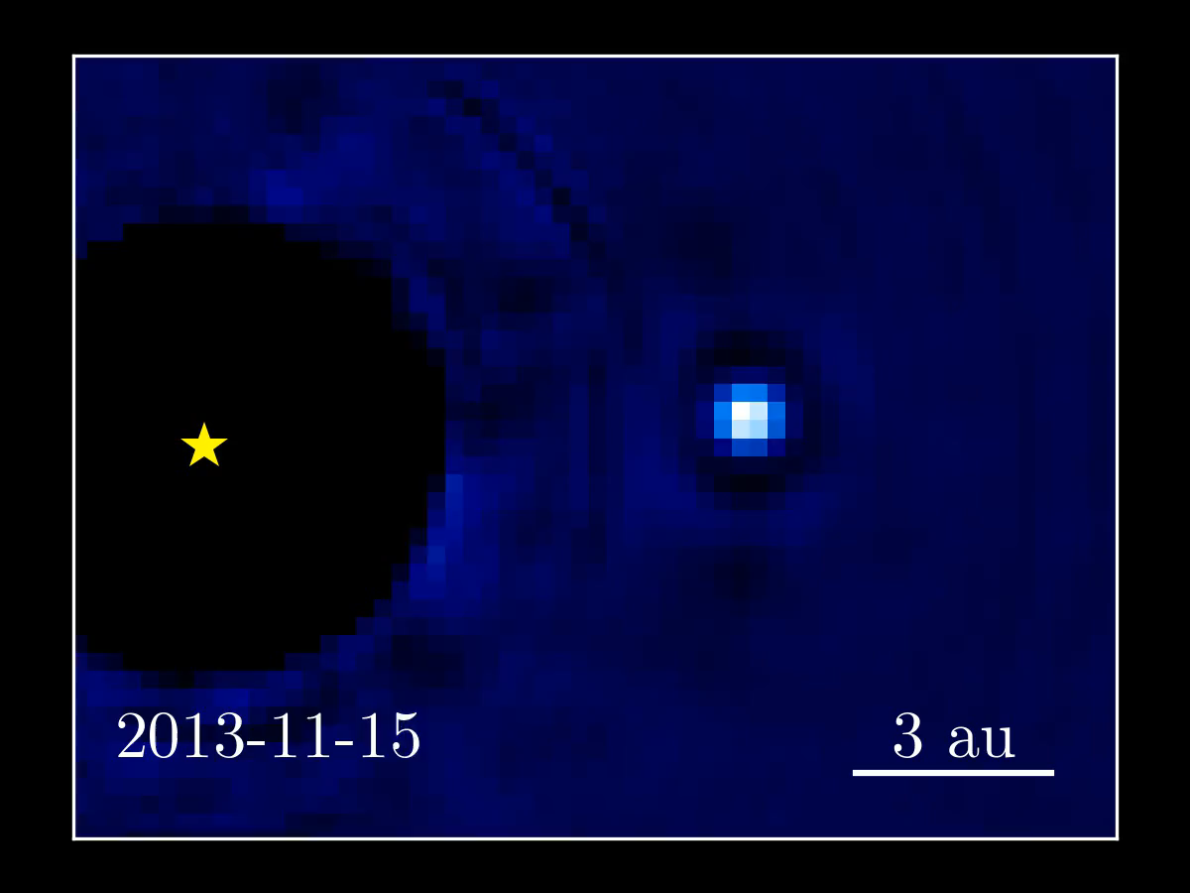
Beta Pic b (13 M_{J})

Slide 6
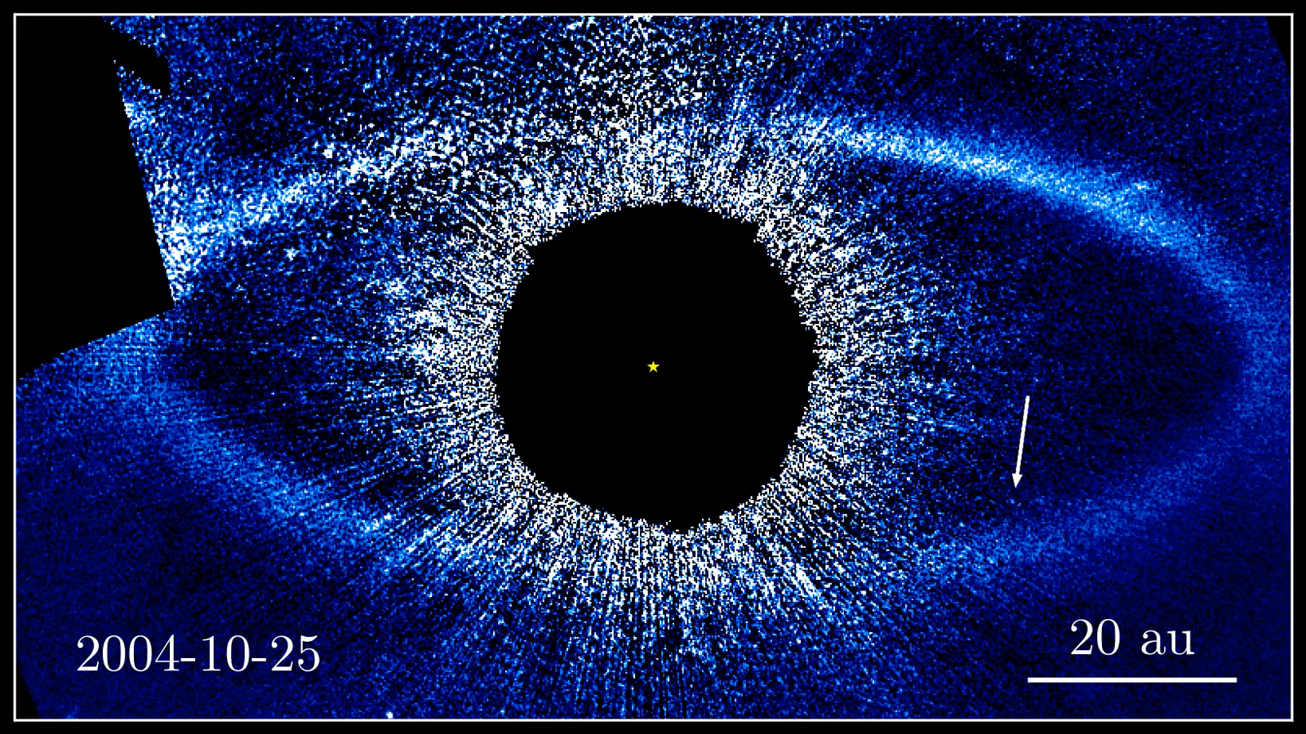
Fomalhaut b

Slide 7
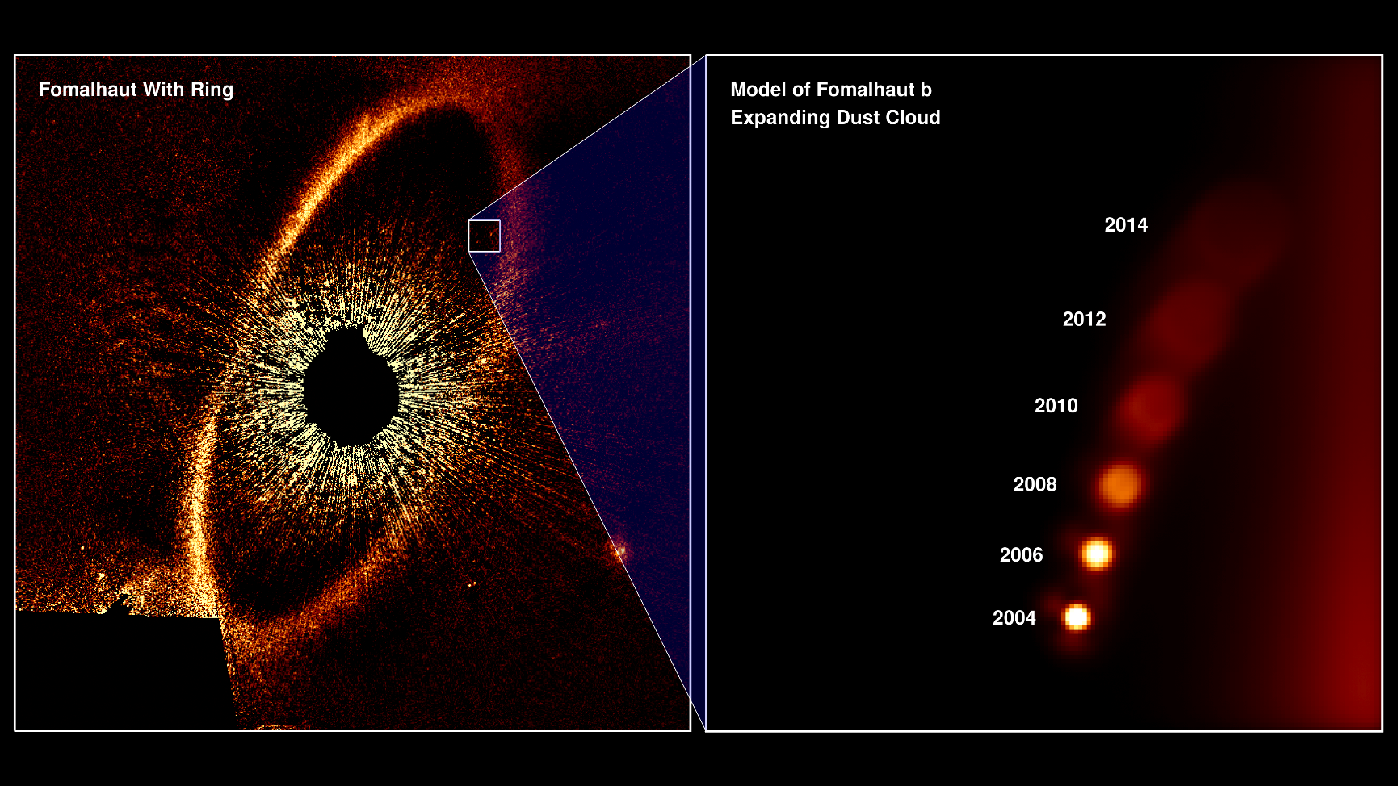
Fomalhaut b (a clump of dust?)

Slide 8
Removing the Light
Light from the star can be removed in two different ways.
One, a physical mask can block the light.
Two, an optical interferometer can “null” the light by interfering the light with itself (shifted by half a wavelength).

Slide 9

Coronagraphy

Slide 10
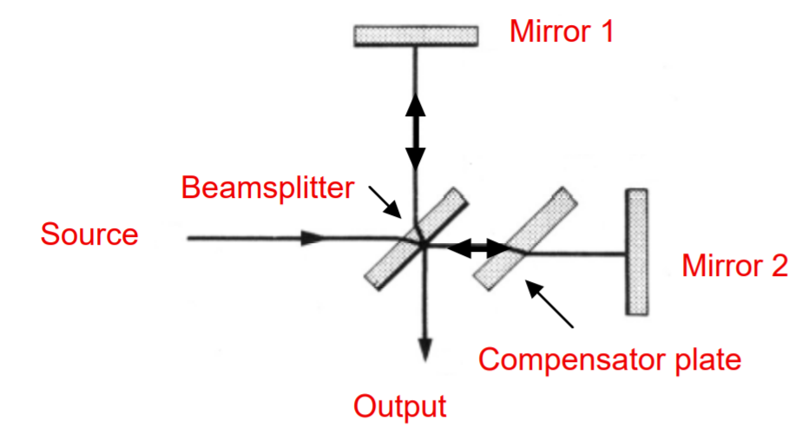
Nulling Interferometer
Light from the source is “nulled” (removed) by passing it through an interferometer.
The interferometer splits the light into two beams and shifts one beam by half a wavelength.
The interferometer recombines the beams into one.
The output light is removed through interference.

Slide 11
gravitational microlensing technique

Slide 12
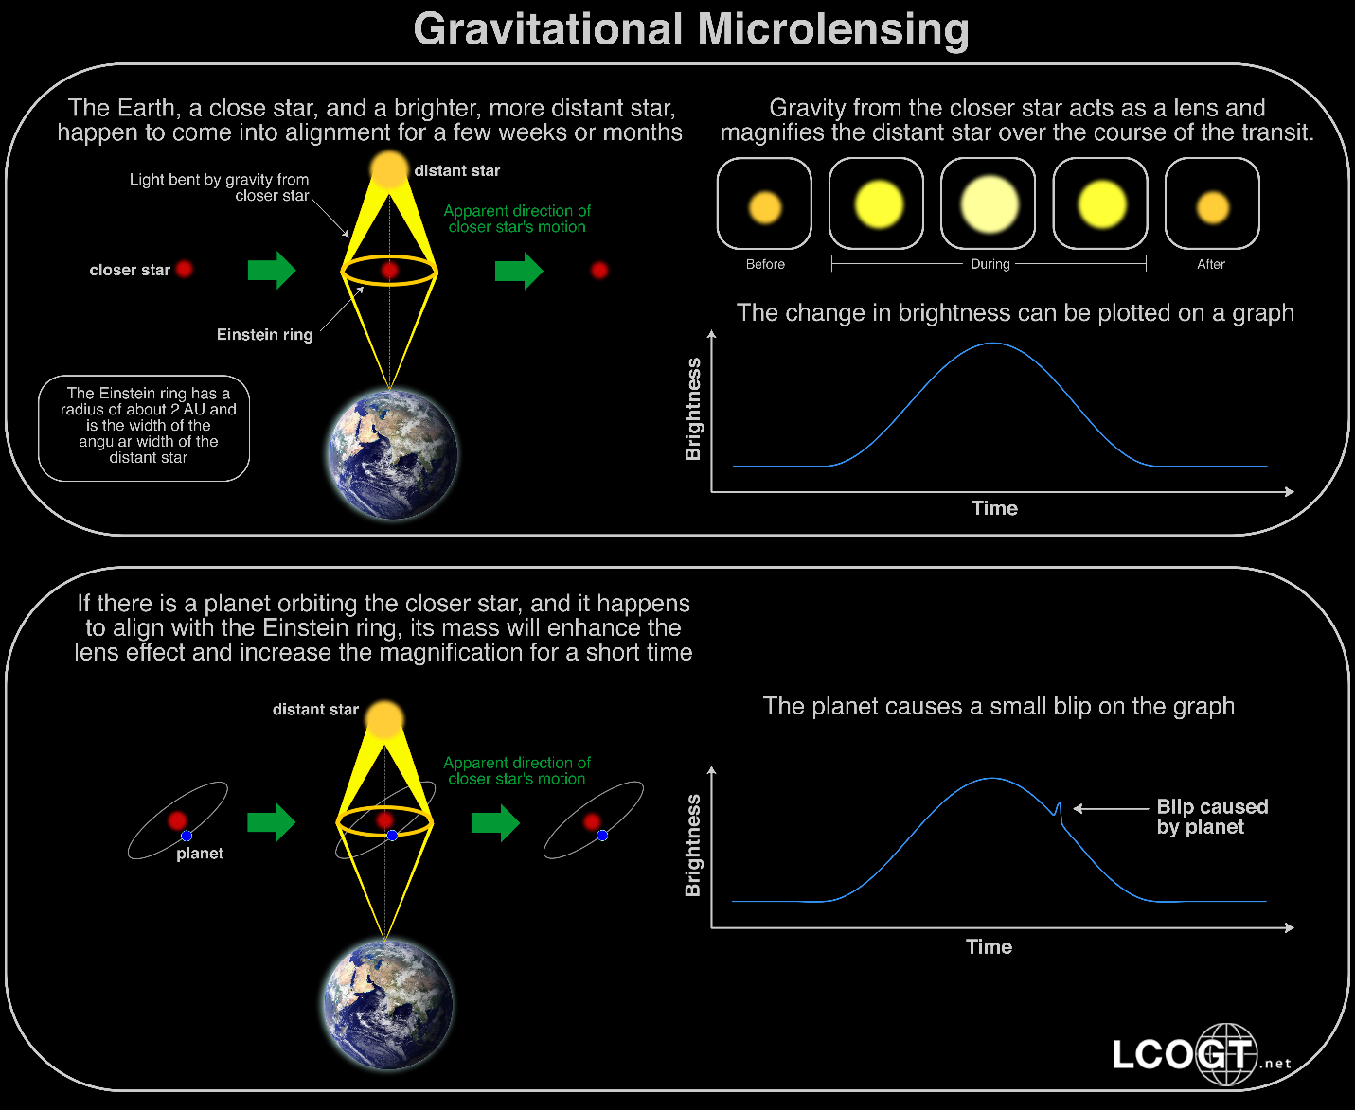
Gravitational Microlensing

Slide 13
habitable zone

Slide 14
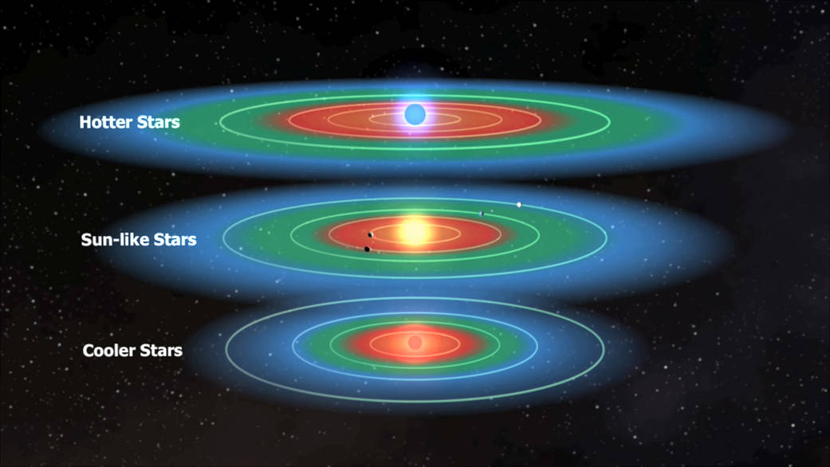
Habitable Zone
The Habitable Zone (HZ) is the region in a planetary system where water is liquid (not too hot, not too cold).
This assumes that life requires water.
It also assumes that bodies do not generate sufficient heat to support life.

Slide 15
Water and Sublimation
If a planet does not have an atmosphere, then the surface pressure will be very low.
At such low pressures, water exists only as ice or gas.
The sublimation temperature is 200 K.
Above this temperature, ice sublimates.
If gravity is not strong enough, the gas will drift into space.
So, for a planet to have liquid water, it must have some atmospheric pressure and be warmer than the freezing point of water.
Note, g scales as R, where g is the gravitational acceleration at the surface of the planet and R is the radius. Smaller planets do not have enough gravity to hold on to an atmosphere.

Slide 16
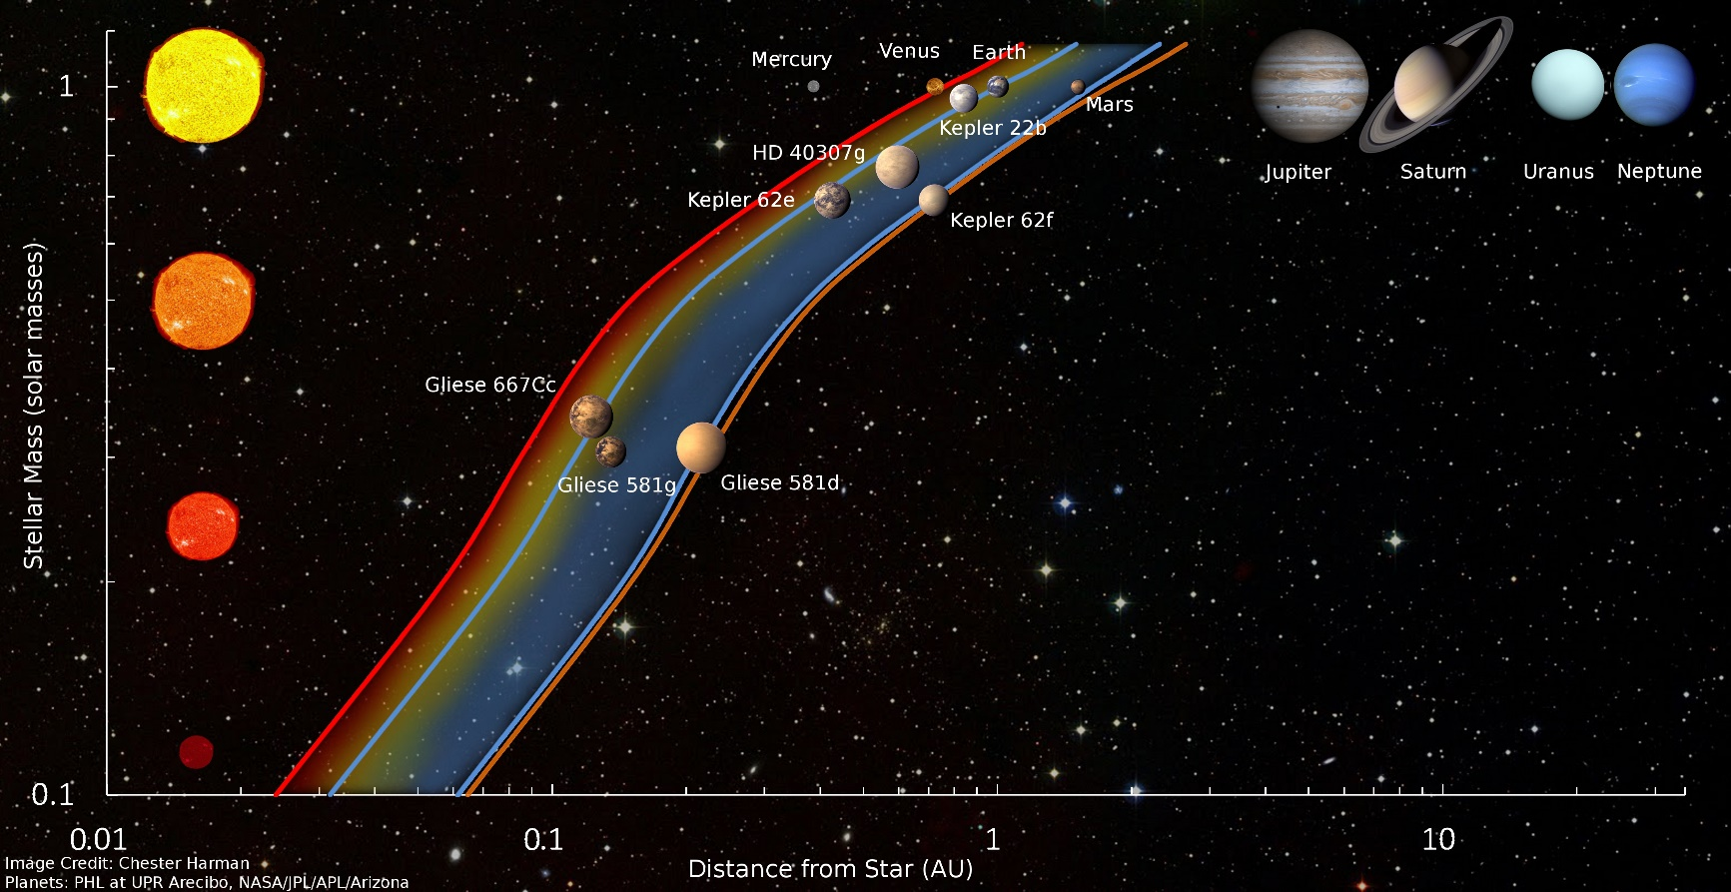
Habitable Zone vs Stellar Mass

Slide 17
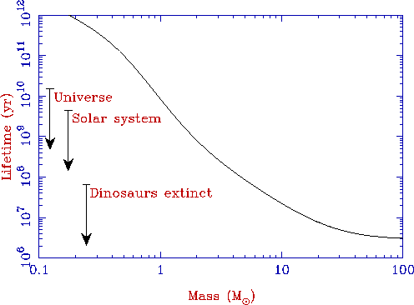
Stellar Host Mass

Slide 18
exoplanet candidates

Slide 19
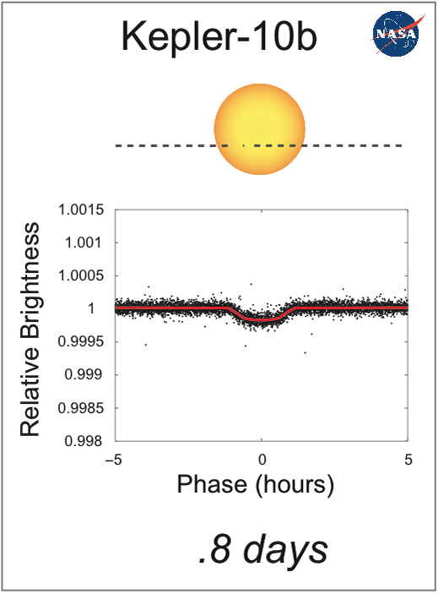
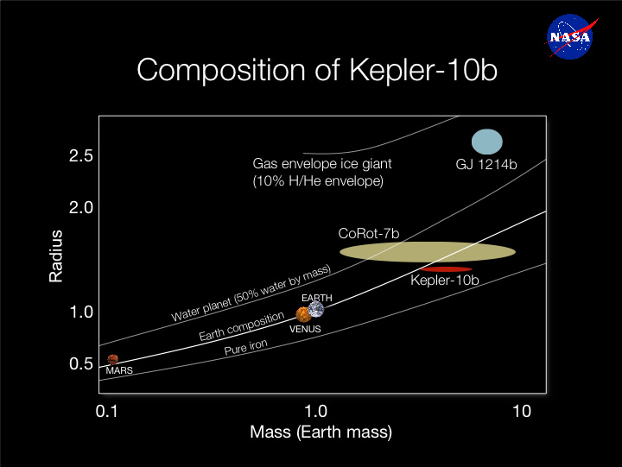
Kepler-10b Like Earth, but Hot

Slide 20
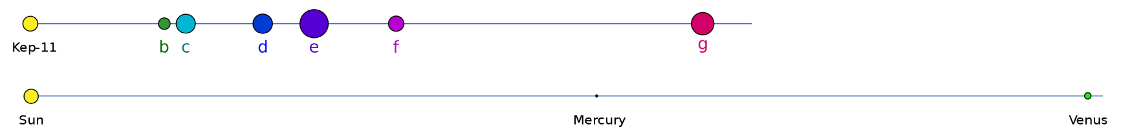
Kepler-11
Kepler-11 has six planets.
The figure below shows the relative locations of the planets as compared to those in our Solar System. The planet sizes have been scaled by a factor of 50.
The smallest planet (b) has is about twice the mass of the Earth.
The planets are all hot.

Slide 21
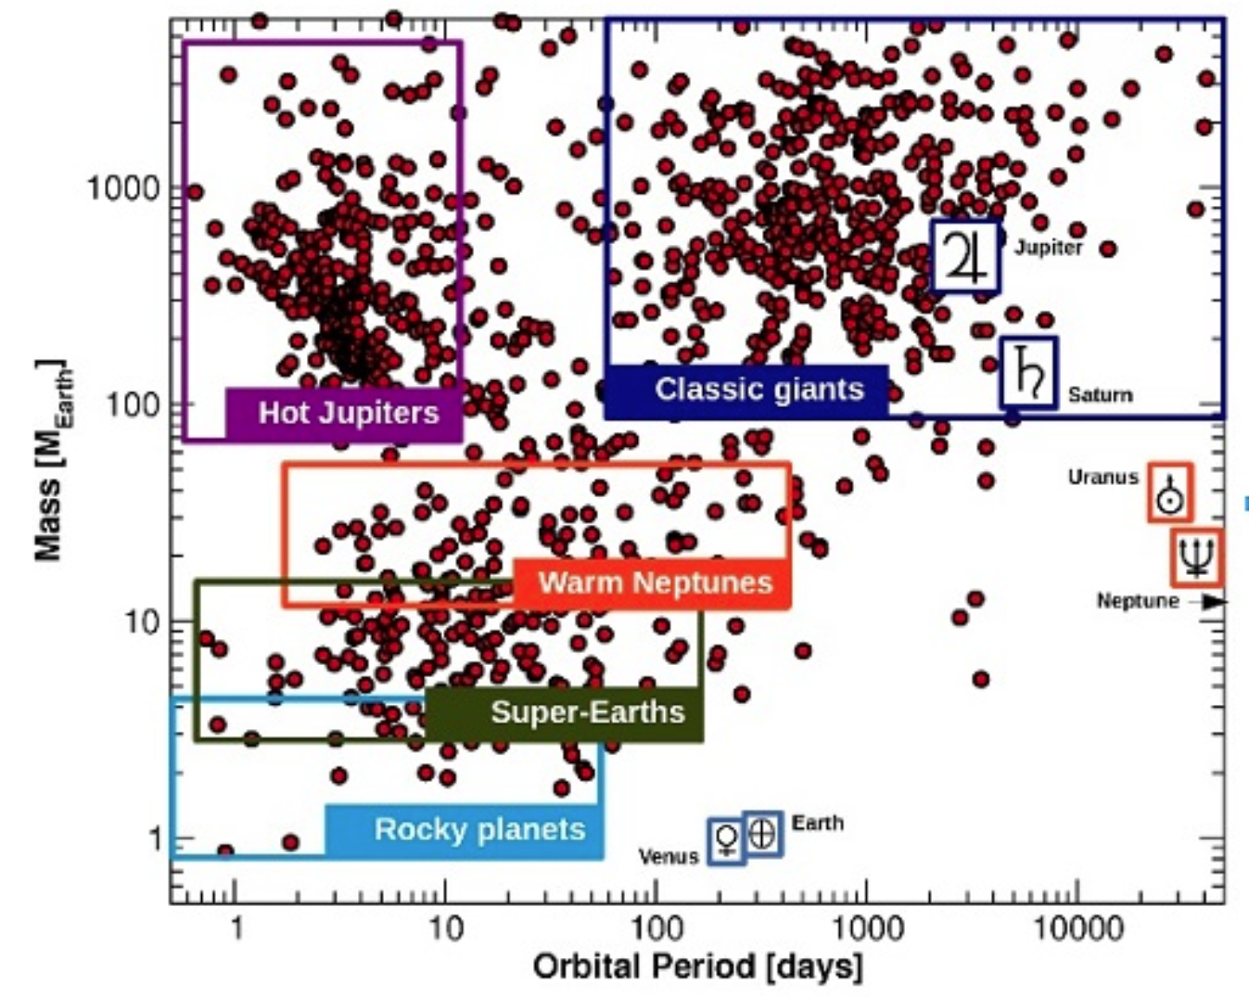
The Exoplanet Portrait
Notes:
Figure 1: The exoplanet portrait (data extracted from exoplanet.eu, April 1st 2015). Short period planets are generally favoured by the two leading techniques (transits and Doppler spectroscopy), which explains why the left part of the diagram is the most populated. The ‘classic’ gas giants are on the top right (massive and long periods), and the bottom left is the realm of the hot neptunes, and super-Earths. The relative paucity of planets in some areas of this diagram tells us about important processes that formed them and shaped the architectures of the systems. For example, the horizontal gap between the Neptunes and the Jupiters is likely caused by the runaway accretion of gas once a planet grows a bit larger than Neptune in the protoplanetary nebula, quickly jumping into the Saturn mass regime. The large abundance of hot-jupiters on the top left is an observational bias due to the high detection efficiency (large planets and short period orbits), but the gap between the hot-Jupiters and the classical gas giants is not well understood and probably has to do with the migration process involved in dragging the hot-Jupiters so close to the star. Detection efficiency quickly drops to the right (longer periods) and bottom (very small planets).

Slide 22
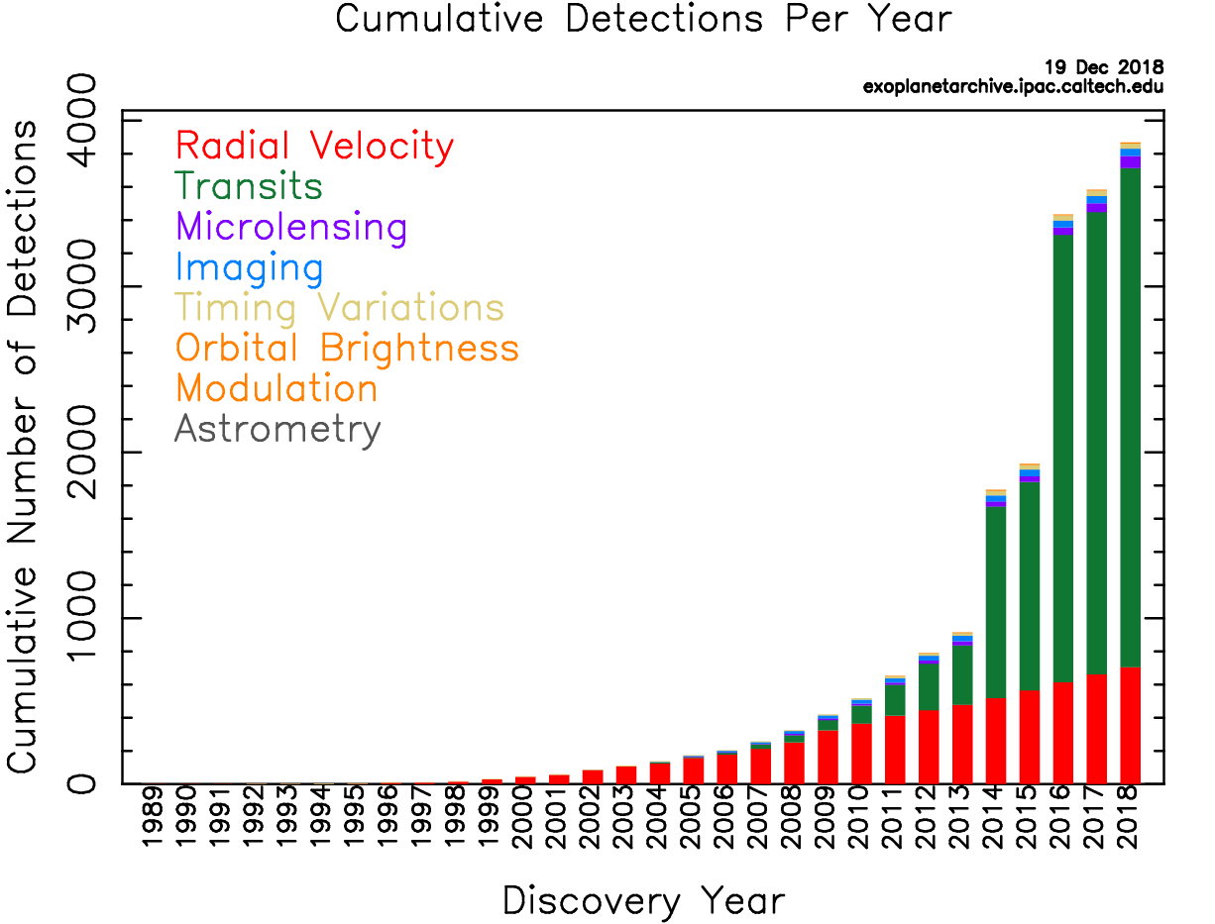
Exoplanet Detections per Year

Slide 23
Hot Jupiters
The nebular hypothesis predicts that gas giant planets should be in the outer part of a planetary system, beyond the frost line.
This aspect of the hypothesis was attractive when we were just looking at our Solar System.
Now, we see hot Jupiter, that is planets like Jupiter that are very close to their stars. Why?
Perhaps the Jupiters formed far away and drifted inward.
This shows the value of looking at other planetary systems in order to understand ours.
Notes:
Figure 1: The exoplanet portrait (data extracted from exoplanet.eu, April 1st 2015). Short period planets are generally favoured by the two leading techniques (transits and Doppler spectroscopy), which explains why the left part of the diagram is the most populated. The ‘classic’ gas giants are on the top right (massive and long periods), and the bottom left is the realm of the hot neptunes, and super-Earths. The relative paucity of planets in some areas of this diagram tells us about important processes that formed them and shaped the architectures of the systems. For example, the horizontal gap between the Neptunes and the Jupiters is likely caused by the runaway accretion of gas once a planet grows a bit larger than Neptune in the protoplanetary nebula, quickly jumping into the Saturn mass regime. The large abundance of hot-jupiters on the top left is an observational bias due to the high detection efficiency (large planets and short period orbits), but the gap between the hot-Jupiters and the classical gas giants is not well understood and probably has to do with the migration process involved in dragging the hot-Jupiters so close to the star. Detection efficiency quickly drops to the right (longer periods) and bottom (very small planets).

Slide 24
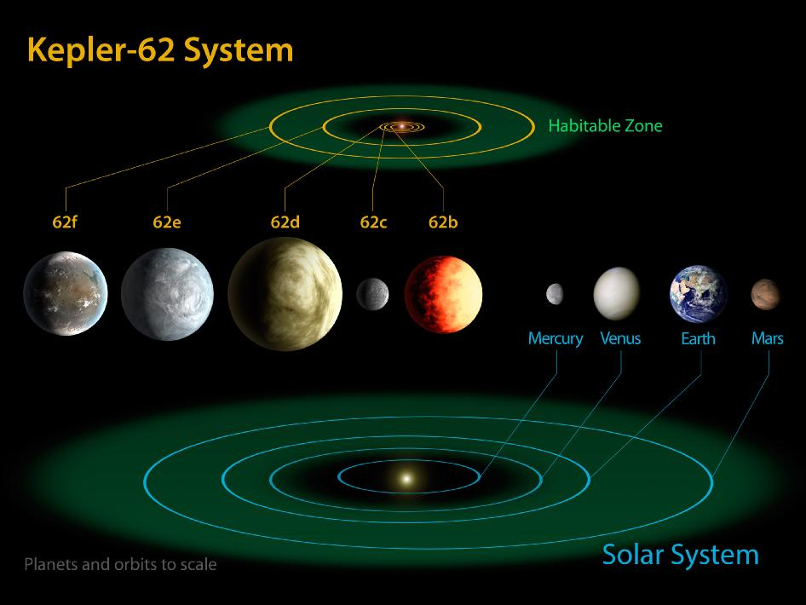
Kepler-62
Notes:
Figure 1: The exoplanet portrait (data extracted from exoplanet.eu, April 1st 2015). Short period planets are generally favoured by the two leading techniques (transits and Doppler spectroscopy), which explains why the left part of the diagram is the most populated. The ‘classic’ gas giants are on the top right (massive and long periods), and the bottom left is the realm of the hot neptunes, and super-Earths. The relative paucity of planets in some areas of this diagram tells us about important processes that formed them and shaped the architectures of the systems. For example, the horizontal gap between the Neptunes and the Jupiters is likely caused by the runaway accretion of gas once a planet grows a bit larger than Neptune in the protoplanetary nebula, quickly jumping into the Saturn mass regime. The large abundance of hot-jupiters on the top left is an observational bias due to the high detection efficiency (large planets and short period orbits), but the gap between the hot-Jupiters and the classical gas giants is not well understood and probably has to do with the migration process involved in dragging the hot-Jupiters so close to the star. Detection efficiency quickly drops to the right (longer periods) and bottom (very small planets).

Slide 25
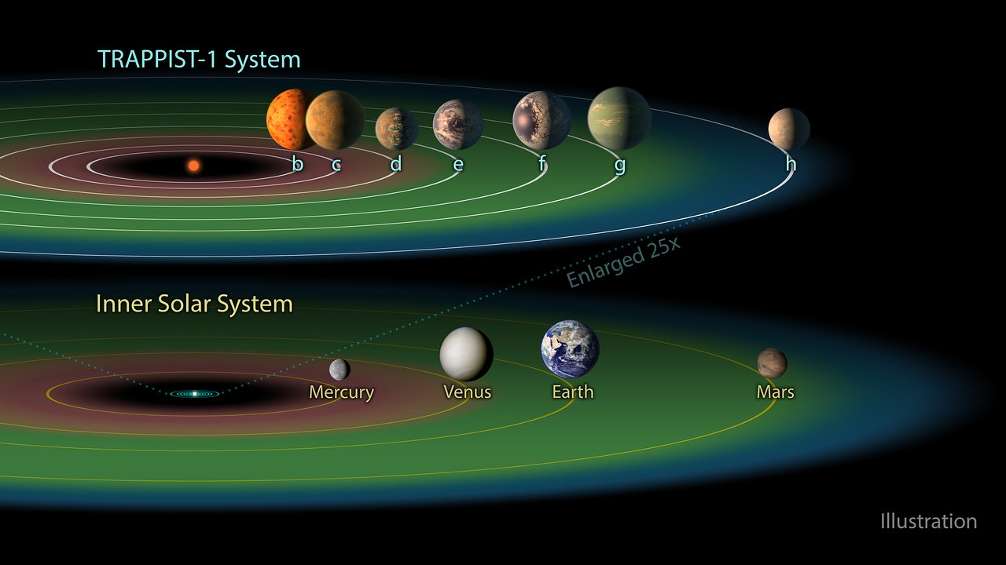
TRAPPIST-1
Notes:
Figure 1: The exoplanet portrait (data extracted from exoplanet.eu, April 1st 2015). Short period planets are generally favoured by the two leading techniques (transits and Doppler spectroscopy), which explains why the left part of the diagram is the most populated. The ‘classic’ gas giants are on the top right (massive and long periods), and the bottom left is the realm of the hot neptunes, and super-Earths. The relative paucity of planets in some areas of this diagram tells us about important processes that formed them and shaped the architectures of the systems. For example, the horizontal gap between the Neptunes and the Jupiters is likely caused by the runaway accretion of gas once a planet grows a bit larger than Neptune in the protoplanetary nebula, quickly jumping into the Saturn mass regime. The large abundance of hot-jupiters on the top left is an observational bias due to the high detection efficiency (large planets and short period orbits), but the gap between the hot-Jupiters and the classical gas giants is not well understood and probably has to do with the migration process involved in dragging the hot-Jupiters so close to the star. Detection efficiency quickly drops to the right (longer periods) and bottom (very small planets).

Slide 26
exoplanet missions

Slide 27
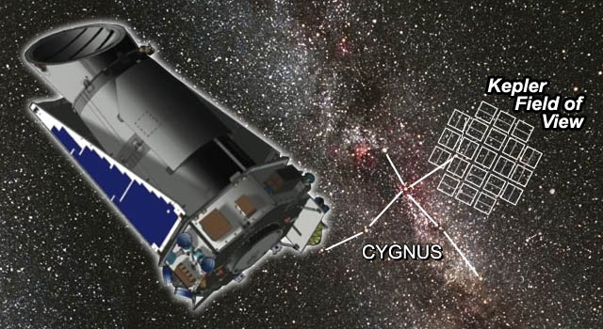
Kepler and K2 Missions
Kepler stared at Cygnus to measure brightness changes ~1% due to transiting planets.
It found thousands of exoplanets.
Candidates confirmed from the ground.
The K2 mission re-uses the telescope and covers many fields.

Slide 28
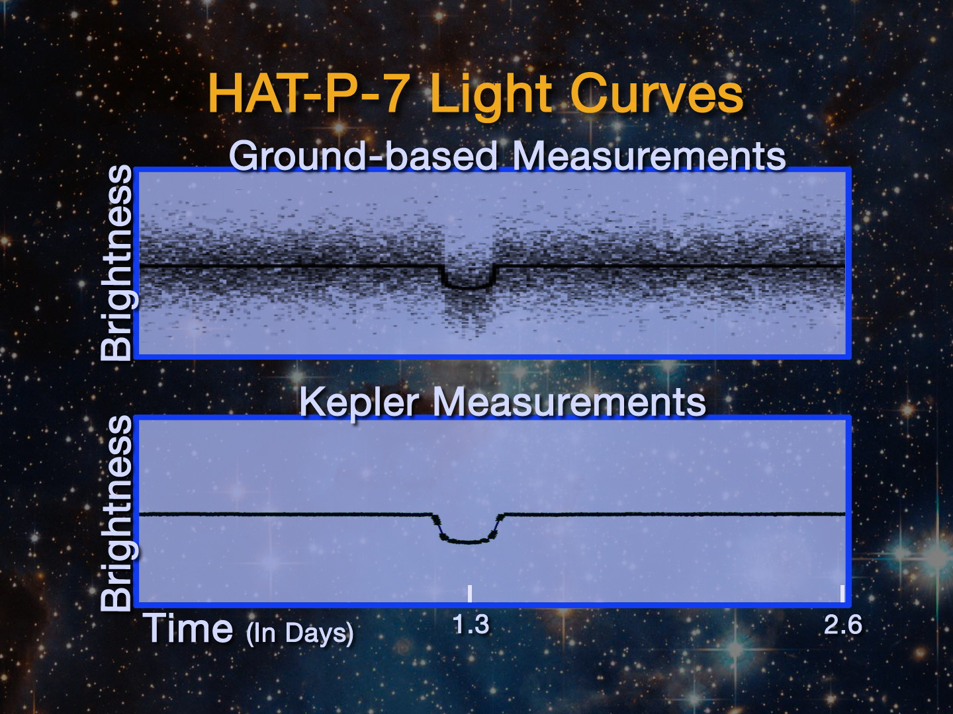
Kepler vs Ground

Slide 29
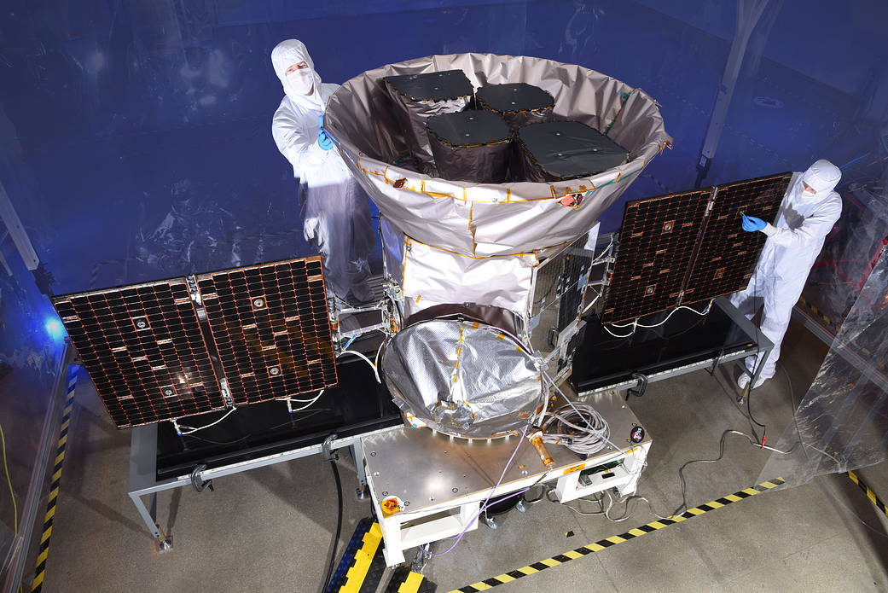
TESS
Transiting Exoplanet Survey Satellite (TESS) is a space telescope for NASA's Explorers program, designed to search for exoplanets using the transit method in an area 400 times larger than that covered by the Kepler mission. It was launched on April 18, 2018 atop a Falcon 9 rocket.
It is expected to find ~20,000 exoplanets.
It will cover almost the whole sky.
It has found over 50 exoplanet candidates in a few months of operation.
Notes:
Figure 1: The exoplanet portrait (data extracted from exoplanet.eu, April 1st 2015). Short period planets are generally favoured by the two leading techniques (transits and Doppler spectroscopy), which explains why the left part of the diagram is the most populated. The ‘classic’ gas giants are on the top right (massive and long periods), and the bottom left is the realm of the hot neptunes, and super-Earths. The relative paucity of planets in some areas of this diagram tells us about important processes that formed them and shaped the architectures of the systems. For example, the horizontal gap between the Neptunes and the Jupiters is likely caused by the runaway accretion of gas once a planet grows a bit larger than Neptune in the protoplanetary nebula, quickly jumping into the Saturn mass regime. The large abundance of hot-jupiters on the top left is an observational bias due to the high detection efficiency (large planets and short period orbits), but the gap between the hot-Jupiters and the classical gas giants is not well understood and probably has to do with the migration process involved in dragging the hot-Jupiters so close to the star. Detection efficiency quickly drops to the right (longer periods) and bottom (very small planets).

Slide 30
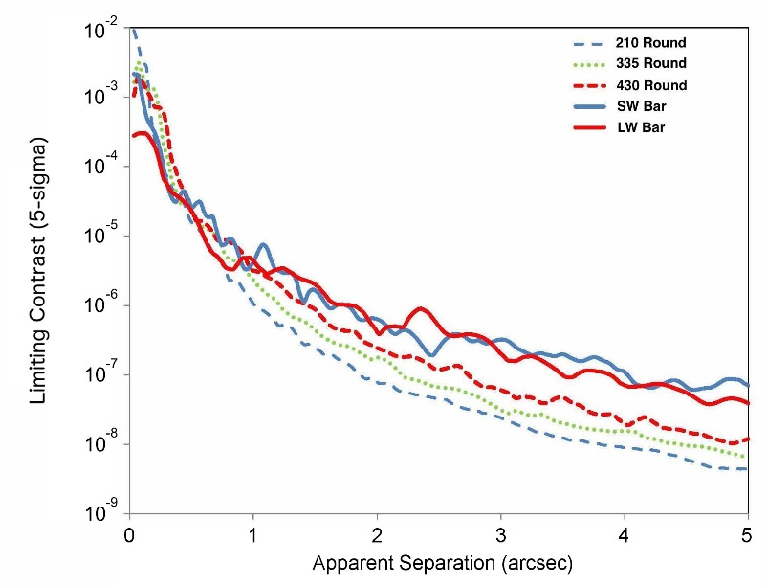
JWST
JWST has coronagraphic imaging capability in its NIRCam instrument.
The instrument has five different coronagraphic masks in the focal plane and two Lyot stops in the pupil plane.
Notes:
Figure 1: The exoplanet portrait (data extracted from exoplanet.eu, April 1st 2015). Short period planets are generally favoured by the two leading techniques (transits and Doppler spectroscopy), which explains why the left part of the diagram is the most populated. The ‘classic’ gas giants are on the top right (massive and long periods), and the bottom left is the realm of the hot neptunes, and super-Earths. The relative paucity of planets in some areas of this diagram tells us about important processes that formed them and shaped the architectures of the systems. For example, the horizontal gap between the Neptunes and the Jupiters is likely caused by the runaway accretion of gas once a planet grows a bit larger than Neptune in the protoplanetary nebula, quickly jumping into the Saturn mass regime. The large abundance of hot-jupiters on the top left is an observational bias due to the high detection efficiency (large planets and short period orbits), but the gap between the hot-Jupiters and the classical gas giants is not well understood and probably has to do with the migration process involved in dragging the hot-Jupiters so close to the star. Detection efficiency quickly drops to the right (longer periods) and bottom (very small planets).

Slide 31
Starshot
Starshot is a project to send a scientific payload to Alpha Centauri.
Whereas it would take tens of thousands of years for a spacecraft to reach the nearest star, Starshot will use laser propulsion to accelerate a spacecraft on a silicon wafer to a fifth the speed of light.
The spacecraft will take 20 years to reach its target.
The payload will contain sensing instruments, such as a detector.
There are many challenges to this project.
RIT has been working on the detector challenge.
https://breakthroughinitiatives.org/Initiative/3
Notes:
Figure 1: The exoplanet portrait (data extracted from exoplanet.eu, April 1st 2015). Short period planets are generally favoured by the two leading techniques (transits and Doppler spectroscopy), which explains why the left part of the diagram is the most populated. The ‘classic’ gas giants are on the top right (massive and long periods), and the bottom left is the realm of the hot neptunes, and super-Earths. The relative paucity of planets in some areas of this diagram tells us about important processes that formed them and shaped the architectures of the systems. For example, the horizontal gap between the Neptunes and the Jupiters is likely caused by the runaway accretion of gas once a planet grows a bit larger than Neptune in the protoplanetary nebula, quickly jumping into the Saturn mass regime. The large abundance of hot-jupiters on the top left is an observational bias due to the high detection efficiency (large planets and short period orbits), but the gap between the hot-Jupiters and the classical gas giants is not well understood and probably has to do with the migration process involved in dragging the hot-Jupiters so close to the star. Detection efficiency quickly drops to the right (longer periods) and bottom (very small planets).

Slide 32
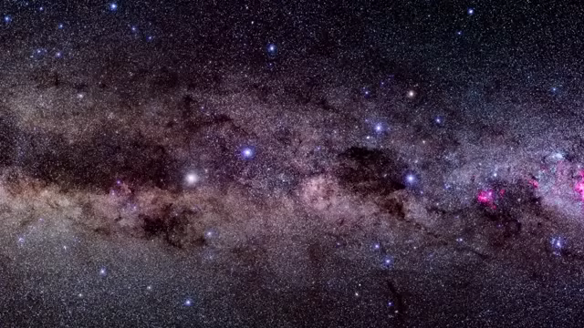
Starshot Animation
Notes:
Figure 1: The exoplanet portrait (data extracted from exoplanet.eu, April 1st 2015). Short period planets are generally favoured by the two leading techniques (transits and Doppler spectroscopy), which explains why the left part of the diagram is the most populated. The ‘classic’ gas giants are on the top right (massive and long periods), and the bottom left is the realm of the hot neptunes, and super-Earths. The relative paucity of planets in some areas of this diagram tells us about important processes that formed them and shaped the architectures of the systems. For example, the horizontal gap between the Neptunes and the Jupiters is likely caused by the runaway accretion of gas once a planet grows a bit larger than Neptune in the protoplanetary nebula, quickly jumping into the Saturn mass regime. The large abundance of hot-jupiters on the top left is an observational bias due to the high detection efficiency (large planets and short period orbits), but the gap between the hot-Jupiters and the classical gas giants is not well understood and probably has to do with the migration process involved in dragging the hot-Jupiters so close to the star. Detection efficiency quickly drops to the right (longer periods) and bottom (very small planets).

Slide 33
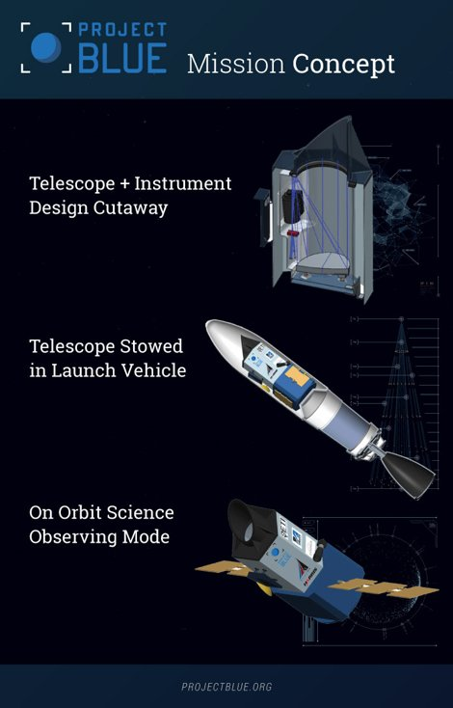
Project Blue
Project Blue is a mission proposed by Jon Morse, former head of Astrophysics for NASA.
The mission is intended to directly image the planet around Alpha Centauri system.
Project Blue can use an existing telescope that was made for national security interests.
The instruments will include a coronagraph.
RIT is the detector lead.
Notes:
Figure 1: The exoplanet portrait (data extracted from exoplanet.eu, April 1st 2015). Short period planets are generally favoured by the two leading techniques (transits and Doppler spectroscopy), which explains why the left part of the diagram is the most populated. The ‘classic’ gas giants are on the top right (massive and long periods), and the bottom left is the realm of the hot neptunes, and super-Earths. The relative paucity of planets in some areas of this diagram tells us about important processes that formed them and shaped the architectures of the systems. For example, the horizontal gap between the Neptunes and the Jupiters is likely caused by the runaway accretion of gas once a planet grows a bit larger than Neptune in the protoplanetary nebula, quickly jumping into the Saturn mass regime. The large abundance of hot-jupiters on the top left is an observational bias due to the high detection efficiency (large planets and short period orbits), but the gap between the hot-Jupiters and the classical gas giants is not well understood and probably has to do with the migration process involved in dragging the hot-Jupiters so close to the star. Detection efficiency quickly drops to the right (longer periods) and bottom (very small planets).

Slide 34
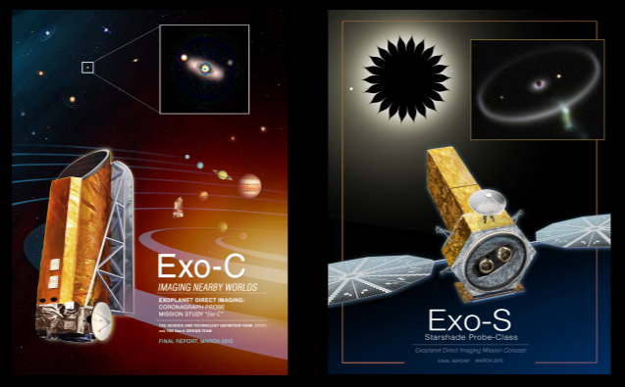
Hab-Ex
The Habitable Exoplanet Observatory (HabEx) is a concept for a mission to directly image Earth-like exoplanets around Sun-like stars.
By measuring the spectra of these planets, HabEx will search for signatures of habitability (water, oxygen).
The HabEx concept study is being undertaken by a Science and Technology Definition Team (STDT) comprised of experts within the community.
Notes:
Figure 1: The exoplanet portrait (data extracted from exoplanet.eu, April 1st 2015). Short period planets are generally favoured by the two leading techniques (transits and Doppler spectroscopy), which explains why the left part of the diagram is the most populated. The ‘classic’ gas giants are on the top right (massive and long periods), and the bottom left is the realm of the hot neptunes, and super-Earths. The relative paucity of planets in some areas of this diagram tells us about important processes that formed them and shaped the architectures of the systems. For example, the horizontal gap between the Neptunes and the Jupiters is likely caused by the runaway accretion of gas once a planet grows a bit larger than Neptune in the protoplanetary nebula, quickly jumping into the Saturn mass regime. The large abundance of hot-jupiters on the top left is an observational bias due to the high detection efficiency (large planets and short period orbits), but the gap between the hot-Jupiters and the classical gas giants is not well understood and probably has to do with the migration process involved in dragging the hot-Jupiters so close to the star. Detection efficiency quickly drops to the right (longer periods) and bottom (very small planets).

Slide 35
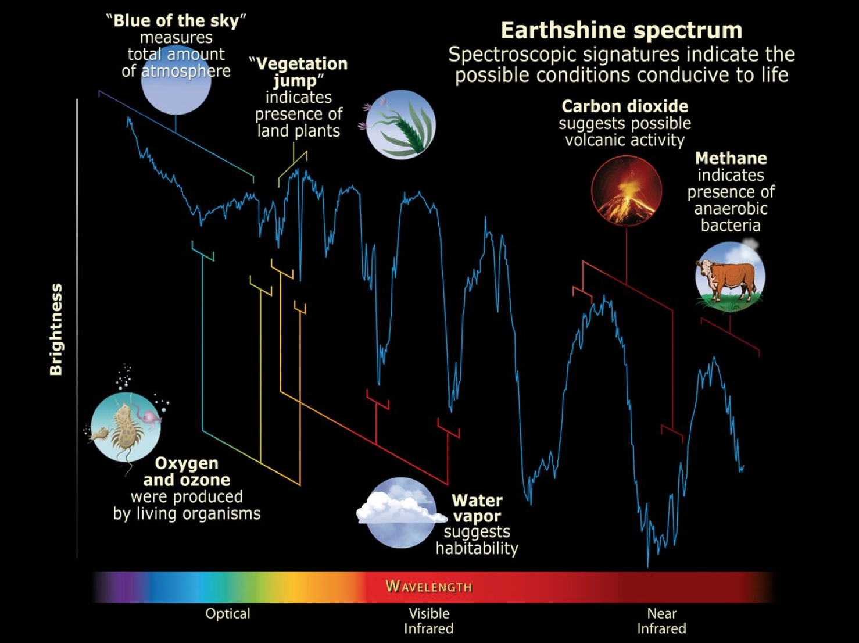
Biosignatures
Notes:
Figure 1: The exoplanet portrait (data extracted from exoplanet.eu, April 1st 2015). Short period planets are generally favoured by the two leading techniques (transits and Doppler spectroscopy), which explains why the left part of the diagram is the most populated. The ‘classic’ gas giants are on the top right (massive and long periods), and the bottom left is the realm of the hot neptunes, and super-Earths. The relative paucity of planets in some areas of this diagram tells us about important processes that formed them and shaped the architectures of the systems. For example, the horizontal gap between the Neptunes and the Jupiters is likely caused by the runaway accretion of gas once a planet grows a bit larger than Neptune in the protoplanetary nebula, quickly jumping into the Saturn mass regime. The large abundance of hot-jupiters on the top left is an observational bias due to the high detection efficiency (large planets and short period orbits), but the gap between the hot-Jupiters and the classical gas giants is not well understood and probably has to do with the migration process involved in dragging the hot-Jupiters so close to the star. Detection efficiency quickly drops to the right (longer periods) and bottom (very small planets).

Slide 36
LUVOIR
LUVOIR is the Large UltraVioet Optical InfraRed survey telescope.
It is a concept that would launch in about 20 years.
It has a wide field imager and a coronagraph instrument.
It could have a star shade.
RIT leads the LUVOIR Detector Technology Working Group and is on the High Definition Imager instrument team.
Notes:
Figure 1: The exoplanet portrait (data extracted from exoplanet.eu, April 1st 2015). Short period planets are generally favoured by the two leading techniques (transits and Doppler spectroscopy), which explains why the left part of the diagram is the most populated. The ‘classic’ gas giants are on the top right (massive and long periods), and the bottom left is the realm of the hot neptunes, and super-Earths. The relative paucity of planets in some areas of this diagram tells us about important processes that formed them and shaped the architectures of the systems. For example, the horizontal gap between the Neptunes and the Jupiters is likely caused by the runaway accretion of gas once a planet grows a bit larger than Neptune in the protoplanetary nebula, quickly jumping into the Saturn mass regime. The large abundance of hot-jupiters on the top left is an observational bias due to the high detection efficiency (large planets and short period orbits), but the gap between the hot-Jupiters and the classical gas giants is not well understood and probably has to do with the migration process involved in dragging the hot-Jupiters so close to the star. Detection efficiency quickly drops to the right (longer periods) and bottom (very small planets).

Slide 37
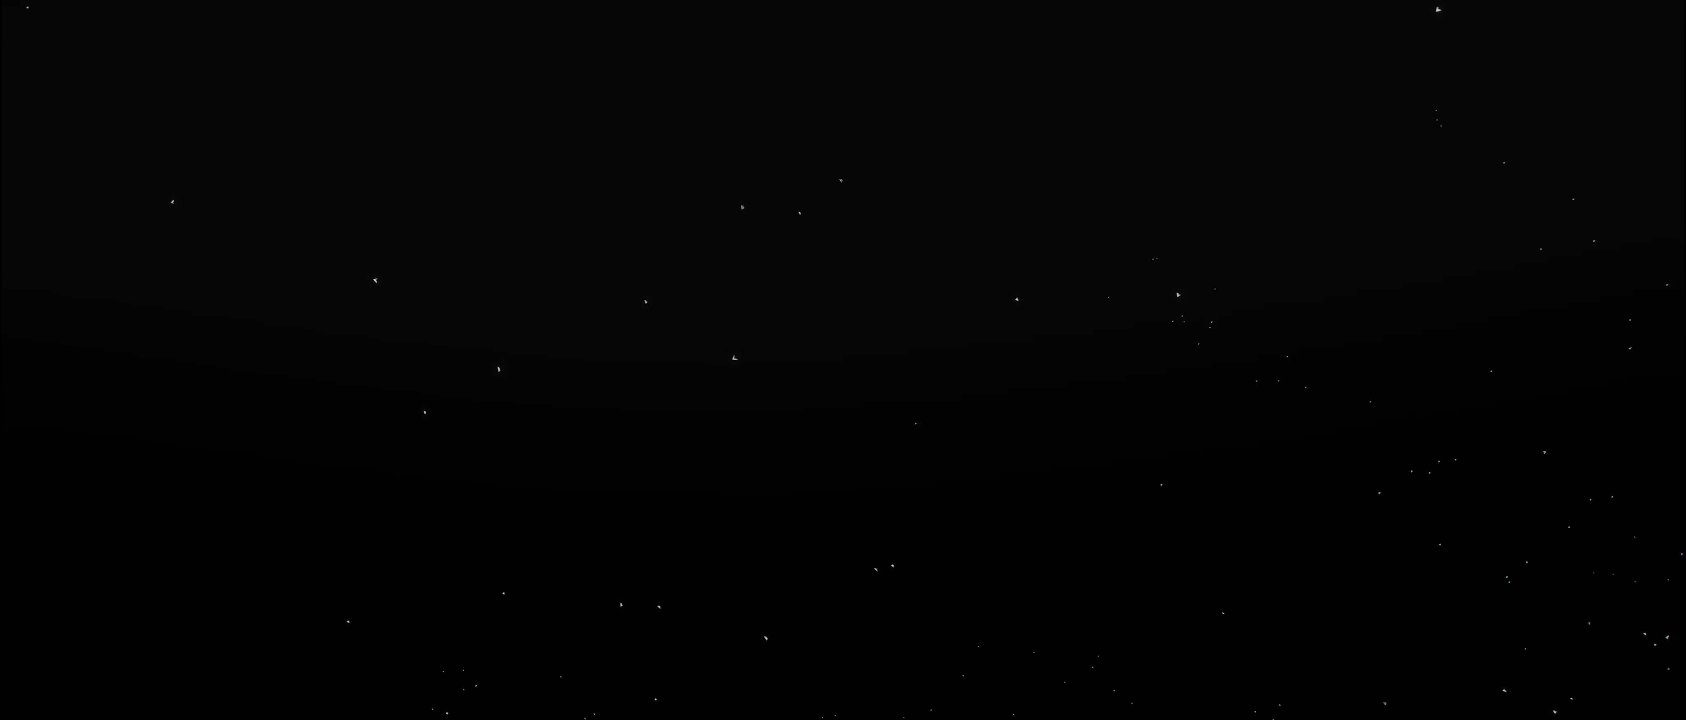
LUVOIR
Notes:
Figure 1: The exoplanet portrait (data extracted from exoplanet.eu, April 1st 2015). Short period planets are generally favoured by the two leading techniques (transits and Doppler spectroscopy), which explains why the left part of the diagram is the most populated. The ‘classic’ gas giants are on the top right (massive and long periods), and the bottom left is the realm of the hot neptunes, and super-Earths. The relative paucity of planets in some areas of this diagram tells us about important processes that formed them and shaped the architectures of the systems. For example, the horizontal gap between the Neptunes and the Jupiters is likely caused by the runaway accretion of gas once a planet grows a bit larger than Neptune in the protoplanetary nebula, quickly jumping into the Saturn mass regime. The large abundance of hot-jupiters on the top left is an observational bias due to the high detection efficiency (large planets and short period orbits), but the gap between the hot-Jupiters and the classical gas giants is not well understood and probably has to do with the migration process involved in dragging the hot-Jupiters so close to the star. Detection efficiency quickly drops to the right (longer periods) and bottom (very small planets).

Slide 38
aliens

Slide 39
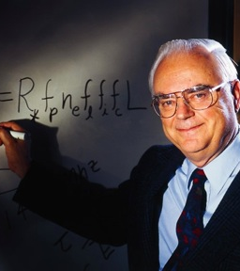
Drake Equation
Frank Drake wanted to estimate how many alien civilizations are detectable in our Galaxy.
He expressed this number through what is now called the “Drake Equation.”
Notes:
Figure 1: The exoplanet portrait (data extracted from exoplanet.eu, April 1st 2015). Short period planets are generally favoured by the two leading techniques (transits and Doppler spectroscopy), which explains why the left part of the diagram is the most populated. The ‘classic’ gas giants are on the top right (massive and long periods), and the bottom left is the realm of the hot neptunes, and super-Earths. The relative paucity of planets in some areas of this diagram tells us about important processes that formed them and shaped the architectures of the systems. For example, the horizontal gap between the Neptunes and the Jupiters is likely caused by the runaway accretion of gas once a planet grows a bit larger than Neptune in the protoplanetary nebula, quickly jumping into the Saturn mass regime. The large abundance of hot-jupiters on the top left is an observational bias due to the high detection efficiency (large planets and short period orbits), but the gap between the hot-Jupiters and the classical gas giants is not well understood and probably has to do with the migration process involved in dragging the hot-Jupiters so close to the star. Detection efficiency quickly drops to the right (longer periods) and bottom (very small planets).

Slide 40
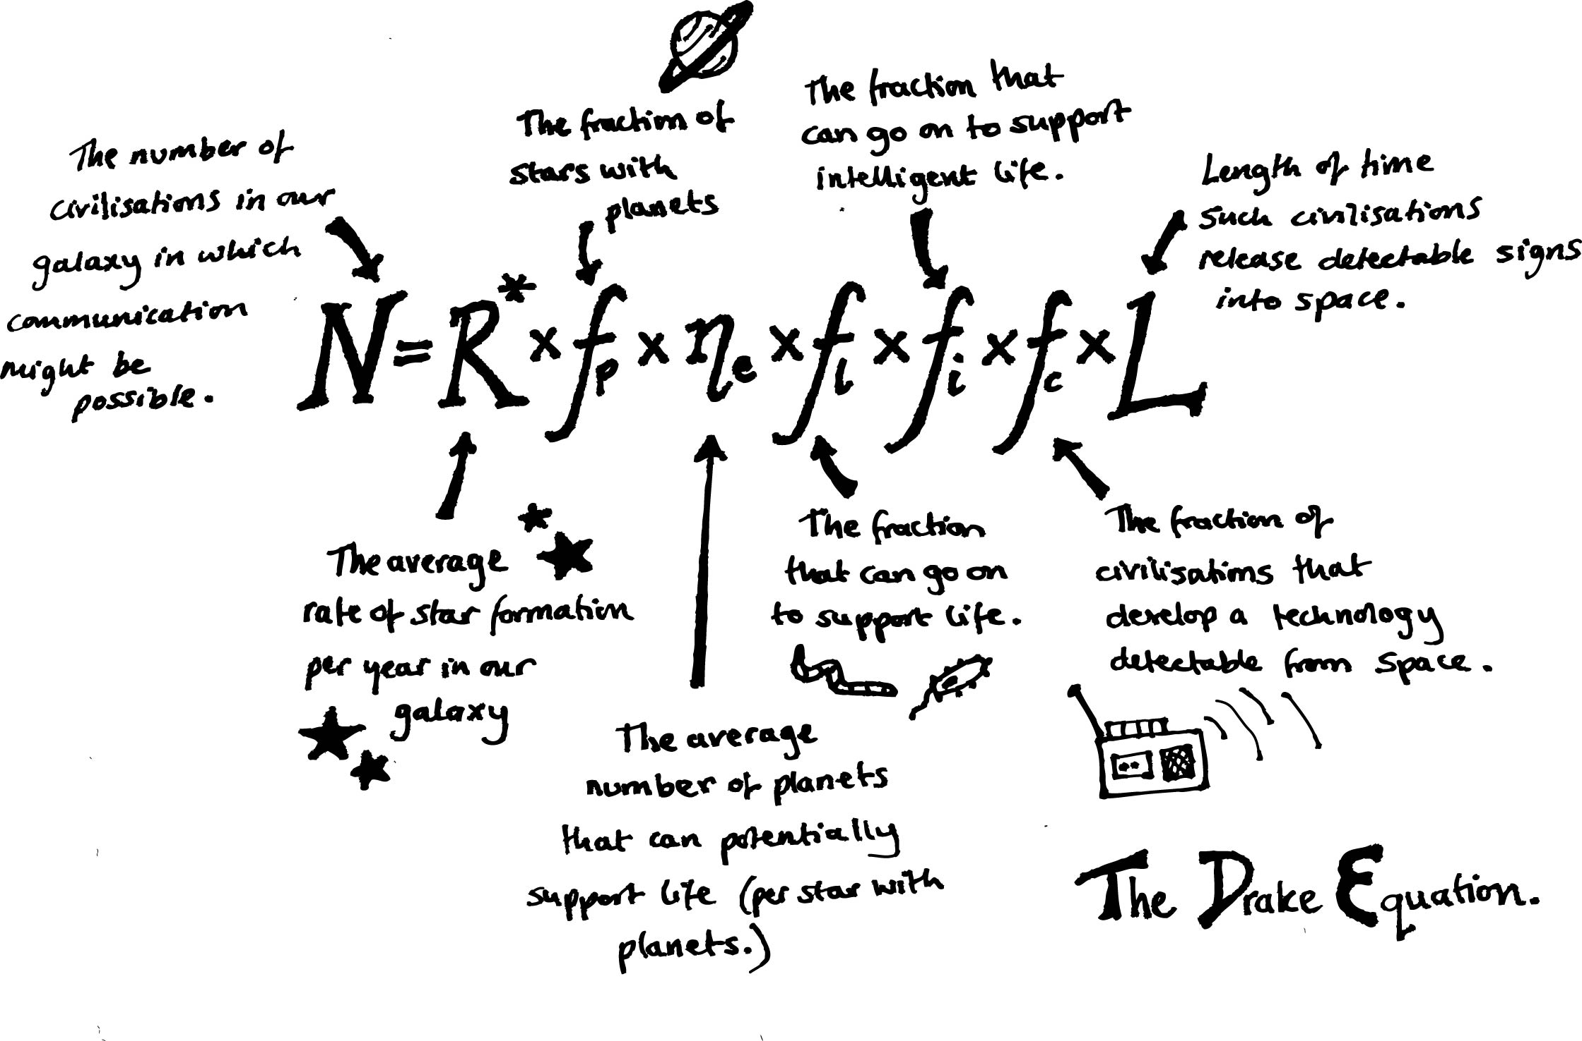
Drake Equation
Notes:
Figure 1: The exoplanet portrait (data extracted from exoplanet.eu, April 1st 2015). Short period planets are generally favoured by the two leading techniques (transits and Doppler spectroscopy), which explains why the left part of the diagram is the most populated. The ‘classic’ gas giants are on the top right (massive and long periods), and the bottom left is the realm of the hot neptunes, and super-Earths. The relative paucity of planets in some areas of this diagram tells us about important processes that formed them and shaped the architectures of the systems. For example, the horizontal gap between the Neptunes and the Jupiters is likely caused by the runaway accretion of gas once a planet grows a bit larger than Neptune in the protoplanetary nebula, quickly jumping into the Saturn mass regime. The large abundance of hot-jupiters on the top left is an observational bias due to the high detection efficiency (large planets and short period orbits), but the gap between the hot-Jupiters and the classical gas giants is not well understood and probably has to do with the migration process involved in dragging the hot-Jupiters so close to the star. Detection efficiency quickly drops to the right (longer periods) and bottom (very small planets).

Slide 41
Drake Equation – My Guesses
R* is a few stars per year.
f_{p} is probably ~100%.
n_{e} could be ~1%.
f_{l}~10%.
f_{i}~10%.
f_{c}~20%
L~100,000 years
So, N=4!
Notes:
Figure 1: The exoplanet portrait (data extracted from exoplanet.eu, April 1st 2015). Short period planets are generally favoured by the two leading techniques (transits and Doppler spectroscopy), which explains why the left part of the diagram is the most populated. The ‘classic’ gas giants are on the top right (massive and long periods), and the bottom left is the realm of the hot neptunes, and super-Earths. The relative paucity of planets in some areas of this diagram tells us about important processes that formed them and shaped the architectures of the systems. For example, the horizontal gap between the Neptunes and the Jupiters is likely caused by the runaway accretion of gas once a planet grows a bit larger than Neptune in the protoplanetary nebula, quickly jumping into the Saturn mass regime. The large abundance of hot-jupiters on the top left is an observational bias due to the high detection efficiency (large planets and short period orbits), but the gap between the hot-Jupiters and the classical gas giants is not well understood and probably has to do with the migration process involved in dragging the hot-Jupiters so close to the star. Detection efficiency quickly drops to the right (longer periods) and bottom (very small planets).

Slide 42
Calculate Yourself!
http://www.pbs.org/lifebeyondearth/listening/drake.html
http://www.astrodigital.org/astronomy/drake_equation.html
Notes:
Figure 1: The exoplanet portrait (data extracted from exoplanet.eu, April 1st 2015). Short period planets are generally favoured by the two leading techniques (transits and Doppler spectroscopy), which explains why the left part of the diagram is the most populated. The ‘classic’ gas giants are on the top right (massive and long periods), and the bottom left is the realm of the hot neptunes, and super-Earths. The relative paucity of planets in some areas of this diagram tells us about important processes that formed them and shaped the architectures of the systems. For example, the horizontal gap between the Neptunes and the Jupiters is likely caused by the runaway accretion of gas once a planet grows a bit larger than Neptune in the protoplanetary nebula, quickly jumping into the Saturn mass regime. The large abundance of hot-jupiters on the top left is an observational bias due to the high detection efficiency (large planets and short period orbits), but the gap between the hot-Jupiters and the classical gas giants is not well understood and probably has to do with the migration process involved in dragging the hot-Jupiters so close to the star. Detection efficiency quickly drops to the right (longer periods) and bottom (very small planets).

Slide 43
Fermi Paradox (Wikipedia)
The Fermi paradox, named after Italian-American physicist Enrico Fermi, is the apparent contradiction between the lack of evidence for extraterrestrial civilizations elsewhere in the Milky Way galaxy and various high estimates for their probability (such as those that result from optimistic parameters for the Drake equation).
Michael H. Hart formalized the basic points of the argument in a 1975 paper. They include the following:
  There are billions of stars in the Milky Way similar to the Sun.
  With high probability, some of these stars have Earth-like planets, and if the Earth is typical, some may have already developed intelligent life.
  Some of these civilizations may have developed interstellar travel, a step the Earth is investigating now.
  Even at the slow pace of currently envisioned interstellar travel, the Milky Way galaxy could be completely traversed in a few million years.
  And since many of the stars similar to the Sun are billions of years older, this would seem to provide plenty of time.
According to this line of reasoning, the Earth should have already been visited by an extraterrestrial civilization, or at least their probes.
Notes:
Figure 1: The exoplanet portrait (data extracted from exoplanet.eu, April 1st 2015). Short period planets are generally favoured by the two leading techniques (transits and Doppler spectroscopy), which explains why the left part of the diagram is the most populated. The ‘classic’ gas giants are on the top right (massive and long periods), and the bottom left is the realm of the hot neptunes, and super-Earths. The relative paucity of planets in some areas of this diagram tells us about important processes that formed them and shaped the architectures of the systems. For example, the horizontal gap between the Neptunes and the Jupiters is likely caused by the runaway accretion of gas once a planet grows a bit larger than Neptune in the protoplanetary nebula, quickly jumping into the Saturn mass regime. The large abundance of hot-jupiters on the top left is an observational bias due to the high detection efficiency (large planets and short period orbits), but the gap between the hot-Jupiters and the classical gas giants is not well understood and probably has to do with the migration process involved in dragging the hot-Jupiters so close to the star. Detection efficiency quickly drops to the right (longer periods) and bottom (very small planets).

Slide 44


Are you an alien?

Slide 45

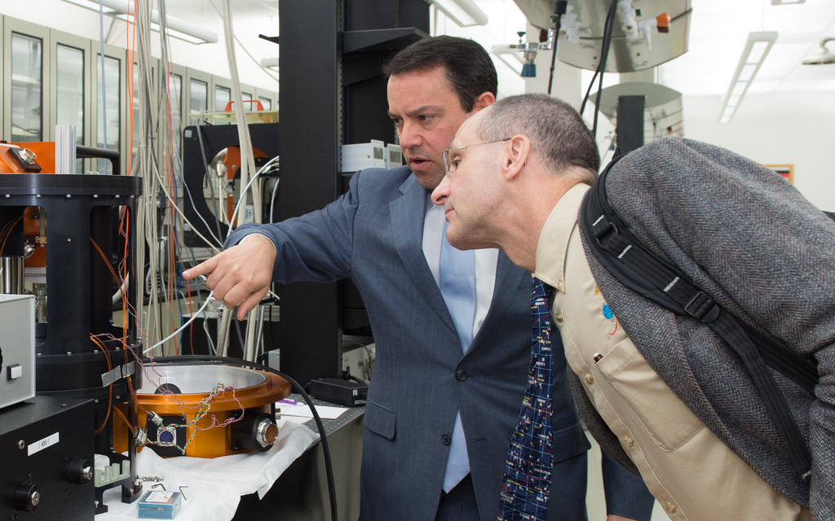
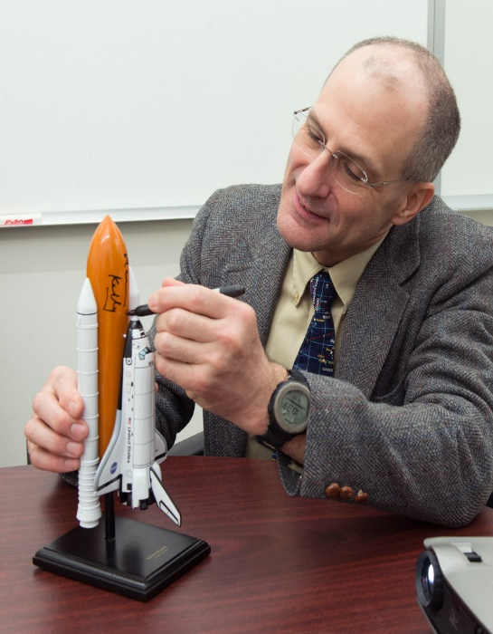
NASA Astronaut Donald Pettit toured the Center for Detectors and challenged students to solve a problem on International Space Station.

Slide 46
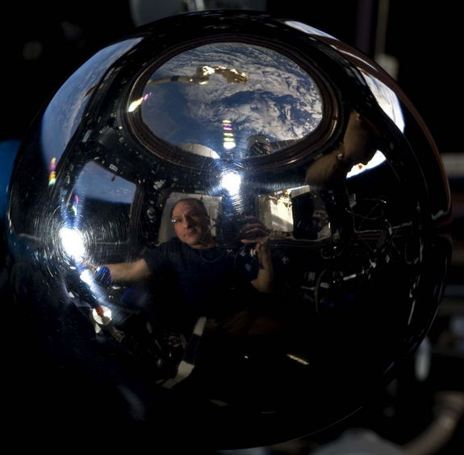
I get asked about NASA and “aliens” every so often. NASA has some credible evidence of alien life in the Mars meteorites found on Antarctica. The Martian Allan Hills meteorite from Antarctica shows evidence of fossil bacteria. There is still much scientific controversy about this but the best evidence to date is the presence of nano-particles of magnetite co-located with the so called fossil bacteria with the same structure as seen in magneto-taxic bacteria from Earth. It is difficult to show how these structures could be formed by non-biological processes. Anyway, this is still controversial and remains the most credible form of evidence I have seen for the presence of alien life forms.
Of course when I am asked this question, my answer is not very satisfying since most people are referring to some form of intelligent alien creature flying some sort of spacecraft. I have seen no credible evidence in or outside of NASA to support any such ideas.

Slide 47
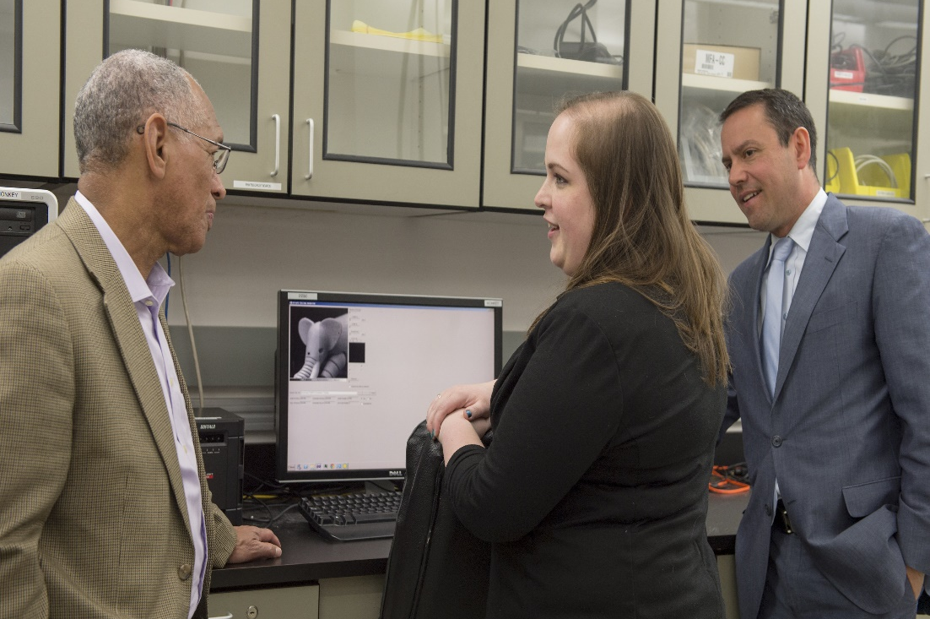
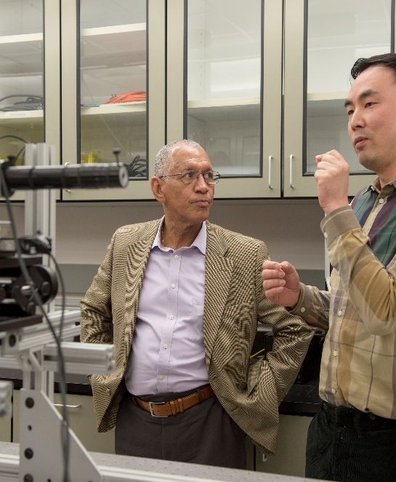

Charlie Bolden, Head of NASA, visited a few years ago.

