Slide 1
University Astronomy
Professor Don Figer
The Galactic Center

Slide 2
Galactic center environment

Slide 3
Aims and outline for this lecture
give an overview and tour of the Galactic center

Slide 5
Galactic Center Fast Facts
radius_{CMZ} = 500 pc, thickness_{CMZ} = 60 pc (“CMZ” = central molecular zone, a region of extraordinary amounts of molecular gas)
volume_{CMZ} = ~0.03% of Volume_{disk}
T_{cloud} = 70 K
turbulent velocities of Δv_{FWHM} ~ 25 km/s over small scales (0.3 pc)
L_{Lyman continuum} = 1-3(10⁵²) photons/second
10% of Galactic star formation
10% of Galactic molecular clouds
25% of all (known) clusters with M>10,000 M_{Sun}

Slide 6
Why Near-infrared?
V band
K band
60 pc

Slide 7
Extinction to GC
Trumpler found 2 mag per kpc of extinction in the V-band to the Galaxy.
The GC is located 8 kpc from the Sun.
That suggests extinction of 16 magnitudes of extinction to the GC in the V-band.
The actual value is 30 magnitudes.
Why?
About half of the extinction is due to extra dust in the GC.

Slide 8
GC Color Composite
HST Paschen-α (Y), Chandra X-ray (B), Spitzer Far IR (R)

Slide 9
GC Color Composite
HST Paschen-α (Y), Chandra X-ray (B), Spitzer Far IR (R)

Slide 10
supermassive black hole

Slide 11
Black Hole in the GC
Stellar motions suggest a 4(10⁶) M_{Sun} black hole.
The first piece of evidence was from infalling gas (~late 1980s).
The second piece of evidence came from stellar motions (~late 1990s).
The final piece of evidence came from individual stellar orbits (~early 2000s).

Slide 12
The Central Parsec

Slide 13
Stellar Orbits Near the GC
Credit: ESO/MPE/M. Schartmann/L. Calçada

Slide 14
2020 Nobel Prize in Physics

Slide 15
Historical Context
1931, Jansky, Sgr A
1968, Becklin & Neugebauer, IR
1973, Rieke & Low, IR
1974, Balick & Brown, Sgr A*
1980-1985, Serabyn & Lacy, gas - M_{BH}=3-4(10⁶) M_{Sun}
1996, Eckart & Genzel, stars - M_{BH}=3(10⁶) M_{Sun}
1998, Ghez et al., stars - M_{BH}=2.6(10⁶) M_{Sun}
2002, Schoedel et al., S2, M_{BH}=4.1(10⁶) M_{Sun}
2003, Ghez et al., S2, M_{BH}=4.6(10⁶) M_{sun}
2009, Gillessen et al., M_{BH}=4.3(10⁶) M_{Sun}
2018, Genzel et al., S2 gravitational redshift
2019, Ghez et al., S2 gravitational redshift
2020, Abuter et al., S2 orbit precession
2020, Nobel Prize

Slide 16
Measuring Mass
Find “test particles” orbiting another object.
Measure position and velocity.
Infer mass using Kepler and Newton.

Slide 17
Kepler and Newton
Kepler (1610)
orbits are ellipses
equal areas are swept in equal time
square of the period is cube of the radius (P²∝ a³)
Newton (1687)
objects remain in motion unless there is a force (dv/dt=0)
force equals mass times acceleration (F=ma)
force exerted by one body is equal to force on that body (F=-F)
gravity is proportional to the product of the masses divided by the square of the distance (F=GMm/r²)

Slide 18
Calculating the Mass
$$F=ma=m\frac{v^{2}}{r}=\frac{m}{r}{\left(\frac{πD}{T}\right)}^{2}=\frac{m}{r}{\left(\frac{2πr}{T}\right)}^{2}=m\frac{4π^{2}}{T^{2}}r$$
$$F=G\frac{Mm}{r^{2}}$$
$$m\frac{4π^{2}}{T^{2}}r=G\frac{Mm}{r^{2}}$$
$$T^{2}=\frac{4π^{2}}{GM}r^{3}\underset{→}{more complete}\frac{4π^{2}}{G(M+m)}r^{3}\underset{→}{\text{M}≫m}\frac{4π^{2}}{GM}r^{3}$$
$$M=\frac{4π^{2}}{GT^{2}}r^{3} \left(=\frac{r^{3}}{T^{2}} in units of AU and years\right)$$
$$M\underset{→}{r=1 AU, T=1 year}=1 M_{Sun}$$
$$M\underset{→}{r=1000 AU, T=16 years}=4({10}^{6}) M_{Sun}$$
$$\overline{ρ}=\frac{4({10}^{6}) M_{Sun}}{\frac{4}{3}πr^{3}}\underset{→}{r=0.1 AU}{10}^{25} M_{Sun} {pc}^{−3}$$

Slide 19
Schwarzchild Radius
Recall equation 18.54, which gives the Schwarzchild radius as
For M~4(10⁶) M_{Sun}, r_{Sch}~0.07 AU.
This corresponds to approximately 0.009 arcseconds, or significantly smaller than the angular resolution of the largest telescopes, including Keck and VLA.
Recall that the EHT resolution is ~0.21 AU at the Galactic center, so it will barely resolve the black hole “shadow.”
Stars with masses like the Sun, would be ripped apart before going into the event horizon and thus would be shredded into a disk.
$$r_{Sch}>2\frac{GM}{c^{2}}\sim 3 km \left(\frac{M}{{1 M}_{⨀}}\right)$$

Slide 20
Technologies
Big telescope mirrors
Jerry Nelson (Keck)
Roger Angel (VLT)
Adaptive optics
Peter Wizinowich (Caltech)
Claire Max (UCSC)
Infrared detectors
Don Hall (HgCdTe, UH)
Al Fowler, Judy Pipher, Bill Forrest (InSb, U of R)
Instruments

Slide 21
massive stars in the galactic center

Slide 22
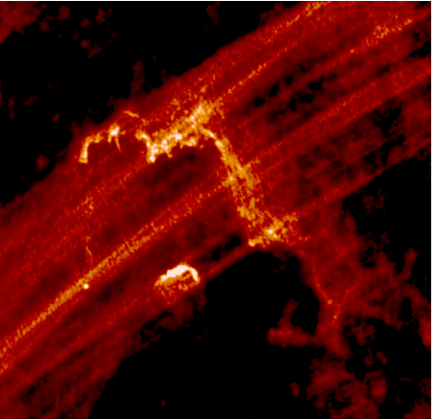
Giant HII Regions: Massive Star Signposts
Quintuplet 6 cm
Arches 6 cm
Center Br-γ
N
E

Slide 23
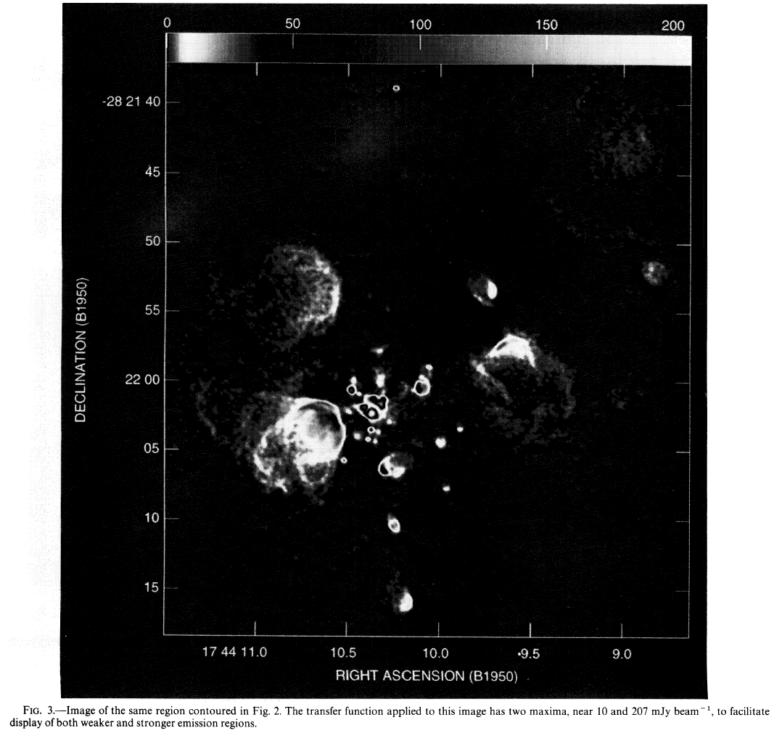
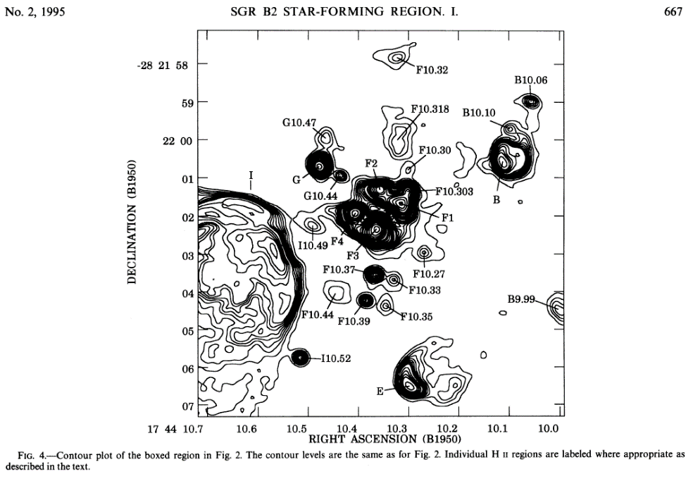
HCHII Regions in Sgr B2
There are ~100 HCHII regions in Sgr B2. Each contains an O or B star.

Slide 24
Young Clusters in the Galactic Center
There are three massive young clusters in the Galactic center.
They each have about a few times 10⁴ M_{sun} in stars.
They are about 2 to 5 Myr old.
They are the Quintuplet, Arches, and Central clusters.

Slide 25
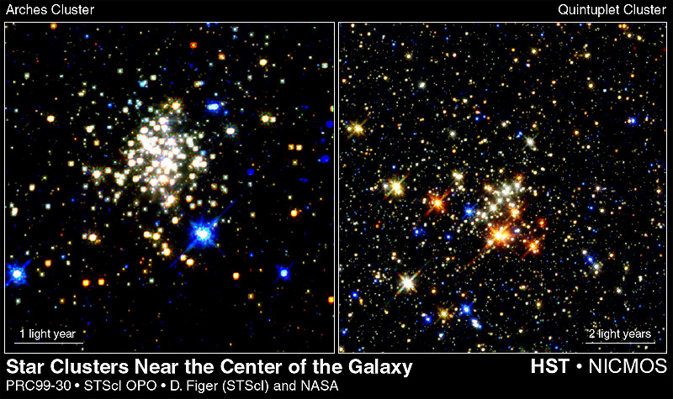
Galactic Center Clusters

Slide 26
Star Formation Near the Black Hole?
The stars near (within 1 pc) the supermassive black hole appear younger than 20 Myr.
Merger rate probably too low.
Unlikely to have drifted inward via dynamical friction.
Tidal forces require > 4(10)¹¹ cm⁻³ for star formation.
Must find a way to compress 20 M clumps.

Slide 27
Summary
The Galactic center has a supermassive black hole.
The GC contains a substantial fraction of the massive star population in the Galaxy.
The Arches Cluster has a shallow slope and upper mass cutoff of ~150 M.
The cloud heating and ionization in the GC is dominated by massive stars.
The GC is presently producing new massive clusters and likely has done so for the past 10 Gyr.
Massive stars may form in “challenging” environments, i.e. near a supermassive black hole.

